Slide 2
यह कार्यक्रम स्वास्थ्य विभाग और राज्य स्वास्थ्य एवं परिवार कल्याण संस्थान (SIHFW), उत्तर प्रदेश की पहल पर उत्तर प्रदेश टेक्निकल सपोर्ट यूनिट (UPTSU) के सहयोग से हो रहा है।
Principal Secretary, Medical Health & Family Welfare, U.P. Shri Partha Sarthi Sen Sharma
Director Administration & Director, SIHFW
Shri Shiv Sahay Awasthi

Slide 3
Understanding STEMI (ST-Elevation Myocardial Infarction)
Dr. Sandeep Chowdhary
CMO, District - Varanasi
CO PI-ICMR,STEMI ACT Project

Slide 4
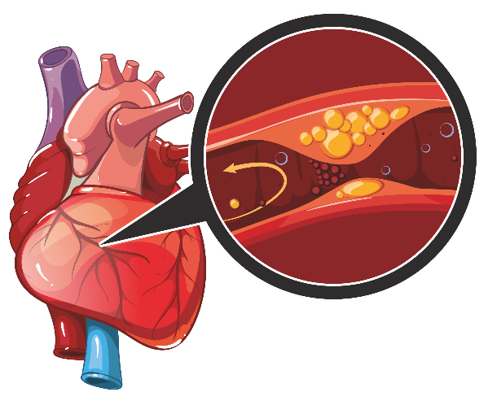
Definition
STEMI stands for ST-Elevation Myocardial Infarction.
It is a type of heart attack that occurs when one of the heart's major arteries is blocked.
The blockage prevents oxygen-rich blood from reaching a part of the heart muscle, causing damage.

Slide 5
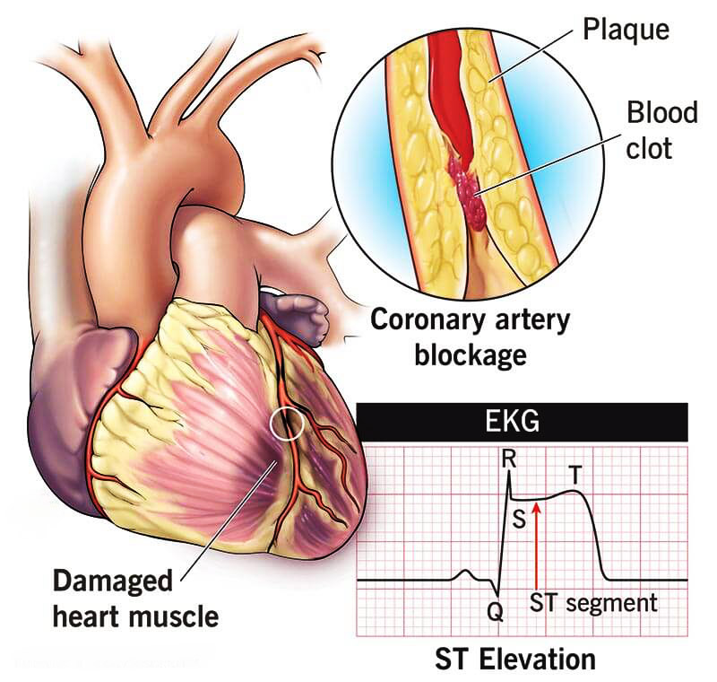
How Does STEMI Occur?
Cause: Usually caused by a blood clot in one of the coronary arteries.
Process:
Fatty deposits (plaques) build up in the arteries.
If a plaque ruptures, a blood clot can form.
The clot can block the artery, stopping blood flow to the heart muscle.

Slide 6
Signs and Symptoms of STEMI
Chest Pain: Intense, squeezing pain or pressure in the chest.
Radiating Pain: Pain may spread to the shoulders, arms, neck, jaw, or back.
Shortness of Breath: Difficulty breathing or feeling out of breath.
Sweating: Sudden cold sweat, often profuse.
Nausea: Feeling sick to the stomach, sometimes with vomiting.
Lightheadedness: Feeling dizzy or faint.

Slide 7
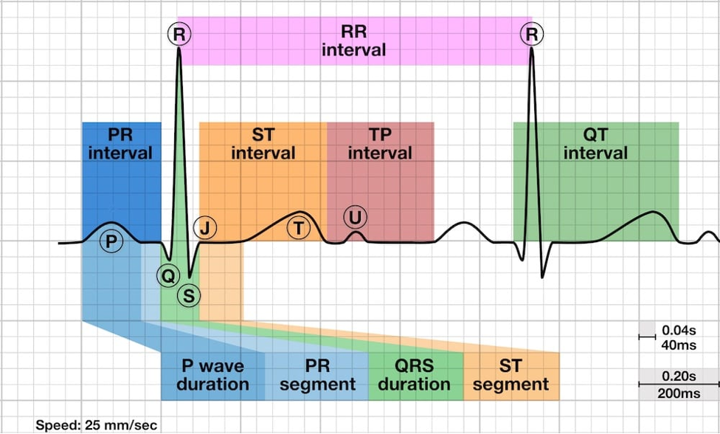
Recognizing Symptoms Early
Important: Recognizing symptoms early can save lives.
Action: If you or someone else has these symptoms, call emergency services immediately (e.g., 911).

Slide 8
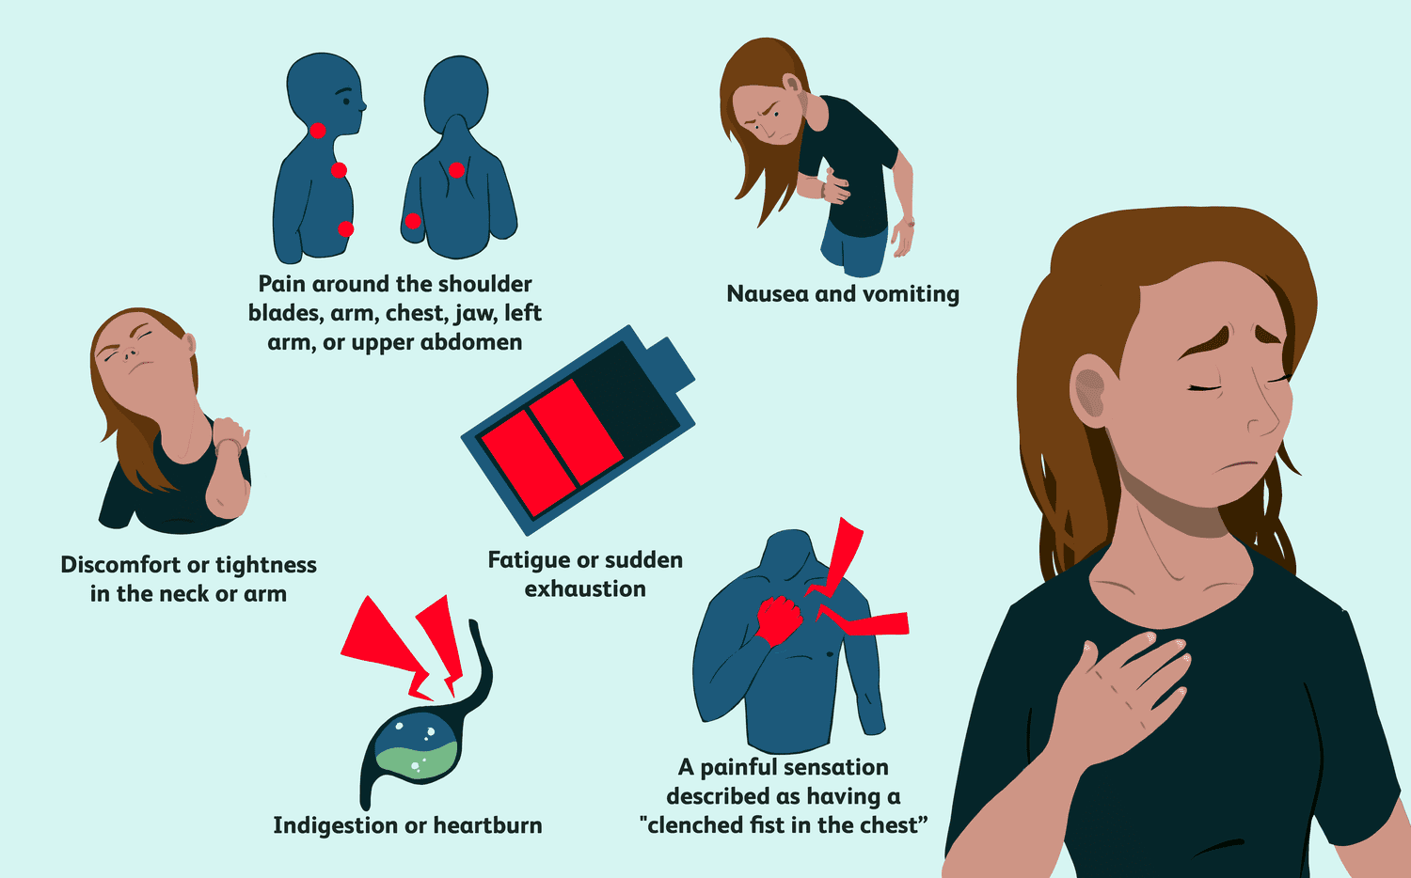
Risk Factors for STEMI
Uncontrollable Factors:
Age (higher risk in older adults)
Family history of heart disease
Controllable Factors:
Smoking
High blood pressure
High cholesterol
Diabetes
Obesity
Lack of physical activity
Unhealthy diet

Slide 9
Preventing STEMI
Lifestyle Changes:
Healthy Diet: Eat a balanced diet rich in fruits, vegetables, and whole grains.
Exercise: Regular physical activity (at least 30 minutes a day).
No Smoking: Quit smoking and avoid second-hand smoke.
Weight Management: Maintain a healthy weight.
Regular Check-Ups: Monitor blood pressure, cholesterol levels, and diabetes.

Slide 10
Immediate Actions During STEMI
Call Emergency Services: Dial 911 or your local emergency number.
Chew Aspirin: If not allergic, chew an aspirin to help thin the blood.
Stay Calm: Try to stay calm and sit down to reduce strain on the heart.
CPR: If the person becomes unresponsive, start CPR if trained.

Slide 11
Long-Term Management Post-STEMI
Medications: Take prescribed medications to prevent future heart attacks.
Follow-Up Care: Regular follow-up with a healthcare provider.
Cardiac Rehabilitation: Participate in a cardiac rehab program to recover and improve heart health.

Slide 12
Conclusion
Summary: STEMI is a serious type of heart attack requiring immediate medical attention.
Key Points: Recognize symptoms early, take preventive measures, and follow medical advice for long-term health.
Reminder: Healthy lifestyle choices can significantly reduce the risk of STEMI.

Slide 13
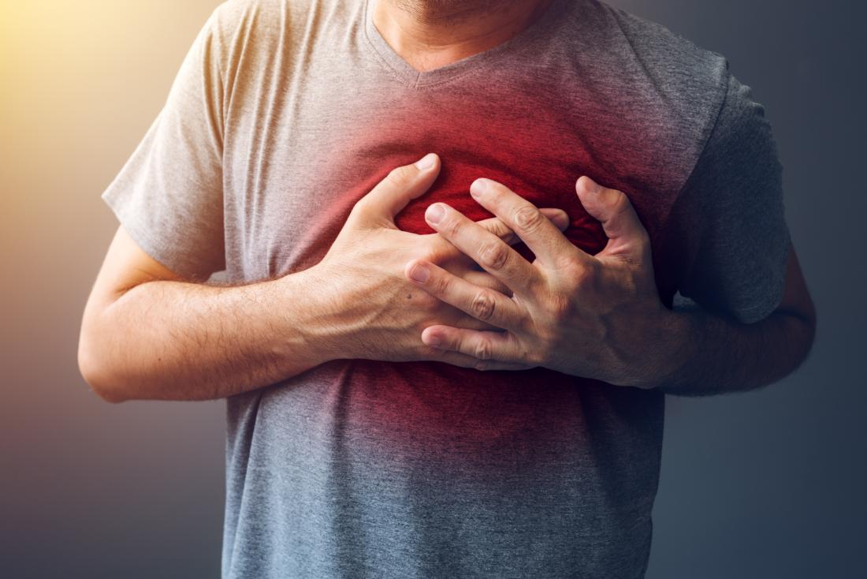
Chest Pain of STEMI
Acute severe retrosternal chest discomfort which is perceived as a pressure or heaviness lasting for more than 20 minutes with or without radiation to arms, back, neck, jaw, or epigastrium, is the most common presentation of STEMI. It is often accompanied by shortness of breath, sweating, nausea, light-headedness and weakness.

Slide 14
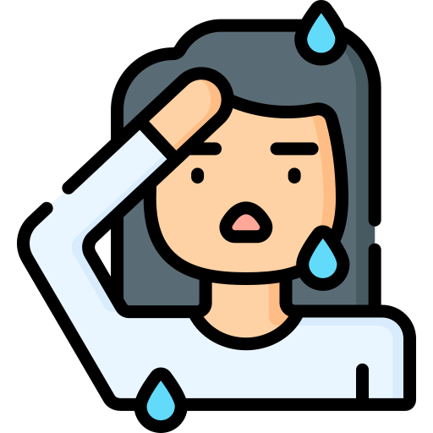
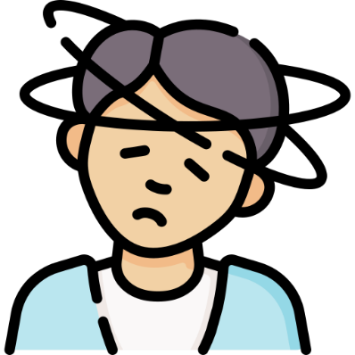
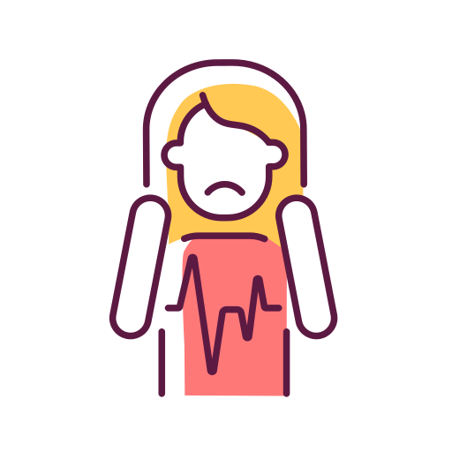
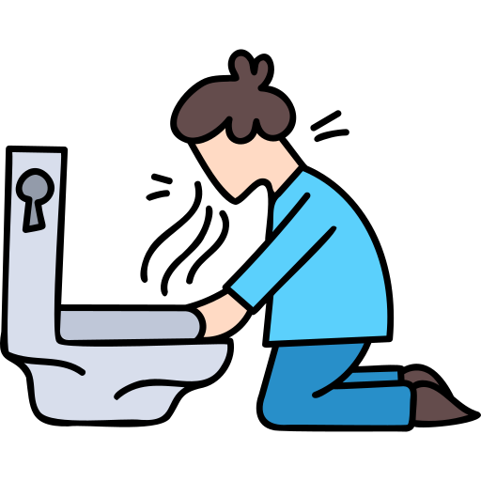
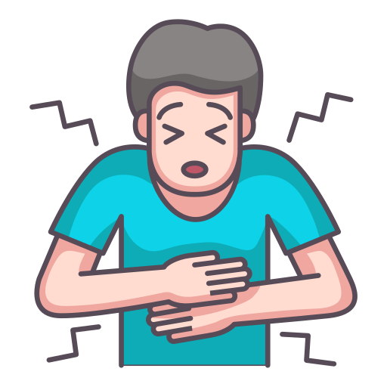
Associated Symptoms
Shortness of breath
Sweating
Syncope or dizziness
Palpitation
Vomiting or pain abdomen

Slide 15
High Risk Individuals
The following group of patients have a higher risk of complications including death-
Old age (age > 75 years of age)
Diabetes mellitus
Prior myocardial infarction or coronary revascularization
Family history of CAD or unexplained sudden death
Renal insufficiency
Peripheral vascular disease

Slide 16
Background
STEMI is the commonest cause of ACS in low income country.
Atherothrombotic occlusion is the underlying cause of STEMI.
Prompt and complete restoration of coronary flow is critically important.
PCI, Thrombolytic therapy and pharmacoinvasive are the modalities reperfusion.
Benefit of reperfusion is function of ischemic time
Access to PCI is limited to small percent of patients.

Slide 21
Signs and Symptoms

Slide 22
Challenges For STEMI System of Care In India
PCI remains unaccessible to majority of patients (done in <10% cases of STEMI)
Alarming treatment delays exist in patients presenting with chest pain
Time to diagnose STEMI and initiation of reperfusion therapy in India is variable
Delay in the treatment will leads to myocardial loss
The start the treatment in golden hours for the Myocardial Salvage

Slide 23
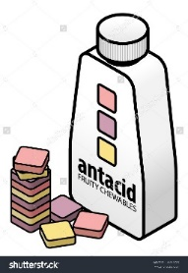
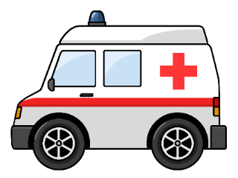
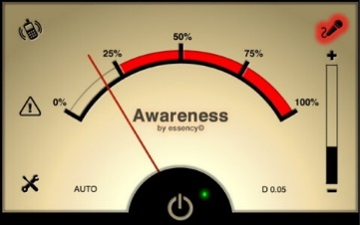
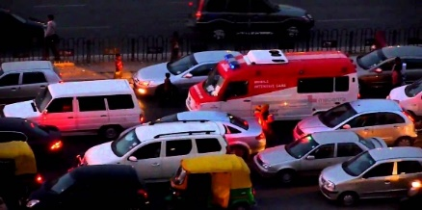
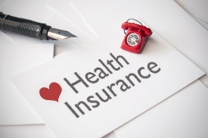
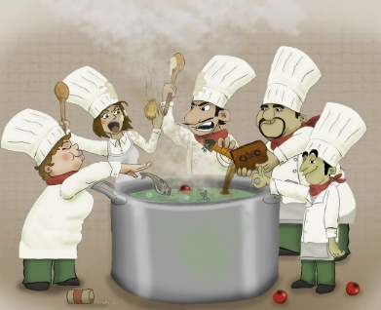
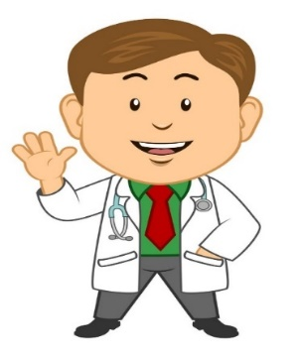
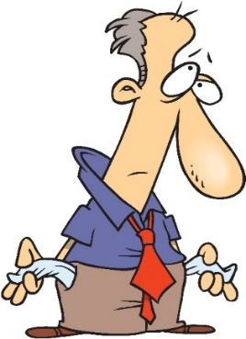
Major issues for the delays seen in Indian settings are
Lack of Awareness
Mistaking MI with Acid reflux disorder
Traffic Jams
Lack of proper Trained staff in ambulance for first aid
Lack of Health Insurance
Trying to get too many opinions
Real Doctor’s View Vs Google Doctor’s View
Financial issues
Concept of Pharmaco Invasive(PI) approach contextualized to the situation in the India

Slide 24
Why This Approach Has To Be Stressed So Much?
Time is Myocardium.
For each 30 min delay in treatment in STEMI patient,1 yr mortality, increases by 7.5% Circulation 2004;109:1223-1225
Mortality benefit with primary PCI is lost if PCI related delay exceeded 60 min.
Nallamothu et al ,Am J Cardiol,2004;94:772-774
Practically, early fibrinolytic therapy can compensate for PCI related delay.
Proportional mortality reduction was significantly higher in patients treated within 2 hours with thrombolytics.

Slide 26
Prevalence of STEMI in India
The exact prevalence of STEMI in India is challenging to determine due to the lack of comprehensive nationwide data.
However, cardiovascular diseases, including STEMI, are a significant health concern in India due to various risk factors such as hypertension, diabetes, smoking, and sedentary lifestyles.

Slide 27
Annual Deaths Due to STEMI in India
Obtaining precise annual death statistics specifically attributed to STEMI in India is challenging.
Cardiovascular diseases, including heart attacks like STEMI, are responsible for a substantial number of deaths in India each year.
According to the World Health Organization (WHO), cardiovascular diseases accounted for 28% of all deaths in India in 2016, which would include STEMI-related fatalities.

Slide 28
Need of the Hour
A well equipped CHCs and PHCs with ECG machines and trained staff will be the first line of defense between Cardiovascular diseases and community.
This, by reducing treatment time will help in saving many lives and reducing morbidity as it is rightly said “TIME IS MUSCLE” in a patient having myocardial infarction.

Slide 29
Burden of Cardiovascular Disease World Wide
Burden of Cardiovasular disease world wide
The Global Burden of Cardiovascular Disease, American College of Cardiology survey 2017

Slide 30
Economic Impact

Slide 31
Dorairaj Prabhakaran, Panniyammakal Jeemon and Ambuj Roy Circulation. 2016;133:1605–1620
Indian Context

Slide 32
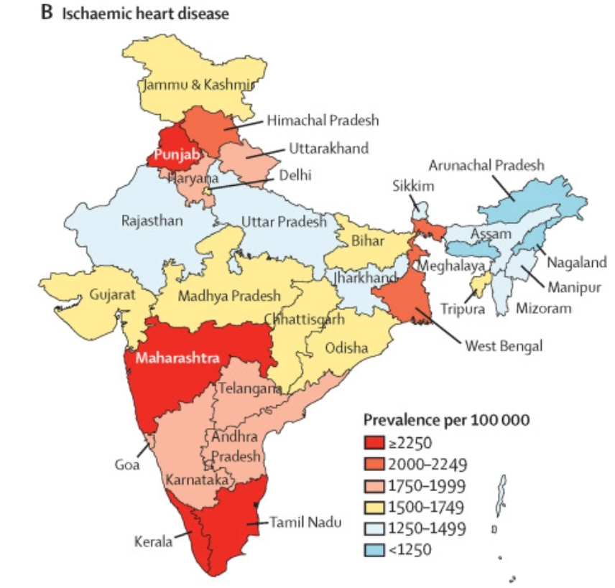
Overview
The changing patterns of cardiovascular diseases and their risk factors in the states of India: the Global Burden of Disease Study 1990–2016 Prabhakaran, Dorairaj et al. The Lancet Global Health, Volume 6, Issue 12, e1339 - e1351

Slide 36
Why UP needs a STEMI cardiac care network
Increasing incidence of cardiovascular diseases in UP from 389.6 to 507 per lakh in between 1990 to 2019**
STEMI is the most common form of ACS in India, with a high case fatality rate
Rising risk factors
Hypertension (11% among women (15-45yrs) and 16.3% among men (15-54yrs))*,
Diabetes (5.7% among women (15-45yrs) and 8.6 % among men (15-54yrs))*
Higher cohort of young population in UP
Large rural population (~18 crore)
**MACE Registry, ICMR. Indian National Database to track cardiac outcomes. https://mace.icmr.org.in/PdfUsed/Definitions%20Used%20MACE.pdf
*NFHS 5

Slide 37
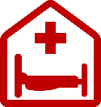
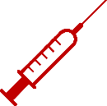
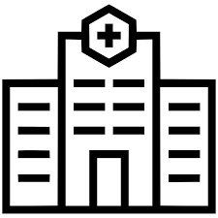
Proposed PI Strategy Model for Uttar Pradesh
Whatsapp Group with specialist to confirm STEMI
Physician
Thrombolysis
Pharmacoinvasive
Cardiologist
Presents to spoke
Discharge
Symptom onset
Spoke Hospital
Hub Hospital
Failed thrombolysis
Primary PCI
Cardiogenic shock lysis contraindicated
Rescue PCI
Presents to hub

Slide 38
District Implementing year | Total Population | ≥18 yr Population | Estimated no. of STEMI/MI/year | Number of Spokes Implementing STEMI program
2022-2023 (DOS 01.09.2022) | 4.5 million approx. | 2.9 million | 9531/year | 19
Facility at hub hospital (Medical College)
Number of Cardiologist | MD Physicians | Nurses | ECG Technician | Cath lab (12Hour) | Tie-up with 108 ambulances
7 | 7 | 46 | 4 | 2 | Available
 |  | Cath Lab-12 CCU-18 Lab-16

Slide 39
District Wise Cases from baseline

Slide 40
Intervention Phase ICMR- STEMI ACT Six Monthly Report- Varanasi District 25-12-2023 to 19-07-2024
No. of Chest pain cases | No. of ECGs done | No. of STEMI cases | No. of eligible patients for thrombolysis | No. of thrombolysis done | Number of patients who refused thrombolysis | Status
2000 | 2000 | 150 | 105 | 120 | 5 | Alive

Slide 41
Spoke wise thrombolysis status in last 6 months

Slide 42
ECG Demonstration

Slide 44
Characteristics of a Thrombolytic Hub
Geographic location
FMC of many patients with STEMI
Yet, 24*7 thrombolysis not happening
24*7 ECG available
Physician/doctor interested in taking care of STEMI
Facility for ICU or monitoring with defibrillation available
Community hospitals, civil hospitals and district level hospitals
Some selected Private hospitals

Slide 45
Training given to MO and Paramedical staff during baseline and intervention phase
Mode of Training | Numbers of Participants
Online | 200
Onsite | 150
Hybrid | 300
weekly training programme at Hub | 500
Workshop | 150
CME | 150

Slide 48
Major issues for the delays seen in Indian settings are
Lack of Awareness
Mistaking MI with Acid reflux disorder
Traffic Jams
Lack of proper Trained staff in ambulance for first aid
Lack of Health Insurance
Trying to get too many opinions
Real Doctor’s View Vs Google Doctor’s View
Financial issues
Concept of Pharmaco Invasive(PI) approach contextualized to the situation in the India

Slide 49
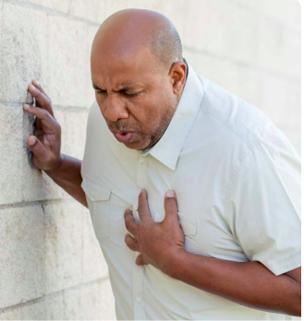
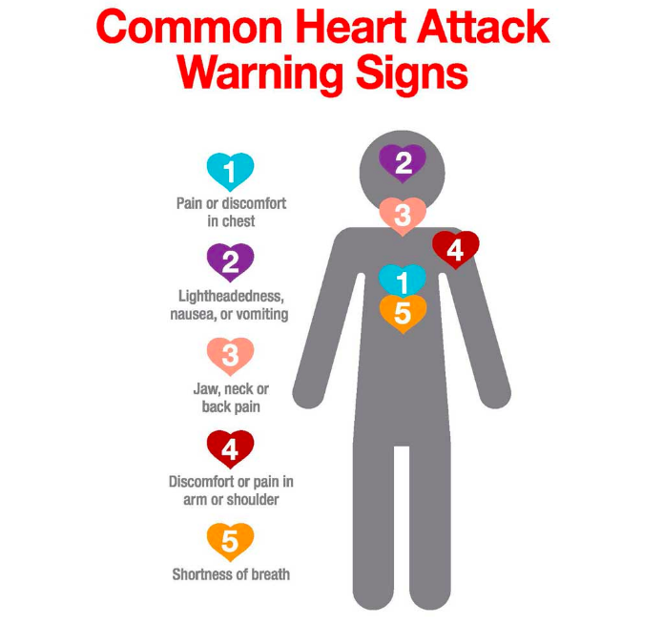
6
6
Profuse sweating

Slide 52
Thank You

