Slide 1
Reducing Maternal Deaths from current MMR (Maternal Mortality Ratio) of 167 by 10% in district X of Uttar Pradesh by year 2025
Presented by
Dr Shalu Mahesh Gupta
Dr Ranjana
Dr Sudhakar Pandey
Dr Hari Shankar Joshi
Dr Manoj Kumar Singh

Slide 2
Identified Potential Topic
Problem Statement: Reducing Maternal Deaths from current MMR (Maternal Mortality Ratio) of 167 by 10% in district Gorakhpur by year 2025.
Public Health Leadership & Management Training

Slide 3
Maternal Mortality Ratio
70
Source: Sample Registration Survey (SRS)
# estimated based on linear regression
* Note: In 2015-17 SRS provided MMR data separately for Uttar Pradesh and Uttarakhand state which led to the increase to 216
Public Health Leadership & Management Training

Slide 4
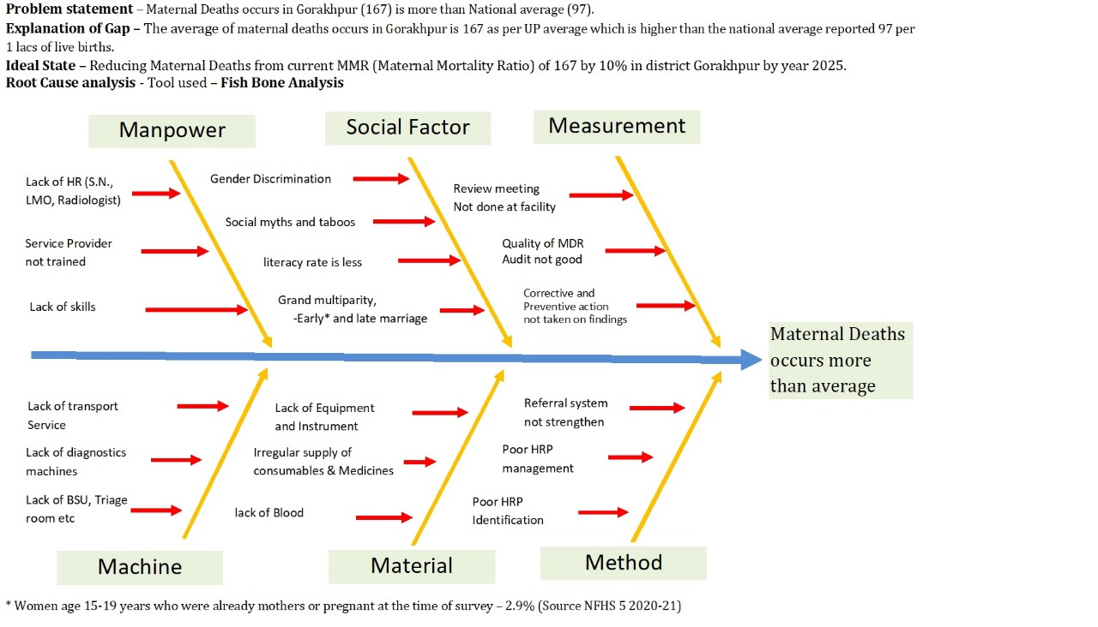
Fish Bone Analysis - Cause and Effect
Public Health Leadership & Management Training

Slide 5
HRP Cases
Complications of Previous Pregnancy (abortion, previous LSCS, anemia)
Previous Medical History (Hypertension-BP>140/90mm of Hg, GDM (GTT>140mg%) Anemia (Hb<7gm%)
Complications of recent pregnancy (Anemia, Hypertension, Bleeding per vaginum, multiple pregnancy)
Complication in recent delivery (prolonged labour, obstructed labour, Bleeding per vaginum, Breech presentation, eclampsia, infection/sepsis)
Public Health Leadership & Management Training

Slide 6
Possible solutions for reduction of MMR
1. Increased access to quality maternal health services (which has almost doubled since 2005) in HRP cases through increased institutional deliveries (about 79% both public and private setup)
2. Early and increased detection of HRP on PMSMA (launched on June 9, 2016) held on 1,9,16,24 of every month.
a. Regular ANC-detection of medical conditions, complications of previous pregnancy and recent pregnancy.
b. Health Education (regarding malnutrition, supplementation, anemia, sanitation and hygiene).
c. Gender and socio-demographic profile studies
d. Timely Screening and follow-up by specialist.
3. Improving referral services and Birth Preparedness and complication readiness (BPCR) for HRP cases.
4. Home based regular follow up by trained health workers ensuring accountability to improve quality of care and equity.
Public Health Leadership & Management Training

Slide 7
Possible solutions for reduction of MMR
5. Positive engagement in between public and private health care providers through PMSMA platform and health camps.
6. Regular refresher courses about safe practices in intra-partum and just immediate post-partum and its management to health care providers from teaching institutions to remaining gaps in knowledge.
7. a. Intensify coordinated efforts between community/regional/national/global level commitment to end preventable MMR.
b. Including WHO aid in increased research evidence, increased clinical and programmatic guidance, providing technical support and setting global standards.
c. Safe motherhood strategies via WHO and UNICEF, ministry of health and family welfare, NITI Aayog, state government, ministry of women and child welfare for planning, policy making, capacity building and monitoring.
Public Health Leadership & Management Training

Slide 8
Identify the criteria for Evaluation
A. Periodic and regular refresher courses in comprehensive maternal health including-
-Safe abortion practices.
-Safe delivery practices and its management.
-Newer contraceptives
-Capacity building
B. Rather than performance orientated goals and targets (like number of surgery conducted by a doctor) emphasis should be on outcome based performance (to avoid unnecessary excessive LSCS which increases MMR)
C. Creating awareness of PMSMA, JSY, JSSK program via ASHA workers, newspapers, TV, radio, social media, word of mouth publicity via community members including friends and relatives.
Public Health Leadership & Management Training

Slide 9
Identify the criteria for Evaluation
D. Digitalization of records to facilitate follow up and monitoring right from ANC period to 6 weeks post natal.
E. Addressing social determinants of maternal health improving literacy, avoiding early marriage and pregnancy, harmful gender norms and inequalities.
F. Improving shortage of essential medical supplies and human resources. Availability of diagnostics and drugs.
G. Home and facility based counselling for danger signs of pregnancy and importance of spacing and family planning.
Public Health Leadership & Management Training

Slide 10
Action Plan
S.N. | Gap Statement | Root Cause | Action proposed | Budgetry | Level of intervention | Priority | Responsibility | Timeline
1 | Lack of HR (S.N., LMO, Radiologist) |  | Demand should be generated |  | State |  | State | NA
2 | Service Provider not trained |  | Training will be planned for all service providers in earliest possible | Yes | District | 1st | ACMO/ MH Consultant | Oct-23
3 | Lack of skills | Lack of hand holding at facility level | Continuous handholding will be done at facility level | Yes | Facility | 1st | MO / Nurse Mentor | Nov-23
4 | Social myths and taboos | Lack of eductaion/ Economic status | Awareness campaigns , IEC should be implemented | Yes | District/ Block/ Villages | 2nd | MO/ ANM/ASHA | Dec-23
5 | literacy rate is less | Social myths and taboos/ Economic status | Awareness campaigns , IEC should be implemented | Yes | District/ Block/ Villages | 2nd | MO/ ANM/ASHA | Jan-24
6 | Grand multiparity, Early and late marriage | Lack of eductaion/ Social myths and taboos/ Economic status | Awareness campaigns , IEC should be implemented | Yes | District/ Block/ Villages | 2nd | MO/ ANM/ASHA | Feb-24
Public Health Leadership & Management Training

Slide 11
S.N. | Gap Statement | Root Cause | Action proposed | Budgetary | Level of intervention | Priority | Responsibility | Timeline
7 | Review meeting Not done at facility | Lack of awareness / monitoring | Meeting should be called at District level | No | District/Block | 1st | ACMO/ MH Consultant/ MOIC | Mar-24
8 | Quality of MDR Audit not good | Lack of knowledge/ monitoring | An awareness training should be planned | Yes | District | 1st | ACMO/ MH Consultant | Apr-24
9 | Corrective and Preventive action not taken on findings | Lack of awareness/ knowledge/ monitoring | CAPA report should be prepared and submitted to district | No | District/Block | 1st | ACMO/ MH Consultant/ MOIC | May-24
10 | Lack of transport Service | Less no of Ambulance/ EMT not trained | No of ambulances should be increases | Yes | State | 2nd | State | Jun-24
11 | Lack of diagnostics machines | USG facility not available at CHC / PHC level Pathology Services not available round the clock | USG should be established at FRU Round the clock lab services should be available at CHC | Yes | State State/ District | 1st | State | Jul-24
12 | Lack of BSU, Triage room etc | BSU Not established | BSU should be established at FRU | Yes | State | 2nd | State | Aug-24
13 | Lack of Equipment and Instrument | Equipments and instruments not in supply | all nacessory should be provided regularly | Yes | State/ District | 1st | State/ ACMO Store | May-24
Public Health Leadership & Management Training

Slide 12
S.N. | Gap Statement | Root Cause | Action proposed | Budgetry | Level of intervention | Priority | Responsibility | Timeline
14 | Irregular supply of consumables & Medicines | All Consumables and medicines are not in supply | all necessary consumables & Medicines should be provided regularly | Yes | State/ District | 1st | State/ ACMO Store | Jun-24
15 | lack of Blood transfusion | CHC has fear for blood transfusion in anemia related to complication management | Training will be planned for all medical officer related to Blood transfusion | No | District | 1st | ACMO | Jul-24
16 | Referral system not strengthen | Pre referral management not done and follow up not taken | A sound referral system should be framed at District level , group creation, referral audit will be done on regular basis | No | District/ Blocks | 1st | ACMO/MOIC | Aug-24
17 | Poor HRP management | Staff not trained/ skilled for HRP management during ANC | HRP management training and monitoring should be done , All HRP should be completed all 4 ANC checkup, USG, Lab tests and consultation with LMO | Yes | District/ Blocks | 1st | ACMO/MOIC | Sep-24
18 | Poor HRP Identification | Staff not trained/ skilled for HRP identification during ANC | HRP identification training should be given to all ANM/SN/CHO. Birth planning should be compulsory for each delivery | Yes | District/ Blocks | 1st | ACMO/MOIC | Oct-24
Public Health Leadership & Management Training

Slide 13
Take home message
Eg. LSAS (Life Saving Anesthetic Skills,
EMoC (Emergency Obstetric Care), SBA (Skilled Birth Attendants) for ANMs and SNs,
CAC (Comprehensive Abortion Care) for medical officers
DAKSHATA/DAKSH for ANMs and SNs
Refresher Course
Through training programs for service providers
Capacity Building
In terms of:
Infra-structure
Man power
Equipment
Strengthening of Delivery Point
Public Health Leadership & Management Training

Slide 14
Hand book for planning, implementation, monitoring services through logistics, supplies, recording, reporting and monitoring system
Maternal Health tool kits
Nischay Pregnancy Kit
To sub-center for early detection of pregnancy
Village Health and Nutrition Days
More than 4.32 crores such days have been held
MCP Card
To improve and monitor quality of MCH interventions
MCTS
Through Web enabled registration
Public Health Leadership & Management Training

Slide 15
MCH Wings
To improve institutional deliveries with focus on quality assurance guideline
Areas with high home delivery rates, SBA trained ANMs must be recruited for conducting deliveries
Prevention of PPH
IFA tablets and supplementation, balanced diet and deworming
To reduce anemia
Under reporting of Maternal Death
Fear of punitive action in health providers
Regular and qualitative maternal death review
At both facility and community level to identify suitable causes, gaps for correction action implementation
Public Health Leadership & Management Training

Slide 16
Action Plan
A robust system for better monitoring and data capturing including transit information of referred cases via WhatsApp group.
Increased home based regular follow ups by health care workers and self appointed community leaders for counselling.
Importance of Post natal check ups to be reinforced by doctors/Nurse Mentors/ASHA/ANM.
Importance of Partograph filling for early detection of obstructed labour by SNs and ANMs.
Public Health Leadership & Management Training

Slide 17
Action Plan
Public private partnerships to improve deficiency in human resources and equipment. Therefore improving quality of services and service providers.
Utilization of human resources through teaching institution of compulsory periphery postings of residents for strengthening of health services at PHCs.
Increasing government health expenditure. (currently only 2.1% (2023) of GDP utilization*)
Public Health Leadership & Management Training
*Ministry of Finance, GOI

Slide 18
Action Plan
Strengthening of data entries on portal by technical staff.
Improving anemia management and detection by digital haemoglobinometer with ANMs and oral IFA distribution.
Availability of PPH and Eclampsia kits at delivery points.
Certification of private and NGO sector to give quality MCH services.
Improving conditional cash transfers and cash based in centric schemes (JSY, JSSK) to increase institutional deliveries.
Public Health Leadership & Management Training

Slide 19
THANK YOU
Public Health Leadership & Management Training

