Slide 1
GROUP-5
REDUCE OUT PATIENT WAITING TIME IN DISTRICT HOSPITAL - ETAWAH FROM 45min TO 25min BY MARCH 2024
TEAM 5 :-
DR POOJA SHARMA
DR PARITOSH SHUKLA
DR DEEPA SINGH
DR SANTLAL PATEL
DR PRAMOD KUMAR

Slide 2
VISION WAITING TIME FOR AN OPD PATIENT IN ANY DISTRICT HOSPITAL SHOULD IDEALLY BE LESS THAN OR EQUAL TO 10 MIN.
Public Health Leadership & Management Training

Slide 3
GAP PRESENTLY THERE IS A GAP OF 35min IN WAITING PERIOD OF OPD PATIENTS.
Public Health Leadership & Management Training

Slide 4
STUDY-DISTRICT HOSPITAL ETAWAH WORKLOAD AND RESOURCES
1.TOTAL PATIENTS - APPROX 1500 PER DAY
- 1100 NEW AND 400 OLD PATIENTS
2.TOTAL DOCTORS - DOING OPD – 13-SPECIALIST DOCTORS
05-GDMO
02-DENTAL
02-AYUSH
NOT DOING OPD :- 02 ANEASTHETIST
01 RADIOLOGIST
01 PATHALOGIST
04 EMO
3.REGISTRATION - COUNTERS 03 (COMPUTERISED)
PRO-02
Public Health Leadership & Management Training

Slide 5
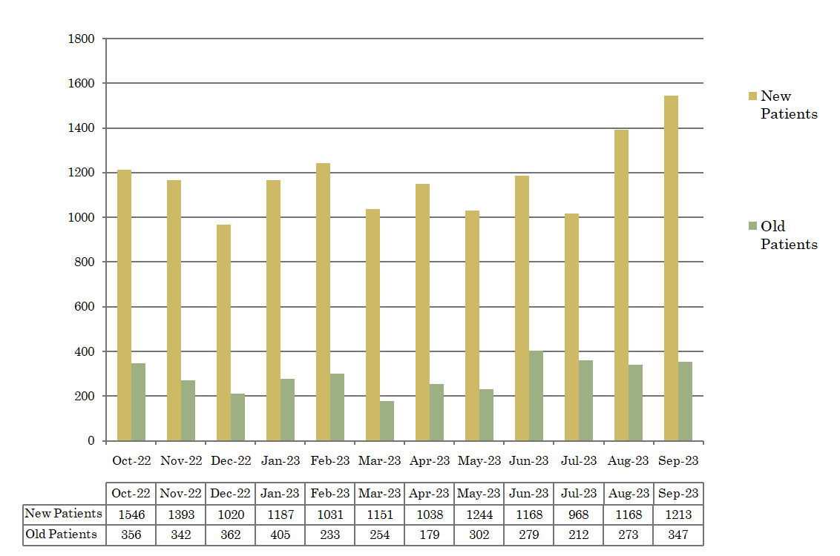
AVERAGE PATIENT / DAY / MONTH
Public Health Leadership & Management Training

Slide 6
Fish Bone Analysis
Infra Structure
People
Policy
No Actual Waiting Area.
People with Nuisance Value
Lack of Proper Signages
Non issue for Hospital incharge
Online Registration System
Non Existent
Interrupted/Absent Internet Services
VIP Culture
No Guidelines to manage OPD Rush
Registration Counters
Less in Number
Less No. of Equipments
Computers & Printers
More than 80% Patients want to come in prime hours (Between 10-12 Noon)
SOP
No clear cut SOP for Patient
Flow.
High Waiting Time for OPD Patients
Help Desk / Triage System
Non Existing
Inactive
Patients Behaviour Issues
Mind set to meet only senior doctor
No policy for hierarchy for consultation
Paramedical/Support Staff
Shortage
Unmotivated
Underpaid
Screening of Patients
No System
Reports & Results
No Clear System
No definite time line
So multiple visit required to collect the report.
Doctors
Shortage
Involved in multiple activities
Over Worked
Irrational/Over Advice for Referrals
Intra Hospital
Inter Hospital
Non availability
of diagnostics at the periphery.
Nodal Officer for OPD Management
Inactive
Non Accountable
Involved in other administrative activities
Irrational /Over Advice for Diagnostics
Old & New Patient Issues.
Non availability of doctors/specialist
at the periphery.
Delayed Starting of OPDs
Human Resource
Procedure
Reports

Slide 7
REASONS FOR LONG WAITING PERIOD 1. EXCESSIVE PATIENTS
DISTRICT MALE HOSPITAL AND FEMALE HOSPITAL ETAWAH ARE IN THE SAME CAMPUS WITH COMMON GATE FOR ENTRANCE.
SINCE THE REGISTRATION COUNTER FOR FEMALE HOSPITAL IS PLACED AFTER THE COUNTERS OF THE MALE HOSPITAL, SO GYNAE AND ANTE NATAL PATIENTS GET REGESTERED AT THE MALE HOSPITAL Ist AFTER WHICH ARE THEN REFERRED IMMEDIATELY, THUS CREATING INCREASE IN THE WAITING PERIOD AT THE LEVEL OF REGISTRATION.
THE ANTE NATAL & OTHER PATIENTS FROM OTHER HOSPITALS (GOVT OR PVT) ARE BEING REFERRED FOR DIAGNOSTIC AND MEDICINES HERE, BECAUSE OF LACK OF HR & DIAGNOSTICS AT THE PERIPHERY.
AFTER THE REGISTRATION; EVERY PATIENT WANTS ALL TYPES OF DIAGNOSTIC, TREATMENT AND MEDICINES (WHETHER THEY REQUIRE IT OR NOT)

Slide 8
Flow Chart of Patient in Distt Hospital
(FROM ENTRANCE TO THE OPD TAKING 45 MINUTES)
Registration Counter
O
P
D
MALE
OPD
NEW
(M&F)
If Pregnant or
Gynae Complaints
Refer to Distt Female Hospital
FEMALE
PRO Desk
O
P
D
Other Complaints
Registration Counter
OPD
PATIENT
Valid OPD Slip
O
P
D
OPD
OLD
PRO Desk
Registration Counter
O
P
D
Invalid OPD Slip
OPD
>15 days
Public Health Leadership & Management Training

Slide 9
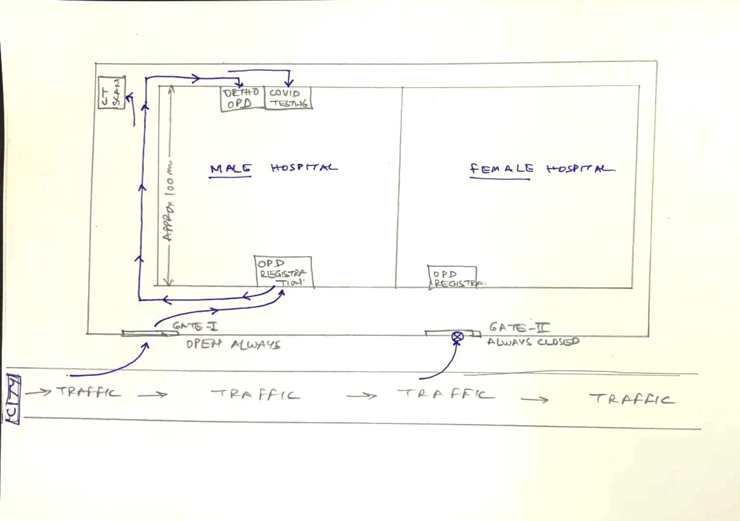
ARIAL VIEW OF DISTT HOSPITAL

Slide 10
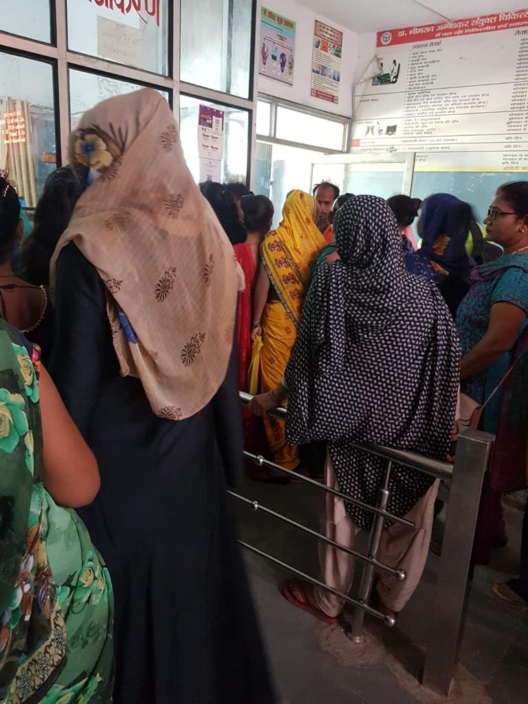
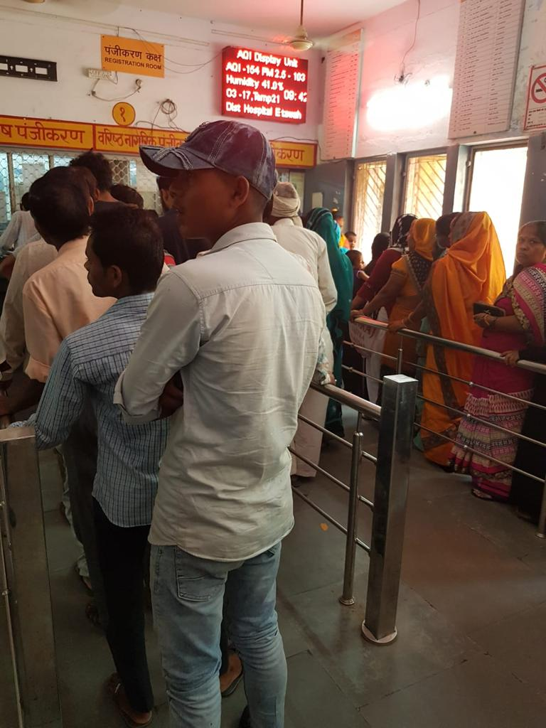
MALE-FEMALE REGISTRATION AT THE SAME PLACE
Public Health Leadership & Management Training

Slide 11
PATIENT LOAD – PER DAY
PIE CHART SHOWING MALE AND FEMALE PATIENT DISTRIBUTION IN DAILY OPD PATIENTS.
Public Health Leadership & Management Training

Slide 12
REASONS FOR LONG WAITING PERIOD 2. INFRASTRURE
THE HOSPITAL IS POORLY PLANNED.
THE OPD ROOMS ARE NOT SERIALLY ARRANGED, THEY ARE NUMBERED RANDOMLY.
RELATED OPDs ARE FAR APART.
OPDS ARE SCATERED OVER DIFFERENT PLACES AND DIFFERENT FLOOR OF THE HOSPITAL. MAKING IT DIFFICULT FOR THE PATIENT TO FIND THEM, THUS EFFECTIVE PERIOD OF WAITING INCREASES.
SOME ROOMS AROUND REGISTRATION AREA ARE NOT UTILIZED APPROPRIATELY.
SOME ROOMS ARE OCCUPIED AND LOCKED BY DWH.
THE STAIRCASE ARE FEW AND VERY NARROW ALSO STEEP, SO THE PATIENTS TAKE MORE TIME GOING UP AND DOWN.
Public Health Leadership & Management Training

Slide 13
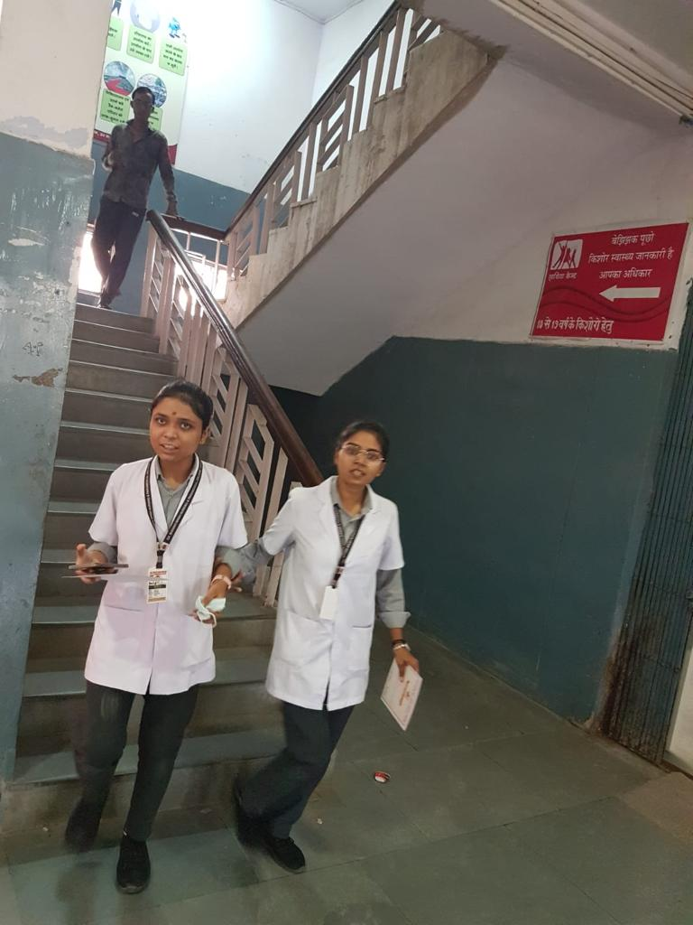
STAIRCASE
Public Health Leadership & Management Training

Slide 14
TIME –MOTION STUDY (TMS) FOR CALCULATING AVERAGE WAITING TIME
BY UTILIZING TIME STUDY METHODOLOGY, ONE CAN ASCERTAIN HOW LONG IT TAKES AN AVERAGE PERSON TO COMPLETE A TASK WITH A SPECIFIC LEVEL OF QUALITY. TMS IS A TYPE OF QUANTITATIVE DATA GATHERING, AN OUTSIDE OBSERVER RECORDS THE TIME AND TIME NECESSARY TO COMPLETE AN ACTIVITY.
BY USING TMS, WE CAN ALSO EVALUATE THE IMPACT OF DIFFERENT METHODS/ SUGGESTIONS IN REDUCING OPD WAITING TIME DOING FOLLOW UP STUDY.
Public Health Leadership & Management Training

Slide 15
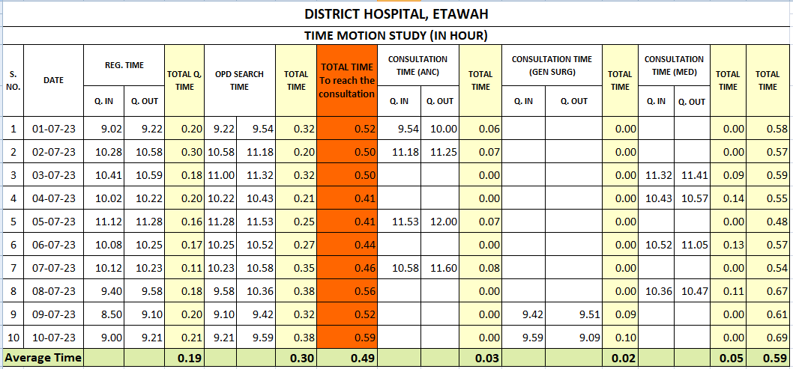
TIME MOTION STUDY
Inference :
Average waiting time to reach the consultation is 0.49 min
Average time for consultation is 0.3 min
Average total time in hospital is 1.0 hour
Public Health Leadership & Management Training

Slide 16
Gap Analysis of the Major Issues :
S.N. | Gap observed | Reason | Level of Intervention | Responsibility
1 | Lack of MO/specialist at the periphery | Lack of doctors at state level | State | State
2 | Doctors involved in activities like VIP duties emergency | Less number of Junior doctors for activities like VIP duties emergency | State | State
3 | No Policy of Hierarchy for consultation | Policy not framed | State | State
4 | Non availability of diagnostics and minor procedures at the periphery | No uniformity in availability of diagnostics & HR at the CHC & PHCs | State and District | State and District
5 | Poorly planned OPD Area with under utilized rooms | New OPDs planned on adhoc basis as per availability of rooms. | District hospital | SIC/CMS
6 | Higher number of patients per day | Poor planning of male and female hospital | Both district hospitals (DH & DHW) | SIC/CMS
7 | Delayed starting of OPDs | Lack of monitoring | District Hospital | SIC/CMS
8 | VIP Culture, consulting during prime time etc | Behavioral & Social issues | DH, CHC, PHC | All involved
Public Health Leadership & Management Training

Slide 17
SWOT Analysis of Major Issues :
Strength : Re-modeling of district Hospital and CHC/PHC under kayakalp. Diagnostics are made available at periphery under PPP model. Provision of on-call private consultants at the level of CHC/PHC as per requirement. Tele consultation which has already started. | Weakness: Lack of all types of HR. Engagement of specialist in multiple public health programmes and other duties. Inappropriate posting of specialist doctors. Lack of managerial staff for managing non-clinical activities.
Opportunities : Budget in RKS and kayakalp is available. Budget for IEC available in different health programmes. Different levels of training are being done. Power to the DHS is given to re-model and plan the hospital. | Weakness: Patient resistance/social behavior. Political involvement/VIP Culture. Out of proportion/too much media involvement which has huge nuisance value leading to negative publicity.
Public Health Leadership & Management Training

Slide 18
SUGGESTIONS : TO REACH THE GOAL...
REDUCING INCOMING PATIENT FLOW BY DIRECTING PREGNANT AND GYNAE PATIENTS TO DISTICT FEMALE HOSPITAL ETAWAH DIRECTLY.
INCREASING THE NO. OF COMPUTERISED OPD REGISTRATION COUNTERS.
INCREASING THE NO. OF PRO DESKS.
COLOR CODED FOOTSPTEPS, PASTED ON FLOOR TO GUIDE THE PATIENTS TO THEIR RESPECTIVE OPDS. (JUST LIKE DELHI METRO)
GOOD AND PROPERLY VISIBLE SIGNAGES SHOULD BE PLACED AT STRATEGIC POSITIONS.
Public Health Leadership & Management Training

Slide 19
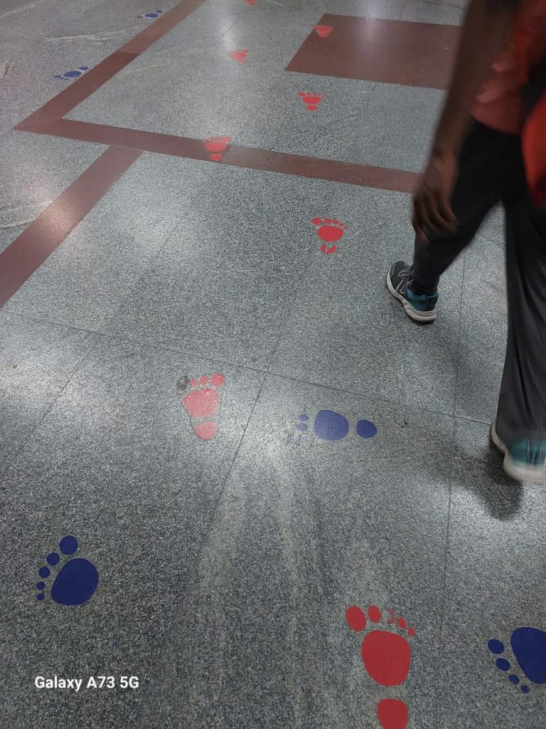
COLOR CODED FOOT STEPS
COST: 50/- INR per step pair
Total Cost : 2.0 Lac
ESTIMATED TIME : 02 MONTHS
Public Health Leadership & Management Training

Slide 20
SUGGESTIONS : TO REACH THE GOAL.....
DOCTOR’S OPD ROOMS MUST BE NUMBERED SERIALLY, STARTING FROM REGISTRATION COUNTER.
PREFERABLLY ALL THE OPD ROOMS MUST BE ON THE GROUND FLOOR.
INCREASE THE NO. OF STAIRCASES (INCREASE THE WIDTH TOO)
THE OPD SHOULD START AND END ON TIME (MAX WINDOW TIME FOR OPD SERVICES TO BE UTILIZED)
Public Health Leadership & Management Training

Slide 21
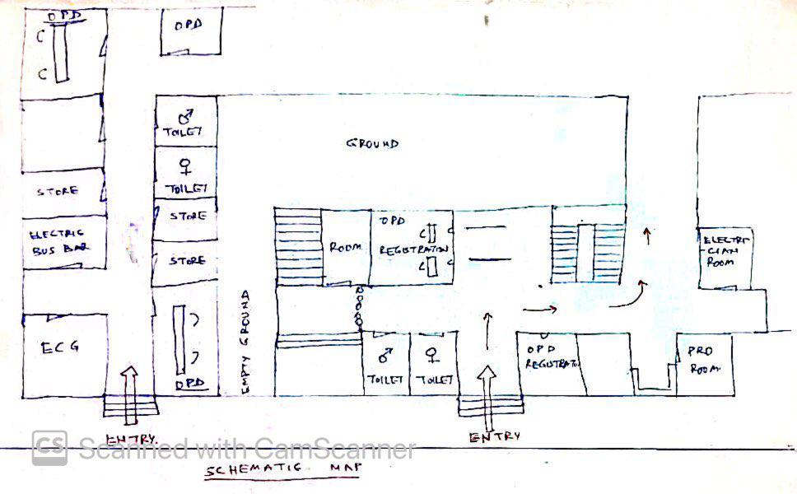
SUGGESTION FOR OPD PLAN ON THE GROUND FLOOR COST : 20 LACS / ESTIMATED TIME : 06 MONTHS
Public Health Leadership & Management Training

Slide 22
SUGGESTION FOR STAIRCASE COST : 50 LACS / ESTIMATED TIME : 06 MONTHS
STAIR CASE
PRESENTLY
STAIR CASE
PROPOSED
Public Health Leadership & Management Training

Slide 23
SUGGESTIONS : TO REACH THE GOAL.....
PATIENTS INFLOW CAN BE MANAGED BY UTILIZING THE SERVICES AT CHCs & PHCs BETTER.
MORE AND MORE FRUs TO BE ACTIVATED AND MADE FUNCTIONAL (MANY FRUs ARE FOR NAMESAKE ONLY, THUS MORE REFERRAL TO DH).
INCREASING TELEMEDICINE AT ALL LEVELS SPECIALLY FOR THE FOLLOW UP TREATMENT .
HWC & CHO CAN PLAY A MAJOR ROLE FOR NCD SCREENING AND TREATMENT.
JUDICIOUS REFERALL FROM PERIFERY TO DH.
Public Health Leadership & Management Training

Slide 24
AMBITIOUS SUGGESTIONS :
CREATING ABHA ID FOR EVERY PATIENT.
THE CONCEPT OF HPR ID SHOULD BE PROMOTED.
HMIS SYSTEM MUST BE ADOPTED AND ALL HEALTH PERSONAL SHOULD BE TRAINED ADEQUATELY.
ONLINE APPOINTMENT SHOULD BE PREFERRED AND ENCOURAGED, ESPECIALLY FOR FOLLOW UP.
GOOD PA SYSTEMS (AUDIO VISUAL) TO BE MADE FUNCTIONAL.
MORE JUNIOR DOCTORS TO BE APPOINTED AS GDMOs & EMOs.
Public Health Leadership & Management Training

Slide 25
BUDGET REQUIREMENT :
S. No | Proposed Change | Quantity | Rate per item | Budget Required | Budget expected from | Remark
Infrastructure Budget
1 | Computer System | 3 | 75000 | 225000 | State | one time activitiy
2 | Public Address system | 3 | 150000 | 450000 | State | one time activitiy
3 | Color Coded Steps | 4000 | 50 | 200000 | State | one time activitiy
4 | Signage | - | 200000 | 200000 | State | one time activitiy
5 | Planning of New OPD floor | - | 20,00,000 | 2000000 | State | one time activitiy
6 | New Stair Case | 1 | 50,00,000 | 5000000 | State | one time activitiy
7 | Extra Entrance | No budget
Total target for One Time Activity |  |  |  | 8075000
HR Budget
8 | Extra PRO | 3*12 (Month) | 20000/- person/month | 720000 | State | Annual Budget
9 | Extra Support Staff | 6*12 (Month) | 11000/- person/month | 792000 | State | Annual Budget
10 | GDMOs Doctors | 3*12 (Month) | 60000/- person/month | 2160000 | State | Annual Budget
11 | Specialist Doctors | 3*12 (Month) | 100000/- person/month | 3600000 | NHM | Annual Budget
12 | Miscellaneous | - | - | 200000 | RKS/State | Annual Budget
Total Annual Budget |  |  |  | 7472000
Grand Total |  |  |  | 15547000
Public Health Leadership & Management Training

Slide 26
GROUP RECOMMENDATIONS: PHASED MANNER: depending on sanction & availability of funds. (they can also be simultaneous)
PHASE 1
NO EXTRA BUDGET SANCTIONED OR MINIMAL BUDGET FROM RKS
START SEPERATE ENTRANCE FOR DISTRICT WOMEN HOSPITAL.
COLOR CODED FOOT STEPS.
PROPERLY VISIBLE SIGNAGES.
04 UNDER UTILZED ROOMS AROUND THE REGISTRATION AREA CAN BE RE-ALLIGNED TO INCREASE OPDs WITH HIGHER FOOT FALLS (eg. Medicine/pediatrics)
PROPER NUMBERING OF EXISTING OPD ROOMS.
UTILISING MAXIMUM WINDOW PERIOD FOR OPD SERVICES.
RESULT
THESE MEASURES WILL REDUCE THE WAITING PERIOD BY “10 to 12 MIN. APROX”
Public Health Leadership & Management Training

Slide 27
GROUP RECOMMENDATIONS:
PHASE 2A
BUDGET UTILIZED FROM RKS OR KAYAKALP
INCREASING REIGSTRATION COUNTERS & PROs.
GOOD PA SYSTEM IN PLACE.
CONVERTING LARGE UNUSED TOILETS NEAR THE REGISTRATION AREA INTO OPD / CONSULATION ROOMS.
PHASE 2B
BRINGING OUT OPERATIONAL / BEHAVIOURAL CHANGES
INCREASING TELEMEDICINE.
CREATING ABHA ID SO THAT PREVIOUS HEALTH DATA IS MADE EASILY AVAILABLE.
ONLINE APPOINTMENT SYSTEM.
MAXIMUM UTILISATION OF SERVICES AT FRUs, CHCs & PHCs.
MAXIMUM UTILISATION OF SERVICES OF CHOs AT HWC.
RESULTS
THESE MEASURES TOGETHER WILL REDUCE THE WAITING PERIOD BY “12 to 15 MIN. APROX ”
Public Health Leadership & Management Training

Slide 28
GROUP RECOMMENDATIONS:
PHASE 3
BUDGET SANCTIONED AS PER DEMAND
BUDGET CAN BE USED FOR CONSTRUCTION OF ADDITIONAL ROOMS ON GROUND FLOOR.
REMODELING OF STAIR CASE. IF ALL THE OPDs ARE ON THE GROUND FLOOR, WE MAY NOT REQUIRE REMODELLING OF STAIRS, SO THIS DECISION CAN BE TAKEN AS PER THE ACTUAL NEED, TO ACHIEVE EFFECTIVE UTILIZATION OF BUDGET.
APPOINTMENT OF MORE JUNIOR DOCTORS. (GDMOs/EMOs)
RESULTS
WITH IMPLEMENTATION OF ALL MENTIONED MEASURES, WE EXPECT TO ACHIEVE THE DESIRED TARGET. i.e. REDUCE OUT PATIENT WAITING TIME IN DISTRICT HOSPITAL-ETAWAH FROM 45min TO 25min.
Public Health Leadership & Management Training

Slide 29
GUIDANCE FROM SENIORS AND SUGGESTIONS FROM COLLEAGUES ARE WELCOME.
THANKS.....!
Public Health Leadership & Management Training

