Slide 1
यह कार्यक्रम स्वास्थ्य विभाग और राज्य स्वास्थ्य एवं परिवार कल्याण संस्थान (SIHFW), उत्तर प्रदेश की पहल पर उत्तर प्रदेश टेक्निकल सपोर्ट यूनिट (UPTSU) के सहयोग से हो रहा है।
Principal Secretary, Medical Health & Family Welfare, U.P. Shri Partha Sarthi Sen Sharma
Director Administration & Director, SIHFW
Dr. Rajaganapathy R

Slide 3
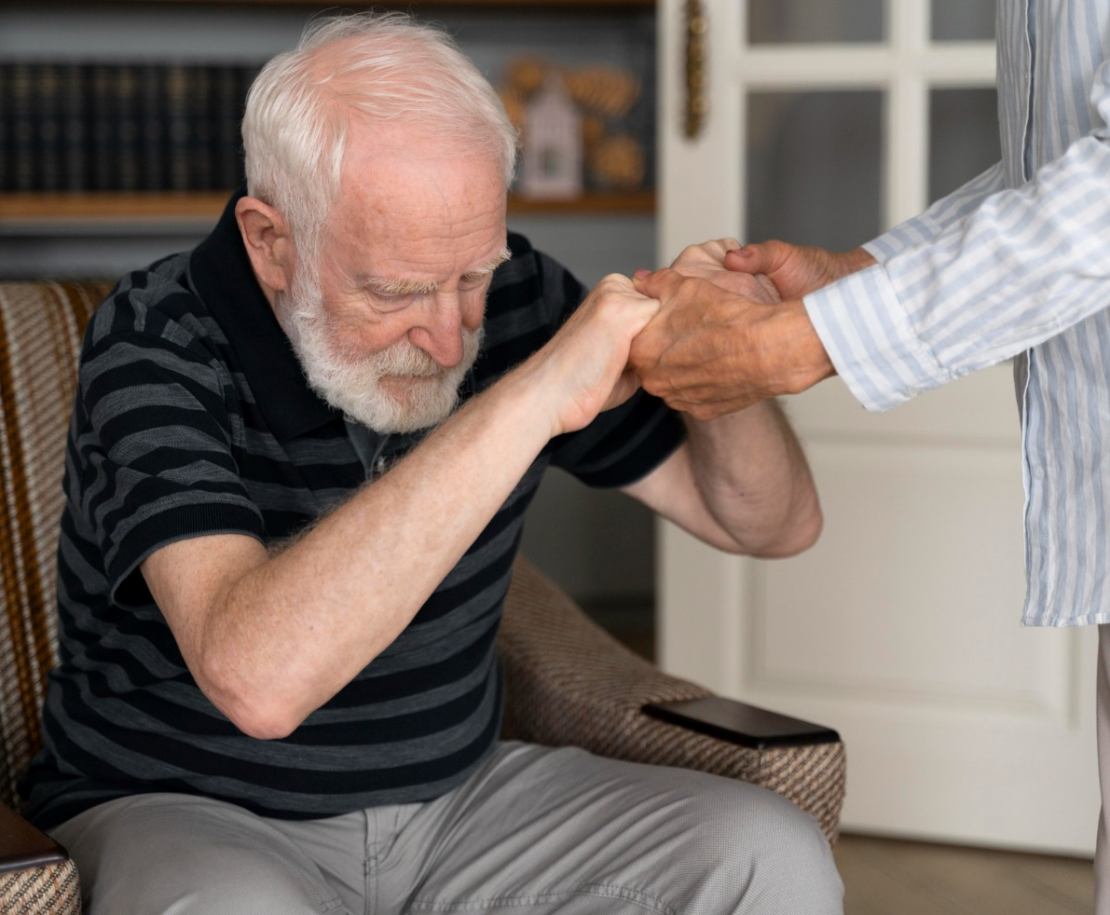
Management of Parkinson’s Disease (PD)
Dr. Prabhat Sharma
MBBS, MD - Medicine, DM – Neurology
King George's Medical University, Lucknow

Slide 4
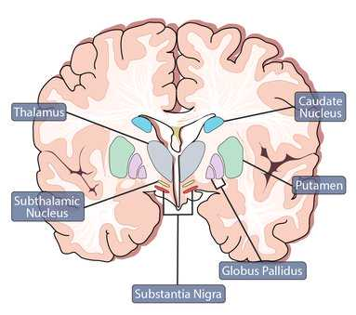
WHAT IS PARKINSON’S DISEASE
It is movement disorder due to defect in basal ganglia-whose function is to ‘smoothen’ action
4

Slide 5
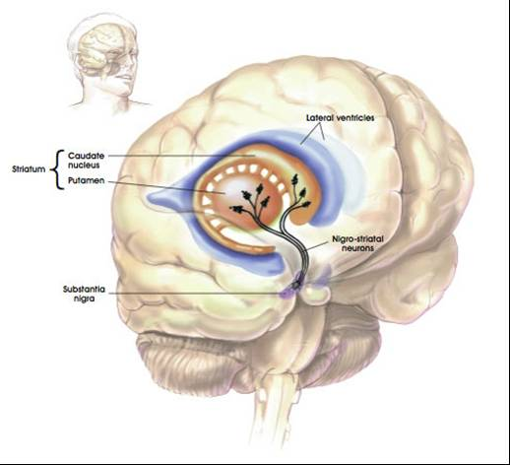
5

Slide 6
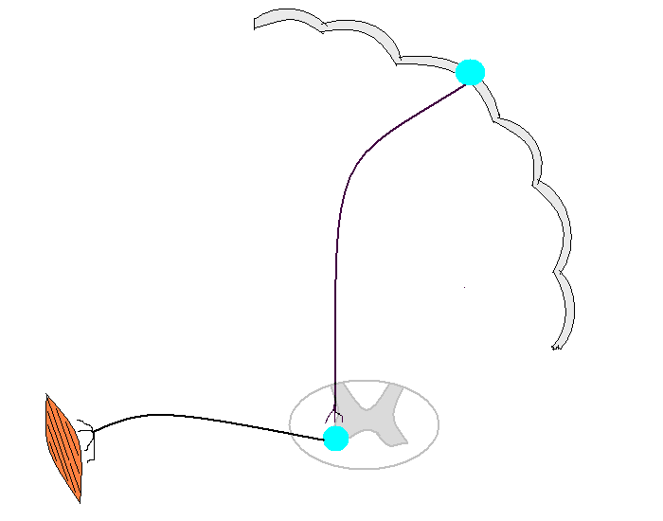
Basal ganglia
Cerebellum
6

Slide 7
NO TESTS FOR DIAGNOSIS OF PARKINSON’S DISEASE DIAGNOSIS IS CLINICAL
Total Body check is deceit, we barely know 15% of body’s working.
For years before the symptoms PD appear the patient has generalized aches and pains
He is ‘tossed’ from one department to another!
7

Slide 8
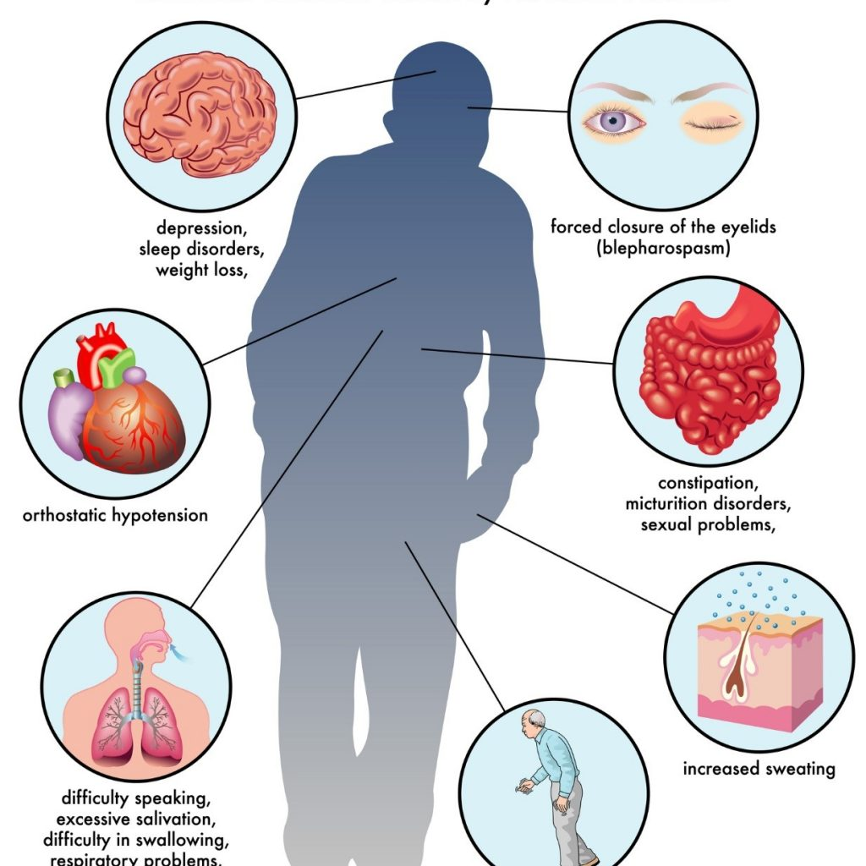
CLASSICAL SYMPTOMS OF PARKINSON’S DISEASE
1. Bradykinesia - Each action is slow, even thought – brady phrenia, lack of spontaneity, decrease blink, swallowing, monotonous voice, mask like facies, micrographia
2. Rigdity (Stiffness) – Festinaire
3. Tremor (कंपन) Coarse 4-8 per sec, rest, pill rolling – D/D – Familial tremor / essential tremor
Drugs causing tremor : Anti Asthma, VPA, Liquor, Anxiety
4. PIGD Postrural Instability Gait Disorder –
Hemi Start (एक तरफा), Years later bilateral
8

Slide 9
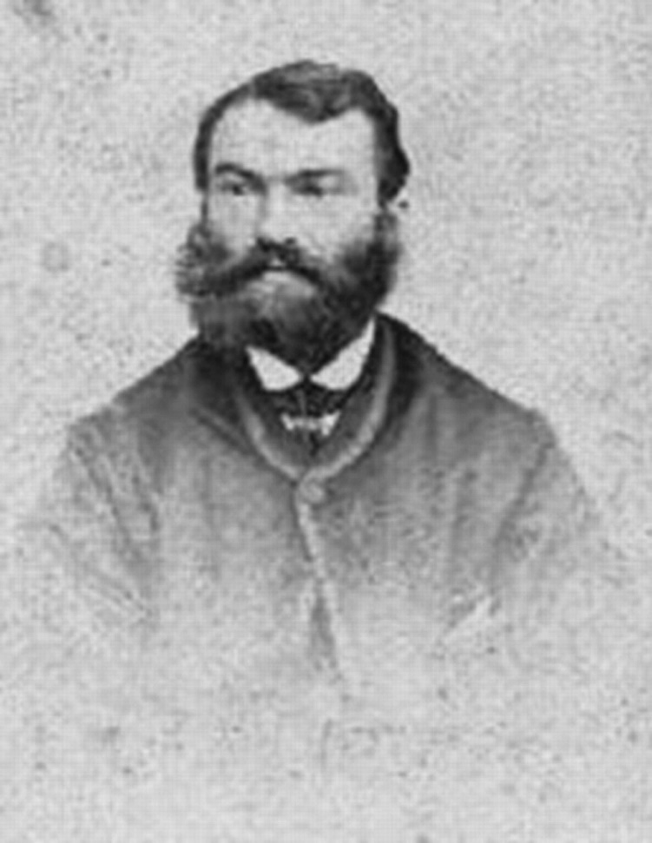
JAMES PARKINSON (1817)
Charak Samhita coded by Shri Agnivesh around 2400 BC in chapter 20 gives a detailed description of Parkinson disease and its treatment. Mucina pruriens, leguminous plant has levodopa, also used as an aphrodisiac in India and Egypt.
9

Slide 10
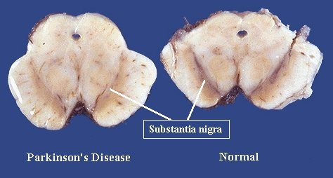
CAUSES OF PARKINSON’S DISEASE
You treat the cause the disease get alright
1. Idiopathic (पता नहीं/अज्ञात) 80% cases. Euphemism
2. Trauma – Boxing उपमा / रूपक
3. Infection – Viral Encephalitis 1919-26 Europe -
Influenza virus (Von economo)
4. Vascular – Hypertension
5. Toxic
a. Organic Compounds –
Pesticides, Roclencticide, MPTP – MPP
b. Drugs – D2antagonist i.e. neuroleptics, lithium
Perinorm
(Demo of skulp)
10

Slide 11
TREATMENT
Phenyl Alanine
Tyrosine
Dopa/Levo Dopa
Levo dopa - Not if ADL is okay
Levo dopa - Start with low doses many times a day
L Dopa 1960s Vienna Hornykiewicz
Newyork Cotzia
Dopamine
Reward Neuro Transmitter –Nicotine And Alcohol
80% decrease, 80% narrowing-stroke
90% decrease - liver damage
NE
E
11

Slide 12
SIDE EFFECTS OF LEVODOPA
GI – NVD
Heart – Rhythm, Decrease BP
CNS – Confusion/Hallucination :
Abnormal movement (Dystonia, Chorea, Athetosis,
Myoclonus, Akathisia)
ON/OFF, YOYO
Skin – Edema, Livedo, Reticularis
Sudden Withdrawal – NMS
Fever rigidity, high mortality
D2Antag treatment
12

Slide 13
OTHER DRUGS
1. Levo dopa Agonist –Bromocriptine, Prami pexole
2. Dopamine releaser - Amantidine
3. Mao B inhvitor - Selegiline – 1960
4. Comt Inhibitor – Entacapone, Tolcapone
5. Non Dopamine drug
a) Motor - Ach antag Pacitane –Side effect – CNS, GI, Eye, Bladder
b) Non motor – Behaviour dementia, Insomnia
6. Surgery – Thalamotomy, Pallidotomy
13

Slide 14
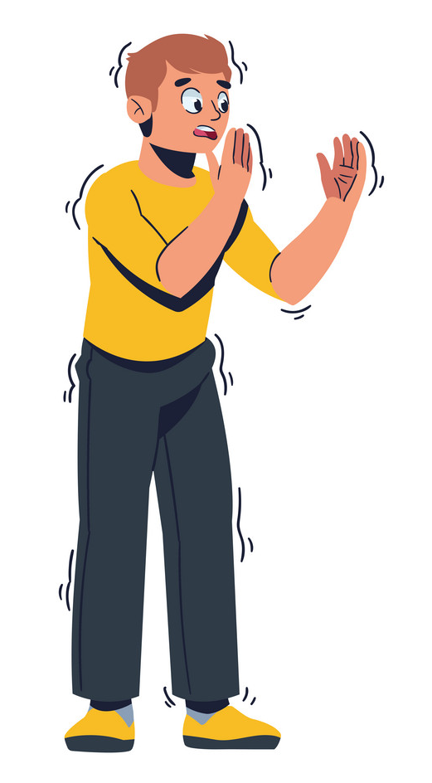
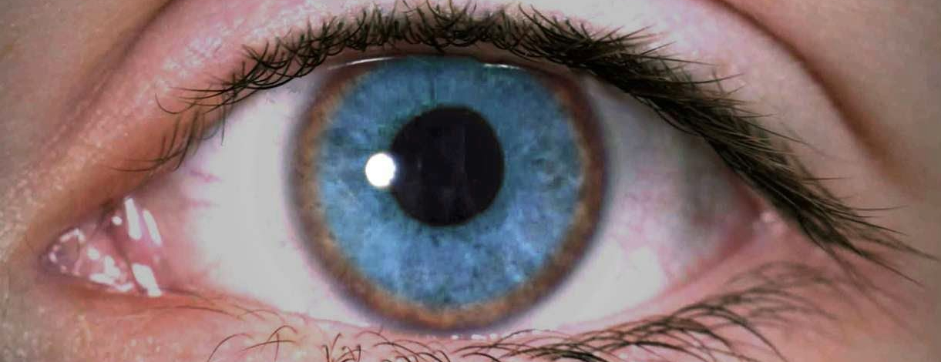
CASE-1
Young – Parkinson – Wilsons
MPTP
Neuroleptic intake
14

Slide 15
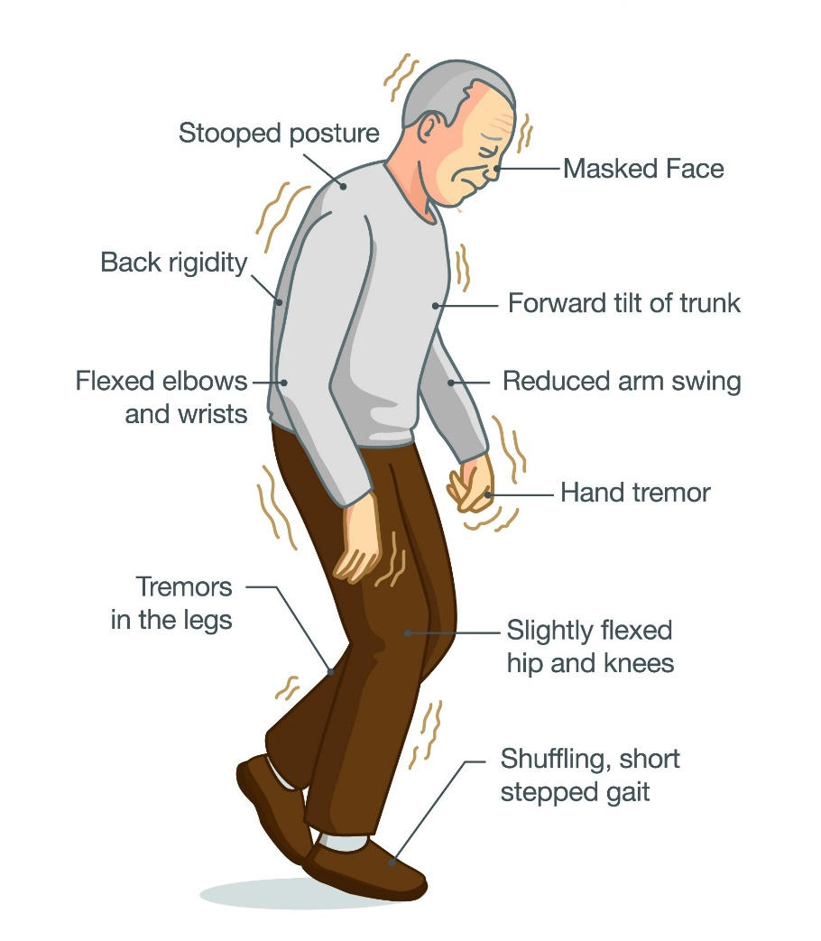
CASE-2
Old – Associated other CNS area involvement, example – MSA
PSP
15

Slide 16
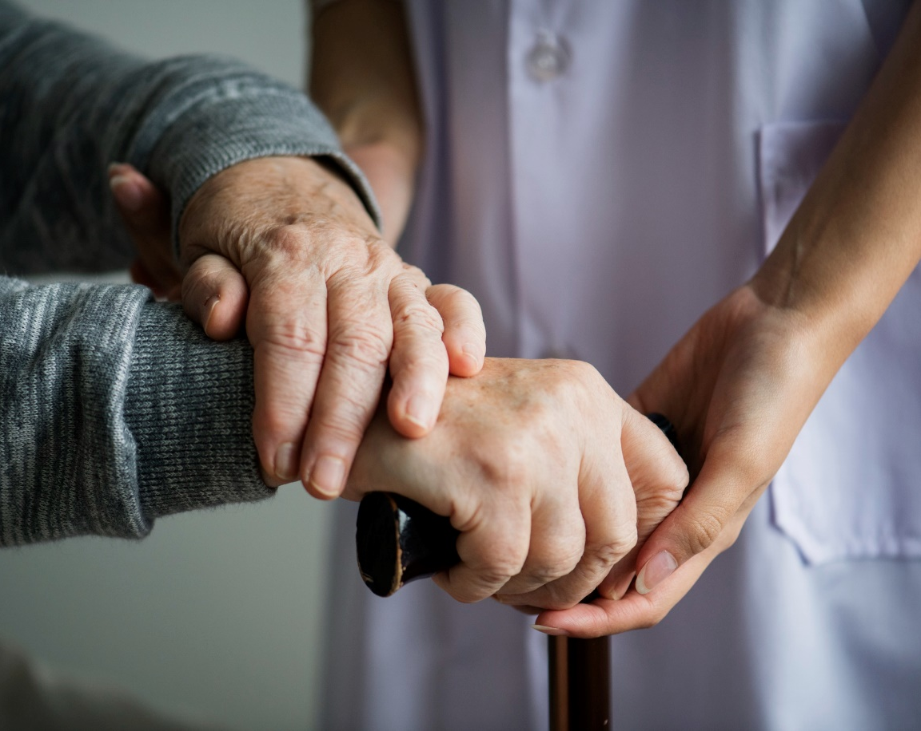
Thank You
Dr. Prabhat Sharma
MBBS, MD - Medicine, DM – Neurology
King George's Medical University, Lucknow

