Slide 1
यह कार्यक्रम स्वास्थ्य विभाग और राज्य स्वास्थ्य एवं परिवार कल्याण संस्थान (SIHFW), उत्तर प्रदेश की पहल पर उत्तर प्रदेश टेक्निकल सपोर्ट यूनिट (UPTSU) के सहयोग से हो रहा है।
Principal Secretary, Medical Health & Family Welfare, U.P. Shri Partha Sarthi Sen Sharma
Director Administration & Director, SIHFW
Shri Shiv Sahay Awasthi

Slide 3
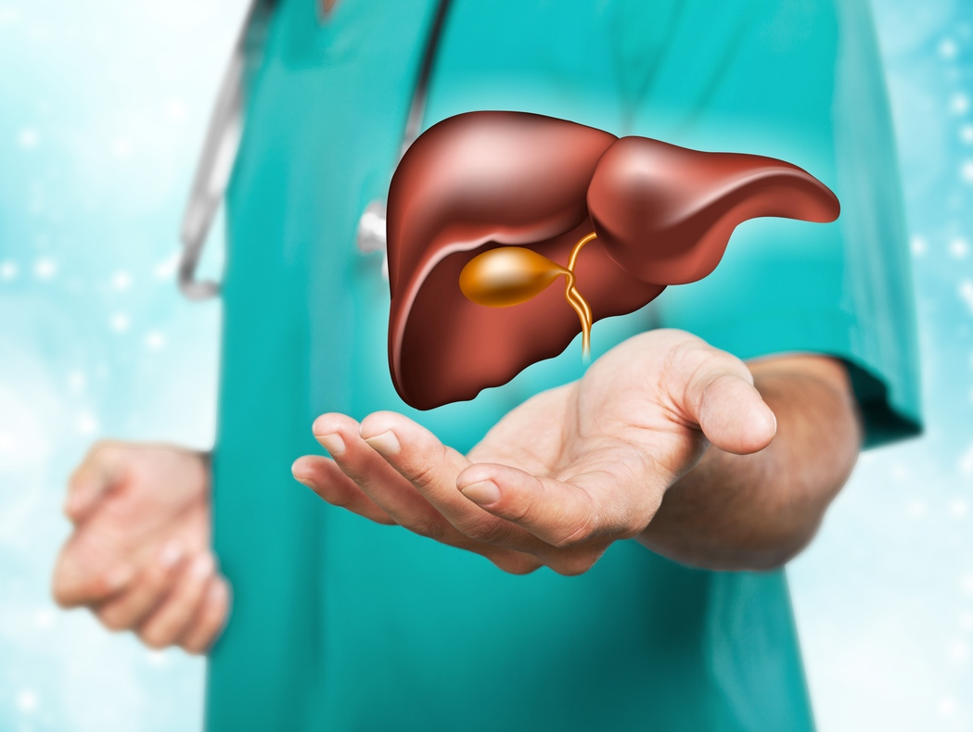
Liver Function Tests Interpretation
Dr. Abhai Verma
Director,
Gastroenterology,
Medanta, Lucknow

Slide 4
Liver Function Tests
Hepatocellular injury
Cholestasis
Others
Alanine aminotransferase (ALT/ SGPT)
Aspartate aminotransferase (AST/ SGOT)
Glutamate dehydrogenase (GDH)
Isocitrate dehydrogenase (IDH)
Lactate dehydrogenase (LDH)
Alkaline phosphatase (ALP)
Gamma glutamyl transferase (GGT)
5”Nucleotidase
Bile salts
Serum bilirubin
Urinary bilirubin
Synthetic functions
Quantitative LFTs
Fibrosis
Prothrombin time (PT/ INR)
Albumin
Dye tests (Indocyanine green clearance test ICG)
Dual cholate test
Aminopyrine breath test
Fibroscan
Ultrasound
Fibrotest
Liver biopsy

Slide 5
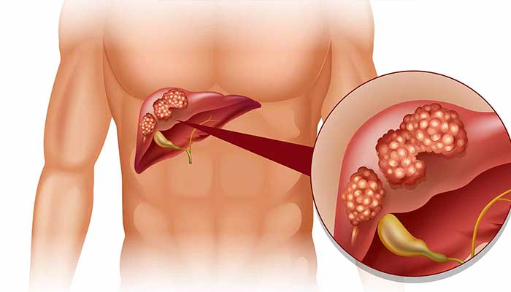
Points to consider
Duration of history
Temporal correlation of events
First LFT
Course of disease and LFT
Drugs

Slide 6
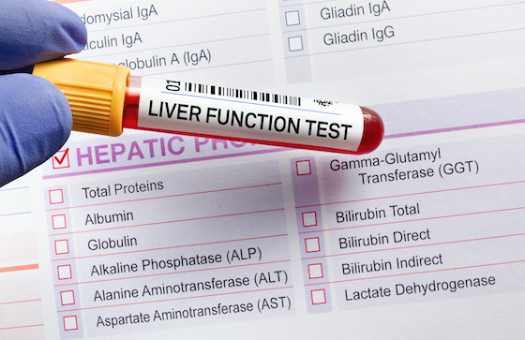
Patterns of LFT derangement
Hepatocellular necrosis
Cholestasis
Extrahepatic
Intrahepatic
Infiltration
Ischemic injury
Hyperbilirubinemia
Overlap is common
Try to figure out any mismatch in proportion of derangement in various components

Slide 7
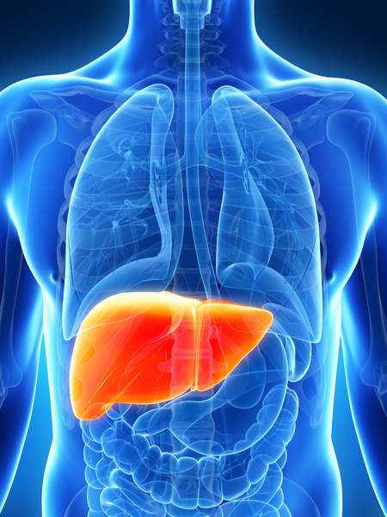
Deranged LFT
Approach depends on which test(s) result is abnormal
LFT derangement
Bilirubin elevation
Enzyme elevation
1

Slide 8
Deranged LFT
Approach depends on which test(s) result is abnormal
LFT derangement
Bilirubin elevation
Enzyme elevation
1
ALT/AST elevation
Alk phosphatase elevation
2
3

Slide 9
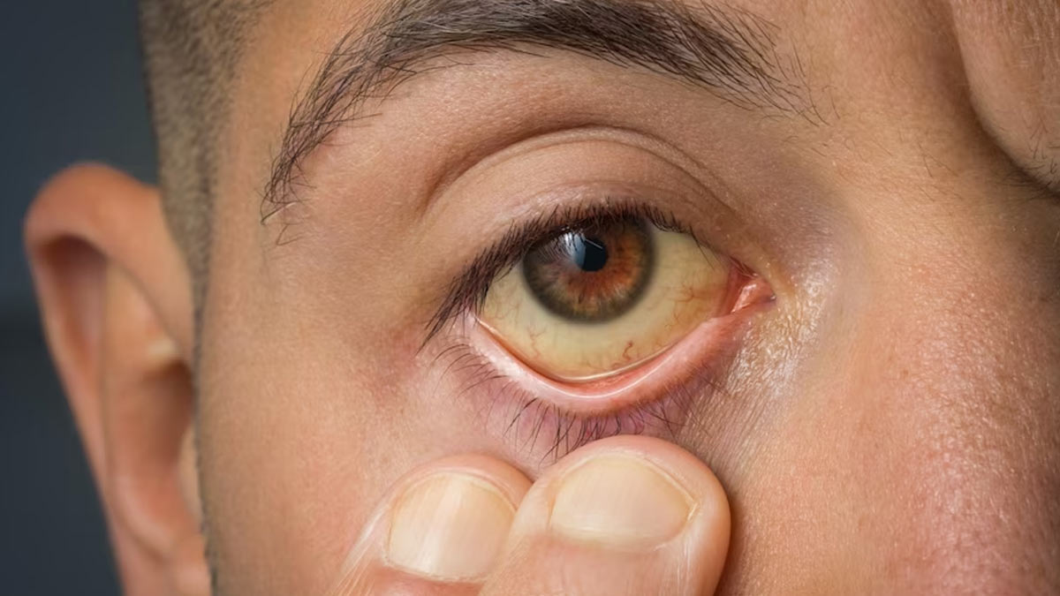
Approach to high bilirubin (jaundice)
1
Elevated serum bilirubin

Slide 10
Approach to high bilirubin (jaundice)
1
Elevated serum bilirubin
Unconjugated (<20% conjugated)
Conjugated (>50% conjugated)
Hemolysis
Disease of Liver or Biliary tree

Slide 11
Approach to high bilirubin (jaundice)
1
Elevated serum bilirubin
Unconjugated (<20% conjugated)
Conjugated (>50% conjugated)
Hemolysis
Disease of Liver or Biliary tree
Ultrasound
No biliary obstruction
(Hepatic disease)
Biliary obstruction (Biliary disease)

Slide 12
Approach to high bilirubin (jaundice)
1
Elevated serum bilirubin
Unconjugated (<20% conjugated)
Conjugated (>50% conjugated)
Hemolysis
Disease of Liver or Biliary tree
Ultrasound
No biliary obstruction
(Hepatic disease)
Biliary obstruction (Biliary disease)
↑ ALT/AST
Hepatitis
Mixed
↑ Alk phos
Cholestasis
Gall stone disease Cancers

Slide 13
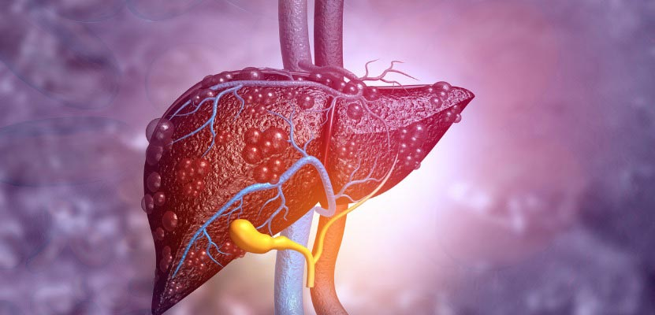
Approach to enzyme elevation
2
Persistent enzyme elevation

Slide 14
Approach to enzyme elevation
2
Persistent enzyme elevation
High ALT/AST
High (>2.0 x ULN)
alkaline phosphatase

Slide 15
Approach to enzyme elevation
2
Persistent enzyme elevation
High ALT/AST
High (>2.0 x ULN)
alkaline phosphatase
Extrinsic cause: often reversible
Viral hepatitis
Intrinsic causes
Alcohol
Obesity
Hepatotoxic drug
Hepatitis B virus Hepatitis C virus
Autoimmune, genetic and other diseases

Slide 16
Approach to enzyme elevation
2
>5
<2
<2
Hepatocellular injury
Mixed pattern
Cholestatic injury
Viral hepatitis
* = Upper limit of normal

Slide 17
Approach to enzyme elevation
2
Persistent enzyme elevation
Alk. Phosphatase elevation
(>2.0 x ULN)

Slide 18
Approach to enzyme elevation
2
Persistent enzyme elevation
ALT/AST elevation
(>1.5 x ULN)
Alk. Phosphatase elevation
(>2.0 x ULN)
GGT
GGT elevated
GGT normal
Alcohol
Cirrhosis
PBC
PSC
Infiltrative liver disease
USG abdomen
Non-hepatic causes
No biliary obstruction
Biliary obstruction

Slide 19
Case 1
A 36/F presents in emergency with fever, anorexia for 7 days and jaundice for 3 days. On examination patient is drowsy, other vitals are stable. Mild icterus is present and no lump in abdomen.
Hb | 11.6
TLC | 11,000 (Polymorphs 76%)
PLT | 198,000
S Creat | 1.0
S Bilirubin (Direct) | 7.6 (4.0)
AST/ ALT | 530/620
ALP | 190 (N 140)
S Prot/ Albumin | 6.2/ 3.3
INR | 2.8
Acute liver failure

Slide 20
Case 2
A 36/F presents in emergency with fever, anorexia for 7 days and jaundice for 3 days. On examination patient is alert, other vitals are stable. Mild icterus is present and no lump in abdomen.
Hb | 11.6
TLC | 11,000 (Polymorphs 76%)
PLT | 198,000
S Creat | 1.0
S Bilirubin (Direct) | 7.6 (4.0)
AST/ ALT | 530/620
ALP | 190 (N 140)
S Prot/ Albumin | 6.2/ 3.3
INR | 1.0
Acute hepatitis

Slide 21
Case 3
A 26/F, 7th post partum day presents in emergency with pain in abdomen and abdominal distension for 3 days and jaundice for 1 day. On examination patient is drowsy, other vitals are stable. Mild icterus is present and 6 cm tender hepatomegaly with moderate ascites
Hb | 11.6
TLC | 11,000 (Polymorphs 76%)
PLT | 198,000
S Creat | 1.0
S Bilirubin (Direct) | 7.6 (4.0)
AST/ ALT | 530/620
ALP | 190 (N 140)
S Prot/ Albumin | 6.2/ 3.3
INR | 2.8
Acute hepatic venous outflow tract obstruction (Budd Chiari Syndrome)

Slide 22
Case 4
A 42/M presents in emergency with high fever, jaundice for 3 days and reduced urine output for 1 day. On examination he is drowsy with BP of 60 systolic, respiratory rate of 28/m. Abdominal examination reveals mild hepatosplenomegaly. His blood investigations are as follows:
Hb | 11.6
TLC | 12,000 (Polymorphs 86%)
PLT | 98,000
S Creat | 2.0
S Bilirubin (Direct) | 8.6 (5.0)
AST/ ALT | 130/120
ALP | 190 (N 140)
S Prot/ Albumin | 6.2/ 3.3
INR | 1.8
Malaria, Dengue, Liver abscess, Sepsis
Notes:
Malaria, Dengue, Liver abscess, Sepsis

Slide 23
Case 5
A 42/M presents in emergency with high fever, jaundice for 3 days and reduced urine output for 1 day. On examination he is drowsy with BP of 60 systolic, respiratory rate of 28/m. Abdominal examination reveals mild hepatosplenomegaly. His blood investigations are as follows:
Hb | 11.6
TLC | 18,000 (Polymorphs 86%)
PLT | 98,000
S Creat | 2.0
S Bilirubin (Direct) | 8.6 (5.0)
AST/ ALT | 130/120
ALP | 590 (N 140)
S Prot/ Albumin | 6.2/ 3.3
INR | 1.8
Cholangitis

Slide 24
Case 6
A 42/M presents in emergency with h/o fever, anorexia and weight loss for 1m and vomiting for 1 wk. On examination thin built (BMI 15), dehydrated, hepatosplenomegaly present, no ascites.
Hb | 10.6
TLC | 12,000
PLT | 198,000
S Creat | 1.0
S Bilirubin (Direct) | 2.6 (1.0)
AST/ ALT | 130/120
ALP | 2590 (N 140)
S Prot/ Albumin | 6.2/ 3.3
INR | 1.5
Infiltrative liver disorders, Cholangitis

Slide 25
HBV: Types of serological markers
Antigen-antibody |  | Nucleic acid
Antigen | Antibody
HBsAg (Hepatitis B surface Antigen) | Anti-HBs (HB surface antibody) | HBV DNA (qualitative or quantitative)
HBcAg (Hepatitis B core Antigen) Does not appears in blood | IgM anti-HBc (HB core antibody IgM)
 | Total anti-HBc (IgM plus IgG)
HBeAg (Hepatitis B e Antigen) | Anti-HBe (Hepatitis B e antibody)

Slide 26
Consequences of hepatitis B virus infection
Hepatitis B virus infection
Acute infection (short duration: <6 mo)
Chronic infection (duration >6 mo)
Asymptomatic
Chronic hepatitis B
Acute viral hepatitis
Cirrhosis: compensated
Acute liver failure
Cirrhosis: decompensated

Slide 27
Serological Patterns of Acute HBV Infection
HBeAg
Anti-HBe
Total anti-HBc
Relative amount
HBsAg
IgM anti-HBc
Anti-HBs
Time since infection

Slide 28
Interpretation of Serological Markers
HBsAg | Total anti-HBc | IgM anti-HBc | Anti-HBs | Interpretation
- |  |  | -

Slide 29
Interpretation of Serological Markers
HBsAg | Total anti-HBc | IgM anti-HBc | Anti-HBs | Interpretation
- |  |  | - | Never exposed

Slide 30
Interpretation of Serological Markers
HBsAg | Total anti-HBc | IgM anti-HBc | Anti-HBs | Interpretation
- | + | - | +

Slide 31
Interpretation of Serological Markers
HBsAg | Total anti-HBc | IgM anti-HBc | Anti-HBs | Interpretation
- | + | - | + | Past natural infection, cleared, immunity achieved

Slide 32
Interpretation of Serological Markers
HBsAg | Total anti-HBc | IgM anti-HBc | Anti-HBs | Interpretation
- | + | - | -

Slide 33
Interpretation of Serological Markers
HBsAg | Total anti-HBc | IgM anti-HBc | Anti-HBs | Interpretation
- | + | - | - | Past natural infection, cleared, anti-HBs has waned over time

Slide 34
Interpretation of Serological Markers
HBsAg | Total anti-HBc | IgM anti-HBc | Anti-HBs | Interpretation
- | - | - | +

Slide 35
Interpretation of Serological Markers
HBsAg | Total anti-HBc | IgM anti-HBc | Anti-HBs | Interpretation
- | - | - | + | Immunity due to vaccination

Slide 36
Interpretation of Serological Markers
HBsAg | Total anti-HBc | IgM anti-HBc | Anti-HBs | Interpretation
- | + | + | +

Slide 37
Interpretation of Serological Markers
HBsAg | Total anti-HBc | IgM anti-HBc | Anti-HBs | Interpretation
- | + | + | + | Recent infection, recovered, immunity achieved

Slide 38
Interpretation of Serological Markers
HBsAg | Total anti-HBc | IgM anti-HBc | Anti-HBs | Interpretation
+ | + | + | -

Slide 39
Interpretation of Serological Markers
HBsAg | Total anti-HBc | IgM anti-HBc | Anti-HBs | Interpretation
+ | + | + | - | Acute infection, ongoing

Slide 40
Interpretation of Serological Markers
HBsAg | Total anti-HBc | IgM anti-HBc | Anti-HBs | Interpretation
+ | + | - | -

Slide 41
Interpretation of Serological Markers
HBsAg | Total anti-HBc | IgM anti-HBc | Anti-HBs | Interpretation
+ | + | - | - | Chronic infection (ongoing)

Slide 42
Interpretation of Serological Markers
HBsAg | Total anti-HBc | IgM anti-HBc | Anti-HBs | Interpretation
- |  |  | - | Never exposed
- | + | - | + | Past natural infection, cleared, immunity achieved
- | + | - | - | Past natural infection, cleared, anti-HBs has waned over time
- | - | - | + | Immunity due to vaccination
- | + | + | + | Recent infection, recovered, immunity achieved
+ | + | + | - | Acute infection, ongoing
+ | + | - | - | Chronic infection (ongoing)

Slide 43
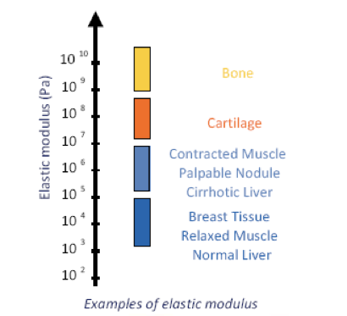
Fibroscan
Stiffness: Ability of a medium not to get out of shape under mechanical stress

Slide 44
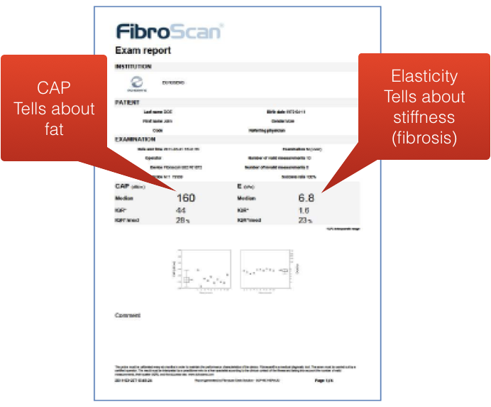

Slide 45
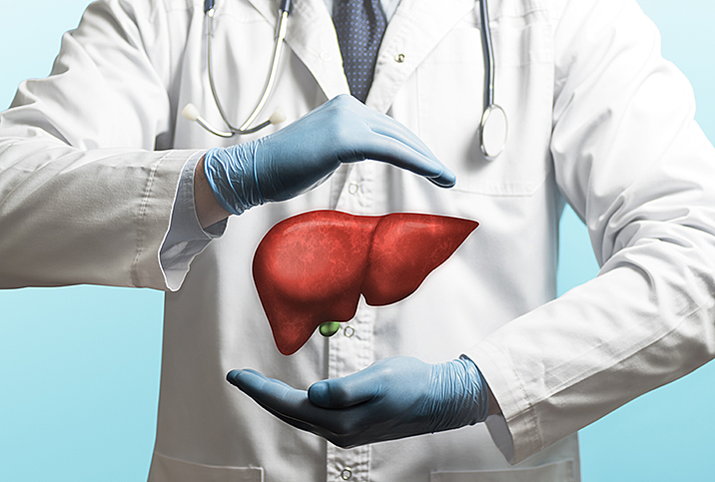
Thank You
Dr. Abhai Verma
Director,
Gastroenterology,
Medanta, Lucknow

