Slide 1


Slide 2
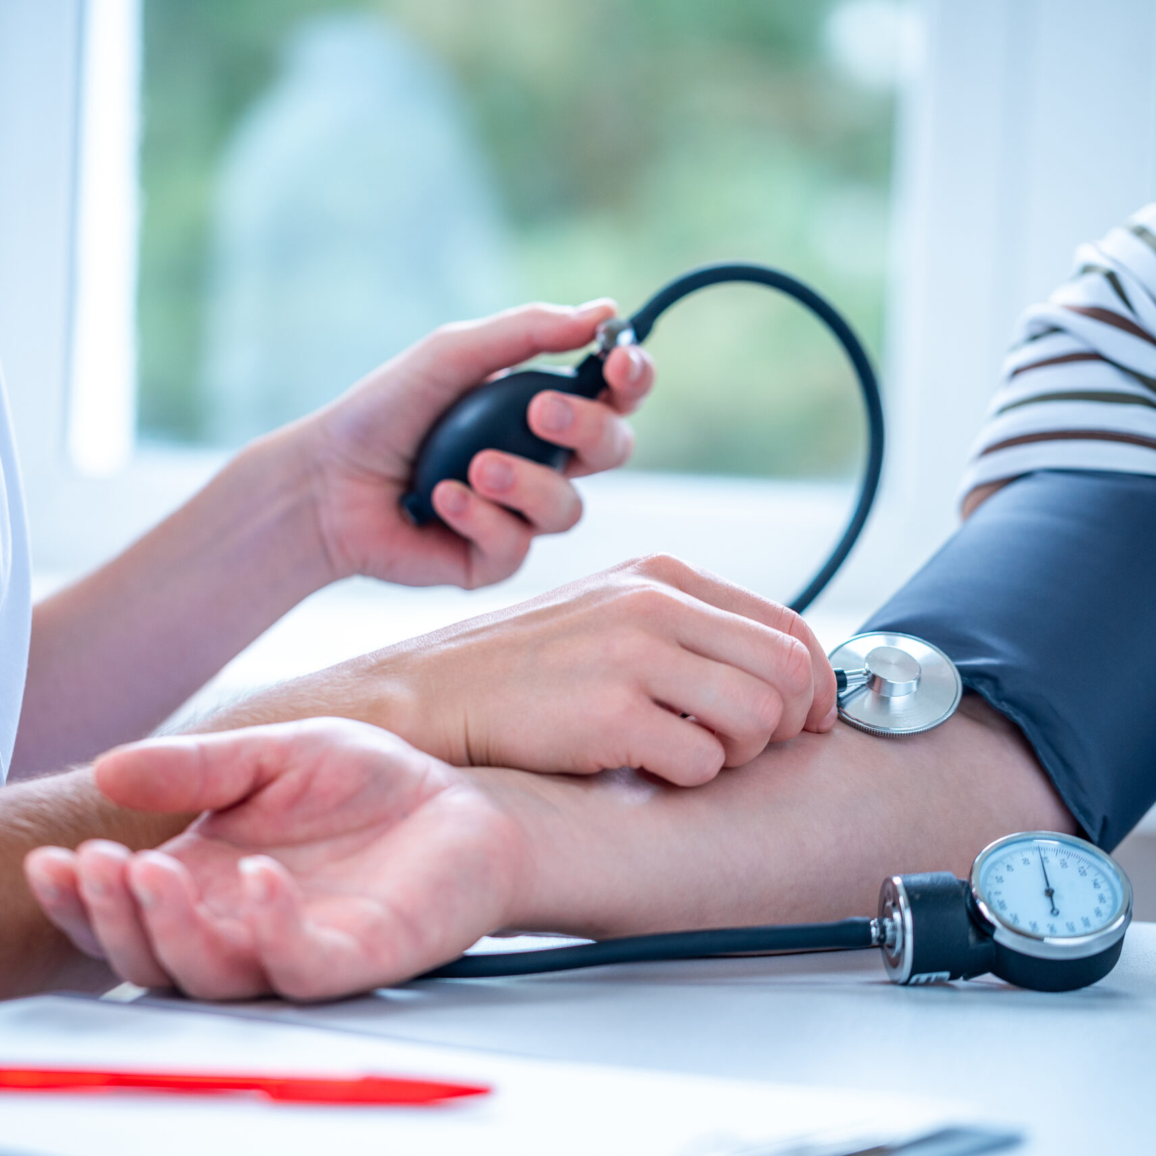

HYPERTENSION
DR. SANDEEP CHOWDHARY
MBBS, MD (MEDICINE)
FICP, FISH, FUPDA
CMO, VARANASI

Slide 3
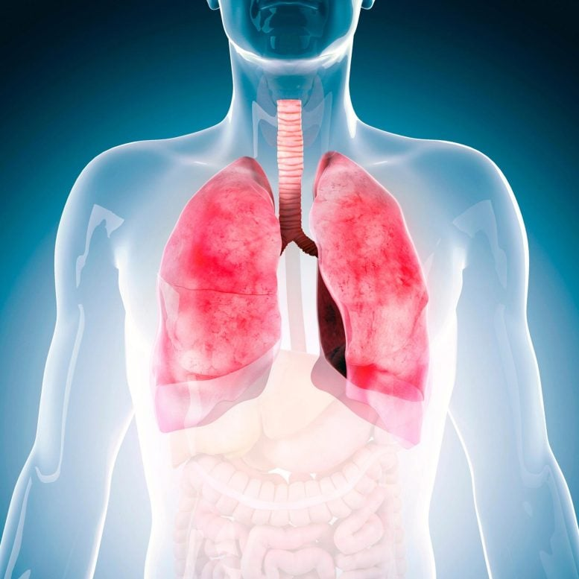
POINT OF DISCUSSION
DEFINITION
CLASSIFICATION
TYPES
EPIDEMIOLOGY
PATHOPHYSIOLOGY
DIAGNOSIS
TREATMENT
PROGNOSIS

Slide 4
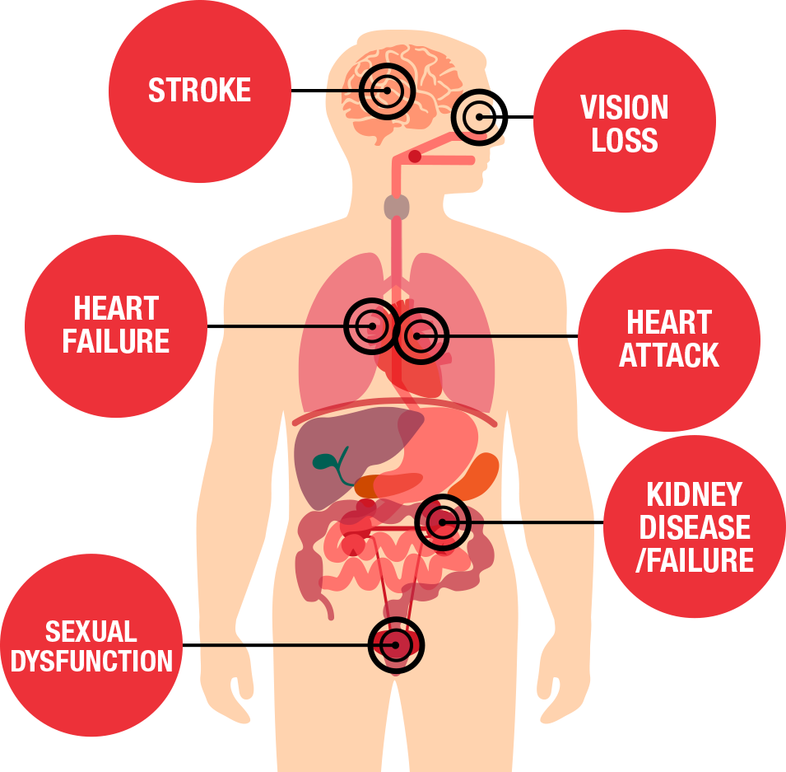
DEFINITION
Hypertension (HTN or HT), also known as high blood pressure (HBP), is a long term medical condition in which the blood pressure in the arteries is persistently elevated.
The SBP will be more than or equal of 120 mmHg and DBP will be more than or equal of 80 mmHg (ACC/AHA)

Slide 5
BP CLASSIFICATION (JNC 7 AND ACC/AHA GUIDELINES)
SBP |  | DBP
<120 | and | <80
120–129 | and | <80
130–139 | or | 80–89
140–159 | or | 90-99
≥160 | or | ≥100
2003 JNC7
Normal BP
Prehypertension
Stage 1 hypertension
Stage 2 hypertension
2017 ACC/AHA
Normal BP
Elevated BP
Stage 1 hypertension
Stage 2 hypertension
Stage 2 hypertension
Major area
of
difference
Blood Pressure should be based on an average of ≥2 careful readings on ≥2 occasions
Adults with SBP or DBP in two categories should be designated to the higher BP category
Whelton PK et al. Hypertension/J Am Coll Cardiol. 2017;Epub ahead of print

Slide 6
TYPES
Pre hypertension: SBP: 120-139 mmHg
DBP: 80-89 mmHg
Hypertension stage I: SBP: 140-159 mmHg
DBP: 90-99 mmHg
Hypertension stage II: SBP: More or equal to 160 mmHg
DBP: More or equal to 100 mmHg
Pregnancy induced HTN: because of increased production of hormones and enzymes during pregnancy.

Slide 7
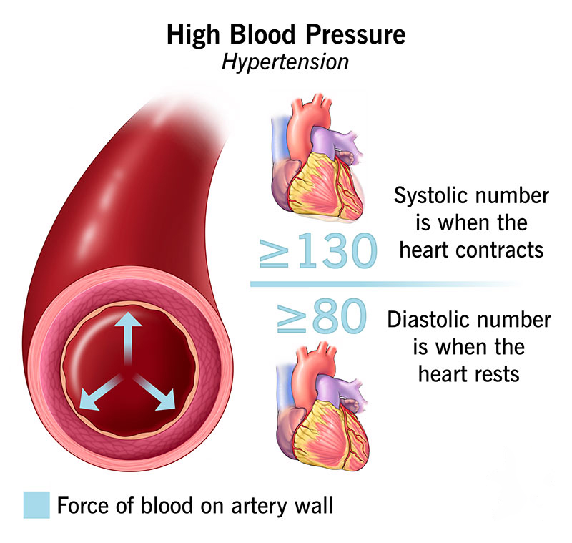
Hypertension is a worldwide epidemic; accordingly, its epidemiology has been well studied in the United States and internationally.
Hypertensive emergencies are most often precipitated by inadequate medication or poor adherence
EPIDEMIOLOGY

Slide 8
Hypertension can be primary, which may develop as a result of environmental or genetic causes, or secondary, which has multiple etiologies, including renal, vascular, and endocrine causes. Primary or essential hypertension accounts for 90-95% of adult cases, and a small percentage of patients (2-10%) have a secondary cause.
There has been an interesting trend in the prevalence of hypertension, which fell in the early 2000s but began trending upward in 2014 (see the image below, which shows the prevalence of hypertension by year and sex). [49] The prevalence of hypertension declined during the first decade of this century, but it has since increased, particularly in men.
Globally, an estimated 26% of the world’s population (972 million people) has hypertension, and the prevalence is expected to increase to 29% by 2025, driven largely by increases in economically developing nations. The high prevalence of hypertension exacts a tremendous public health burden. For example, as a primary contributor to heart disease and stroke, the first and third leading causes of death worldwide, respectively, high BP was the top modifiable risk factor for disability adjusted life-years lost worldwide in 2013.

Slide 9

Hypertension and sex- and age-related statistics :-
Females have a lower prevalence of hypertension until the fifth decade of life. Afterward, the prevalence of hypertension is increased in females compared to males.

Slide 10
ETIOLOGY
Primary HTN: It is the elevation in BP without an identified cause.
Secondary HTN: It is the elevation in BP with an exact cause. This type is account for 5-10% of total cases.

Slide 11
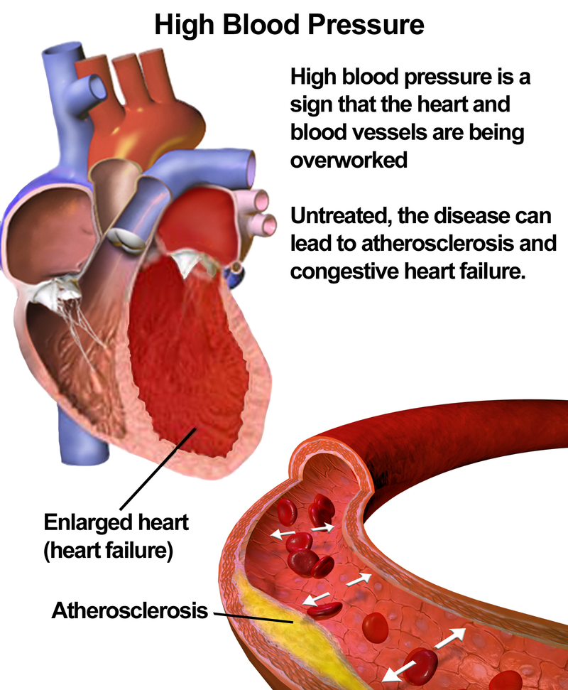
PRIMARY HYPERTENSION
Also known as essential hypertension, is high blood pressure that doesn't have an identifiable cause.
Most common type of high blood pressure, affecting 85% of people with the condition.
Develops gradually over many years, and is sometimes caused by: Family history, Obesity, Unhealthy diet, and Excessive salt consumption.
Symptoms of primary hypertension include :
  Severe headaches
  Chest pain
  Dizziness
  Difficulty breathing
  Nausea Vomiting
  Blurred vision or other vision changes
  Anxiety

Slide 12
SECONDARY HYPERTENSION
Underlying cause of high BP in about 10% of adults with hypertension
Common causes
Renal parenchymal disease
Renovascular disease
Primary aldosteronism
Obstructive sleep apnea
Drug or alcohol induced
Uncommon causes
Pheochromocytoma/paraganglioma
Cushing’s syndrome
Hypothyroidism
Hyperthyroidism
Aortic coarctation (undiagnosed or repaired)
Primary hyperparathyroidism
Congenital adrenal hyperplasia
Mineralocorticoid excess syndromes other than primary aldosteronism
Acromegaly
Whelton PK et al. Hypertension/J Am Coll Cardiol. 2017 [Epub ahead of print].

Slide 13
THE CAUSES OF SECONDARY HTN INCLUDES
  Congenital narrowing of aorta
  Renal disease
  Endocrine disorders like Cushing's syndrome
  Neurological disorders like brain tumors and head injury
  Sleep apnea
  Medications like oral contraceptive pills, NSAID, and cocaine
  Cirrhosis of liver

Slide 14
RISK FACTORS
MAJOR RISK FACTORS
MINOR/ UNCERTAIN RISK FACTORS
NON-MODIFIABLE FACTORS: cannot be changed
1. Increasing age
2. Male gender
3. Family history
4. Genetic abnormalities
Obesity
Physical inactivity
Stress ("type A" personality)
Postmenopausal estrogen deficiency
High carbohydrate intake
Alcohol
Lipoprotein Lp(a)
Hardened (trans)unsaturated fat intake
Chlamydia pneumoniae
POTENTIALLY MODIFIABLE FACTORS: could be changed
1. Hyperlipidemia
2. Hypertension
3. Cigarette smoking
4. Diabetes

Slide 15
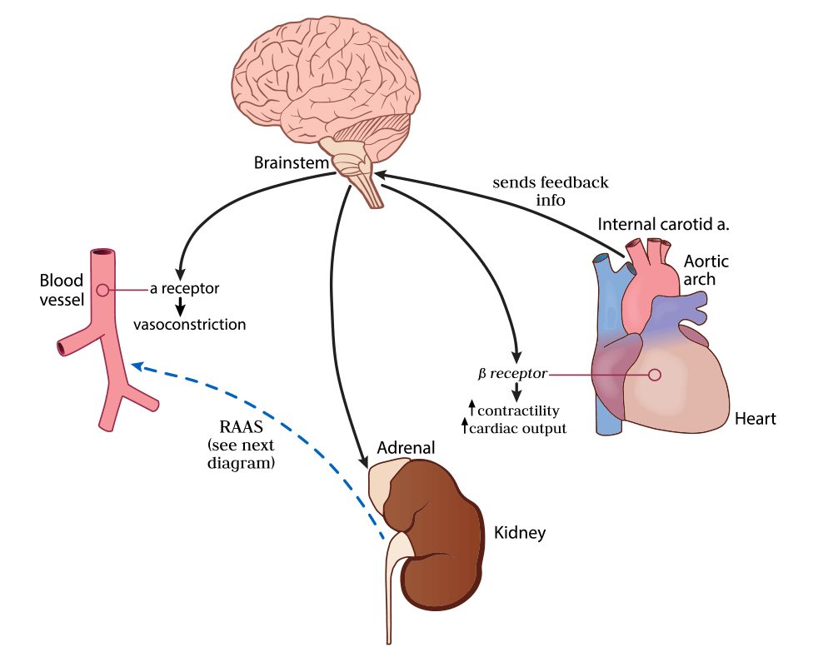
PATHOPHYSIOLOGY
Hypertension can be primary, which may develop as a result of environmental or genetic causes, or secondary, which has multiple etiologies, including renal, vascular, and endocrine causes. Primary or essential hypertension accounts for 90-95% of adult cases, and a small percentage of patients (2-10%) have a secondary cause. Hypertensive emergencies are most often precipitated by inadequate medication or poor adherence.

Slide 16
According to data from the National Health Examination Surveys (NHANES), the age-adjusted prevalence of hypertension varies from 18% to 32%. The National Center for Health Statistic Surveys (NCHS) reported the awareness for hypertension increased from 53% over 1960-1962 to 89% over 1988-1991. The percentage of patients engaged in hypertension treatment increased from 35% to 79% during this period.
A 2005 NHANES report in the United States found that in the population aged 20 years or older, an estimated 41.9 million men and 27.8 million women had prehypertension (SBP, 120-139 mm Hg; DBP, 80-99 mm Hg), 12.8 million men and 12.2 million women had stage 1 hypertension (SBP, 140-159 mm Hg; DBP, 90-99 mm Hg), and 4.1 million men and 6.9 million women had stage 2 hypertension (SBP ≥160 mm Hg; DBP ≥100 mm Hg).

Slide 17
Data from NHANES spanning 2011-2014 in the United States found that in the population aged 20 years or older, an estimated 86 million adults had hypertension, with a prevalence of 34%. 2017 Data from the NCHS spanning 2015-2016 show a hypertension prevalence of 29.0% among those aged 18 and older. There was also an increasing trend of hypertension in adults between 1999-2000 and 2009-2010, and 2013-2014, with mild declines in 2011-2012 and 2015-2016.

Slide 18
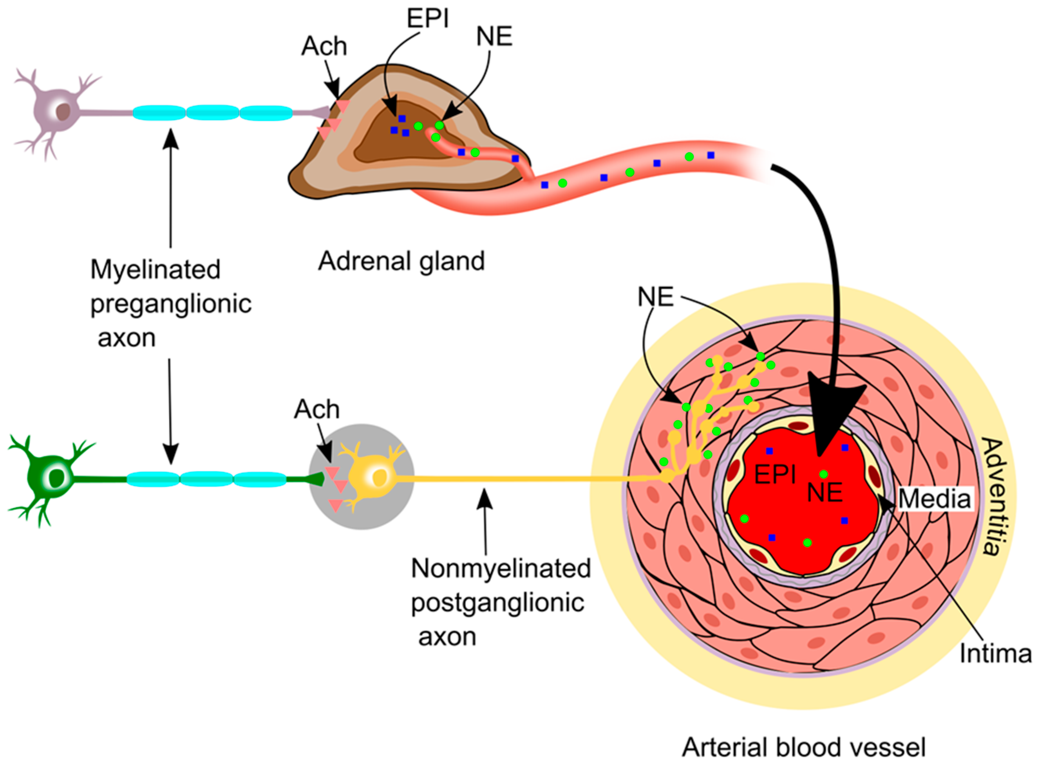
PATHOPHYSIOLOGY OF HTN
The normal blood pressure is maintained by four mechanisms
  Sympathetic nervous system activities
  Activities of vascular endothelium
  Activities of renal system
  Activities of endocrine system

Slide 19
  SYMPATHETIC NERVOUS SYSTEM ACTIVITIES
When the BP is decreasing the activation of SNS will occur. The increased SNS activity increases the heart rate and cardiac contraction.
The increased the heart rate and cardiac contraction produce vasoconstriction in the peripheral arterioles and promotes the release of renin from kidney.
The net effect of SNS activation is to increase the arterial blood pressure by increasing cardiac output and systemic vascular resistance.
BP=CO X SVR

Slide 20
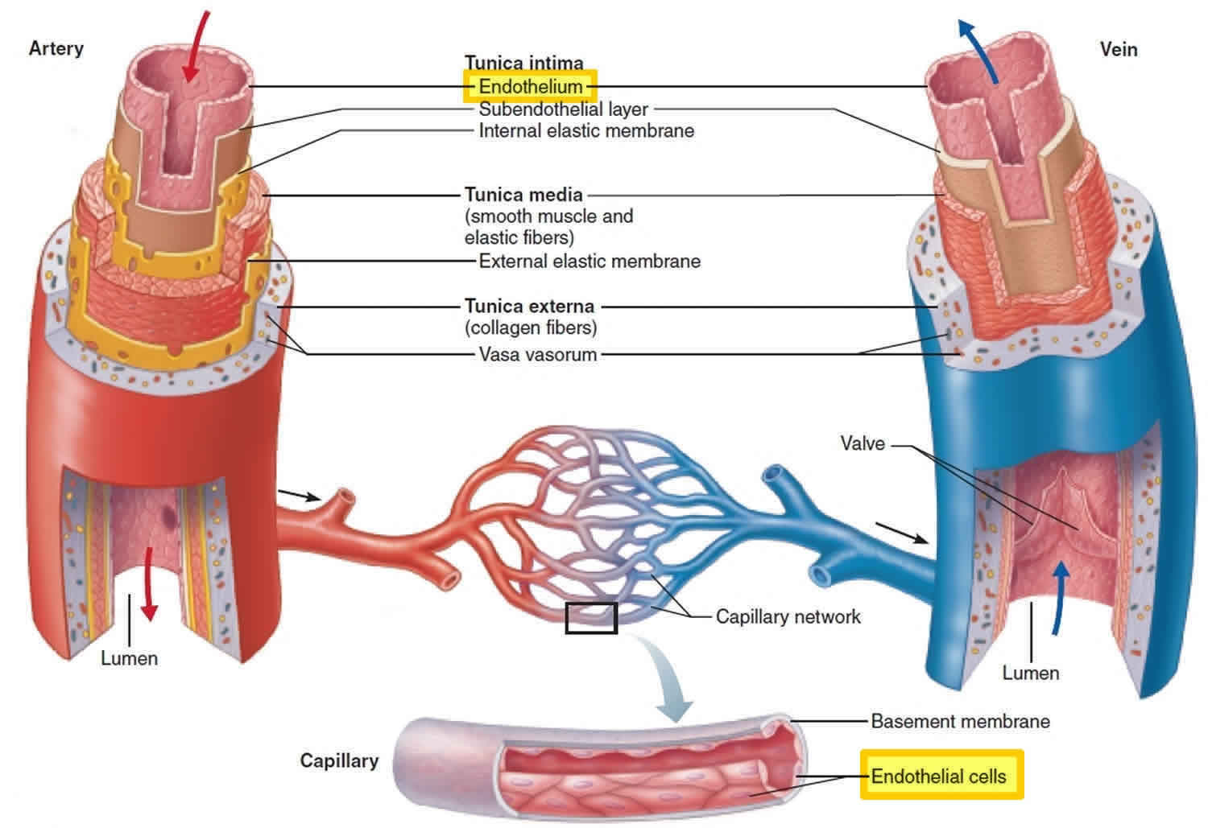
  ACTIVITIES OF VASCULAR ENDOTHELIUM
The vascular endothelium is a single cell layer that lines the blood vessal.
It will produce vasoactive substances and growth factors like nitric acid, endothelin etc..
These substances are potent vasoconstrictors and causes increases blood pressure level.

Slide 21
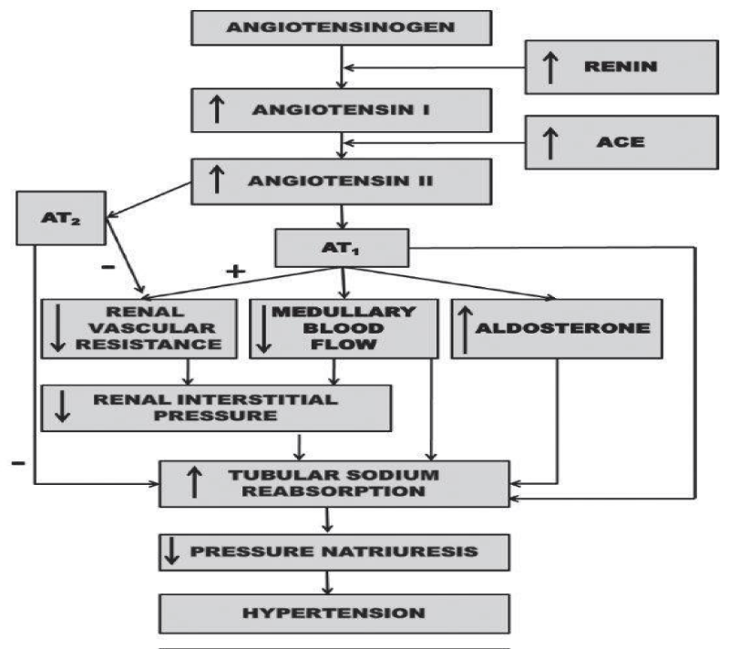
ACTIVITIES OF RENAL SYSTEM
Seriki A Samue, Adebayo O Francis and Odetola O Anthony

Slide 22
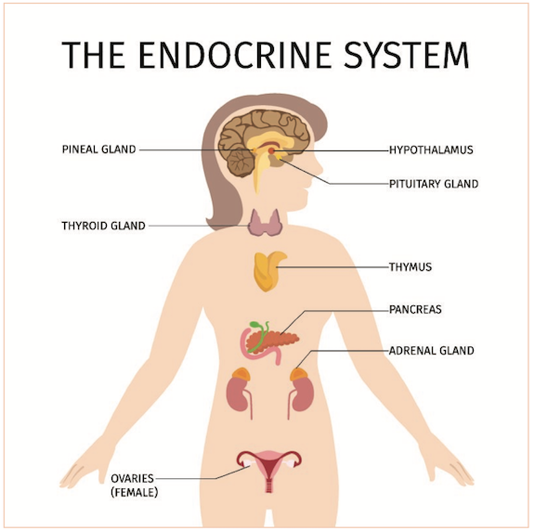
  ACTIVITIES OF ENDOCRINE SYSTEM
When the angiotensin-II is stimulated in the adrenal cortex, it will secrete aldosterone.
The aldosterone will stimulate the kidneys to retain sodium and water. Thus the BP and cardiac output will get increased.

Slide 23
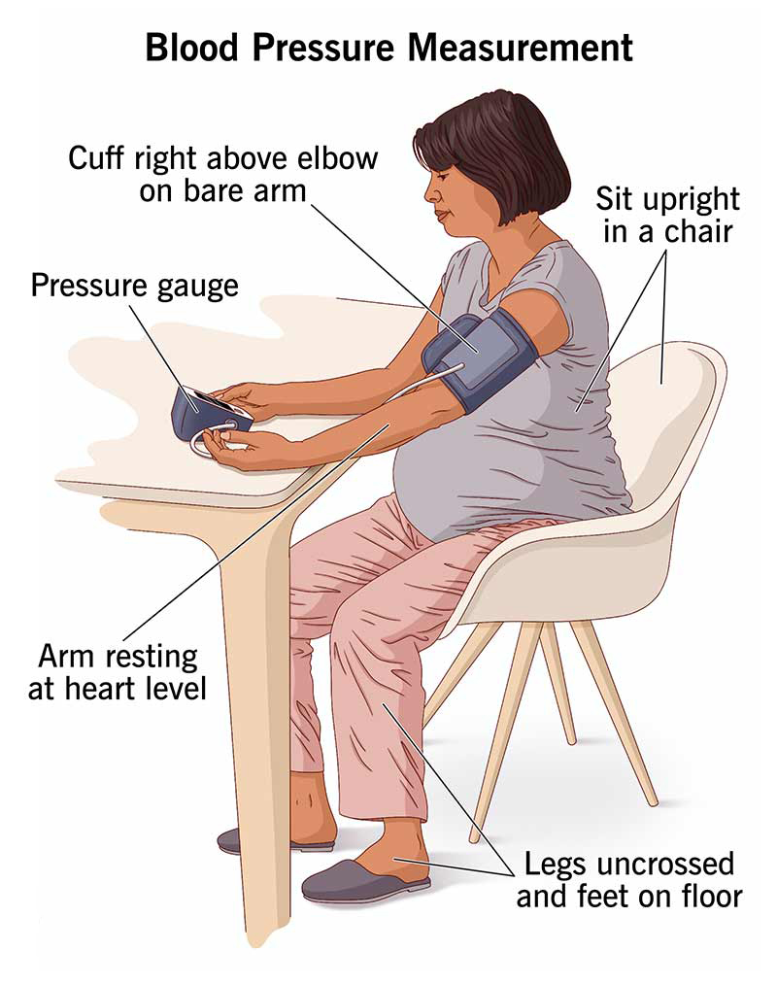
BP MEASUREMENT

Slide 24
OFFICE BP READINGS: CHECKLIST FOR ACCURATE MEASUREMENTS
Key Points | Specific Instructions
Step 1: Prepare patient | -Have patient relax, sitting in a chair (feet on floor, back supported) for >5 min. -Avoid caffeine, exercise, and smoking for ≥ 30 min before measurement. -Ensure bladder emptied. -No talking during rest period or measurement. -Remove clothing covering location of cuff placement. -Measurements while patient sitting/lying on exam table do not fulfill criteria.
Step 2: Use proper technique | -Use validated BP measurement device that is calibrated periodically. -Support patient’s arm (e.g., resting on a desk). -Position middle of cuff on patient’s upper arm at mid-sternum (right atrium). -Use correct cuff size, such that the bladder encircles 80% of the arm. -Either stethoscope diaphragm or bell may be used for auscultatory readings.
Step 3: Take proper measurements | -At first visit, record BP in both arms. Subsequently, use arm with higherBP. -Separate repeated measurements by 1–2 min. -For auscultatory readings, estimate SBP by palpation and inflate cuff 20–30 mm Hg above. Deflate 2 mm Hg per second and listen for Korotkoff sounds.
Step 4: Document BP readings | -Note time of most recent BP medication before measurements. -Record SBP and DBP.
Step 5: Average readings | -Use average of ≥2 readings obtained on ≥2 occasions to estimate level of BP.
Step 6: Provide readings to patient | -Provide patients SBP/DBP readings both verbally and in writing.

Slide 25
OUT OF OFFICE BP READINGS
Greater use of out of office BP measurements (ABPM or HBPM) for confirmation
of office hypertension and recognition of White Coat/Masked Hypertension
In adults not taking antihypertensive medication
Confirmed (Sustained) Hypertension
  Elevated office and out of office average BP
  Substantially higher risk of CVD compared to adults with normal office and out of office BPs
  Require therapy (nonpharmacological or combined nonpharmacological and antihypertensive drug therapy)
White Coat Hypertension (WCH)
  Office Hypertension not confirmed by out of office BP readings
  Present in about 10-25% of adults with office hypertension
  CVD risk profile more like adults with normal BP than adults with sustained hypertension
  May not need treatment for hypertension (should be monitored for development of sustained hypertension)
White Coat Hypertension (WCH)
  Elevated office BPs but normal out of office BPs
  May not require antihypertensive drug therapy
Masked Hypertension (MH)
  Normal office BP but out of office BP hypertension
  Present in about 10-25% of adults with normal office BP
  CVD risk profile more like adults with sustained hypertension than adults without hypertension
  Should be considered for antihypertensive drug therapy
Whelton PK et al. Hypertension/J Am Coll Cardiol. 2017;Epub ahead of print

Slide 26
BASIC AND OPTIONAL LABORATORY TESTS FOR PRIMARY HYPERTENSION
Basic testing | Fasting blood glucose*
 | Complete blood count
 | Lipid profile
 | Serum creatinine with eGFR*
 | Serum sodium, potassium, calcium*
 | Thyroid-stimulating hormone
 | Urinalysis
 | Electrocardiogram
Optional testing | Echocardiogram
 | Uric acid
 | Urinary albumin to creatinine ratio
*May be included in metabolic panel. eGFR indicates estimated glomerular filtration rate.

Slide 27
CLINICAL FEATURES
Some times the high blood pressure does not causes any symptoms, so that it is known as silent killer disease.
In some patients the symptoms will develop like,
Severe head ache
Blurred vision
Dizziness
Nausea
Vomiting
Fatigue
Confusion epistaxis
Chest pain
Shortness of breath
Irregular heart beat
Papilledema

Slide 28
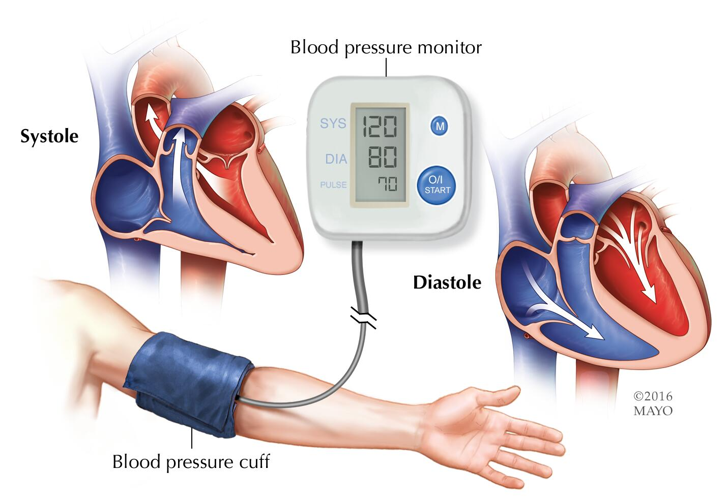
DIAGNOSTIC EVALUATIONS
History collection and physical examination
Medical history of diabetes mellitus
Complete blood count
Chest x-ray
ECG

Slide 29
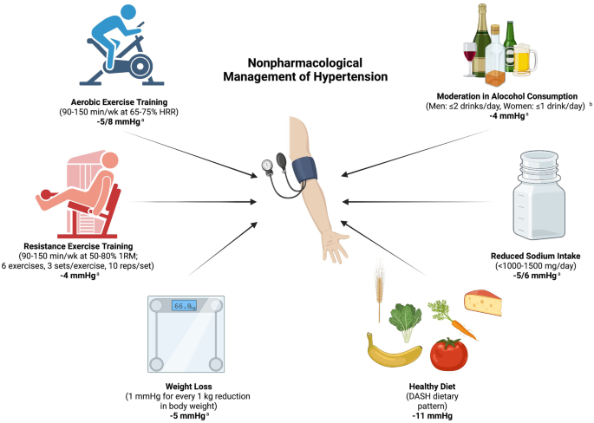
MANAGEMENT
Mainly the management of hypertension is possible by two ways, which include
  Life style modification
  Pharmacological therapy

Slide 30
  LIFE STYLE MODIFICATION
The life style modification measures mainly includes,
  Weight reduction
  DASH Diet (Dietary approaches to stop hypertension)
  Dietary sodium reduction
  Reduce alcohol
  Exercise
  Stress management

Slide 31
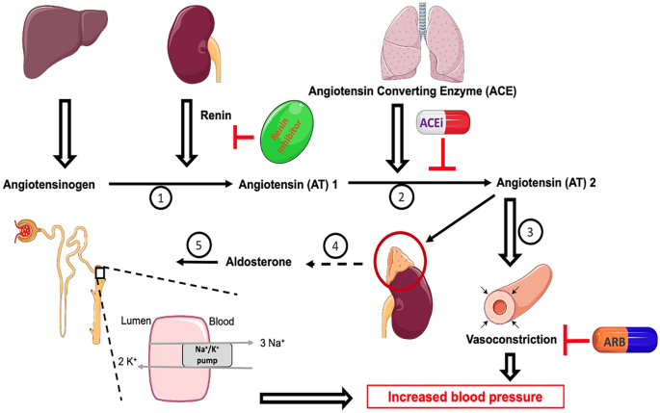
  PHARMACOLOGICAL THERAPY
Various groups of drugs are used for the treatment of hypertension, collectively these drugs are called as anti-hypertensive drugs, which includes,
Diuretics: it helps the kidneys to inhibit the sodium reabsorption in the distal convoluted tubules, ascending limb and loop of henle.
Eg: chlorothiazide, furosemide
Beta blockers: These medications reduces the workload of the heart and blood vessal and causing the heart to beat slowly and with less force.
Eg: Atenolol, propanolol
Alpha blockers: These medications causes the peripheral vasodilation of blood vessals.
Eg: Prazosin

Slide 32
Vasodilators: These medications acting directly on the muscles in the wall of arteries and preventing the muscles from tightening and arteries from narrowing.
Eg: Nitroglycerin, Sodium nitro prusside
ACE Inhibitors: This group of medication will reduce the conversion of A-I to A-II and prevents vasoconstriction.
Eg: Captopril, Ramipril
Calcium channel blockers: These medicines will block the movement of extra cellular calcium into the cells and causing vasodilation and decreased heart rate.
Eg: Amlodipine, Verapamil

Slide 33
ALGORITHM FOR TREATMENT OF HYPERTENSION
Lifestyle Modifications
Not at Goal Blood Pressure (<140/90 mmHg)
(<130/80 mmHg for those with diabetes or chronic kidney disease)
Initial Drug Choices
Without Compelling
Indications
With Compelling
Indications
Stage 1 Hypertension
(SBP 140–159 or DBP 90–99 mmHg)
Thiazide-type diuretics for most.
May consider ACEI, ARB, BB, CCB,
or combination.
Stage 2 Hypertension
(SBP >160 or DBP >100 mmHg)
2-drug combination for most (usually thiazide-type diuretic and
ACEI, or ARB, or BB, or CCB)
Drug(s) for the compelling indications
Other antihypertensive drugs (diuretics, ACEI, ARB, BB, CCB)
as needed.
Not at Goal
Blood Pressure
Optimize dosages or add additional drugs
until goal blood pressure is achieved.
Consider consultation with hypertension specialist.

Slide 34
CHOICE OF DRUG
Condition | Preferred drugs | Other drugs that can be used | Drugs to be avoided
Asthma | Calcium channel blockers | a-blockers/Angiotensin-II receptor blockers/Diuretics/ACE-inhibitors | b-blockers
Diabetes mellitus | a-blockers/ACE inhibitors/Angiotensin-II receptor blockers | Calcium channel blockers | Diuretics/b-blockers
High cholesterol levels | a-blockers | ACE inhibitors/ A-II receptor blockers/ Calcium channel blockers | b-blockers/Diuretics
Elderly patients (above 60 years) | Calcium channel blockers/Diuretics | β-blockers/ACE- inhibitors/Angiotensin-II receptor blockers/α- blockers
BPH | a-blockers | b-blockers/ ACE inhibitors/Angiotensin-II receptor blockers/Diuretics/Calcium channel blockers

Slide 35
ANTIHYPERTENSIVE THERAPY: SIDE-EFFECTS AND CONTRAINDICATIONS (CONTD.)
Class of drug | Main side-effects | Contraindications/ Special Precautions
Calcium channel blockers (e.g. Amlodipine, Diltiazem) | Pedal edema, Headache | Non-dihydropyridine CCBs (e.g diltiazem)–Hypersensitivity, Bradycardia, Conduction disturbances, CHF, LV dysfunction.
a-blockers (e.g. prazosin) | Postural hypotension | Hypersensitivity
ACE-inhibitors (e.g. Lisinopril) | Cough, Hypotension, Angioneurotic edema | Hypersensitivity, Pregnancy, Bilateral renal artery stenosis
Angiotensin-II receptor blockers (e.g. Losartan) | Headache, Dizziness | Hypersensitivity, Pregnancy, Bilateral renal artery stenosis

Slide 36
Condition
Pregnancy
Coronary heart disease
Congestive heart failure
Preferred Drugs
Nifedipine, labetalol, hydralazine, beta-blockers, methyldopa, prazosin
Beta-blockers, ACE inhibitors, Calcium channel blockers
ACE inhibitors,
beta-blockers
1999 WHO-ISH guidelines

Slide 37
NURSING MANAGEMENT
Proper history collection should be done which includes family history also.
Dietary habits should be assessed
Identify the medical history such as diabetes, CAD, renal disease etc…
Instruct the patient to avoid smoking and alcoholism
Auscultate heart rate and palpate peripheral pulses.
Identify the use of medications such as contraceptives, steroids, NSAID etc…
Monitor vital signs frequently
Provide diet which is low in sodium and rich with fruits and vegetables.
Monitor the blood cholesterol level frequently

Slide 38
DISEASES ATTRIBUTABLE TO HYPERTENSION
Heart Failure
Left Ventricular Hypertrophy
Gangrene of the Lower Extremities
Myocardial Infarction
Aortic Aneurym
Coronary Heart Disease
HYPERTENSION
Hypertensive encephalopathy
Blindness
Chronic Kidney Failure
Cerebral Hemorrhage
Stroke
Preeclampsia/Eclampsia

Slide 39
PROGNOSIS
Prognosis depends on how well it is controlled. If blood pressure is kept under control, the prognosis is favourable.
Healthy lifestyle habits make prognosis good in HTN patients, such as:
  Exercising daily for about 30 minutes,
  Eating a low-salt diet,
  Not smoking,
  Maintaining a healthy weight, and
  Taking prescribed medication regularly.

Slide 40
TAKE AWAY….
Hypertension is a major cause of morbidity and mortality, and needs to be treated
It is an extremely common condition; however it is still under-diagnosed and undertreated
Hypertension is easy to diagnose and easy to treat
Life style modification should always be encouraged in all Hypertensive patients
Aim of the management is to save the target organ from the deleterious effect
Besides pharmacology we have other choices and one has to be acquainted with that choice

Slide 41

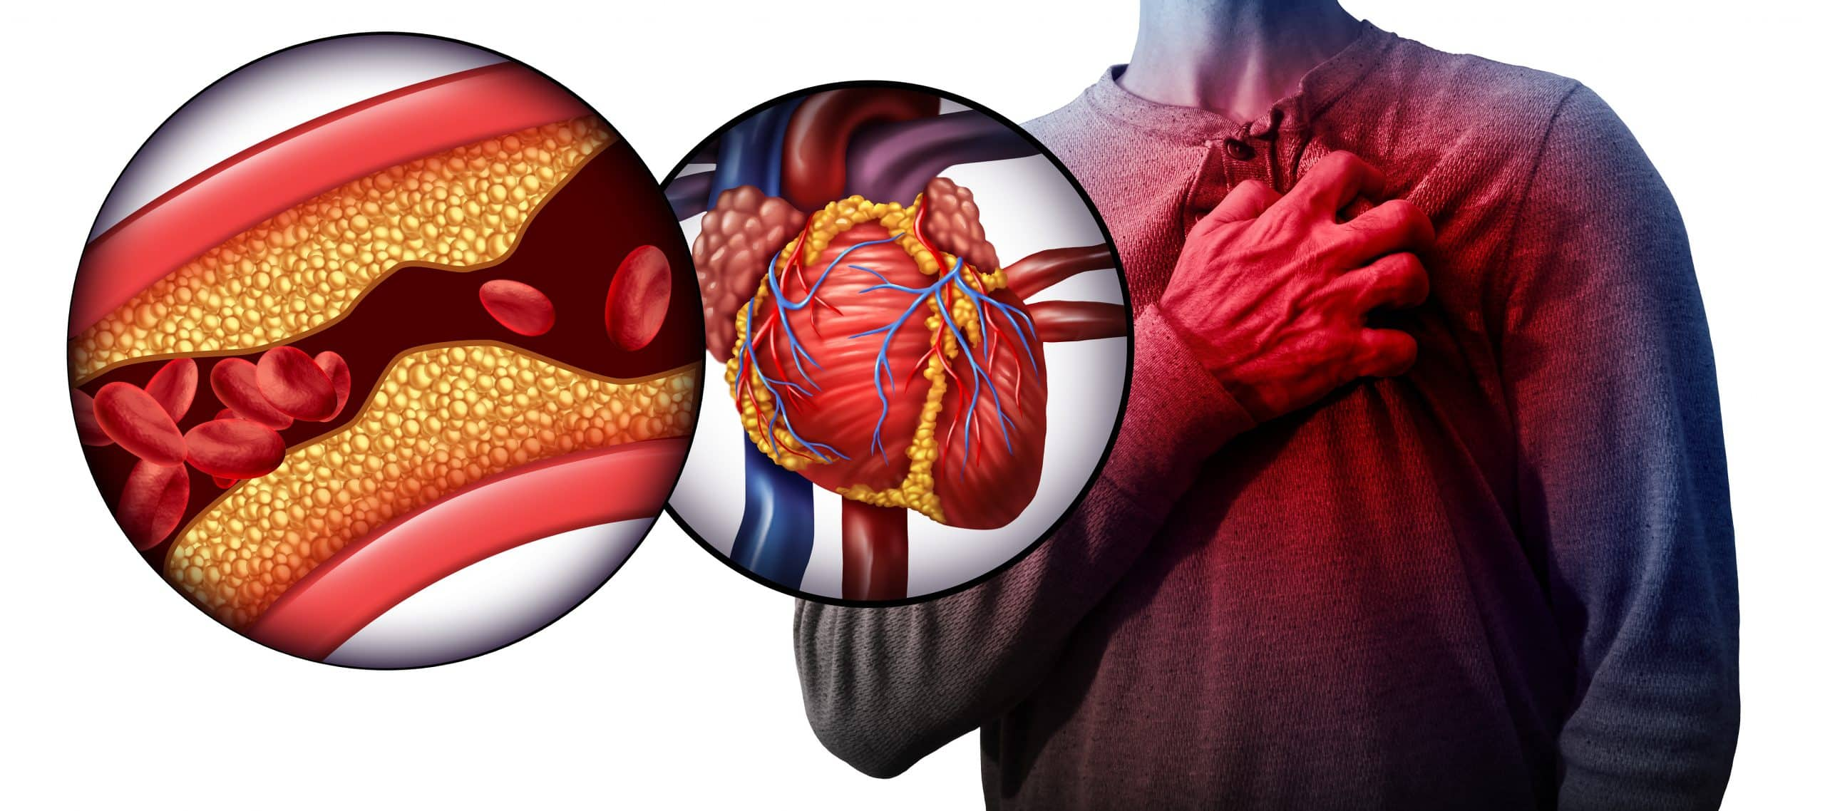
Thank You
DR. SANDEEP CHOWDHARY
MBBS, MD (MEDICINE)
FICP, FISH, FUPDA
CMO, VARANASI

