Slide 1
यह काययक्रम स्वास्थ्य विभाग और राज्य स्वास्थ्य एिं पररिार कल्याण संस्थान (SIHFW), उत्तर प्रदेश की पहल पर उत्तर प्रदेश
टेक्निकल सपोटय यूवनट (UPTSU) के सहयोग से हो रहा है।
Principal Secretary, Medical Health & Family Welfare, U.P.
Shri Partha Sarthi Sen Sharma
Director Administration & Director, SIHFW
Dr. Rajaganapathy R

Slide 3
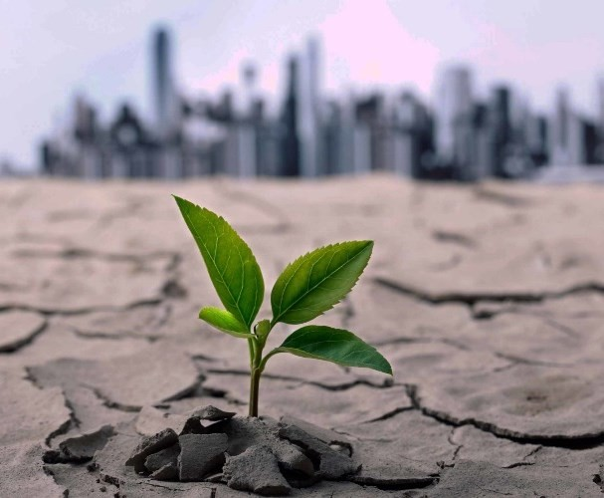
HEAT RELATED ILLNESSES
CAUSES DEFINITIONS PREPAREDNESS MANAGEMENT AND
REPORTING
Dr Vikasendu Agarwal
State Nodal National Program On
Climate Change and Human Health

Slide 4
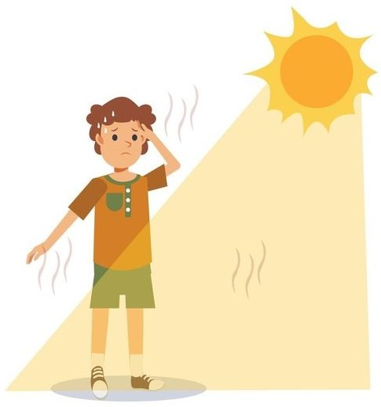
Heat-related Illness
Prolonged exposure to high temperatures, especially when combined with dehydration and inadequate cooling mechanisms, can lead to these illnesses.
A spectrum of medical conditions caused by exposure to elevated temperatures.
Range from mild heat cramps to more severe heat exhaustion or
life-threatening heatstroke.

Slide 5
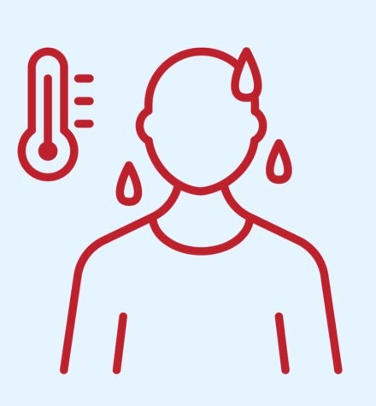
ARE hris A PRESSING PUBLIC HEALTH ISSUE?
Over 25,000 recorded deaths in India over the past two decades (NDMA Guidelines for Preparation of HAP, 2017)
Under-reporting is suspected, and future predictions suggest a doubling of HRI deaths in the next two decades (WMO, 2021).
Increase of 95.2% in the number of deaths in India in 2022 from 2021 due to HRIs. Mortality is higher among males than females with 85% of males between the age group of 18-60 years (NCRB 2022)
2023 – the warmest year on record (WMO, WHO).
86% of the days in 2023 from 1st January to 30th September had extreme weather events with 2923 human deaths (Centre of Science and Environment).

Slide 6
Vulnerability Profiles
Vulnerable Areas to extreme heat affects
Slums
Low-income
neighbourhoods
Hotspots such as areas
with no tree cover or surface water reservoirs
Vulnerable Population Groups to extreme heat affects
Infants/Children
Pregnant women
Elderly people
Workers
Economically Weaker Sections
People with Disabilities
Chronic Disease Patients

Slide 7
What is a heat wave?
A period of unusually high temperatures as compared to what is normally expected over a region
The temperatures at which Heat waves are declared differ from place to place based on the temperature climatology (historical temperatures) of that region
The impact of heat waves gets aggravated by supportive meteorological factors such as high humidity, high wind speed, duration of heat wave events, etc.
How to check Heatwave levels?
India Meteorological Department provides color-coded Heat Wave warning information through its daily bulletins as well as through a GIS-based visualization platform for the next 5 days.
https://mausam.imd.gov.in/imd_latest/contents/all_india_forcast_bulletin.php

Slide 8
What is criterion for declaring heat wave in India?
Heat wave is considered if maximum temperature of a station reaches at least 40⁰C or more for Plains and at least 30⁰C or more for Hilly regions.
Based on Departure from Normal
Heat Wave: Departure from normal is 4.5⁰C to 6.4⁰C
Severe Heat Wave: Departure from normal is >6.4⁰C
Based on Actual Maximum Temperature
Heat Wave: When actual maximum temperature ≥ 45⁰C
Severe Heat Wave: When actual maximum temperature ≥47⁰C
If above criteria met at least in 2 stations in a Meteorological sub-division for at least two consecutive days and it declared on the second day.

Slide 9
What is a warm night?
A warm night is declared only when the maximum temperature remains 40⁰C or more. It is defined based on
departures of actual minimum temperatures as follows:
Warm night: minimum temperature departure is 4.5⁰C to 6.4⁰C
Very warm night: minimum temperature departure is >6.4⁰C
What is Hot and Humid Weather?
When observed maximum temperatures over any station remains 3°C above normal along with the above normal relative humidity, it is termed as Hot & Humid Weather over that station.
What are 90,95 and 98 percentile temperatures of a month?
The maximum temperature percentile of a station refers to the ranking of the maximum temperature of any particular day with respect to all the maximum temperatures recorded for all the days of that months in record.
the maximum temperature above 90th /95th/98th percentile indicate the unseasonably warm day of any month.
For example, if there were 100 maximum temperature value records and these are arranged in ascending order, then the highest 90th value will be called 90thpercentile, 95th value will be called 95th percentile and 98th value will be termed as 98th percentile.
Statistically, the percentile values convey the information that 90th percentile temperature indicate that the 90 percent of times the maximum temperatures will be cooler than this temperature.

Slide 10
What is the impact of Relative Humidity over Heat Wave scenario on humans?
The high values of Relative Humidity aggravate the impact of Heat Waves because they compromise the body’s
response to heating through perspiration by reducing the evaporation rate.
As high relative humidity leads to slower evaporation rate of sweat thereby reduces the efficiency of colling mechanism of the human body.
What is the impact of Winds over Heat Wave scenario on humans?
The high values of wind speed aggravate the impact of Heat Waves. During high temperature days, the surface wind gets heated up in contact with the land surface. When the hot surface wind blows and comes in contact with the human body, they tend to increase the temperature of human body thereby increasing the impact of hot temperatures.
How warm nights or high minimum temperatures affect humans?
The minimum temperatures are generally seen during the night times.
If the minimum temperature at night are warmer than normal then they also give a cascading effect on the next
day maximum temperatures.
The maximum temperatures may be attained the following day earlier and may also last for longer duration.
When the high day time and night time temperatures are seen together then they tend to increase the heat stress on human as human body finds it difficult to recover from the heat of the day during night hours.

Slide 11
How heat discomfort is determined?
Colour Code | Alert | Warning | Impact | Suggested Actions
Green (No action) | Normal Day | Maximum temperatures are near normal | Comfortable temperature. No cautionary actionrequired. | Nil
Yellow Alert (Be updated) | Hea t Aler t | Heat wave conditions at isolated pockets persists on 2 days | Moderate temperature. Heat is tolerable for general public but moderate health concern for vulnerable people e.g. infants, elderly, people with chronic diseases | (a) Avoid heat exposure. (b) Wear lightweight, light- coloured, loose, cotton clothes. (c) Cover your head: Use a cloth, hat or umbrella
Orange Alert (Be prepared) | Severe Heat Alert for the day | Severe heat wave conditions persists for 2 days Through not severe, but heat wave persists for 4 days or more | High temperature. Increased likelihood of heat illness symptoms in people who are either exposed to sun for a prolonged period or doing heavy work. High health concern for vulnerable people e.g. infants, elderly, people with chronic diseases. | (b) Avoid heat exposure– keep cool. Avoid dehydration. Drink sufficient water- even if not thirsty. Use ORS, homemade drinks like lassi, torani (rice water), lemon water, buttermilk, etc. to keep yourself hydrated
Red Alert (Take Action) | Extreme Heat Alert for the day | Severe heat wave persists for more than 2 days. Total number ofheat/severe heat wave days exceeding 6 days. | Very high likelihood of developing heat illness and heat stroke in all ages. | Extreme care needed for vulnerable people.
It is determined by a combination of meteorological (temperature, Relative Humidity,wind, direct sunshine), social/cultural (clothing, occupation, accommodation) and physiological(health, fitness, age, level of acclimatization) factors.
What is heat index?
Combination of air temperature and relative humidity,
Measures how hot the body perceives when relative humidity is factored in with the actual air temperature.
Also referred as apparent temperature
The human body uses sweat mechanism to cool its temperature -
The sweat from the body gets evaporated leading to cooling of the body surface temperature.
If The Relative Humidity Is High, Then The Rate Of Evaporation From The Body Decreases
It compromises temperature mechanism.
the body’s ability to efficiently using
cool its
perspiration

Slide 12
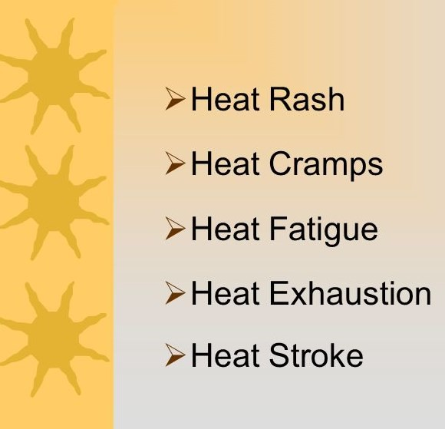
TYPES OF
HEAT-RELATED ILLNESSES
Spectrum of heat illness – Increasing order of severity
Heat edema/rash
Heat cramps
Heat syncope
Heat exhaustion
Heat stroke

Slide 13
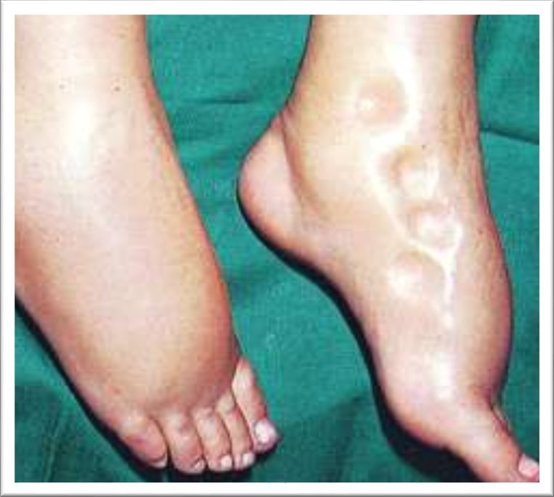
Heat Edema
Pitting edema
Most commonly in hands and feet
Can last from days to weeks
Bed ridden elderly are more prone
High temperature → vasodilation → pitting edema
Treatment:
Self limited
Reassurance, limb elevation, bandages
Avoid high temperatures and adequate rehydration.

Slide 14
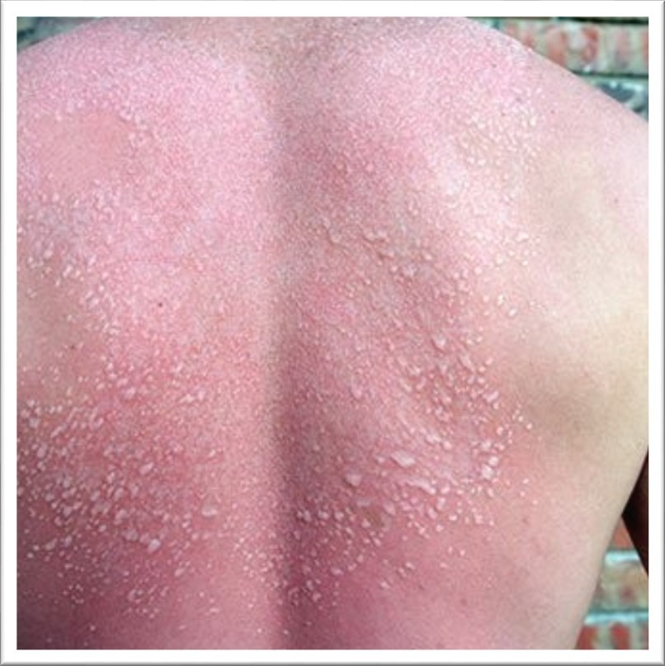
Heat Rash
Also known as “Prickly Heat.”
Occurs when sweat cannot freely evaporate from the skin and sweat ducts become plugged. This inflammation can cause a red rash.
This can be prevented by wearing clothes that allow sweat to evaporate as well as bathing regularly and drying the skin.

Slide 15
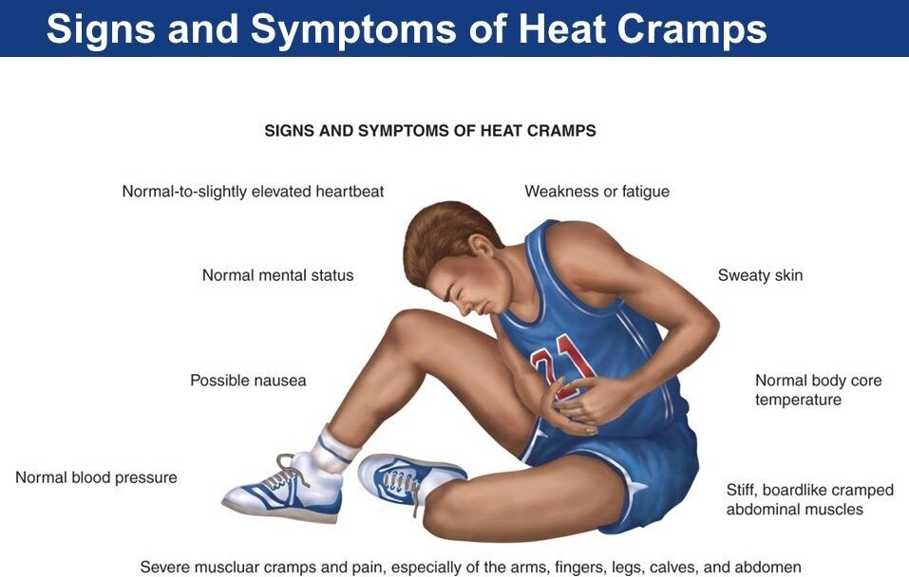
Heat Cramps
Localized, painful, involuntary spasms of
skeletal muscles.
Cramps in the arms, legs, or abdomen
Occur in individuals who sweat profusely then drink large quantities of water, but do not adequately replace the body’s salt loss
Causes:
Sodium and/or chloride depletion
Dehydration
Impaired circulation in working muscles
Alterations in spinal neural reflex activity increased by fatigue
Most commonly affected muscles are:
Treatment:
Slow, passive stretching of involved muscle.
Massage
Ice
Fluids replacement
Calf, quadriceps, hamstrings, abdominal muscles.
Prevention
Replace salts during and after heavy sweating.

Slide 16
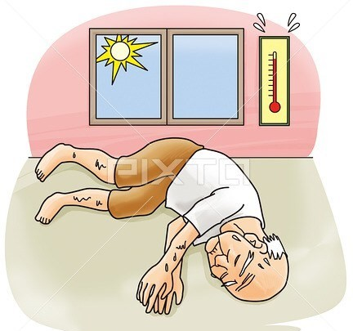
Heat Syncope
Insufficient blood supply to the brain due to vasodilation of the skin vessels
Decreased venous return
Less CO2
Low perfusion to the brain
Symptoms:
Light headedness
Dizziness
Fainting
Fainting
Or
Treatment:
Put the patient in a cool place and elevate the legs
If regained consciousness: rest and adequate rehydration.
If remained unconscious: treat as shock.
Drop in blood pressure as a result of
vasodilation.

Slide 17
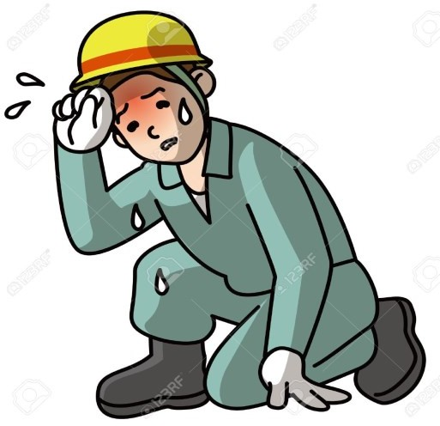
Heat Exhaustion
Symptoms
Skin is clammy and moist
Extreme weakness Of fatigue
Nausea
Headache
Complexion pale or flushed
Body temperature normal or slightly elevated
Causes
Mild form of shock caused when the circulatory system begins to fail as a result of the body’s inadequate effort to give off excessive heat
Although not an immediate threat to life, if not properly
Treatment
treated, could evolve into
Do not leave the person alone
Move to a cool place to rest
Drink water or electrolyte fluids
Treat for shock, if necessary
If unconscious/fails to recover rapidly/has other injuries/has
a history of medical problems, seek medical attention.
heat stroke.

Slide 18
Heat Stroke
Causes
Symptoms
Severe and sometimes fatal condition resulting from
Stop Sweating
Rapid Pulse & Mental Confusion
Loss of Consciousness
Convulsions
Body Temperature > 105
Hot, dry skin
Can die unless treated promptly
the failure of the body to regulate its core
temperature
The body’s normal cooling mechanisms stop
functioning, sweating stops.
Medical
attention.
emergency requiring immediate medical
Types
Treatment
Classic (non-exertional):
Sedentary, elderly, chronically ill individuals
Young individuals exposed to hot environment for long periods.
Exertional:
In young individuals involved in heavy exercise for a prolonged period of time in a hot environment.
Remove the victim to a cool area
Soak clothing with cool water and fan
vigorously to increase cooling
Monitor vital signs

Slide 19
Heat Stroke

Slide 20
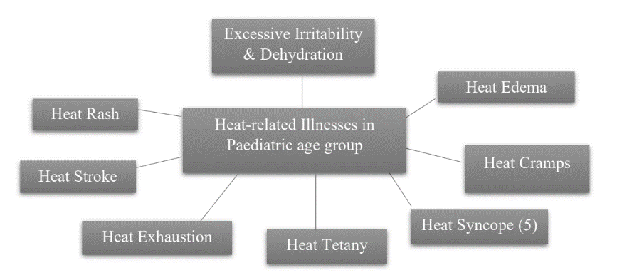
HEAT RELATED ILLNESSES IN PEDIATRIC AGE GROUP

Slide 21
Heat Health Action Plan

Slide 22
Implementation of Heat Action Plan
Phase 1 – Pre-Heat Season (January-March)
Convening inter-departmental meetings for a review of the Health Action Plan
Area mapping to plan and execute targeted activities
Enlisting high-risk areas in the district vulnerable to heat waves
Identifying the key community and non-governmental actors to facilitate the implementation of the Heat Action Plan and awareness generation activities
Organizing preventative training and outreach efforts for health workers, link workers, school children, and the local community with the Health Department
Ensuring dissemination of IEC related to Heat Related Illnesses
Establish Heat Wave Action Web Page (Heat wave warning mechanism, Identification of dry areas, Display of High risk areas) on Disaster Management / District Website

Slide 23
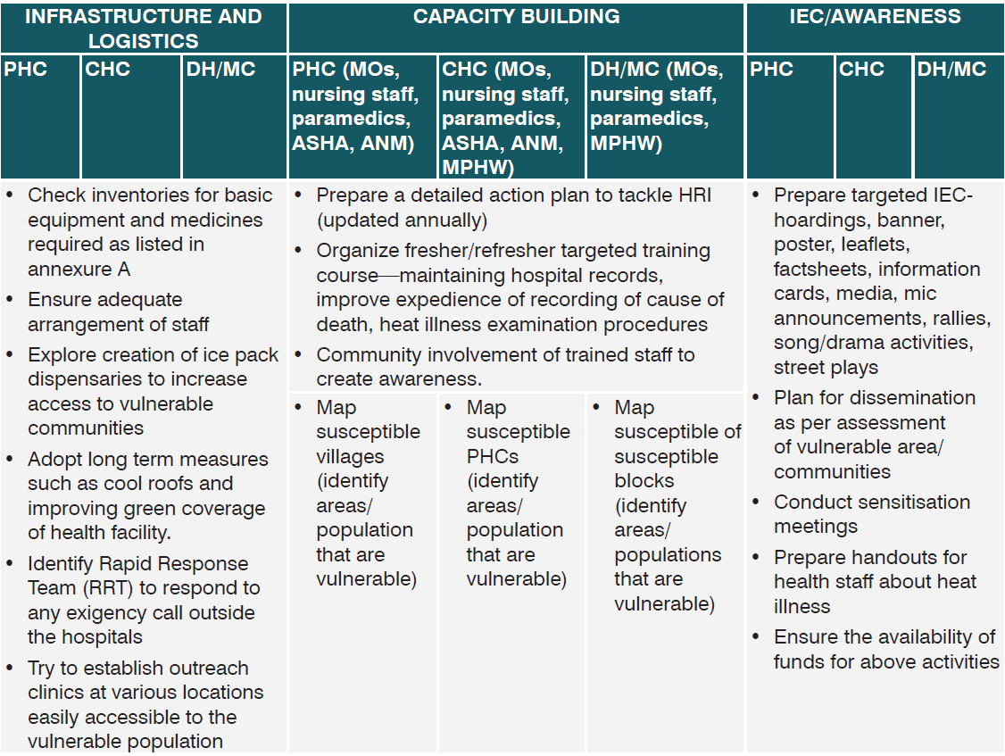
Hospital Preparedness
Chart
Pre-Heat Season

Slide 24
Phase 2 – During the Heat Season (March-July)
Keeping the hospitals ready with all necessary logistics and proper training of Health HR on Heat related illnesses
Creating an Active Heat Alert and appropriate local response when a heat wave event is identified by the meteorological department
Notifying key agency leaders and ensuring functioning communication channels with all the stakeholders
Modifying heat alert level in accordance with the severity of changing temperature thresholds and the latest forecast
Expanding access to shaded areas for outdoor workers, slum communities, and other vulnerable populations by community/district administration.
Continued surveillance of temperature data and forecasts
Instructing water department or local municipal department to availability of staff and clean drinking water
during a heat alert
Establishing ORS corners at crowded places like Collectorate/Tehsil, Bus stations, Railway stations in
coordination with different agencies and administration

Slide 25
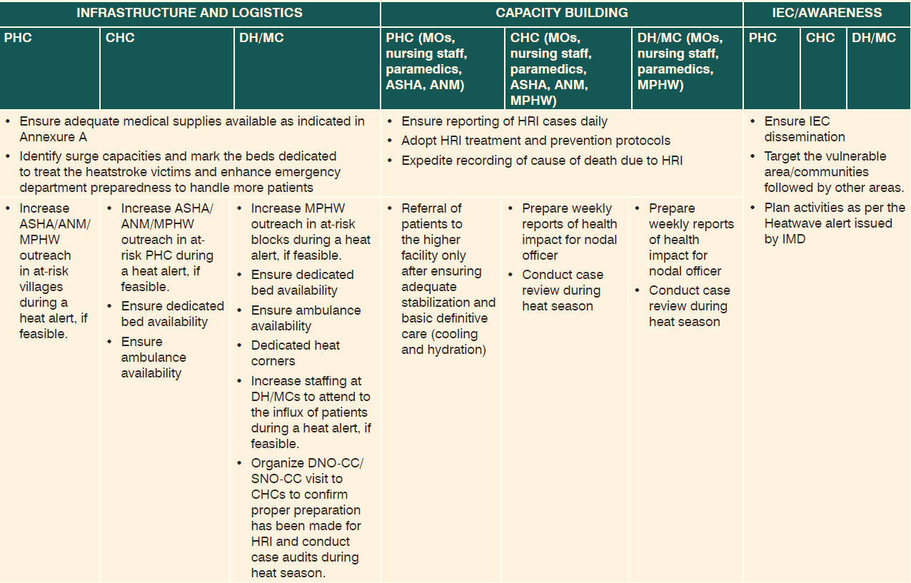
Hospital Preparedness
Chart
Heat Season

Slide 26
Phase 3 – Post-Heat Season (July-September)
Review of quantitative and qualitative data for process evaluation and improvement. Revision of the plan is to be based on the performance feedback
Convening evaluation meetings with relevant stakeholders for the review of the Health Action Plan.
Build on the “Green Cover” activity to establish a tree-plantation campaign in hotspot areas such as roadsides and during the plantation festival in June.
Incorporate student volunteers and/or encourage industries / builders to plant trees to help this effort

Slide 27
Hospital Preparedness Chart
Post Heat Season

Slide 28
Establishment of Cold Rooms For Management of Heat Stroke
Goal: To reduce core body temperature to ~ 39ºC (102ºF) and to avoid hypothermia
Requirements for Emergency cooling at PRIMARY AND FIELD LEVELS
Purpose: Rapid cooling of a patient suffering from moderate to severe heat-related illnesses and rapid referral and transport to secondary/tertiary level health facility, if needed, after first-aid and stabilization
 | Requirements for Heat Stroke Room at TERTIARY AND SECONDARY LEVELS
Purpose: Immediate and rapid cooling of a patient suffering from heat exhaustion or suspected heat stroke

Slide 29
 | DH and SDH | CHC
Dedicated rooms/ beds | Dedicated heat stroke room/beds (adult+paediatric) (Minimum 5 beds) | Dedicated heat stroke room/beds (adult+paediatric) (Minimum 2 beds)
 | Selecting a heat stroke room/ beds A room/beds in the health facility where the ambient temperature could be maintained optimally with appropriate natural shading / ventilation. It should not on the top floor of a building It can be cooled effectively with fans and coolers if air conditioning is not available. Refrigerator, ice box, ice packs, ice cool water, cool blankets, wet linens, garden sprayer should be available in or close to the room round the clock.

Slide 30
Desirable Logistics for Supportive care
Rectal
Thermometers
Continuous core temperature monitor probe
Stethoscope, BP apparatus, ET tube and laryngoscope
Core Body Temperature Measurement
Glucometer and testing strips
Logistics for Supportive care
Ryle’s tube (may use for cold water/cold NS gastric lavage for internal cooling
ECG machine with Gel, electrodes, ECG paper
Multiparameter monitor
High flow oxygen
Keep posters of HRI Clinical protocols and HRI surveillance case definition/reporting on walls for easy reference
Defibrillator
Treatment
protocols
Medicines: Lorazepam, Diazepam, IV anti-seizure medicines like
phenytoin and valproate, ORS
Cold IV normal saline (0.9%), dextrose 50% in water solution (D50W),
Dopamine, dobutamine

Slide 31
Essentials for Emergency Cooling at Primary and Field Levels
 | PHC | Ambulance
Core body temperature measurement | Rectal Thermometers
Cooling equipments (Goal: to reduce core body temperature to ~39°C (102.2°F) and to avoid hypothermia) | For optimal room/air cooling and refrigeration/ice box functional AC/Cooler/fans and proper maintenance (for room cooling) functional refrigerator/ice box for ice cubes, cold water, IV fluids
 | For rapid cooling for all heatstroke cases at primary/field/community level Water spray bottles (to be used with fanning) Towels/sheets: soak with cool water ICE packs: minimum 6 ice packs/patient [Effective, rapid cooling requires 6 packs/patient: on each side of neck (2), in armpits (2), over groin folds (2)]

Slide 32
Essentials of Heat Stroke Room at Tertiary and Secondary Levels
COOLING EQUIPMENTS
For optimal room/air cooling and refrigeration/ ice box
For evaporative cooling for all paediatric cases, most adult heatstroke cases especially classic heatstroke
For immersive cooling for exertional heatstroke in adults to fill with cold water and/ice cubes
functional AC/Cooler/fans and proper maintenance
Water spray bottles (used with fans)
Portable bath tub (cool water temperature to kept at 15.5°C/60F)
ICE packs: minimum 6 ice packs/dedicated bed [Effective, rapid cooling requires 6 packs/patient: on each side of neck (2), in armpits (2), over groin folds (2)]
Waterproof zipper body bags/cadaver body bags
functional refrigerator/ ice box for ice cubes, cold water, IV fluids
Towels/sheets: soak with cool water

Slide 33
Management workflow of Suspected Heatstroke victims

Slide 34
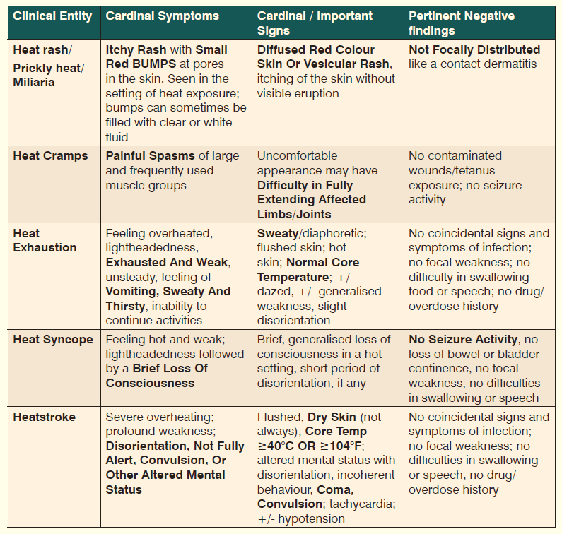
Sepctrum of Heat Related Illnesses

Slide 35
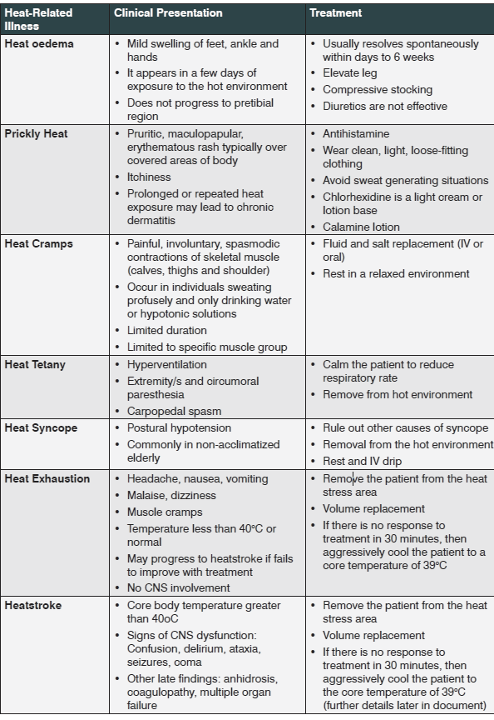
Prevention and Management of Heat-related Illnesses

Slide 36
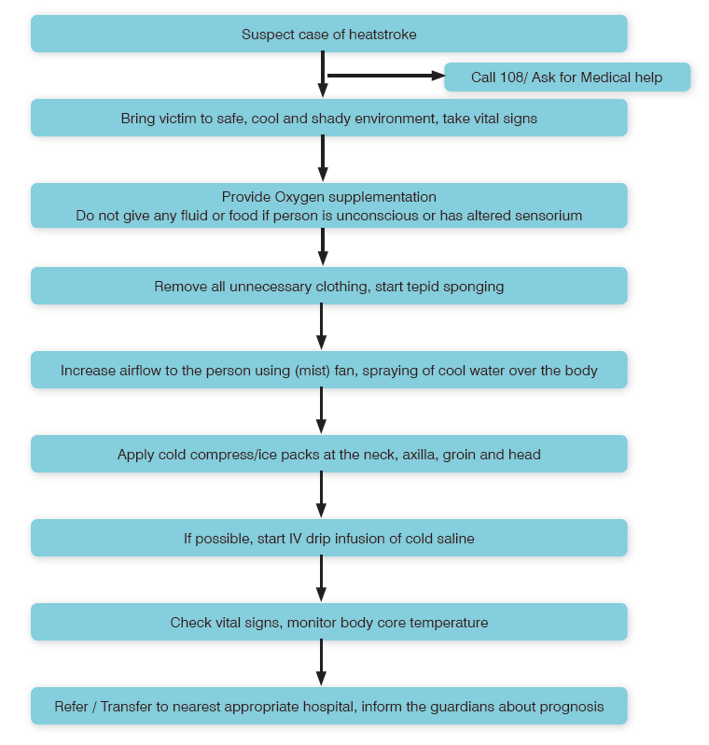
Management workflow of Suspected Heatstroke victims
At PHC level
Before referral to higher centre

Slide 37
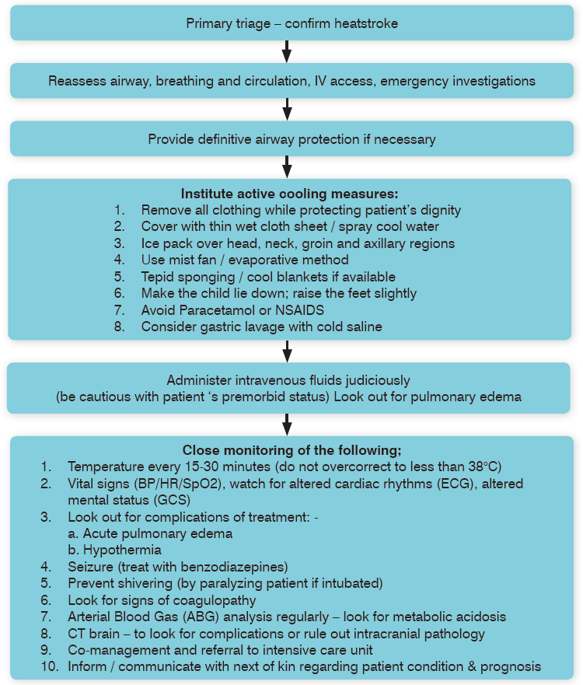
Management Workflow in Emergency Department for Management of Heatstroke Patient
At tertiary level

Slide 38
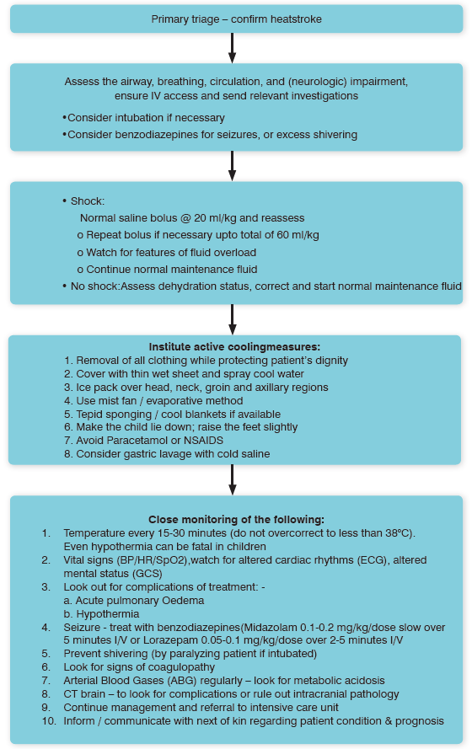
Clinical Work flow in Emergency Department for
Management of Heatstroke in children

Slide 39
Reporting of Heat Related Illnesses

Slide 40
Case Definitions
1. Suspected Heatstroke case:
(definition applicable during Heatwave season, i.e., March to July)
Altered mental status (including disorientation, delirium, seizure,
obtundation) with
hot and dry skin and deranged vitals, i.e., tachycardia,
tachypnoea and wide pulse
pressure
Altered mental status (including disorientation, delirium, seizure,
obtundation) with
elevated core body temperature
≥ 40ºC/≥104ºF
or
III. without signs of stroke, history of infection, or signs of medication overdose
Confirmation is not required

Slide 41
Case Definitions
Suspected Heatstroke Death: death on account of suspected heatstroke case
Confirmed Heatstroke Death: A suspected heatstroke death confirmed by the death investigation committee (heat death committee/three-man committee) at the district level.
Confirmed Cardiovascular death* includes death resulting from an
acute myocardial infarction (MI) or
sudden cardiac arrest or heart failure (HF) or
cardiovascular (CV) procedures or
CV haemorrhage or death due to other CV causes.
(*Clinical confirmation from treating physician, PM not necessary)

Slide 42
Integrated Digital Heat-Related Illness Surveillance
The current HRI surveillance formats are under process of digitation on IHIP portal. This will allow data entry from health facilities at level equivalent to IDSP P-form. Form next year, all the health facilities, PHC and above, of heat-prone States/UT will require to submit daily data on IHIP.
HRI data collection - A P-form user, once logged into to the IHIP platform, will be able to access the HRI data collection page through a separate link for (NPCCHH). Total numbers of emergency visits (medicine, casualty, paediatrics), suspected heatstroke cases and deaths, confirmed cardiovascular deaths and other unknown deaths that occurred in the health facility during 24hr period of 8:00am previous day to 8:00am on the day of reporting should be submitted daily as per the case definition provided.
For suspected heatstroke cases and deaths, patient details limited to their socio-demographic information, provisional diagnosis and circumstances of onset of heatstroke should be entered to allow better understanding of impact of ambient heat.

Slide 43
Integrated Digital Heat-Related Illness Surveillance
Reporting of a confirmed heatstroke death - The digital data collection will allow uploading of completed suspected death investigation. Uploading of completed investigation report will be allowed at health facility and also at district level. A blank data collection form (as per Chapter 7 of National Action Plan on Heat Related Illnesses) will be available for download on the data collection page itself.
HRI dashboard - The integrated dashboard will provide visualization of health data with observed meteorological parameters like daily maximum and minimum temperatures and relative humidity from India Meteorological Department. Time (daily, weekly, monthly) and place (up to district level) distribution of suspected heatstroke cases and deaths will be visualized.
Monitoring of trends of all-cause deaths and emergency OPD visits with maximum temperatures will provide understanding of overall health impact and health serviced demand. District, state and central level access will allow near real-time tracking of heat and its health impacts at the respective levels for necessary action.

Slide 44
Guidelines for the analysis of suspected Heatstroke cases and deaths
Analysis should be done at the District Surveillance Unit by the District nodal officer
Periodicity of analysis will be weekly. Data from the previous week, i.e. Monday to Sunday, should be analysed by Tuesday of the
current week
Analysed report should be e-mailed to the State Surveillance Unit by Tuesday 04:00 PM
Analysis will be done on time, place, and person indicators as shown below

Slide 45
Death Audit of Suspected Heat-related Deaths

Slide 46
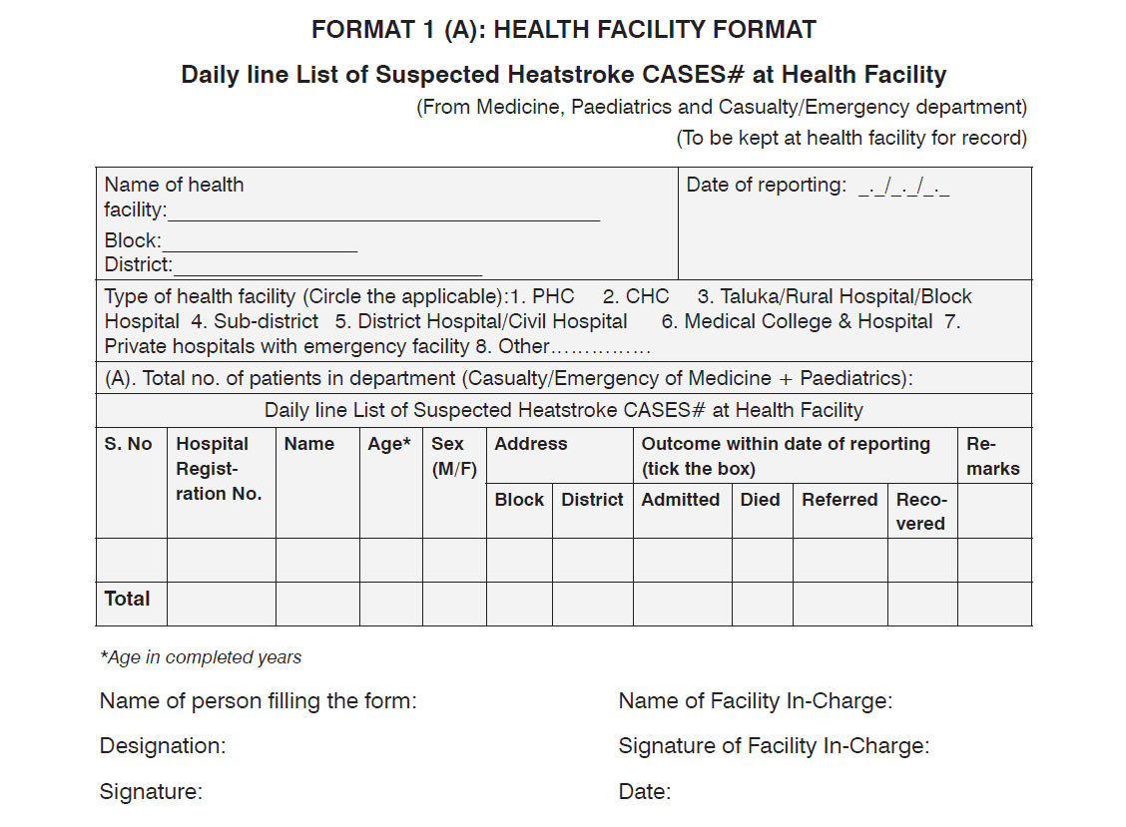

Slide 47
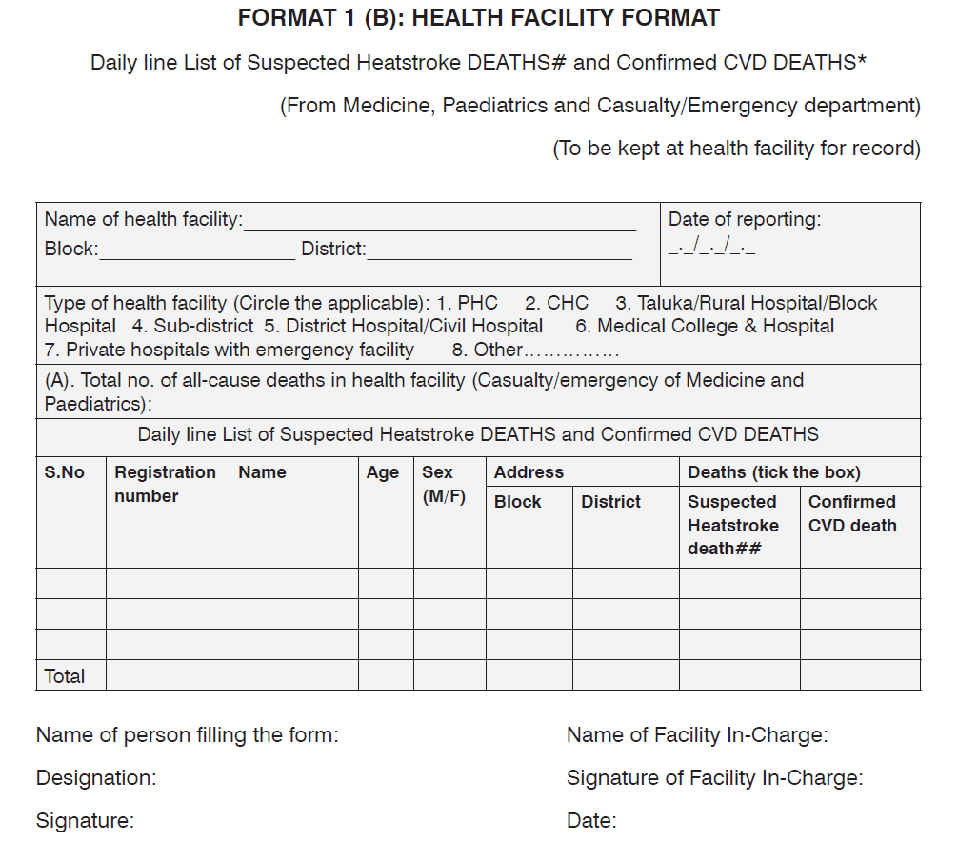

Slide 48
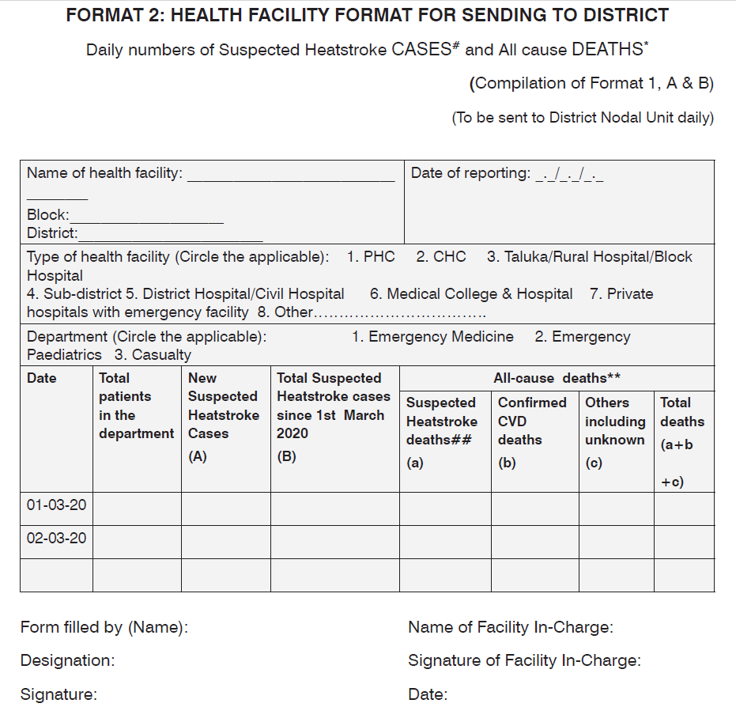

Slide 49
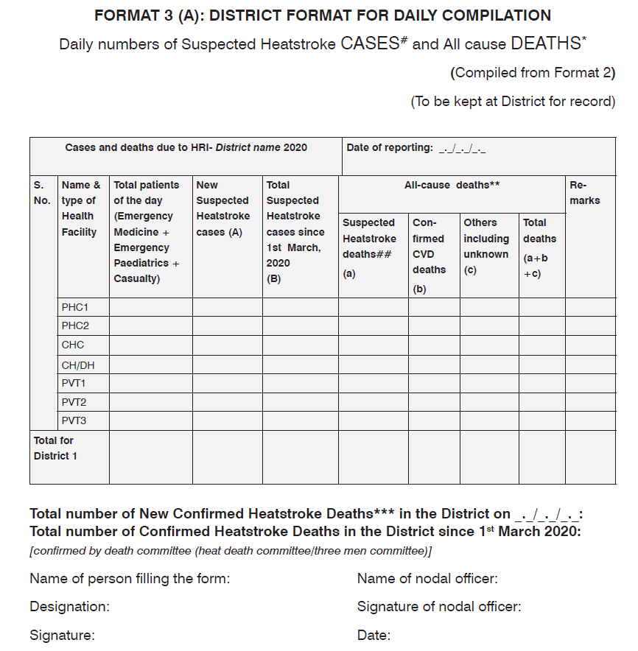
#Suspected Heatstroke - Altered mental status with high core body temperature (≥ 40°C/≥104°F) or hot and dry skin with deranged vitals (tachycardia, tachypnea, wide pulse pressure), during heatwave season (March to July), without stroke, infection, or medication overdose signs.
*Cardiovascular death - includes death resulting from an acute myocardial infarction (MI) or sudden cardiac arrest or heart failure (HF) or cardiovascular (CV) procedures or CV haemorrhage or death due to other CV causes.
(To be compiled by the District Nodal Officer on daily basis)

Slide 50
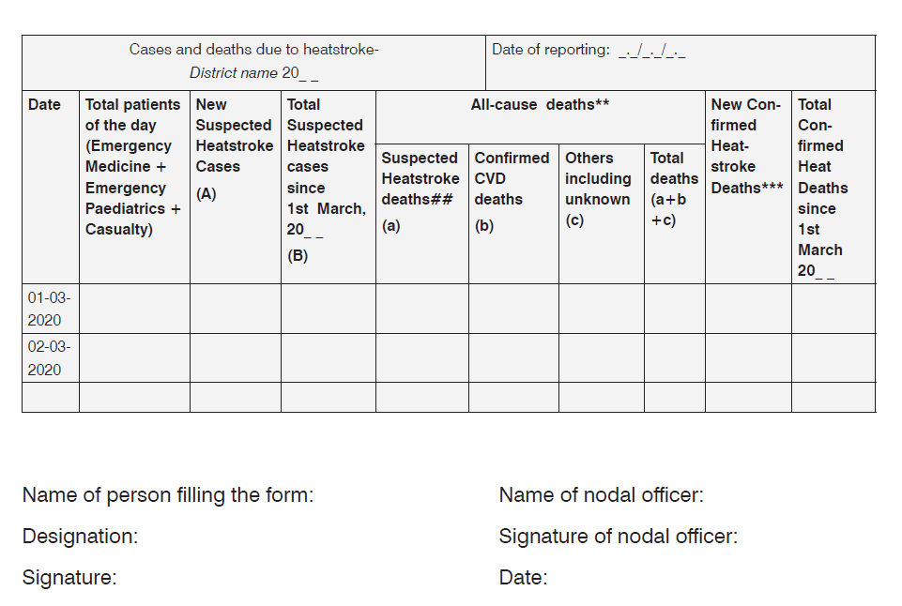
FORMAT 3 (B): DISTRICT FORMAT FOR SENDING TO STATE (Compiled from Format 3 A) (To be sent to State Nodal
Unit daily while keeping a copy for the record)
(To be compiled by the District Nodal Officer on daily basis)

Slide 51
IHIP reporting format for Heat-Related Illness

Slide 52
HRI Surveillance Log in credentials for training of learners
Website | https://ihiplearning.in/npcchh
Username | hfuser2
Password | Learnihip@2019

Slide 53
HEAT RELATED ILLNESSES
A Clinical Perspective
Prof. D Himanshu Reddy
Professor Medicine Department
King George’s Medical University
Lucknow

Slide 54
Scope of Presentation
Understanding the development of heat related illness
Identifying heat injuries and differentiating from mimics
Management approach

Slide 55
Pathophysiology of Heat Related Illnesses
The body dissipates heat into the environment via four mechanisms –
Evaporation
Radiation
Conduction
Convection

Slide 56
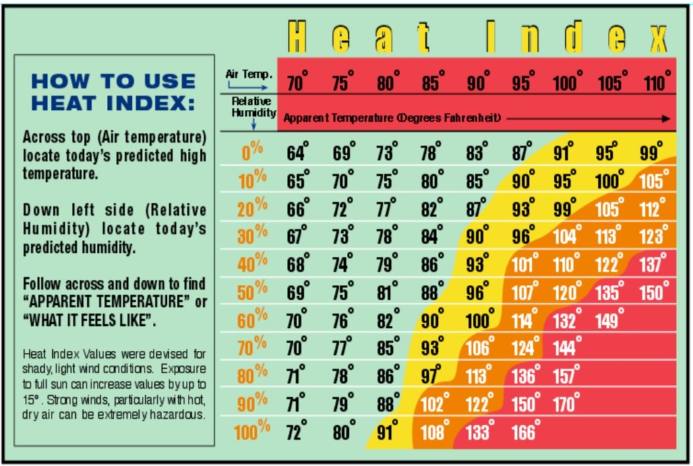

Slide 57
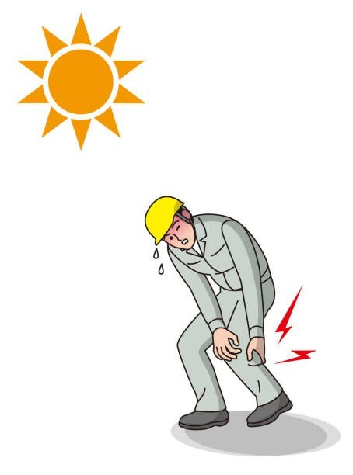
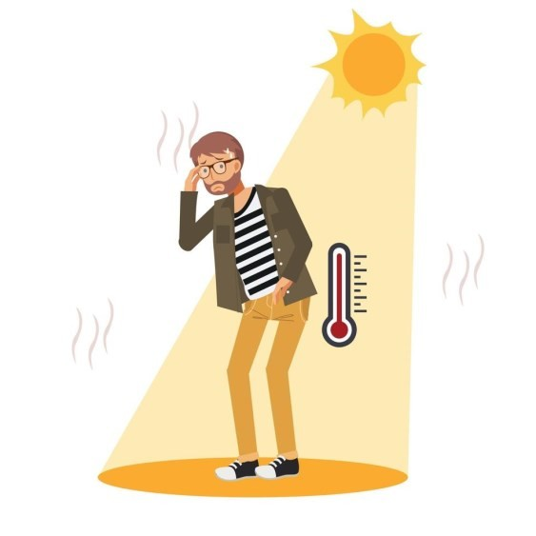
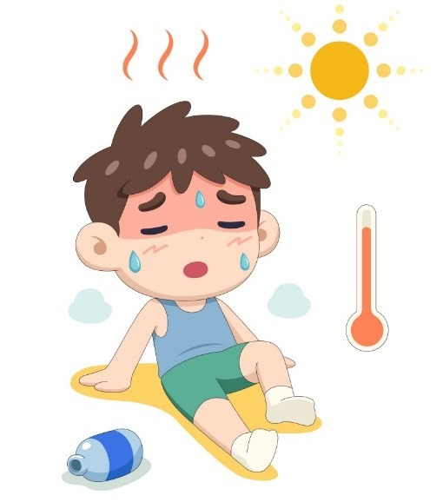
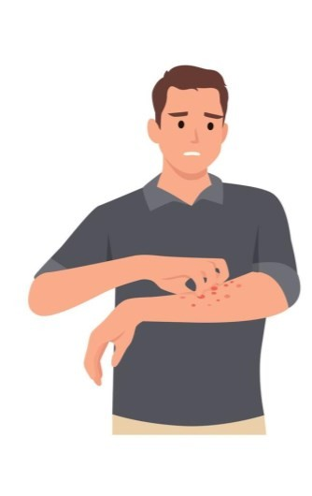
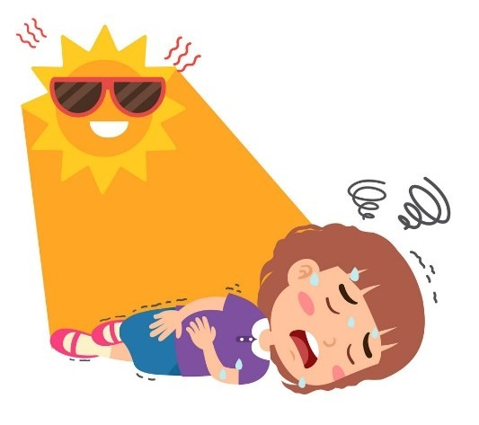
Types of Heat Related Illnesses
Heat Rash
Heat Cramps
Heat Exhaustion
Heat Syncope
Heat Stroke

Slide 58
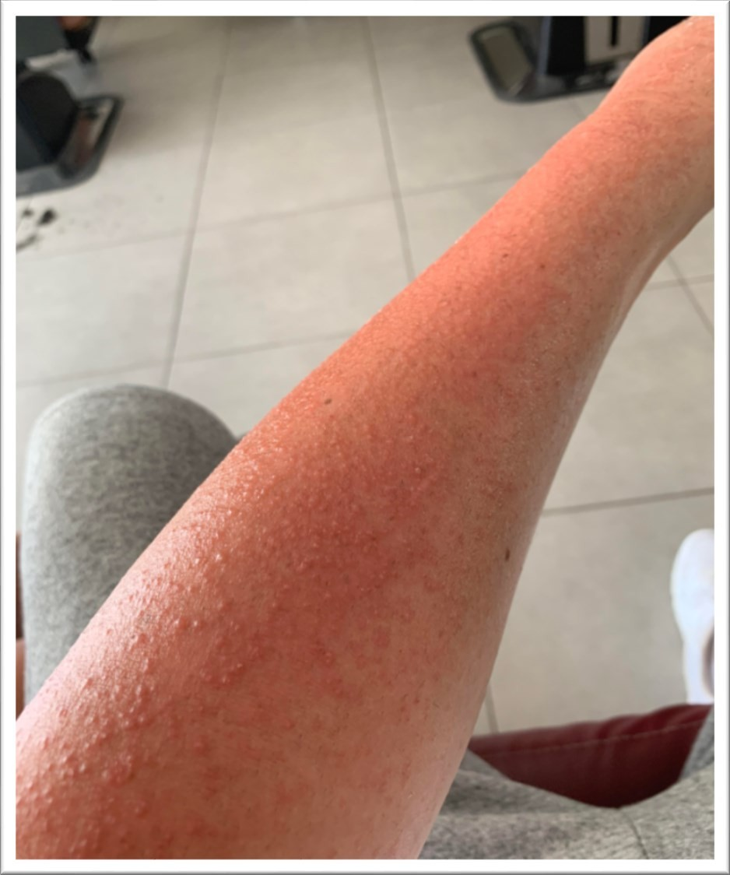
Prickly heat (miliaria rubra, lichen tropicus) is a maculopapular, pruritic, erythematous rash that commonly occurs in clothed areas.
Management:
Loose clothes and keep dry, antihistamines, chlorhexidine in a light cream or lotion

Slide 59
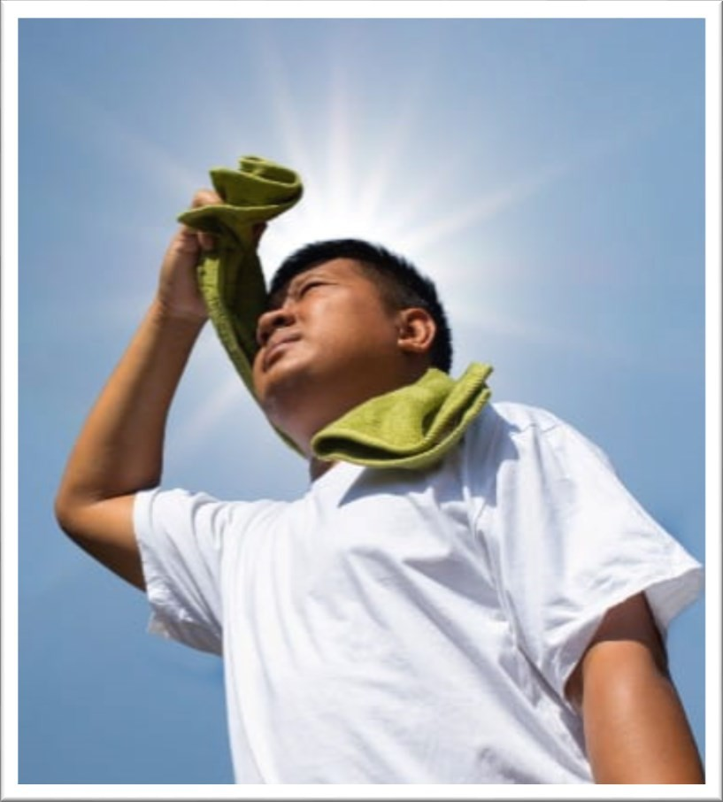
Heat syncope (exercise-associated collapse) Occur during
endurance exercise
elderly
during prolonged standing while stationary in the heat.
Management :
Removal from the heat source
Recover promptly with cooling and rehydration.

Slide 60
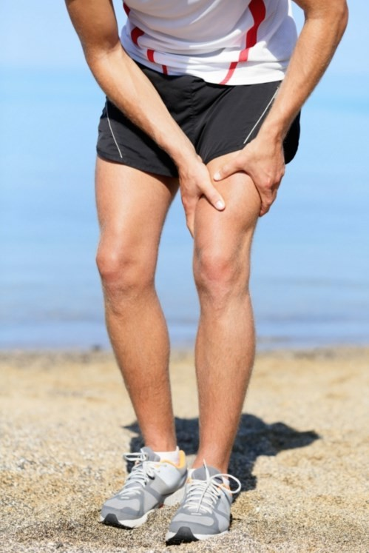
Heat cramps (exercise-associated muscle cramps)
Intermittent, painful, and involuntary spasmodic contractions of skeletal muscles.
Occur in an unacclimated individual who is at rest
Occur after vigorous exertion in a humid, hot environment
Patient is profusely diaphoretic
Management : Intravenous fluids

Slide 61
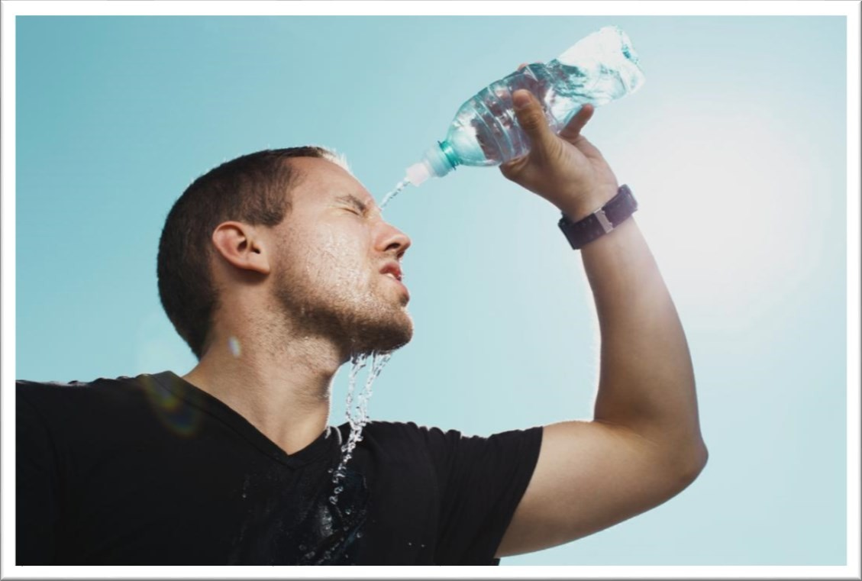
Heat Exhaustion :
due to a low cardiac output
profound CNS disturbance is absent.
can present as thirst, oliguria, nausea and vomiting, headache, weakness, occasionally syncope, sinus tachycardia, and hypotension.
If left untreated, Heat Exhaustion
might progress to heatstroke

Slide 62
What is Heat Stroke?
This is a combination of –
Hyperthermia [classically defined as a core body temperature of at least 105°F (40.5°C)].
Loss of the capacity to dissipate heat (Loss of ability to sweat is often a late and ominous sign).
CNS impairment, ranging in severity from confusion to coma.

Slide 63
What are the types of Heat Stroke?
Classic (non-exertional) heat stroke (NEHS)
Commonly affects sedentary
elderly individuals, persons who
are chronically ill and are on treatment.
Exertional Heat Stroke Occurs in young, otherwise healthy individuals who engage in heavy exercise during periods of high ambient temperature and humidity and the body’s cooling mechanism cannot get rid of the excessive heat.

Slide 64
How to identify Heat Stroke?
Presence of risk factors –
Environment that is hot and humid.
People aged 65 and older
People with chronic medical conditions-
Poorly controlled diabetes mellitus
Compromised cardio-vascular functions
Alcoholism
Anorexia, dehydration
Dermatological conditions with decreased sweating
Previous heat-related illness
Parkinson's disease
Thyrotoxicosis

Slide 65
Medications :
Alcohol
Anticholinergics, Beta blockers, Alpha-adrenergics, Antihistamines, TCAs, SSRIs, Phenothiazines, Cocaine
Calcium-channel blockers, Diuretics, Aspirin, and Lithium

Slide 66
How to identify Heat Stroke?
Hyperthermia : Core temperature readings may be obtained with rectal or oesophageal thermometers as per guidelines.
Though practically not possible due resource constraints in peripheral health facilities.
We can identify heat stroke by –
Patient having exposed to hot and humid environment
Patient’s fever not responding to anti-pyretics
Dry skin, loss of sweating, confusion
Oral temperature >104.3 degree F (Oral temperatures are generally 0.7°F lower than rectal readings)

Slide 67
Profound CNS disturbance: confusion and agitation, irritability, ataxia, seizures and coma.
Other diagnostic features are: Headache , nausea and vomiting, anxiety , dizziness , fainting, tachycardia , jaundice , Muscle tenderness, hypotension , gastrointestinal bleeding (uncommon) , bruising and skin bleeding (uncommon).

Slide 68
Mimickers of Heat Stroke
Sepsis
Malaria
Neuroleptic malignant syndrome ( in patients taking anti psychotics)
Malignant hyperthermia ( If there is a history of recent inhalational
anaesthetic)
Recreational drug toxicity, particularly involving cocaine, amphetamines and ecstasy
Other rare causes are Thyroid Storm, Pheochromocytoma and Anti cholinergic Poisoning.

Slide 69
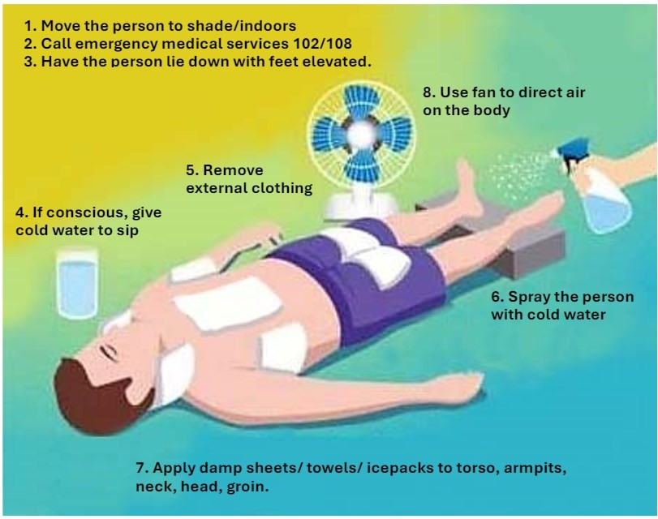
How to Manage Heat Stroke?
On site Management

Slide 70
How to Manage Heat Stroke?
During Transport -
Above mentioned measures to be continued.
Start intravenous fluids.
Pay attention to airway, breathing and circulation.

Slide 71
How to Manage Heat Stroke?
Management at health care facility
An elevated core temperature in the setting of CNS dysfunction should trigger a presumptive diagnosis of heat stroke.
A lower core temperature should not rule out heat related illness as the patient body temperature might have been brought down by the first aid given during transportation.
“Prompt correction of hyperthermia by immediate cooling and support of organ system function are the two main therapeutic objectives in patients with heat stroke”

Slide 72
How to Manage Heat Stroke?
Primary goal : Rapidly lowering the core temperature to about 102.2°F (39°C)(to avoid overshooting and rebound hyperthermia) by reducing at least 0.3°F/min.
Active external cooling generally is halted at 102°F (39°C) to prevent
overshooting.
Temperature Monitoring : By flexible indwelling thermistor rectally or by temperature-sensing Foley catheter.

Slide 73
How to Manage Heat Stroke?
External Cooling :
Immersion cooling
Evaporative cooling
Internal Cooling

Slide 74
External Cooling
Immersion cooling :
Immersion in an ice bath
Ice water can reduce core body temperature to less than 102.2°F in
approximately 20-40 minutes.
Patients cooled in an ice bath frequently suffer afterdrop (their core temperature continues to decline even after they are removed from the bath).
Extremely uncomfortable for patients who are awake.
Cooling blankets used in conjunction with ice packs to the axilla, groin, neck, and head, may be the most rapid methods of cooling.

Slide 75
External Cooling
Evaporative cooling :
The following procedure is followed:
Remove all of the patient’s clothing.
Insert a rectal thermometer for continuous monitoring.
Mist over patient constantly, using spray bottles filled with tepid (15°C) water.
Place large fans to circulate warm room air (ideally 40°C) directed at
the patient.

Slide 76
Internal Cooling
Gastric, bladder, and rectal cold water lavage can all be readily performed.
This should be regarded as an approach for use when external cooling may not be feasible or is ineffective.

Slide 77
How to Manage Heat Stroke?
Emergency Life Support
Assess using Advanced Trauma Life Support (ATLS) protocols
Administer oxygen along with cooling
Patients with an altered level of consciousness, significant hypercapnia, or persistent hypoxia should be intubated and mechanically ventilated.
Circulatory support is usually given with –
IV fluids as 0.9% NaCl or 5% dextrose
Avoid K+ containing fluids
Gradually reduce concentration of Na+ if hypernatraemic.
If inotropes are required, try to use those with less alpha-adrenergic activity eg, dopamine.

Slide 78
How to Manage Heat Stroke?
Management of Volume Depletion and Electrolyte imbalance
Infusions may require 1 to 1.5 L/hour.
Central Venous Pressure (CVP) monitoring may be of help in appropriate fluid resuscitation.
Catheterization should be done to monitor urine output.

Slide 79
How to Manage Heat Stroke?
Medications –
Supplemental oxygen.
Infusion of dextrose 50% in water solution (D50W) if hypoglycemic.
Benzodiazepines and anticonvulsants - to control shivering and fits
Neuroleptics - to treat excessive shivering.
In patients not controlled by the above medications, thiopentone infusion 1% or non depolarizing muscle relaxants may be required.
Antipyretics and dantrolene are not effective in treating heat stroke
and should not be used.

Slide 80
How to Manage Heat Stroke?
Monitoring :
Hepatic, renal, and clotting function should be monitored for 48 hours after admission and treatment.
Arterial blood gas testing
Blood Glucose
Serum Electrolytes (Sodium, potassium, phosphorus, calcium, magnesium)
Muscle function tests (Creatinine kinase (CK), lactate dehydrogenase (LDH),
aldolase, and myoglobin)
Complete blood cell count
Imaging in the form of X-ray chest and CT head (based on the judgement of the
treating physician)

Slide 81
Complications and Poor prognostic indicators
Complications
Hyperkalemia
Hypocalcaemia
Acidosis
Rhabdomyolysis
Disseminated intravascular coagulation
Hepatic failure
Acute kidney injury
Ventricular fibrillation (often fatal)
Poor prognostic indicators
Coagulopathy
Lactic acidosis (in the absence of severe physical exertion)
Core temperature >42.2°C
Coma lasting >4 hours
Acute kidney injury
Hyperkalaemia
Very high transaminase level
Prolonged period of hyperthermia.

Slide 82
Follow Up of Patient
Schedule a follow-up visit 7 days after hospital
Patient education post-heatstroke :
Abstain from exercise for at least 7 days after hospital discharge.
Acclimatize: Remain in a cool environment and slowly increase the duration, intensity, and heat exposure over 2-4 weeks to acclimatize.
Evaluate: If heatstroke symptoms return may consider for a heat
tolerance test as per sports or occupational requirements.

Slide 83
Follow Up of Patient
Prevent exposure and adapt:
▫ Schedule activities during cooler times of the day and wear light-coloured,
loose-fitting clothing.
▫ Avoid dehydration by drinking ample amounts of isotonic fluids, avoid fluids containing alcohol and caffeine .
▫ Be aware of medication side effects such as medications that cause bradycardia, diuresis, or reduce sweating.

Slide 84
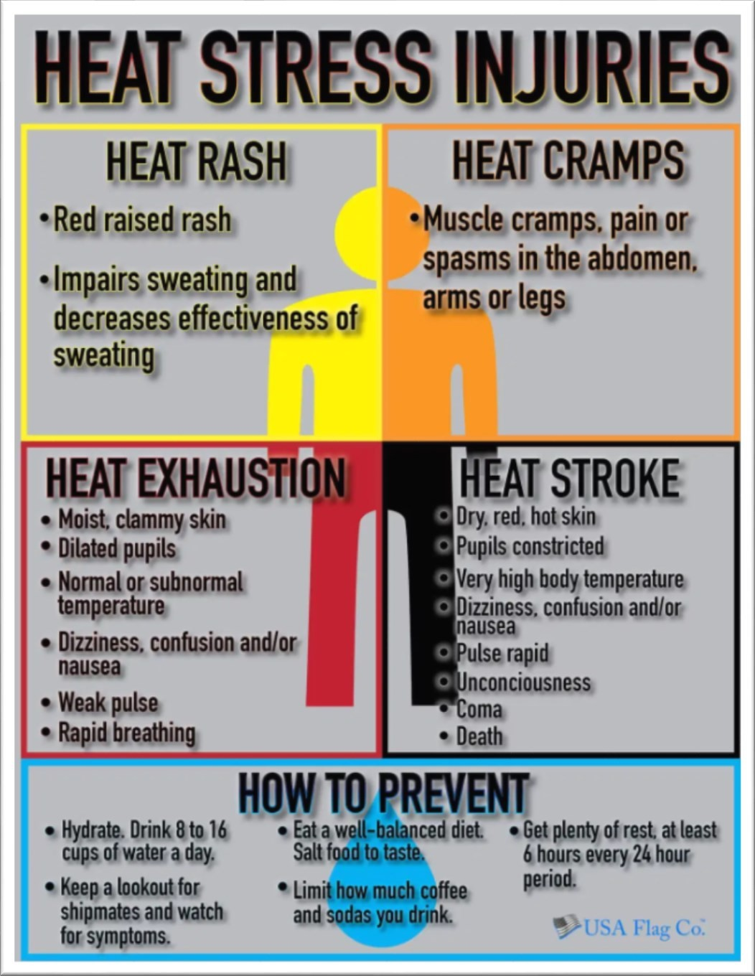

Slide 85
Conclusion
Remember three simple measures –
Water, Rest, Shade.
Drink fluids/ Buttermilk/ coconut water/ lemonade
Take breaks

Slide 86
References
Guidelines on Prevention and Management of Heat Related Illnesses 2015 Emergency Medical Relief Directorate General of Health Services Ministry of Health and Family Welfare Nirman Bhawan, New Delhi
Occupational Safety and Health Administration guidelines for Heat related Illnesses
Harrison's Principles of Internal Medicine, 21e

Slide 87
Acknowledgement
Dr. Pahul Ahuja, Department of Medicine
Dr. Sujeet Kumar, Department of Medicine

Slide 88
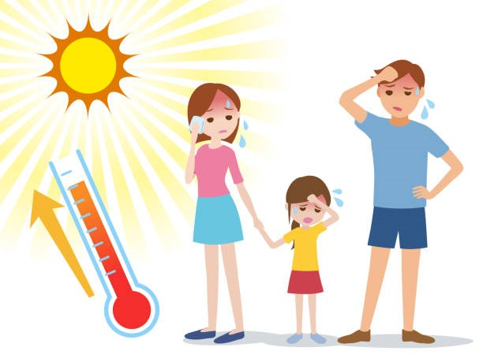
Thank You

