Slide 1
Addressing the Scarcity of Specialist Doctors in District Hospitals of Uttar Pradesh By
Dr. Mohd. Masoodul Hasan Usmani (Dermatologist)
Dr. Rishi Kumar Saxena (Chest Specialist)
Dr. Brijesh Singh Verma (Medicine)
Dr. Ajeet Kumar Singh (Orthopedician)
Dr. Devendra Kumar Shukla (Orthopedician)

Slide 2
Introduction
The National Health Policy 2017 envisages the attainment of the highest possible level of health and well-being for all.
Government of UP is committed to provide quality health care to common man. An important step towards improving quality of healthcare delivery is through the Indian Public Health Standards (IPHS):a set of uniforms standards to provide norms and benchmarks for quality of infrastructure, human resources and services to be delivered from public health facilities at all levels.
Service Delivery as per IPHS 2022Specialist IIM Project\IPHS Standatd 2022.pptx
District Hospital should be able to provide all basic specialty services and should aim to develop super-specialty services gradually and should also needs to be ready for epidemics and disaster management all the times.
In addition, it should provide facilities for skill-based trainings for different levels of health care workers.
Specialist Doctors are key Human Resource of above defined activities

Slide 3
A total of 1989 Specialist working in Districts Hospitals
Even when Contractual doctors are also taken into account , most of sanctioned posts are vacant
Department | Sanctioned | Available (Regular + Contractual) | Vacant | % Vacant
Gynecologist | 466 | 289 | 177 | 38.0
Anesthetist | 367 | 273 | 94 | 25.6
Pediatrician | 305 | 389 | -84 | -27.5
General Surgeon | 246 | 193 | 53 | 21.5
Pathologist | 243 | 185 | 58 | 23.9
Radiologist | 222 | 129 | 93 | 41.9
General Physician | 220 | 180 | 40 | 18.2
ENT | 137 | 121 | 16 | 11.7
Ophthalmologist | 177 | 194 | -17 | -9.6
Orthopedics | 198 | 216 | -18 | -9.1
Psychiatry | 45 | 38 | 7 | 15.6
Microbiologist | 54 | 9 | 45 | 83.3
Dermatologist | 83 | 52 | 31 | 38.6
Forensic Specialist | 17 | 9 | 8 | 47.1
Data as per Karmik Swasthya Bhavan (as of Oct 2023)

Slide 4
Human Resource being wasted in non specialty work
Lack of Managerial support/work over burden
Specialists doing most of non specialist work and is not able to achieve academic excellence/
research leading to apathy among Specialist .
A
Lack of Capacity Building in Updating via CME and Hands on trainings for concerned specialty.
Overburdened without Helping hands like Junior Residents as in Medical Colleges
B
Shortage of Specialist
at production level in medical colleges
Due to overcrowding, decreased patient consultation time leading to dissatisfaction, of practice, in Drs as well as in Pt.
Postmortem VIP/ Mela duties /court evidences for medico legal /postmortem work.
Scarcity of Specialists at DH
1
2
3
1
2
D
C
Insufficient salaries in comparison to private sector. sufficient salary start only at Level 4
Para Medics are also not trained fully in Procedural Assistance where intervention is required.
Lack of equipments, Investigation facilities and drugs does not offer attraction for proper medical practice
Work conditions , Job descriptions not attracting young specialists with overemphasis on non specialty work.
Promotion at 6, 11 and 17 years ( with cooling period of 6 and 7 years at L3 & L4 stages) as against 4,8,12 yrs in medical colleges.
Currently 9000 Non-Specialist & approx 2000 Specialists are in PMS services
1
2
1
2
3
Apathy for proper medical practice present
Not up to the mark job description & financial reimbursement

Slide 5
Only One Hospital in a District which has Beds ranging from 50 to 500 will enter this one format only If in a District there are multiple Hospitals with Beds ranging from 50 to 500, each of them will fill it separately .
Name of Mandal | Name of District | Name of Hospital with No of Beds in Hospital (Ranging from 50-500 Bedded) | S No | Specialty Wise (Permanent + Contractual) | No of each Specialist in concerned Hospital | Total OPD PER/ Specialist wise in August should 1500/Month | Total IPD PER Specialist wise in August should be 500/Month | No of Procedures/ Surgeries/ Imagining Procedures/Pathological/Microbiological test in August Month | Total Specialty wise Referrals in August to Tertiary Care including Super specialties/ Medical Colleges
 |  |  | 1 | General Physician
 |  |  | 2 | Critical Care Specialist
 |  |  | 3 | Surgeon
 |  |  | 4 | Gynaecologist
 |  |  | 5 | Orthopedician
 |  |  | 6 | Anaesthesiologist
 |  |  | 7 | Chest Specialist
 |  |  | 8 | Ophthalmologist
 |  |  | 9 | Otolaryngologist
 |  |  | 10 | Radiologist
 |  |  | 11 | Paediatrician
 |  |  | 12 | Psychiatrist
 |  |  | 13 | Dentist
 |  |  | 14 | Pathologist
 |  |  | 15 | Microbiologist
 |  |  | 16 | Oncologist
 |  |  | 17 | Community Medicine Consultant
 |  |  | 18 | Dermatology
 |  |  | 19 | Geriatrician
 |  |  | 20 | Emergency Medicine
IPHS Norms-8hr Shift for 25 Days/M
60 Pts OPD/Day/(1500/M)
and
20 Pts IPD/Day/(500/M)
Physician/Surgeon/Gynecologist/Pediatrician/Orthopedic / Ophthalmologist/ENT Surgeon /Dermatologist.
For General duty Medical Officer 75 Pt/day in OPD
Psychiatry and Dental OPD 20 Pts/day in OPD
Activity-1 done to ascertain work load of specialists with permission of
DG MH
Current Data of August 2023 was collected from DG office in this format to oversee specialist workload as compared to IPHS Norms.
In 24 Districts in their 12 Mandals, 30 District Level Hospitals responded in time.

Slide 6
Analysis of OPD and IPD of Aug 2023 of 30 District Level Hospitals in 24 Districts of 12 MandalsAnalysis of Specialist OPD, IPD ,Procedures,Tests for Aug 2023.xlsx
Existing specialists in PMS Services are overburdened with patients
As per IPHS Norms 2022, 6 days a week(Total 25 Days/Month)
OPD Norms @ 60 Pts/day (1500 Pts/Month)
IPD Norms @20 Pts/day (500 Pts/ Month)
(0PD) In 18 District Hospitals from 13 District level Hospitals out of 30 District Hospitals in 24 Districts
Specialists- 9 General Physician,
8 Gynecologist ,
5 Orthopedics,
4 Chest Specialist,
3 Dermatologist and Ophthalmologist respectively
2 ENT, Surgery and Radiology respectively
1 Pedia ,Patho, Psychiatry and Community Med respectively
Are Giving Consultation to 1500 Pts +/Month
(IPD) In 5 District Hospital in 5 District level Hospitals out of 30 Districts Hospitals in 24 Districts
Specialist -5 Gynecologist
1 Pediatrician
Are Examining ,Admitting and Treating 500 Pts + /month

Slide 7
From where will the specialists come and what options do they have
Recruitment pool
Public Sector Job
1) Govt Medical college
2) PMHS
UTTAR PRADESH now has 67 Medical Colleges seats 2022-23
1954 PG Medical seats In Govt Colleges
1567 PG Medical seats in Pvt colleges
32 DNB seats in Govt colleges
165 DNB seats in Pvt Colleges
Includes preclinical subjects like anatomy ,physiology , biochemistry and pharmacology which we do not desire in PMS
45471 PG medical seats in entire Country
Private Sector Job
1)Private Medical College
2)Private clinic based /corporate hospital based/ other hospital based

Slide 8
Activity at health facility for local solutions at Balrampur Hospital Lucknow- 2A
Issue
High OPD load in Skin department( 800-1000 footfall )400-500/doctor/day in Balrampur Hospital Lucknow.
Plan:-Doctors and Diseases for training identified
Footfall in OPD of various diseases studied and six diseases with maximum footfall identified.
Two MBBS doctors namely Dr Dinesh Kumar and Dr Umme Farwa (NHM) were trained in 6 diseases which constitute 60-70% of skin department OPD and added to help Dermatology in september to november 2023.
Outcome
Disease diagnosis, treatment and outcome same. Trained doctors became well versed
in heavy footfall 6 diseases. Interested Doctors without specialty may
be trained in specific diseases with heavy load to help specialists.
Future plan
To add more diseases in training.

Slide 9
Activity at health facility for local solutions at Balrampur Hospital Lucknow- 2B
Issue
Sudden spike in patients in Medicine OPD Department of Balrampur hospital Lucknow in late august
2023, with many requiring admission in IPD leading to IPD load as well. Fever cases was identified as
cause of spike.
Plan
Similar expert with knowledge who could be spared, identified and trained in management protocols.
OPD rooms identified in same department.
Outcome
Month | Dr Om Kar Yadav | Dr SK Shukla | Total Patients
September 2023 | 2736 | 4391 | 7127
October 2023 | 3376 | 3425 | 6801
November 2023 | 1948 | 1967 | 3915
Data upto 23rd nov
4000- 7000 patients per month were treated by identified doctors otherwise these pts would have added to physician load. They additionally helped in quick disposal of general diseases like Diabetes, Hypertension and Hypothyroidism.
Disease outcome remained same

Slide 10
Solutions to issue- Track establishments
Principles of solutions
Solutions to acute shortage of specialists must take into account the very limited pool of recruitment available and available options for newly pass outs.
Comfort Zone Working conditions with proper promotional growth, reduction in loss of specialty devoted time to non specialty works which can be handled by MBBS doctors or GDMO and proper avenues of academic growth with reasonable financial reimbursement will be key to attracting new doctors decreasing attrition rate.
Solutions must cover the root causes of apathy of specialists as discussed in fish bone analysis
Some of activities at department level are taking place and good work must continue
A) Academic environment and CME
1.C-Moc and E-Moc trainings in progress and postings in FRU happening. More Surgical procedures may be included. More skills like emergency procedures to be included for both doctors and assisting paramedical staff. (A2/C2/B1)
2. 6-month USG training and 3 wks Obs USG trainings planned and started by department.(A2/B1)
3. A very laudable initiative of CMEs being organized in different specialties at SIHFW. (Since 1 yr) CME Numbers may be increased. Online CMEs started titled shukrawar ki shaam doctors ke naam. Observer ship programmes at centre of excellences like KGMU/SGPGI/RMLor other Medical Colleges may be restarted. (A2/B1)

Slide 11
4. Case Based Presentations and CMEs from Concerned Specialty via ZOOM fortnightly for all MO’s on 2nd and 4rth Tuesday in Tubercular Diseases from State TB Cell happening (Since 1and ½ yrs Dr.Rishi being State Nodal for it ) (B1)
C) Help from internal sources
1. Contractual and Reappointment specialist Drs staff already recruited. (Reappointment place of posting should be in ratio of structural logistics).(B1)
2. E-Sanjeevani Tele Consultation for Community Health Officers from their respective Health and Wellness Centers for Consultation of Patients Schedule wise from concerned Specialist happening. (Since 2 yrs) (B1)
3.Interested MBBS Doctors in same hospital may be trained in specific diseases with heavy load to help specialists as done or similar expert with knowledge may be utilised for disease specific overloads to help other specialties both activities successfully taken up at balrampur hospital under our project. (B1)
D) External inputs
1. Joining of specialists at level 2 happening. Attrition rate high , reasons to be studied but prima facia appear to be linked to working conditions. (B1)
2. 2-year work experience course in Pediatrics going on in BRD medical College Gorakhpur.(Since 3 yrs) Different medical colleges may be contracted on same lines for 2-year courses in different subjects. STRONG RECOMMENDATION (B1)
E) Monitoring of work conditions to keep an eye
1. 24 X 7 Real Time Monitoring of 58 Districts Hospitals happening ( Since 6 Months) from Directorate at ICCC by approx. 2000 CCTV installed at 16 various locations like IPD Wards/OPD Chambers/Emergency Wards/Dispensing Areas etc with maintaining privacy at all cost for Pts by HOPE (Health Online Parameters Evaluation installed at Directorate. (D3)

Slide 12
2. JDs may be appointed as mentors for a year or so to oversee new joinees do not have adjustment issues in the system (D3)
F) Input of Equipments, Investigation facilities and Drugs
1. Purchase of equipments and provision of investigations and avaibility of drugs are taking place post covid epidemic but needs to be enhanced as per treatment guidelines of various diseases to make PMS hospitals at par with medical colleges and private sector and to ensure attraction for proper medical practice. (C1)

Slide 13
Study by WHO in state of Chhattisgarh to provide a detailed examination of the state of the health labor market in Chhattisgarh to provide an insight into key human resources for health and the bottlenecks and opportunities in the State. The report focused on Medical Officers, specialist doctors, nurses and the roll-out of health and wellness centers. Based on the results of the analysis, nine main issues related to the policy questions were highlighted and recommendations and policy options were proposed which were however specific to Chhattisgarh.
Reference from similar activities done in other parts of country
Issues | Recommendation | Policy Options
MO’s and Specialist Doctors
Unmet need for specialty care Shortage of specialists in DHs and CHCs | Promote diploma/alternative short training courses and task-shifting. | Improve recruitment process Introducing task-shifting from specialists to MOs in DHs and CHCs MOs (without PG qualification) to be trained in essential surgeries, diagnosis and treatment of common diseases of secondary-level care and given permission and incentives to perform these procedures . Restart Family Medicine PG diploma course and recognize it as specialization under DHS . Start other multi-skilling courses Adopt the NHM flexible norms for engaging visiting specialists for fixed days or surgeries Greater use of existing mechanisms like DNB

Slide 14
High vacancy rates of MOs and specialists, especially in rural and remote areas | Improve recruitment process | Direct recruitments of specialists in regular appointments of DHS by modifying selection rules v Regular recruitment drives (at least one annually). Interaction with medical students in the State during internship Better deployment strategy for and PGs on bond Transparent deployment (allocation of locations of posting) according to merit Facilitate recruitment of regular posts from outside the State by introducing flexibility in the selection of the process
 | Improve supportive services and other benefits to improve retention in remote areas | Facilitate enrolment of rural students v Improve financial and non-financial incentives in less desirable locations. Ensure career pathway is improved by serving in rural and remote areas by the following: o points in PG entrance for MOs serving in tribal areas o sponsor MOs in rural, remote and tribal areas to attend special PG family medicine courses (post MBBS) o time-bound transfer option for doctors posted in tribal areas o compulsory posting (around 20% part of career) in tribal areas for every regular MO/specialist o making at least 3-year service in tribal areas compulsory for promotions

Slide 15
Administrative Medical Officers (AMO’s)
Lack of coherent administration procedures for AMOs | Improve administration of AMOs Improve capacity of AMOs | Introducing policy to facilitate transitioning from contractual to regular AMO Creating an attractive career pathway for this cadre Invest further in their skills

Slide 16
Our recommendations
1. Most of the activities in Policy options adopted by Chhattisgarh state is already adopted by UP Govt. Good work and already implemented activities as highlighted before must continue and additions as discussed to be added up
(A/B/C/D as per Fish Bone Analysis)
2. Successfully activity done in implementing this project at health facility Balarampur hospital Lucknow ,so training for high footfall disease training and basic Screening of Signs and Symptoms of various Specialties by Concerned Nodal Specialists to MBBS MO’s at PHC/CHC level will decrease the Pt load and only Pts who require intervention at Secondary Care Center will be referred from Primary Care Center and Health and wellness Center. Seasonal disease spikes to be handled by similar experts at hand as experimented in our project (B1)
3. Every district to nominate MBBS doctors let say 10 in number rotation wise from CHC/PHC for performing Postmortem in District Hospital. These to be trained for 6-12months at heavy PM load mortuaries like KGMU Lucknow thus sparing specialist from district hospital for non specialty work.(A1)
4.Different Medical Colleges may be contracted on lines of BRD MC GKP Pediatric certificate course for 2-year courses in different subjects. (B1)
5. Working condition promotional avenues and financial reimbursement of Government Medical College and PMS services specialists to be kept at par. (D2/D3/D1)

Slide 17
6.To increase sanctioned post of EMO for one chair 24x7x 365 hrs to 4 from existing 3 posts, as this sucks one
specialist from district hospital permanently. (B1)
7. Clubbing some Specialties may be considered and requisite capacity building taken up. Cardiologist , Chest Specialist Physician Can be clubbed as with General Physician and a common physician pool may be created. Similarly Microbiologists may be clubbed with Pathologists and Radiotherapist in PMS may be trained for cancer screening and deployed accordingly. (B1)

Slide 18
Further plan Recommendation
The Chhattisgarh study, although extensive, has not delved at length into the position and job profile movement of specialists. It has emphasized input processes.
In our situations the confounding factors and complexities are enormous. One more complex factor to cope with will be the input of corporate hospitals in UP, especially in Lucknow, Varanasi, and Ayodhya in the immediate future. These corporate hospitals will attract specialists from the very same small pool we are expecting them to come to us.
Hence, a comprehensive study on the position of specialist doctors, their production, and job profile movement is required. We propose to produce a WHITE PAPER on the above in cooperation with the Johns Hopkins Institute and IIM Lucknow. Subject to approval, we will communicate with the above institutes and present various feasibilities of such a study, along with the budget required.

Slide 19
Sincere thanks to
Principal Secretary Medical, Health and Family Welfare and Medical Education
Shri Partha Sarthi Sen Sharma IAS.
Director General Medical and Health Dr. Brijesh Rathor
Director Administration Dr. Raja Ganapathi R IAS
Director IIM Ms. Archana Shukla and Faculty of IIM Lucknow
Special Thanks to Dr. Brian from Johns Hopkins Bloomberg School of Public Health and Shri Aman for conducting excellent leadership training and allowing us to place our points in the form of a project on various issues in the Medical and Health sector.

Slide 20
Be an Asset and not a Liability to the System Thank You

Slide 22
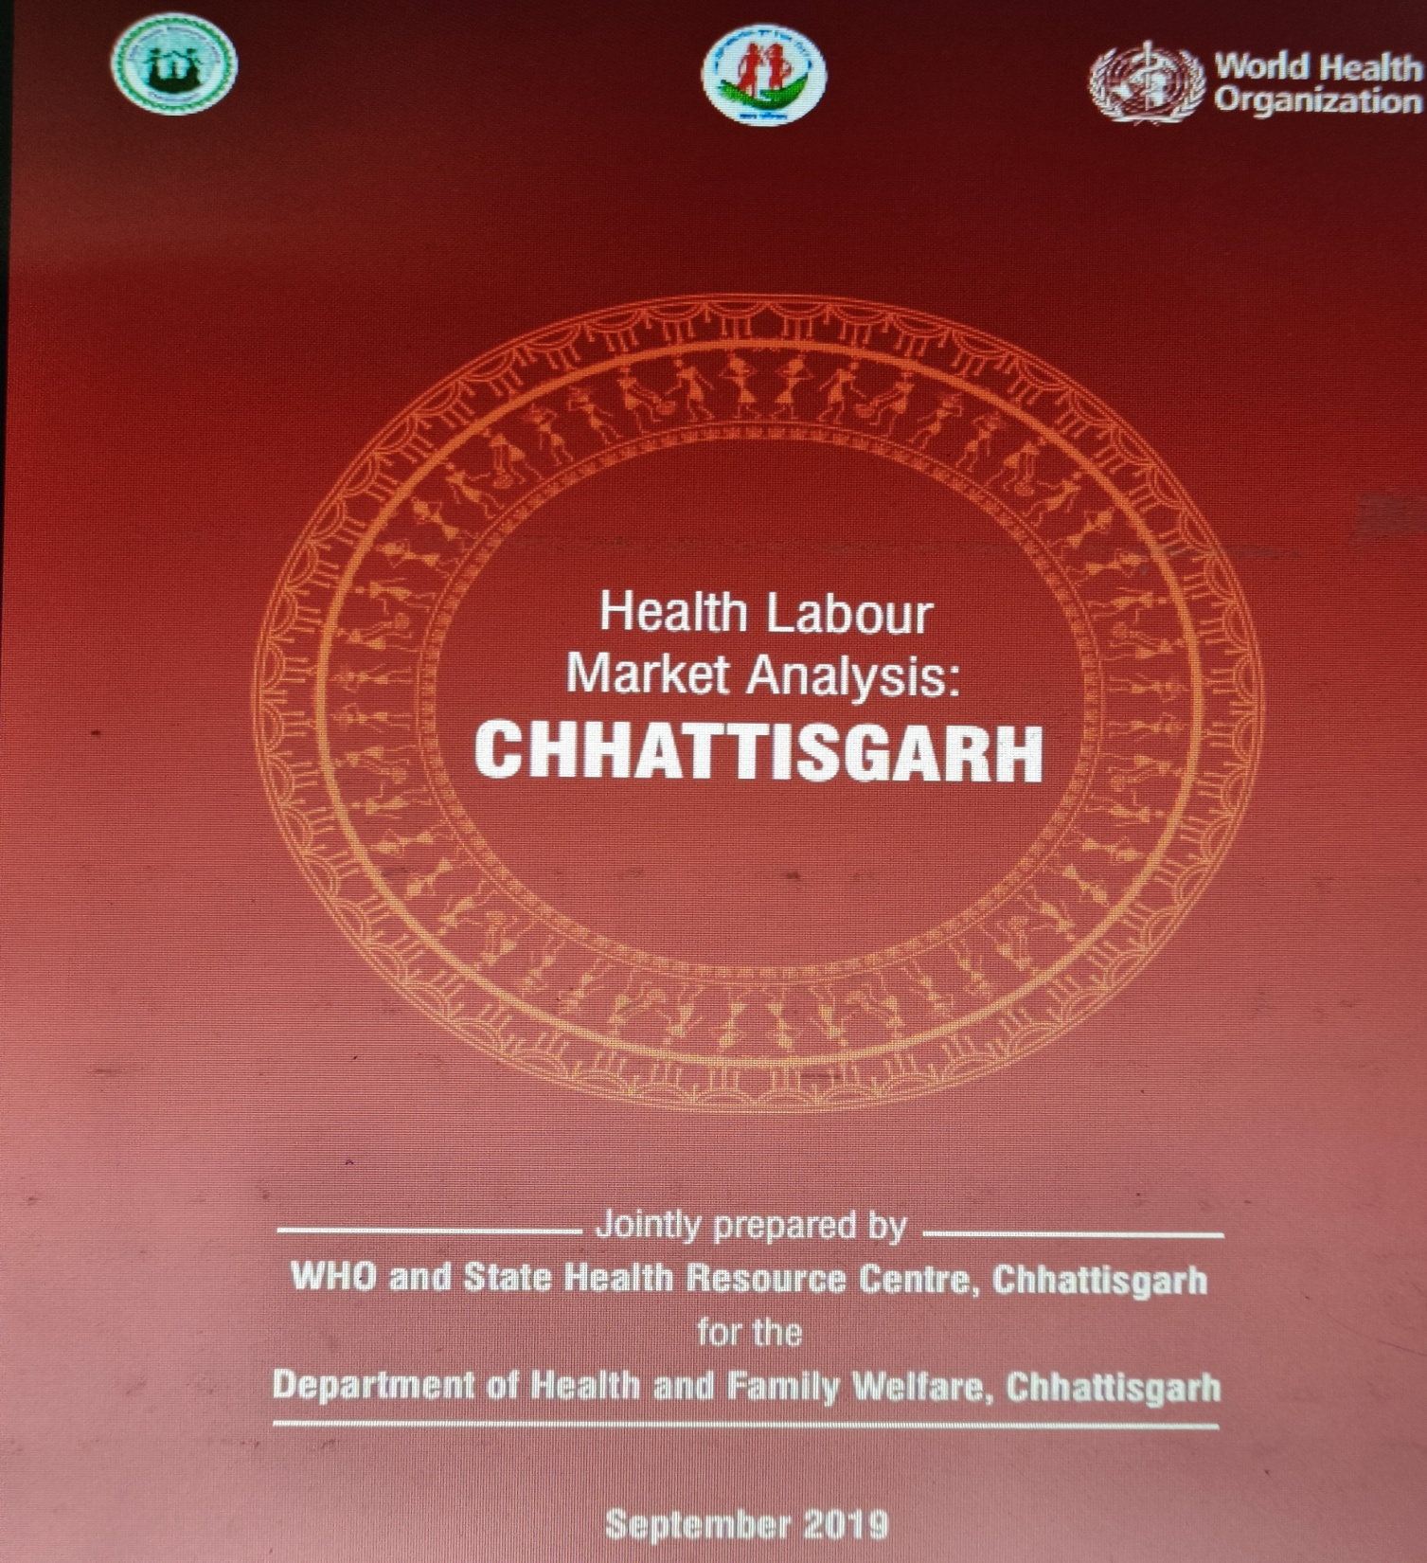

Slide 23
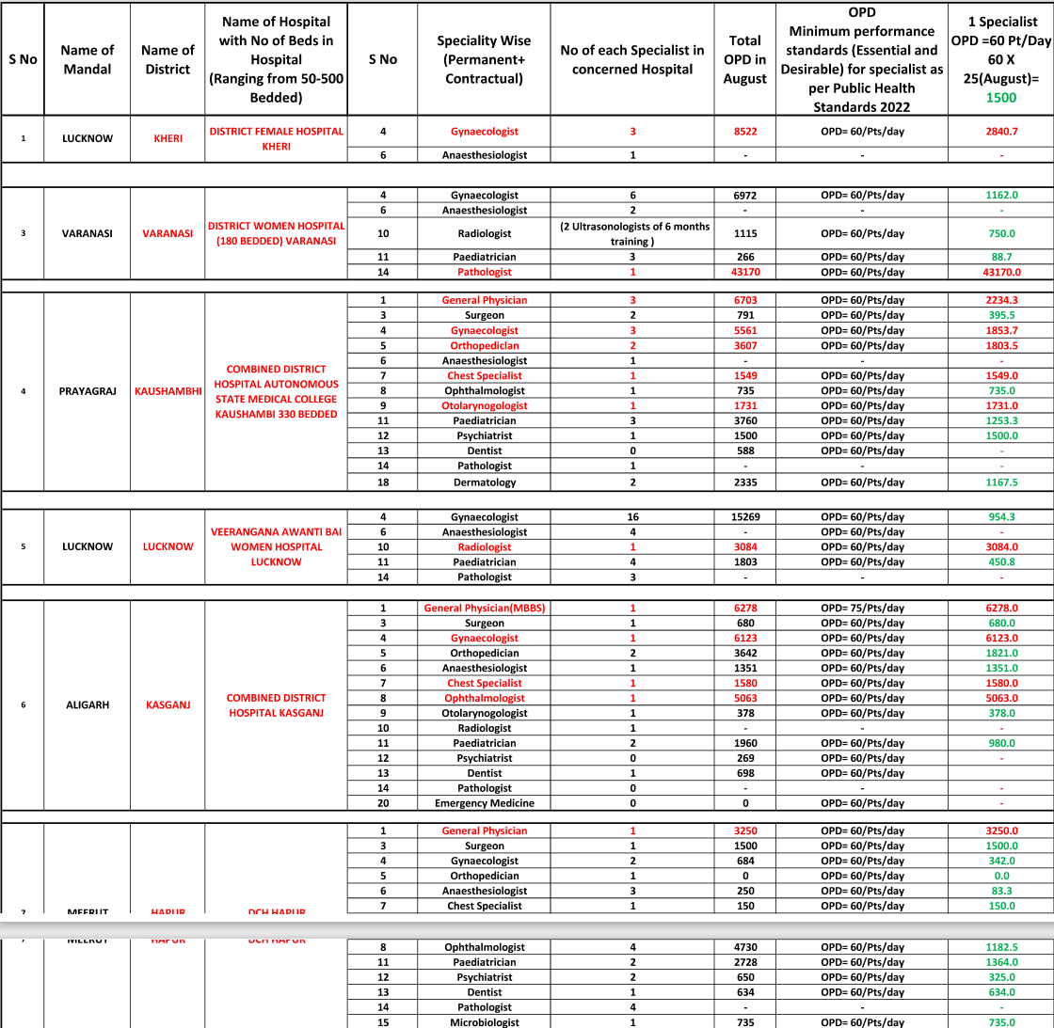
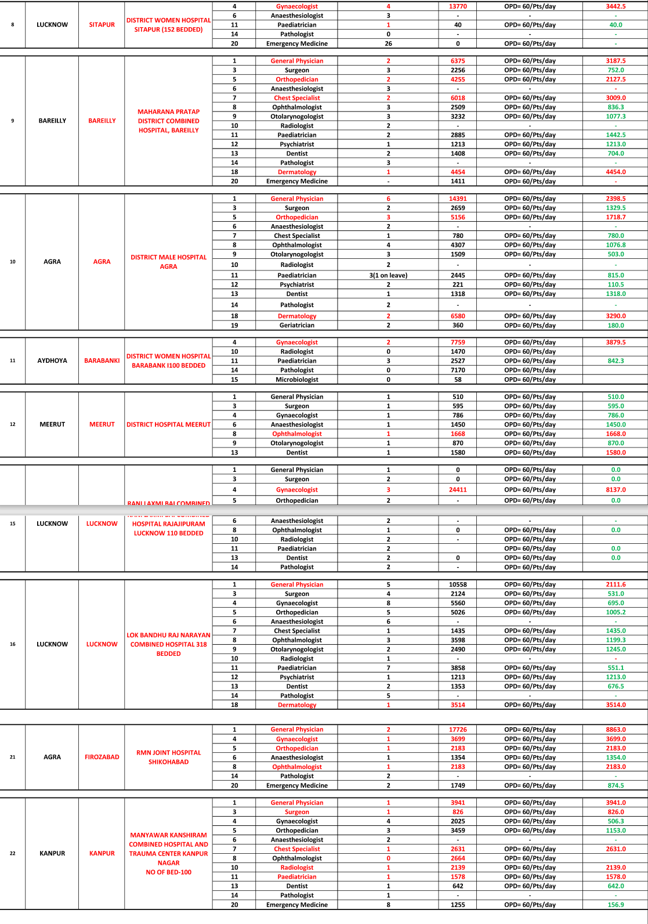
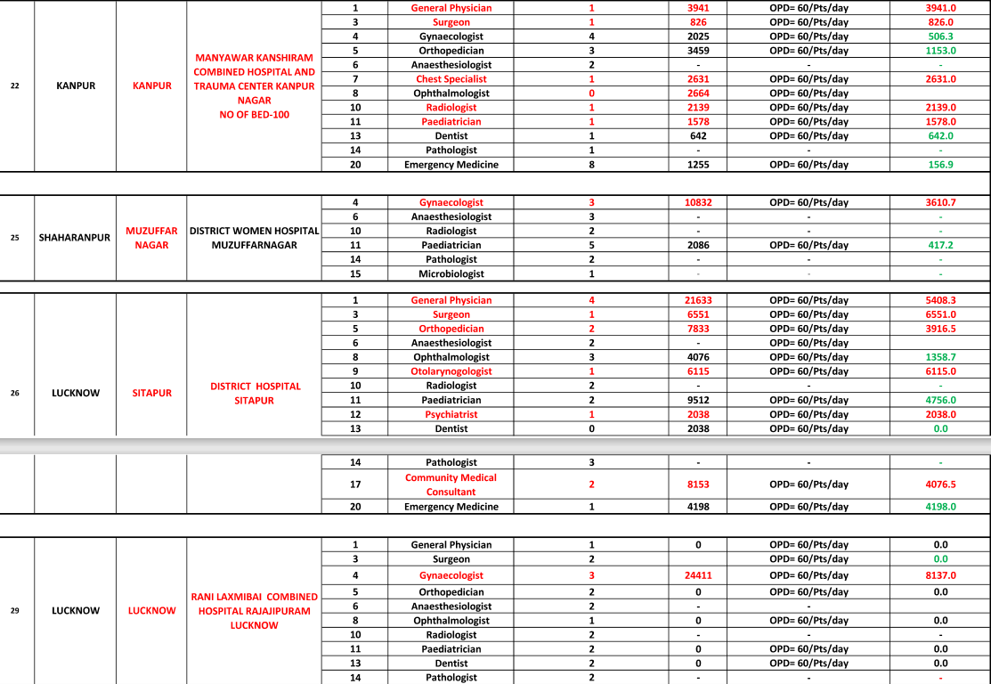

Slide 24
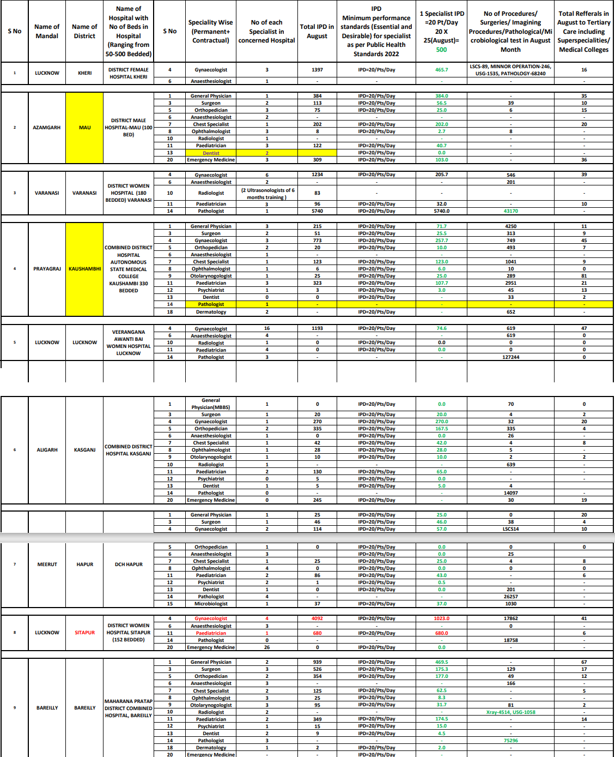
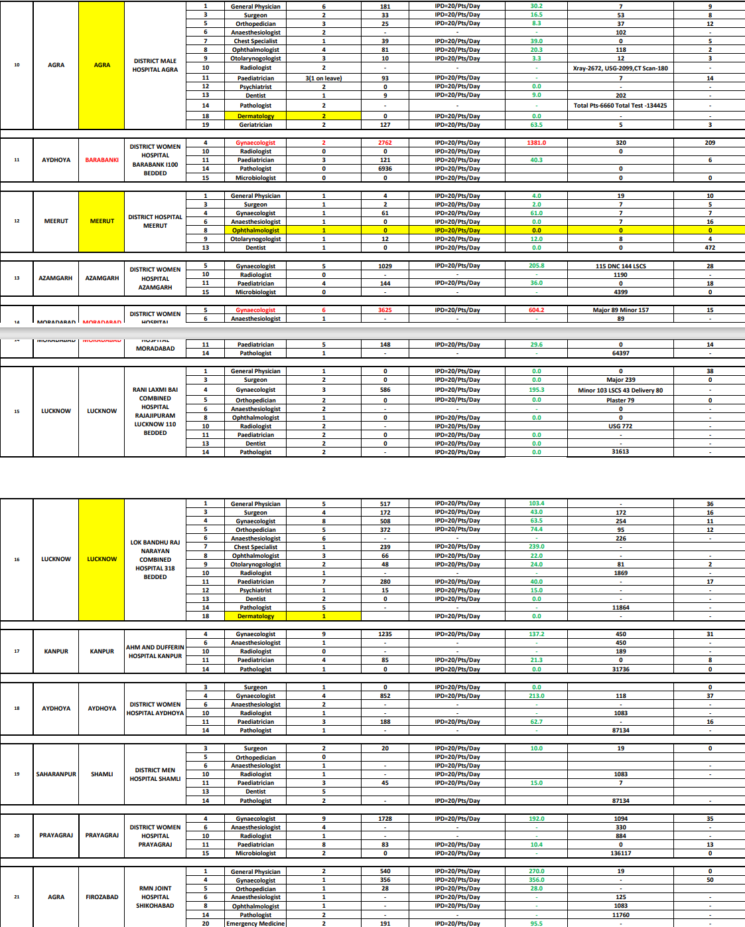
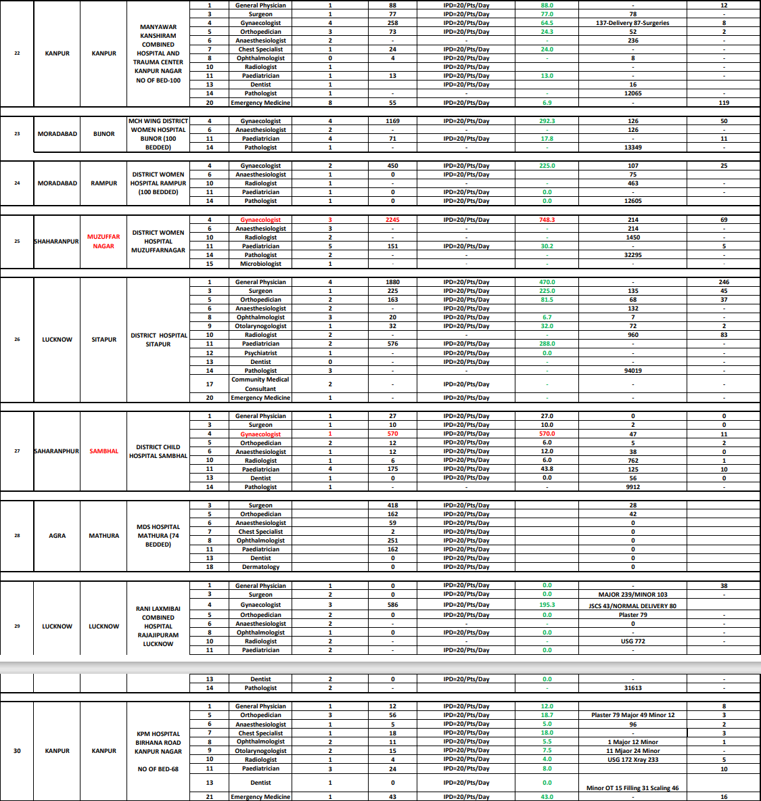

Slide 25
Total
Working
Specialist
Doctors at
District level at
50-200 bedded
Male/ Female/
Combined / DH/
MCH wing Hospitals of UP
SN | Name of speciality in DH and 50 bedded and above Hospitals | Total regular working
1 | Anaesthesia | 225
2 | cardiologist | 19
3 | Dermatologist | 52
4 | ENT | 101
5 | Forensic medicine | 9
6 | General Medicine + Family Med(2)+sports Med(1) | 184
7 | General Surgery | 170
8 | Gynae and Obs | 235
9 | Ophthalmology | 197
10 | Ortho paedics | 218
11 | Paediatrics | 315
12 | Pathologists | 58
13 | Microbiologist | 11
14 | Psychiatry | 29
15 | Radiodiagnosis | 106
16 | TB and Chest | 60
 | Total basic specialities Including 15 in RFHW training | 1989
17 | Urosurgery Superspeciality | 1
18 | CTVS Superspeciality | 2
19 | Immunology Superspeciality | 1
20 | Neurology Superspeciality | 1
21 | Neurosurgery Superspeciality | 2
22 | Pediatric surgery Superspeciality | 1
23 | Radiotherapy | 4
24 | DNB (subjects unknown) | 11
25 | Pharmacology | 6
26 | Physiology | 4
27 | SPM | 9
Total of 1974 regular specialists doing essential services in hospitals
CURRENT STATUS
Data as per manav sampada portal . September 2023

Slide 26
Total all hospitals UP specialist as in manav sampda march 2024
Row Labels Count of eHrms Code Cardio-Thoracic Surgery 2 Anatomy 4 Anesthesia 409 Cardiology 17 CLINICAL PATHOLOGY 90 Community Medicine 51 D.N.B. 29 Dermatology 24 DIPLOMA IN MEDICINE AND RADIA. THERAPY 35 E.N.T or Oto-Rhino-Laryngology 77 ENT 25 Family Medicine 7 Forensic Medicine 19 General Medicine 290 General Surgery 317 Genito-Urinary Surgery 1 Geriatric Medicine 2 Gyancology & Obstratics 120 Immuno Haematology and Blood Transfusion 4 Internal Medicine 1 Medicine 12 Microbiology 20 Neuro Surgery 2 Neurology 1 Obs & Gyn 9 OBS & GYNAECOLOGY 343 Ophthalmology 126 OPTHALMOLOGY 216 Orthopaedics 107 ORTHOPAEDICS 226 Otorhinolaryngology 28 Paediatric Surgery 3 PAEDIATRICS 689 Pathology 121 Pediatrics 1 Pharmacology 26 Physiology 17 Plastic Surgery 1 Psychiatric 3 PSYCHIATRIC MEDICINE 6 Psychiatry 39 PUBLIC HEALTH 43 Pulmonary Medicine 6 Radio - Diagnosis 7 Radio - Therapy 10 RADIO-DIAGNOSIS 102 Rhematology 2 Sports Medicine 1 Surgery 3 Surgical Oncology 1 TB & CHEST DISEASES 59 Tuberculosis & Chest Diseases 48 Vascular Surgery 1 Venereology 2 VENEROLOGY AND DERMATOLOGY 45 (blank) Grand Total 3850

Slide 27
Job in a Govt Medical College | Govt Job in PMS
Promotion at 4,8 & 12 (Jr Prof) level 4 Promotions are fairly regular (And where Tikku commission applicable salaries are much more) | Promotion at 6, 11 and 17 years ( with cooling period of 6 and 7 years at both stages). Sufficient salaries in comparison to private sector start only at Level 4
At least District level posting. Children education is better at district level | Many hospitals (100beded) at block village level, affecting lifestyle and children education
Advantage of vacations , help from Jrs in clinical work, Fellowships/ regular CMEs, foreign education upto 2yrs, Journal funds/research operation funds available. | Advantage of Jrs and avenues of cme and further capacity building lacking. Foreign education not available Observer fellowship not available
Leave for conference available | Freedom of leave and tours even for speciality associated conference not available.
Structurally and equipment wise better equipped than PMHS hospitals hence better job satisfaction | Lack of equipment Investigation and drugs does not offer attraction for medical practice
Doing only specialty and teaching work | Doing non specialty work in addition also in PMHS is considered top priority. Postmortem VIP/ Mela duties and court evidences as medico legal /postmortem work is done by PMS drs even in medical college run PM houses
Even in Govt job, Medical Colleges are better option in terms of salary, promotion, practice and job descriptions

