Slide 1
"Promoting Exclusive Breastfeeding in Neonates: Challenges and Solutions"
Dr Jaya Dehalvi
Dr Vivek Srivastava
Dr Swatantra Prakash Singh
Dr Krishna Kumar Verma
Dr Roopam Saroj

Slide 2
KEY POINTS
1- NFHS-5 showed very low coverage of early initiations and exclusive breastfeeding you can compare UP and India 2- Pre-counselling session for PW during ANC 3- Birth campaign should counsel on BF 4- Exclusive BF counselor in PNC ward 5- Encourage BF in labour room to tackle early initiations of BF 6- Encourage and capacity building of MO and staff nurse on BF (After C-section ) 7- IEC in Hindi and Urdu language 8- IPC on BF with each beneficiaries during stay in PNC ward 9- PW issue and doubt should be addressed related to BF 10- Missed opportunity during Night delivery

Slide 3
PARAMETERS | IDEAL STATE | CHALLENGES
Well-Trained Healthcare Professionals | Healthcare providers well-trained in lactation support. | Inadequate training of healthcare staff in breastfeeding assistance and support
Supportive Healthcare Facilities | comfortable spaces and supportive policies for breastfeeding. | lacking designated lactation rooms and breastfeeding-friendly environments.
Post-Discharge Support | Ongoing support provided to mothers after discharge. | Limited follow-up and support after leaving the hospital
Comprehensive Education and Awareness | Accurate and comprehensive information about breastfeeding benefits widely available. | Lack of consistent and comprehensive education, leading to misconceptions and mixed messaging.

Slide 6
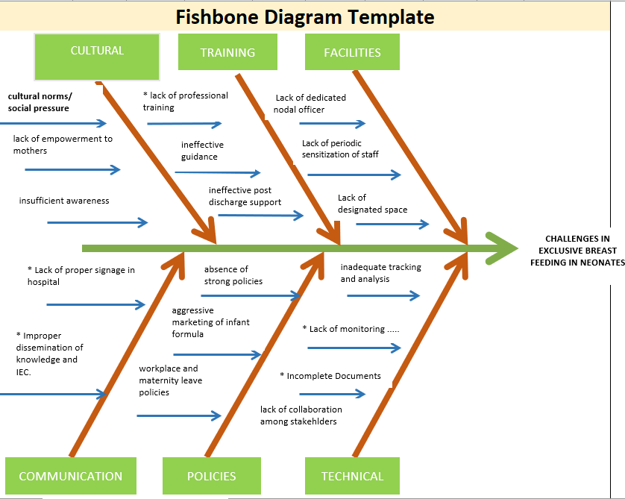

Slide 7
Solutions
Concept of Panna Maa
Follow up Appointments, Hotlines, virtual consultation, helpline number . CHO can be utilized for itRegular sensitization of doctors, staff , paramedical, regarding benefits and techniques of breast feeding
Branding of facilities: Signages/ proper display inside the hospital using audiovisual aids about the BB and EB
Strengthen or incorporate monthly review mechanism at DHS
Capacity building of Medical officer/Staff nurse and Field level worker (ANM) and Private practitioners
Collaboration with others Stake holders .i.e IAP and Federation of Obstetric and Gynecological societies
Strengthen of monthly data validation at block and district
Periodic IEC activities
Monthly /Weekly awareness campaigns at facility and community level
Family participants through comprehensive education during post natal ward
ACMO-RCH is over burden need to assigning Nodal officer at hospital
Survey for Reasons for not initiating early breastfeeding and exclusive breastfeeding
Reduction in Marketing of Infant Formula

