Slide 1




CURBING IRRATIONAL USE OF MEDICAL ABORTION DRUGS TO REDUCE INCIDENCE OF OBSTETRIC HAEMORRHAGE
DR. TABASSUM KHAN
DR. SANDEEP KR. SINGH
DR. SANJIV PRABHAKAR
DR. RISHI SAHAI
DR. RAM KISHORE
DR. NISHI KANT GUPTA

Slide 2
Your Title Here
IDENTIFYING AND UNDERSTANDING PROBLEM
MMR -97/LAC LIVE BIRTH.
UNSAFE ABORTION IS THIRD MOST IMPORTANT CAUSE OF HIGH MMR.
UP TO 20% MATERNAL DEATHS ARE ATTRIBUTABLE TO UNSAFE ABORTION.
IRRATIONAL USE OF MEDICAL ABORTION DRUGS IS AN EMERGING CAUSE OF UNSAFE ABORTIONS.
UNSAFE ABORTIONS ARE PREVENTABLE.
Your Subtitle Here

Slide 3
Your Title Here
DEFINING THE IDEAL STATE
FOR MEDICAL ABORTION GOI FORMULATED GUIDELINE IN HANDBOOK OF MMA
MEDICAL ABORTION CAN BE PRESCRIBED BY CERTIFIED MEDICAL PRACTIONER WITH BACKUP FACILITIES IN CASE OF FAILED/INCOMPLETE ABORTION
Your Subtitle Here

Slide 4
Your Title Here
GAP ANALYSIS
SELF ADMINISTRATION OF THESE DRUGS BY PREGNANT WOMEN IS A COMMON PRACTICE. THEY TAKE PILLS ON THEIR OWN WITHOUT PRESCRIPTION AND MANY ARE ADMITTED TO HOSPITAL WITH LIFE THREATENING COMPLICATIONS.
IN MAJOR CITIES SALE OF ABORTIFACIEANT DRUGS WITHOUT PRESCRIPTION IS UPTO 47% …IN RURAL AREAS IT MAY BE UPTO 80%
TO ACHIEVE MMR 70/LAC LIVE BIRTH THIS PRACTICE NEEDS INTERVENTION
CURBING THE IRRATIONAL USE OF ABORTIFACIENT DRUGS WILL CONTRIBUTE SIGNIFICANTLY TO REDUCE MMR
Your Subtitle Here

Slide 5
Your Title Here
WHY DOES THE GAP EXISTS ?????
OVER THE COUNTER AVAILABILITY OF ABORTIFACIENT DRUGS
LAW PREVAILS BUT NOT EFFECTIVELY IMPLEMENTED
LACK OF KNOWLEDGE OF END USERS AND SERVICE PROVIDERS
EASY TO CONSUME
EASE TO TERMINATE PREGNANCY WITHOUT SOMEONES KNOWLEDGE
HUGE PROFIT OF RETAILERS
QUACKARY
INSUFFICENT AVAILABILITY OF SPECIALIST
INADEQUATE TRAINING/CAPACITY BUILDING
IMPROPER FUNCTIONING OF DISTRICT LEVEL COMMITEE
Your Subtitle Here

Slide 6
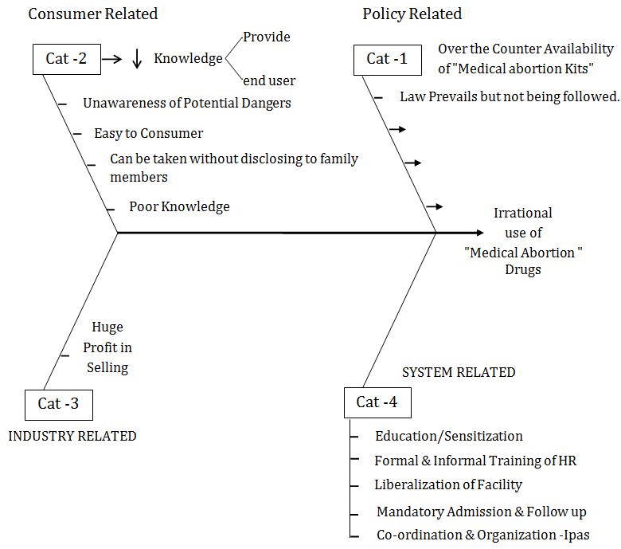
Your Title Here
Step -4 - Why does gap Exist
"Root Cause"
Your Subtitle Here

Slide 7

SUGGESTIONS
DISSEMINATION OF INFORMATION AMONGST ALL CONCERNED
CAPACITY BUILDING OF SERVICE PROVIDERS
AMMENDMENT IN MTP ACT ..IF POSSIBLE
STRICT CONTROL ON OVER THE COUNTER SALE OF ABORTIFACIEANT
INTRODUCING APPROPRIATE SEX EDUCATION PROGRAMME AT 10+2 LEVEL
ENSURING FUNCTIONALITY OF DISTRICT LEVEL COMMITTEE
ENGAGEMENT OF NGO AT ALL POSSIBLE LEVELS OF INTERVENTION
PARENTING COUNSELLING AT VILLAGE LEVEL OF GIRLS OF VULNERABLE AGE GROUP
ENFORCEMENT OF LAW PERTAINING TO SALE OF ALCOHOL TO MINOR

Slide 8

EXPECTED OUTCOME
DECREASE MMR
DECREASE IN HOSPITAL EMERGENCY ADMISSIONS
DECREASED NEED OF BLOOD TRANSFUSIONS
DECREASED INCIDENCE OF CONGENITAL BIRTH DEFECTS
DECREASED INCIDENCE OF PRE TERM BIRTHS
DECREASED NEONATAL MORTALITY

Slide 9
WHAT WE DID
AWARENESS AMONG SERVICE PROVIDERS,BENEFICIARIES AND SOCIAL WORKERS / NGO.
COUNSELLING OF CLIENTS.
CAFETERIA APPROACH FOR ABORTION SERVICES.
EXPLAINING POTENTIAL DANGERS OF SELF MEDICATION FOR ABORTION

Slide 10
ACHIEVMENTS @DWH JLN
MONTH | TOTAL ABORTION | SELF DRUG | DOCTOR ADVISED | NATURAL
JUNE-JULY’23 | 108 | 104 | 03 | 01
JULY-AUG’23 | 84 | 78 | 04 | 02
AUG-SEPT’23 | 65 | 51 | 12 | 02
SEPT-OCT’23 | 71 | 61 | 09 | 01
OCT-NOV’23 | 43 | 30 | 13 | 00
NOV-DEC’23 | 77 | 45 | 26 | 06
DEC-JAN’24 | 60 | 44 | 13 | 03
JAN-FEB’24 | 69 | 59 | 09 | 01

Slide 11
CONCLUSION
SIGNIFICANT REDUCTION IN SELF INDUCED ABORTIONS.
AWARENESS OF ALL CONCERNED IS THE KEY.
CHANGE IN BEHAVIOR OF CLIENTS OBSERVED.
SUSTAINING THE BEHAVIORAL CHANGES IS A CHALLENGE.
COUNSELLERS CAN PLAY LEAD ROLE.

Slide 12
FISH BONE-SELF MEDICATION
POLICY
MMA RULES LIBERALISATION
MTP ACT AMMENDED ACCORDINGLY
PROVIDERS
AWARENESS & ORIENTATION
TRAINING/ WORKSHOP
PATIENT
DANGERS OF SELF MEDICATIN
COUNSELLING

