Slide 1



Golden Hour Of Life
BUILDING
Resilience for
a SAFER
Tomorrow
Let’s begin…
CONFIDENTIAL AND PROPRIETARY
Any use of this material without specific permission of Medanta Holdings Pvt. Ltd. is strictly prohibited

Slide 2
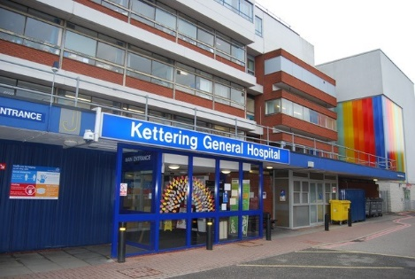

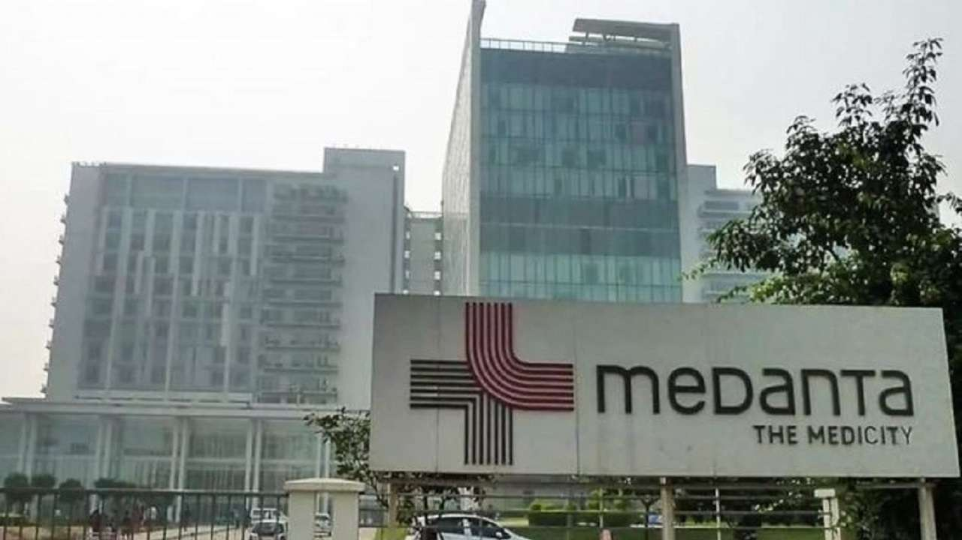
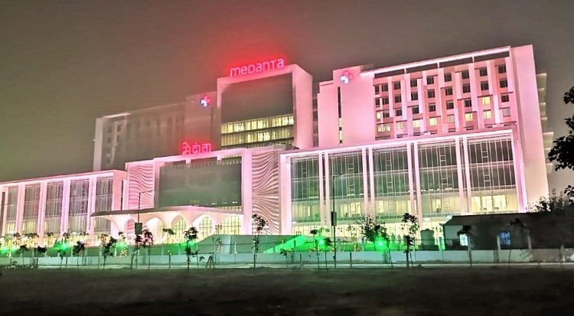
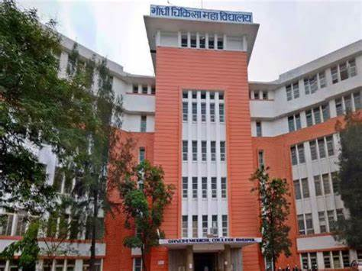

Slide 3
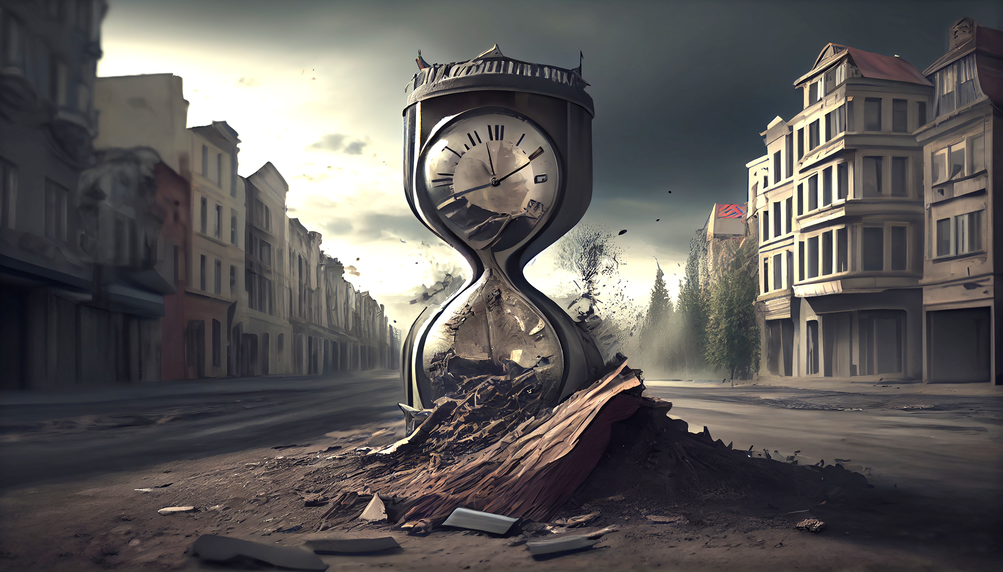

GOLDEN HOUR
The Critical time between life and death
The "Golden Hour" in emergency management refers to the critical first hour following a traumatic injury or medical emergency.
During this time frame, prompt and effective medical intervention can significantly impact a person's chances of survival and long-term recovery.

Slide 4

Here are the key reasons why the “GOLDEN HOUR”
is crucial in emergency management
Lifesaving Interventions
Reduced Complications
Improved Outcome
Preventing Shock
Effective Pain Management
Preservation of Vital Organs
Minimizing Disability
Enhanced Response Coordination
Optimal Resource Allocation
Community Preparedness

Slide 5
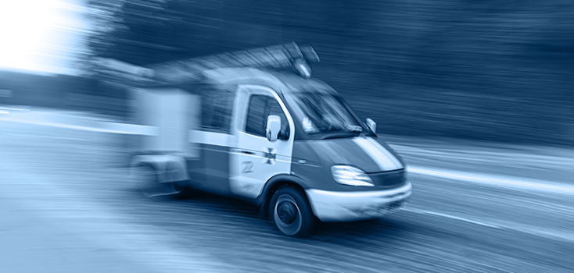
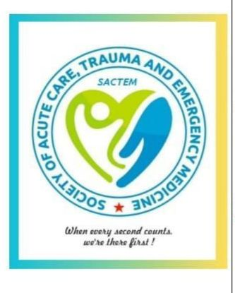
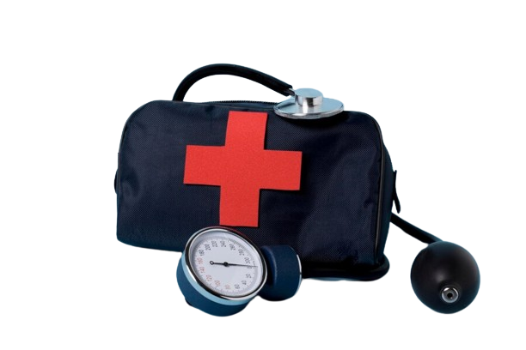
Fast response time is VITAL in an emergency
92%
% of People found alive
47%
25%
0 – 1 hr
1 – 3 hrs
3 – 6 hrs
Time Spent Incapacitated

Slide 6
Need of an hour
First 10 minutes there are high chances of survival using hand only CPR followed with DC shock . Cardiac arrest revival need to be done in 4 mins and angioplasty in 90 mins
RTA patient vital needs to be stabilise in 1 hour
In Stroke cases CT head-25 mins, rTPA-60 mins
Sepsis- C/S and BSA in 60 mins of arrival in ED
In Snake bite- ASV as soon as possible
Methyl alcohol poisoning- Assessment and ABG as soon as possible Management within one hour

Slide 7
Initial Approach to a patient in Emergency
Primary Survey (ABCDE): First 5 Minutes
Airway, Breathing, Circulation, Disability and Exposure
Secondary Survey:
First 15 minutes of patient encounter
  More in-depth history
  Complaint-specific physical exam
Include bedside ultrasound assessment here. Other time-sensitive interventions Chest drain, anti- seizure medications, etc.
Both the primary and secondary survey should be completed in less than 20
minutes, correcting problems along the way. Providers do not move on to the secondary survey until problems with the primary survey have been addressed.

Slide 8
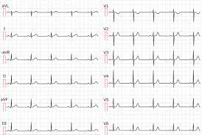
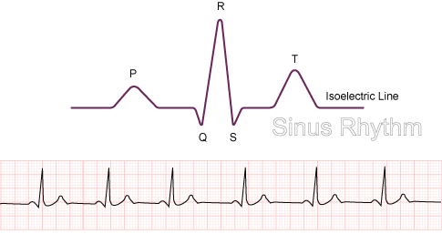
?
FAMILIAR

Slide 9
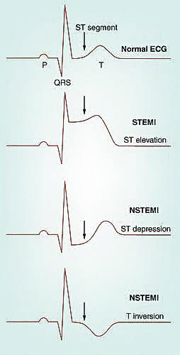

Slide 10
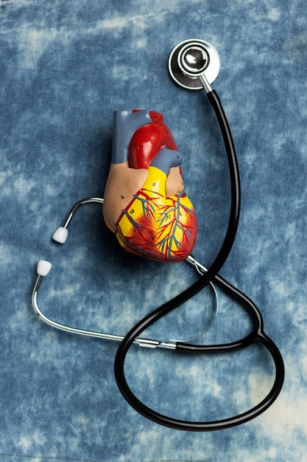
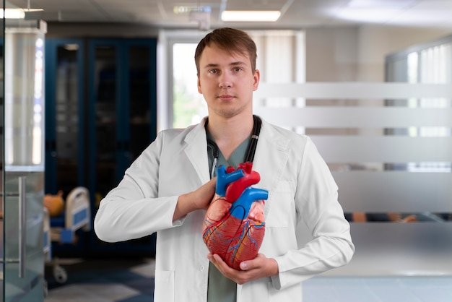
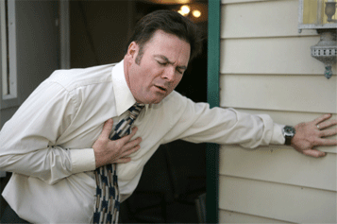
CARDIOVASCULAR EMERGENCIES
Cardiac Arrest
Pulseless VT / VF
Asystole /PEA
Myocardial Infarction
ST elevation MI / Non ST / Unstable Angina
Arrhythmia
Tachycardia and
Bradycardia

Slide 11
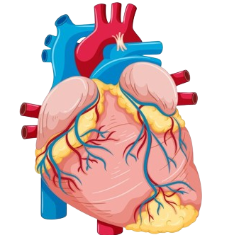
How to Diagnose a Heart attack?
Chest Pain
Not Relieved with Rest
Worsens with exertion
Pressure Tightness
Palpitations
Doesn’t change with body position
Radiation to Left arm and Jaw

Slide 12
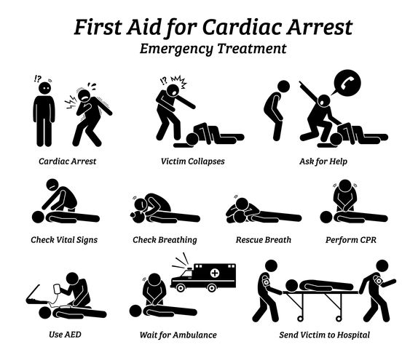
WHAT TO DO PRIMARILY?
Calm the
Patient Down
Call for Help(Nearest Health Facility/ Ambulance)
Administer Aspirin(325 mg), an aspirin tablet can lower the risk of clot formation.
Treatment within the first 90 minutes of a heart attack dramatically increases the chances of survival. Before the person reaches a hospital
Monitor the Patient for signs of Distress and avoid panic as it affects patient Outcome

Slide 13
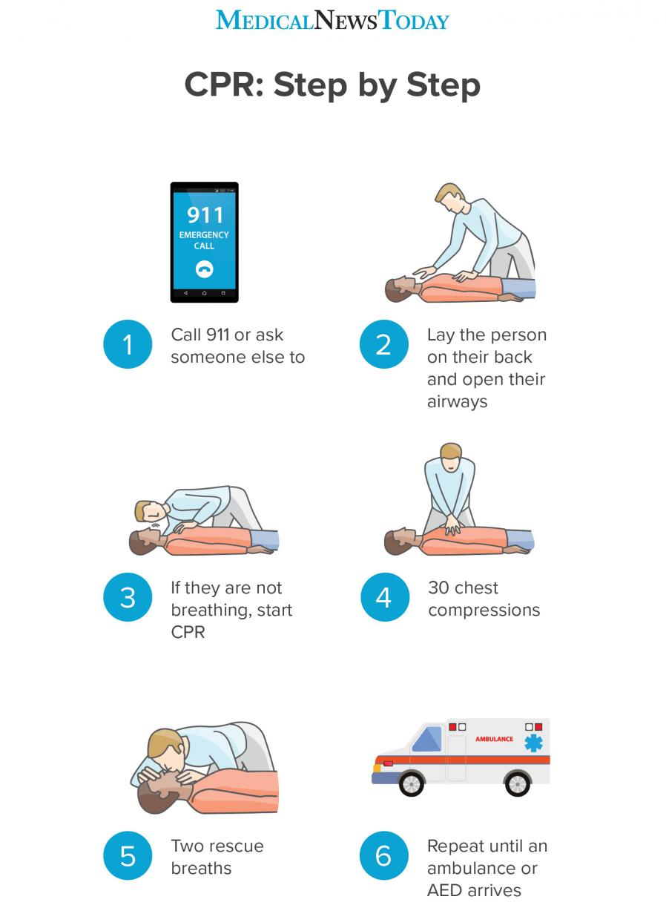
CHAIN OF SURVIVAL
Early access to care- Know the signs
Early CPR (cardiopulmonary resuscitation), “quality chest compressions”
Rapid defibrillation.
Effective paramedics.
Admission and Follow up care.
Call 108 or ask someone else to
Lay the person on their back and one their airways
If they are not breathing, start CPR
30 Chest Compressions
Two rescue breaths
Repeat Until an ambulance or AED arrives

Slide 14
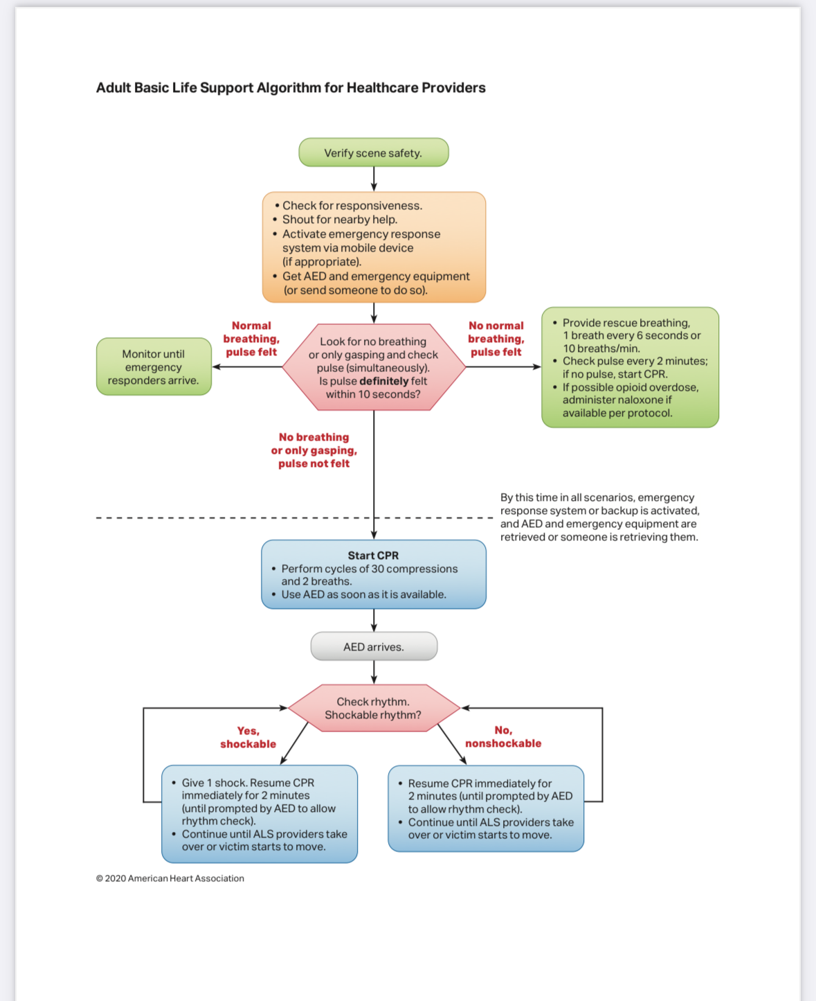
BLS

Slide 15
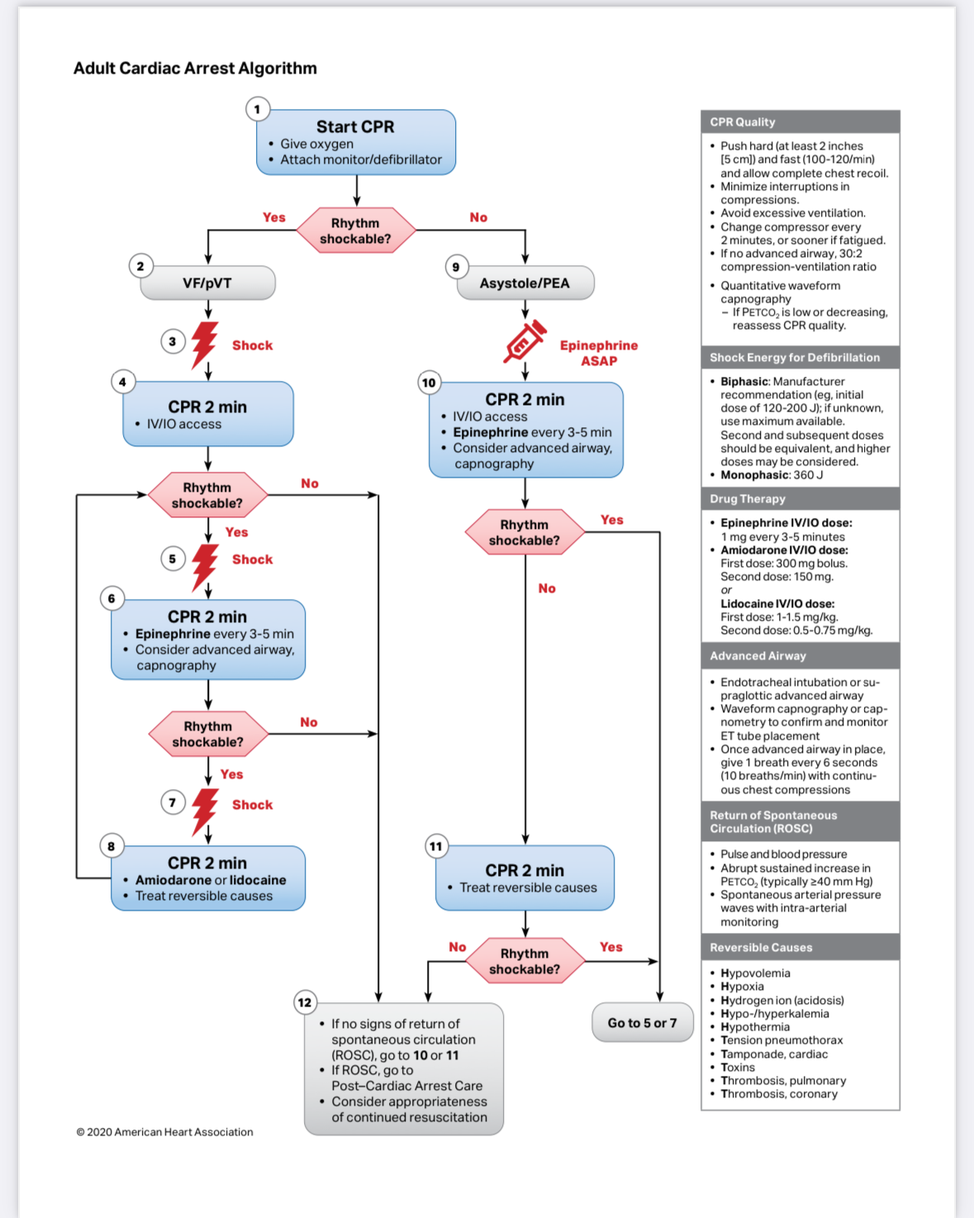
ACLS

Slide 16
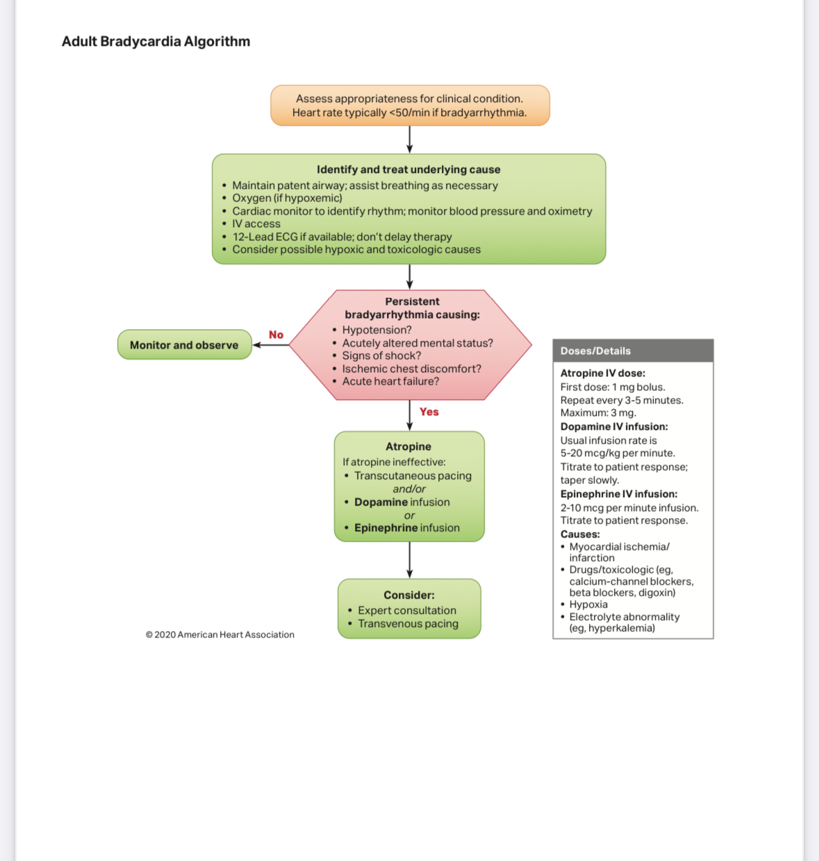
Bradycardia

Slide 17
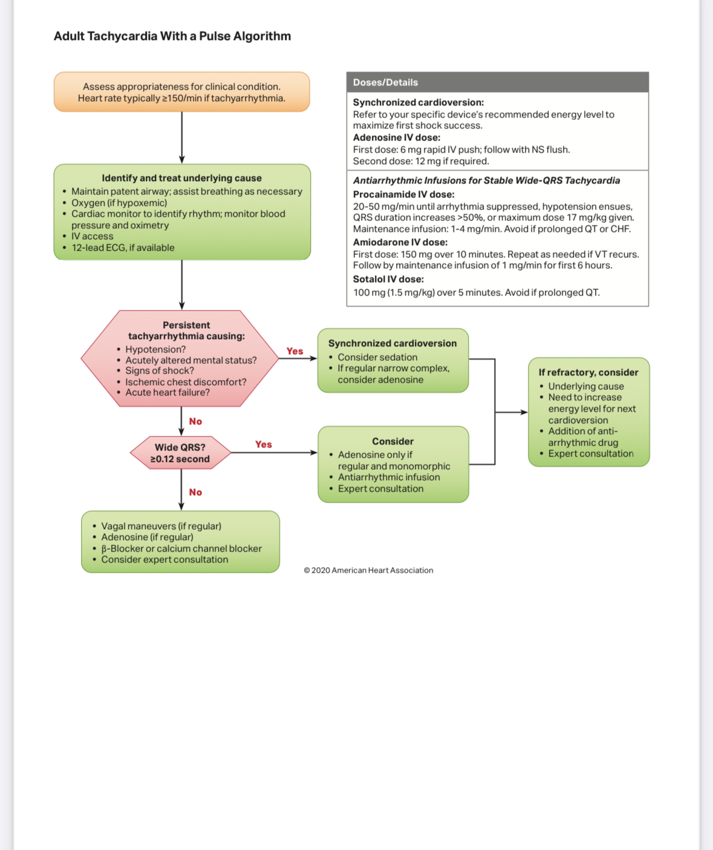
Tachycardia

Slide 18
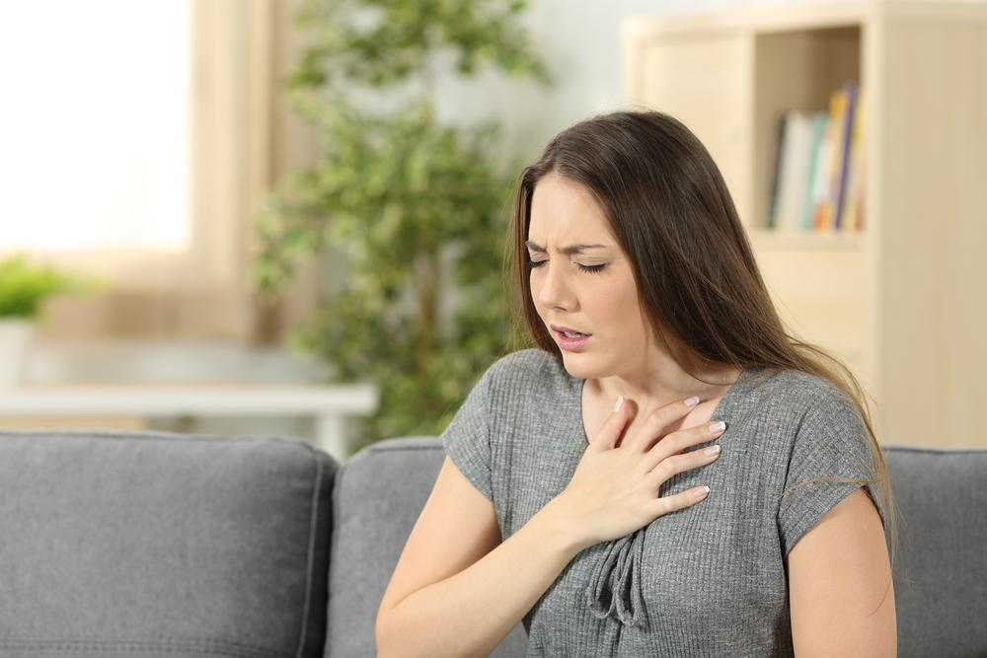
RESPIRATORY EMERGENCIES
- Respiratory Failure
- Asthma/COPD
Pneumothorax
Pneumonia

Slide 19
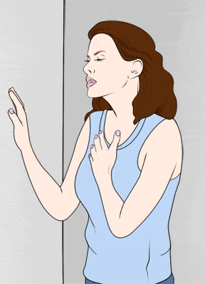
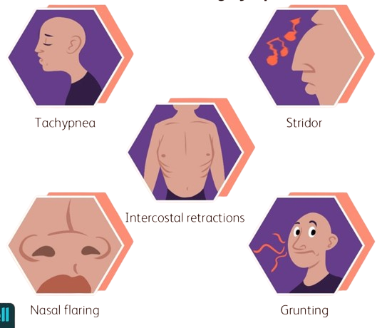
LABORED BREATHING SYMPTOMS

Slide 20
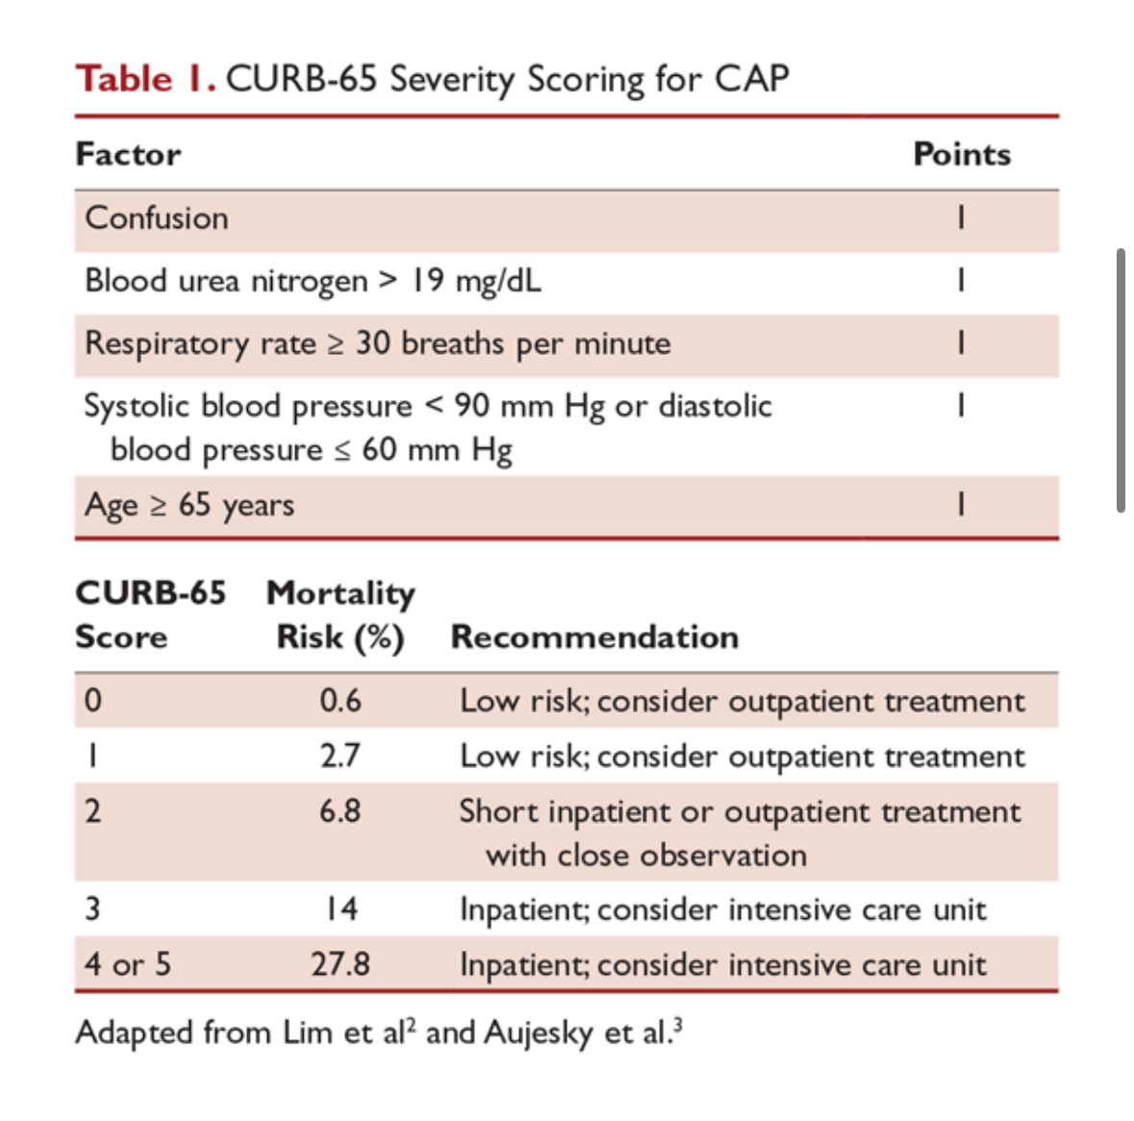
Pneumonia

Slide 21
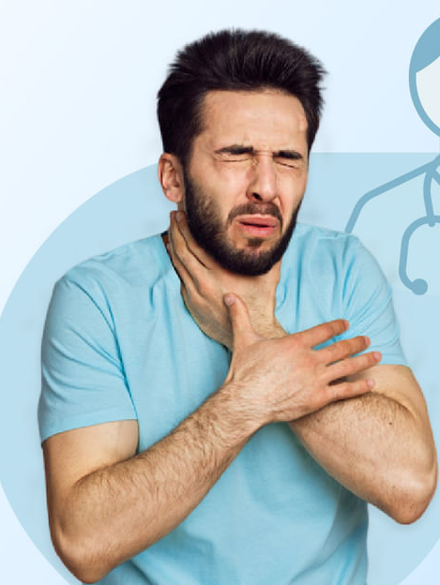
CHOKING FOREIGN BODY
Recognizing Foreign Body Insertions
    Pain, discomfort, or sudden choking.
    Visible foreign object or obstruction in a body cavity.
Stay Calm
Step 1 : Assess the Situation
Step 2 : Encourage Coughing (For Partial Obstruction)
Step 3 : Perform Abdominal Thrusts (For Severe Choking)(Adults)
                The Heimlich maneuver
Step 4 : Call for Help
Step 5 : Assist an Unconscious Person
Do NOT:
            Using fingers to blindly remove an object, which can push it further.
    Slapping the person's back for choking.
Step 6 : Stay with the Person.

Slide 22
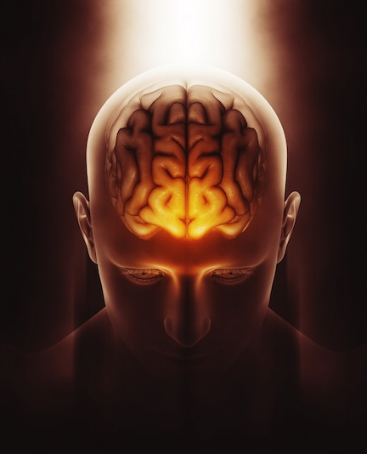
Stroke
Head Injury
NEUROLOGICAL EMERGENCIES
Coma
Seizures
Syncope

Slide 23
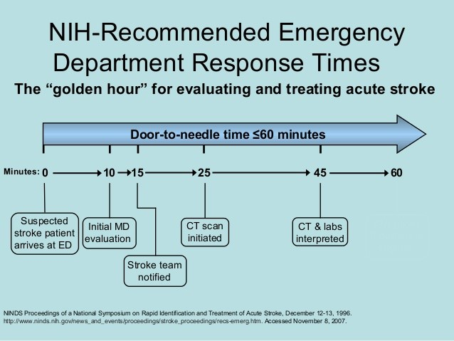

Slide 24
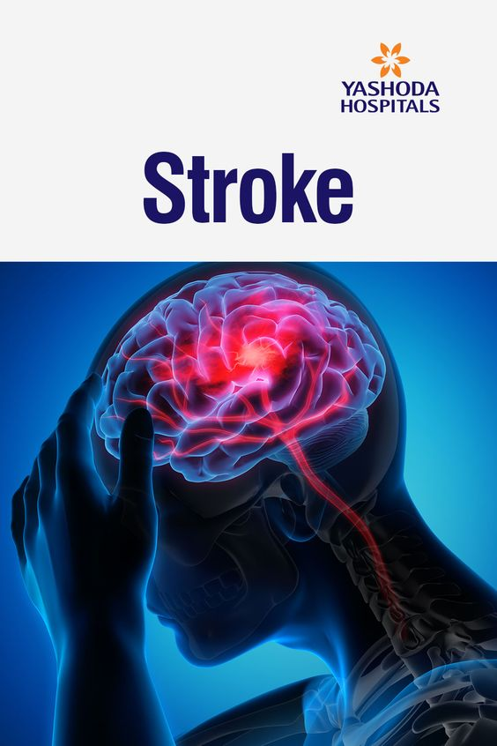
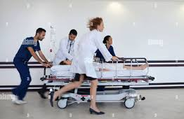
Stroke
Damage to the brain from interruption of its blood supply
What to do?
Get to the Hospital ASAP
Early treatment with medication like tPA (clot buster) can minimize brain damage. Other treatments focus on limiting complications and preventing additional strokes.

Slide 25
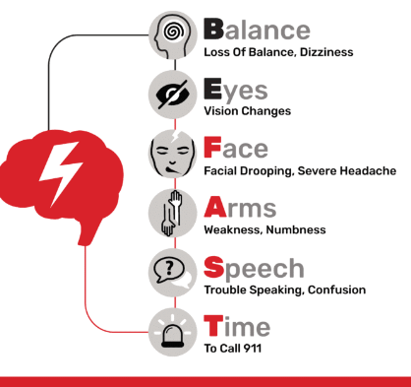
WHEN IT COMES TO STROKE
B
E
F
A
S
T
Any one of these SIGNS
could mean a STROKE

Slide 26
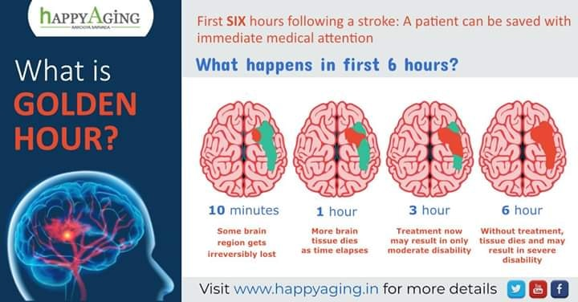
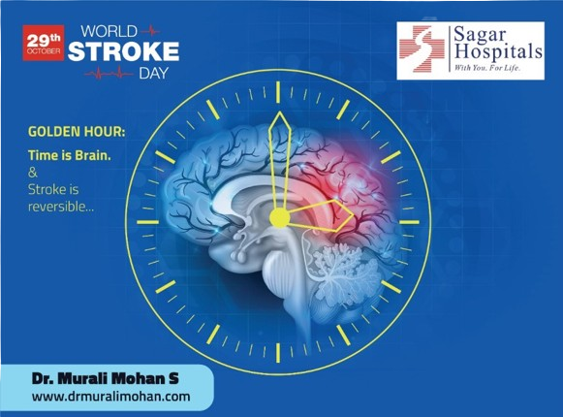
STROKE!
10 Minutes
Some brain regions (red) already are irreversibly lost.
1 Hour
More time elapses, more brain tissue dies. Urgent treatment could still limit the disability.
3 Hours
The window is closing. Treatment at this time may result in moderate disability.
Golden Hours
6 Hours
Without treatment, all at-risk tissue has died; the unfortunate result may be severe disability.

Slide 27
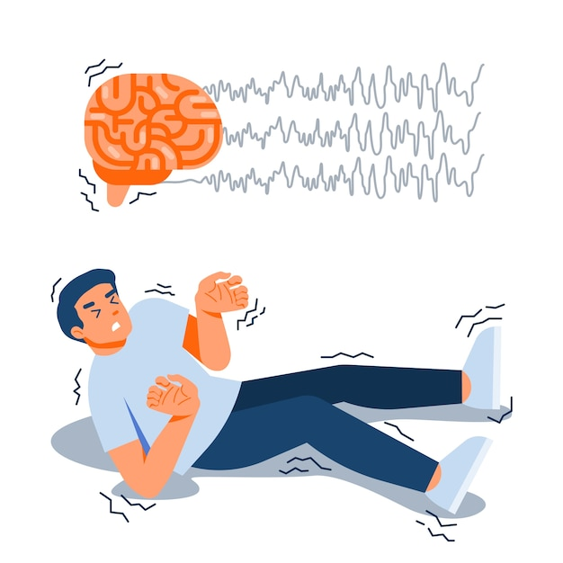
SEIZURE
CAUSE
Epilepsy, Photosensitivity, Drug Reaction or Overuse, Metabolic Disturbances, Infection, Brain tumor.
RECOGNISE THE SIGNS
Uncontrolled shaking or convulsions.
Loss of consciousness.
Drooling or foaming at the mouth.
Stiffening of limbs.
MANAGEMENT
Safety first - Remove Dangerous Instruments, Reassure and Keep Calm.
Protect the Head(Soft Clothing beneath the head).
Loosen Tight clothing.
Turn to the side(Recovery Position). Why?
Do not restrict movement.

Slide 28
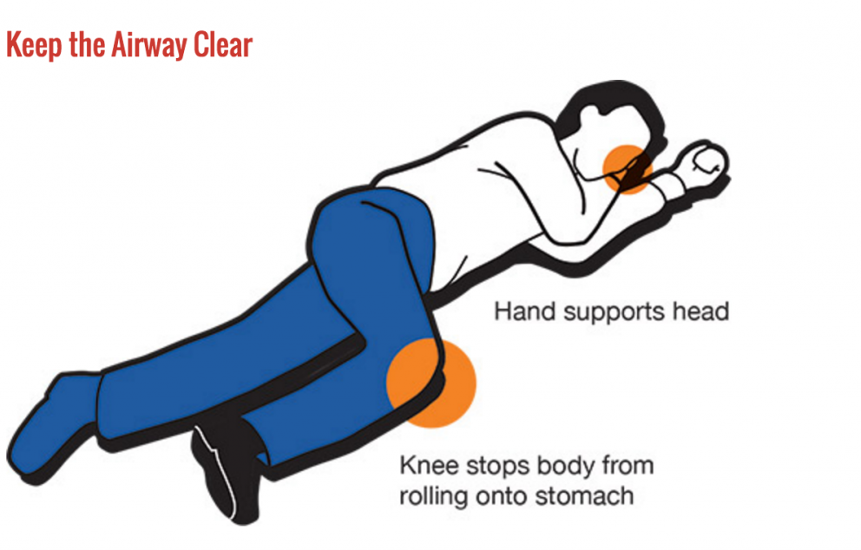
SEIZURE – THE RECOVERY POSITION

Slide 29
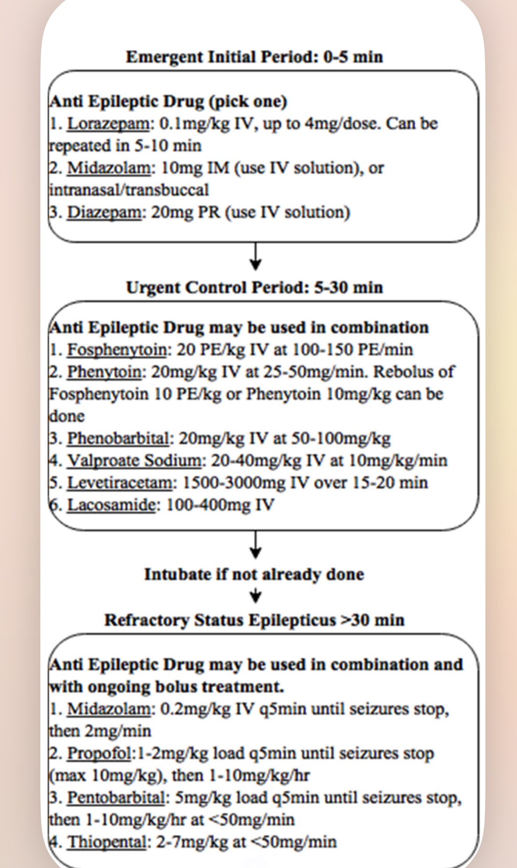
Status epilepticus

Slide 30

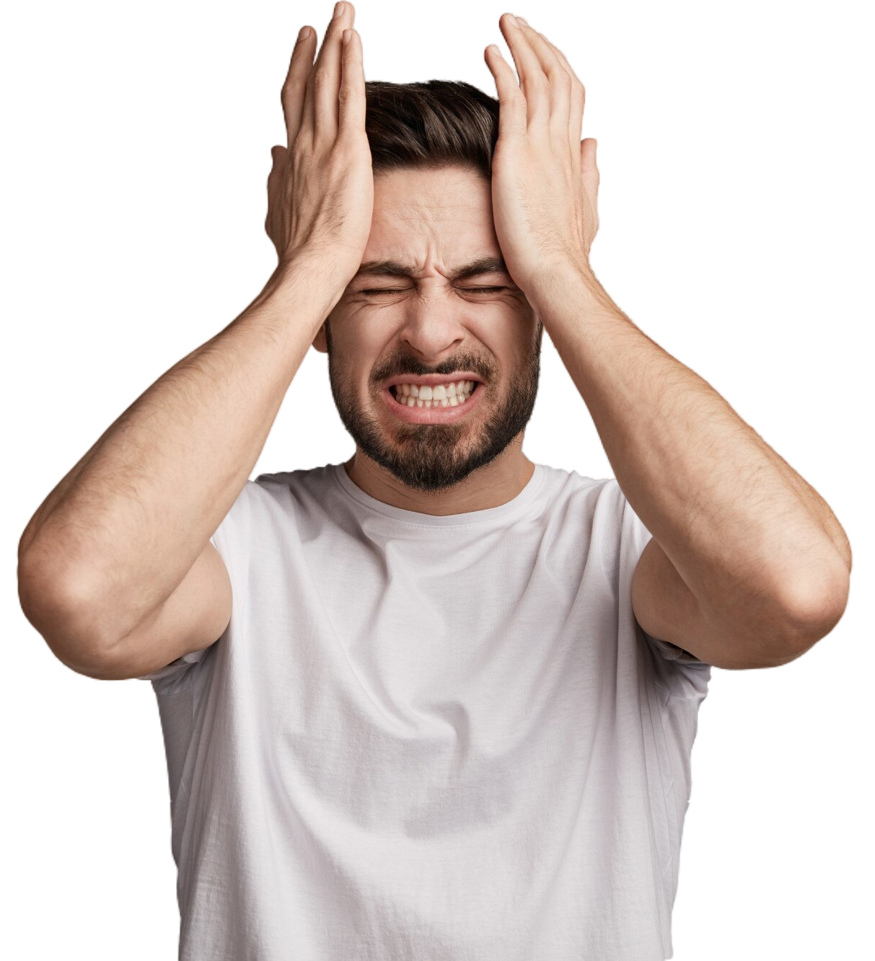
HEADACHE
RED
FLAGS
New onset of headache with new systemic or neurological features.
Headache that becomes worse on immediate upright posture.
New onset of, or change in headache in patients above 50 years of age.
In patients under 5 years of age.
Headache increasing by coughing, laughing or straining.
Headache after head injury or within 90 days of injury

Slide 31
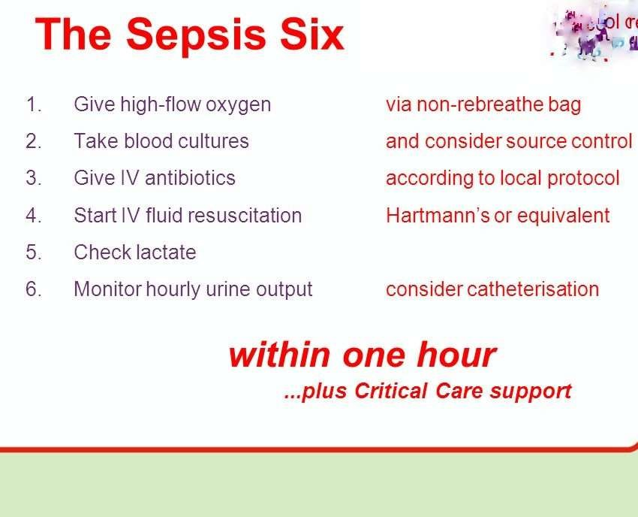
Infectious Diseases

Slide 32

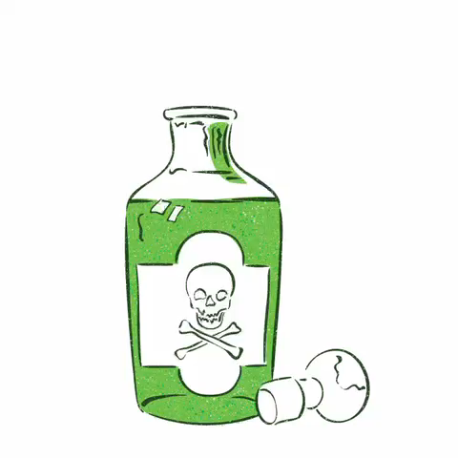
TOXICOLOGY EMERGENCIES
Unknown poisoning
OP poisoning
Snake
Bite
Allergic reaction
Methyl Alcohol Poisoning

Slide 33
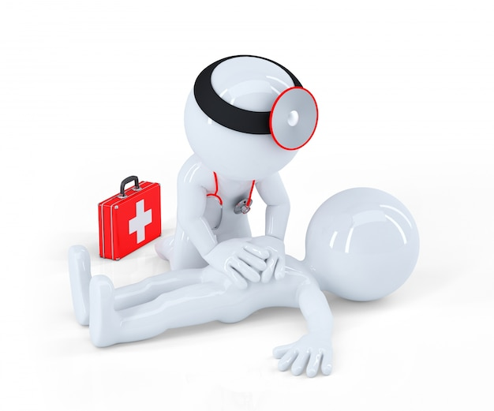
First Aid for Poisoning
AIIMS Helplines :Poison Information Centre- 1800 116 117 ( toll free) 26593677, 26589391, ( functions round the clock)
SWALLOWED POISON
Do not give anything, call the poison control center
INHALED POISON
Get victim to fresh air, call poison control center
POISON ON SKIN
Remove contaminated clothing and rinse skin with water for 10 minutes, call the poison control center
POISON IN EYE
Flush eye for 15 minutes using a large cup filled with lukewarm water held 2-4 inches from eye, call the poison control center

Slide 34
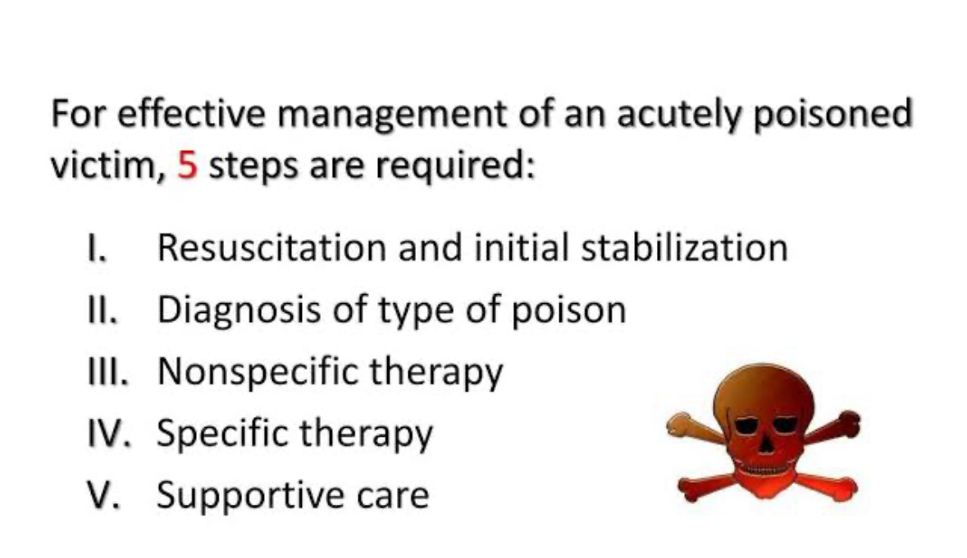
Stepwise management-

Slide 35
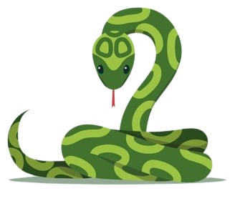
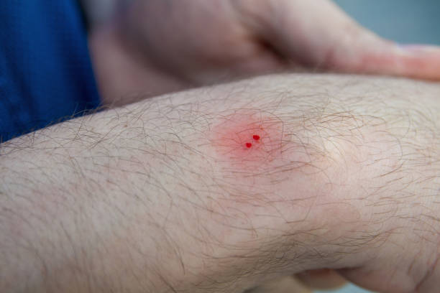
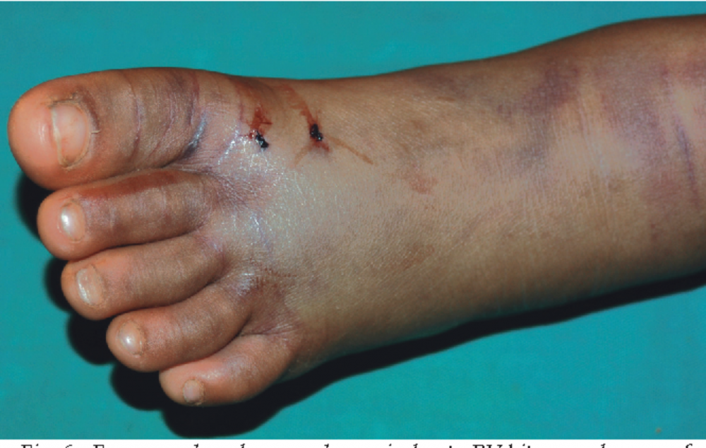
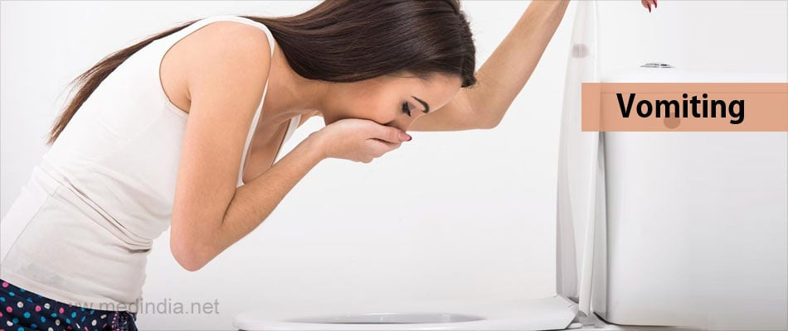
SNAKE BITE
Identifying Snake Bites
    Two puncture marks at the site of the bite.
Swelling, redness, and pain around the bite area.
Nausea, vomiting, or difficulty breathing in severe cases.

Slide 36
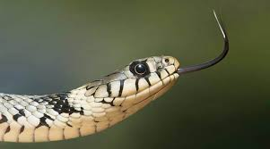
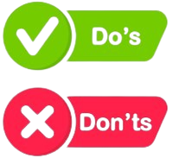
SNAKE BITE
STAY CALM
Step 1: Move Away from the Snake
Step 2: Immobilize the Affected Area
Keep it still and at or slightly below heart level.
    Remove tight clothing or jewelry near the bite area.
Step 3: Clean the Wound
Do NOT:
    Cutting the wound.
    Sucking out venom.
    Using a tourniquet.
    Applying ice.
Step 4: Apply a Bandage
Step 5: Keep the Person Calm
Step 6: Seek Medical Help
Note the Time

Slide 37
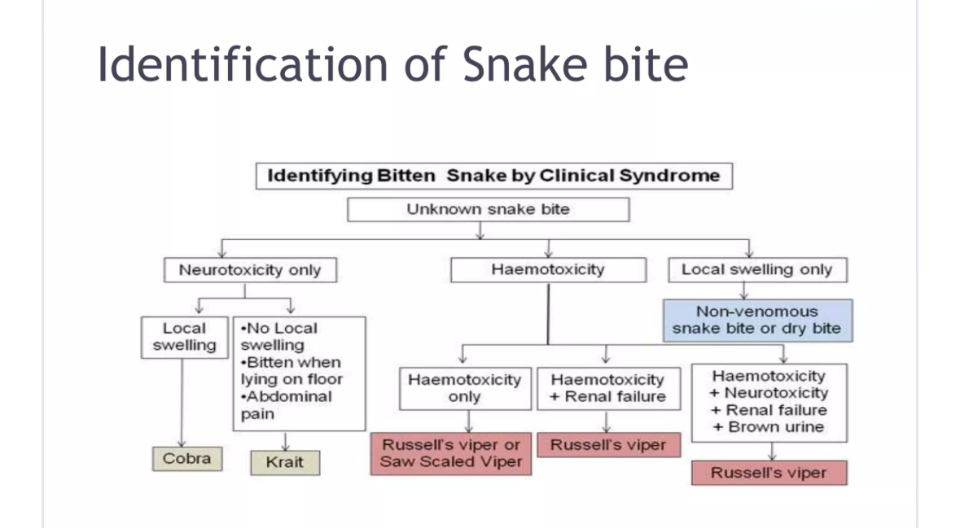

Slide 38
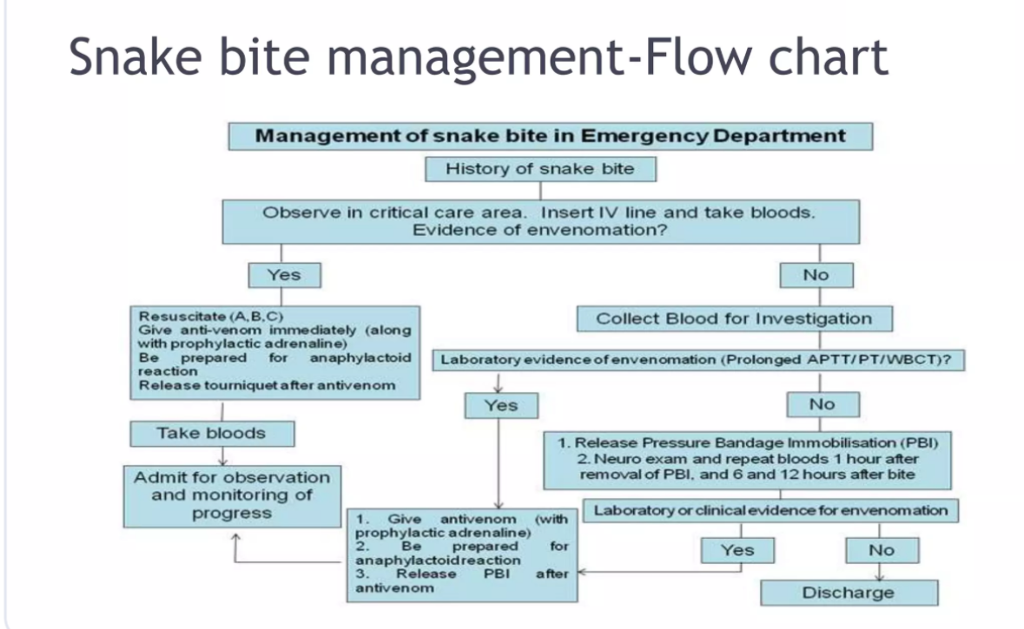

Slide 39
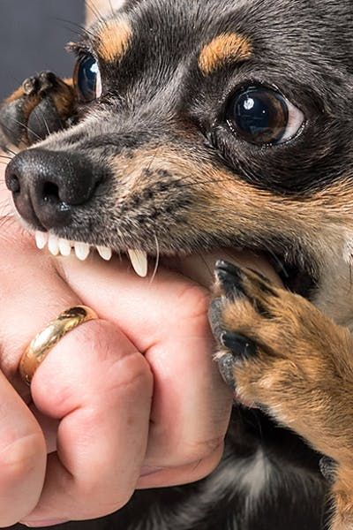
ANIMAL BITE
Assess the Severity
Safety First
Wash the Wound
Do NOT:
    Squeezing the wound to force out blood.
    Using strong antiseptics or chemicals that may damage tissue.
Apply an Antiseptic
Seek Medical Attention Immediately
Vaccination and Immunoglobulin as per below Criteria.
Tetanus Shot
Document the Incident
Follow-up Care

Slide 40
CATEGORY I
CATEGORY II
CATEGORY III
TYPE OF CONTACT
TYPE OF CONTACT
TYPE OF CONTACT
Touching or feeding of animals
Licks on intact skin
Nibbling of uncovered skin
Minor scratches of abrasions without bleeding
Single of multiple transdermal bites for scratches
Licks on broken skin
Contamination of mucous membrane with saliva
TYPE OF EXPOSURE
TYPE OF EXPOSURE
TYPE OF EXPOSURE
None
Minor
Severe
MANAGEMENT
MANAGEMENT
MANAGEMENT
None, if reliable history is available
Wound management
Anti rabies vaccine
Wound management
Rabies immunoglobins
Anti rabies vaccine

Slide 41

ENDOCRINOLOGY AND ELECTROLYTE EMERGENCIES
Hypoglycemia and Hyperglycemia
Thyroid disorders
Electrolyte and fluid Imbalance
            Diarrhoea
            Hypothermia and hyperthermia

Slide 42

Know the Difference

Slide 43

ABDOMINAL PAIN
RED
FLAGS
Sudden onset abdominal pain
Absent bowel sounds
Tenderness
Evidence of weight loss
Palpable mass in abdomen
Localised tenderness away from umbilical region
Pain with nighttime wakening
Rectal abnormalities(fissures, ulcerations)

Slide 44

GATROINTESTINAL
RED
FLAGS
Bilious vomiting
Bloody vomiting
Light headedness
Diarrhea persistent to more than 6 weeks
Rectal bleeding
Black stools
Family history of abdominal or ovarian cancer

Slide 45


UROLOGICAL EMERGENCIES
NON TRAUMATIC
Hematuria
Renal colic
Urinary retention
Testicular Torsion
TRAUMATIC
Renal trauma
Urethral injury
Bladder trauma

Slide 46



TRAUMA AND ENVIRONMENTAL EMERGENCIES
Major Trauma (Fall, RTA)
Heat Stroke
Burn and Chemical Injuries
Electrocution

Slide 47




IDENTIFYING MAJOR TRAUMA
    Severe bleeding
    Unconsciousness
    Severe injuries or fractures
    Difficulty breathing
    Shock or altered
    mental status

Slide 48

ATLS

Slide 49

HEAD INJURY
RED
FLAGS
Altered consciousness
Behaves unusually or seems conscious and irritable
Double vision
Progressively detiorating neurologic examination
Repeated vomiting
Seizure
Slurring speech
Unsteady on feet

Slide 50

BACKACHE
RED
FLAGS
Follow
T
U
N
A
F
I
S
H
T
Trauma
Unexplained weight loss
Neurologic symptoms
Age > 50 years
Fever
IVDU (intra venous drug use)
Steroid use
History of cancer(Prostate, renal, breast, lungs)
U
N
A
F
I
S
H

Slide 51

RECOGNIZING BURNS AND CHEMICAL INJURIES
Redness, blistering, or charred skin for burns.
Chemical exposure, discoloration, or skin damage for chemical injuries.

Slide 52

First Aid
for
BURNS
Step 1: Stop the Burning Process
Step 2: Remove Contaminated Clothing
Step 3: Cover the Burn or Injury
Do NOT:
    Popping blisters.
    Applying creams or ointments.
    Using adhesive bandages directly on burns.
Step 4: Elevate if Possible
Step 5: Manage Pain
Step 6: Seek Medical Help

Slide 53


RECOGNIZING ELECTROCUTION
Victim is unconscious or injured near electrical source.
Visible burns or entry/exit wounds.
Victim may still be in contact with the electrical source.

Slide 54

Universal Choking Sign

Slide 55



Slide 56
Relief of Choking in Responsive Adults and Children
Use abdominal thrusts (the Heimlich maneuver)
It may be necessary to repeat the thrust several times to clear the airway

Slide 57
Step | Action
1 | Stand or kneel behind the victim and wrap your arms around the victim’s waist
2 | Make a fist with one hand
3 | Place the thumb side of your fist against the victim’s abdomen, in the midline, slightly above the navel and well below the breastbone
4 | Grasp your fist with your other hand and press your fist into the victim’s abdomen with a quick upward thrust.
5 | Repeat thrusts until the object is expelled from the airway or the victim becomes unresponsive.
6 | Give each new thrust with a separate, distinct movement to relieve the obstruction

Slide 58

Abdominal thrusts (the Heimlich maneuver)
Notes:
Although chest thrusts, back slaps, and abdominal thrusts are feasible and effective for relieving severe FBAO in conscious (responsive) adults and children ≥1 year of age, for simplicity in training it is recommended that abdominal thrusts be applied in rapid sequence until the obstruction is relieved (Class IIb, LOE B). If abdominal thrusts are not effective, the rescuer may consider chest thrusts (Class IIb, LOE B).

Slide 59

Chest Thrust
(Pregnancy , Obese patients)
Notes:
Pregnancy , Obese patients

Slide 60
Relief of Choking in Unresponsive Adults and Children
Activate Emergency Response System
Place the adult on a firm flat surface
Open the victim’s airway and remove the object if you see it.
Begin CPR
Notes:
you find that a victim that is already unconscious, activate the emergency response system and begin CPR.
You have successfully opened the airway in the unresponsive victim if you feel air movement and the chest rises when you give breaths.

Slide 61


Slide 62
Golden Hour Of Life Course
One day course
Pre and post course test
50 MCQS
Team of 6 Emergency Medicine Experts
Workshop(Practical) after every lecture
Course completion certificate if passed successfully
Emergency Manual - free of cost

Slide 63
Topics to be covered in this course
Chapter 1: Emergency Airway Management
Chapter 2: Cardiovascular Emergencies
Chapter 3: Pulmonary Emergencies
Chapter 4: Neurological emergencies
Chapter 5: Toxicology emergencies
Chapter 6: Endocrinology and electrolyte emergencies
Chapter 7: Urological emergencies
Chapter 8: Trauma and environmental emergencies
Chapter 9: Disaster Management
Chapter 10: Psychiatric emergencies
Chapter 11 : Infectious Diseases and needle stick injuries
Chapter 12: Role Of counselling In EM department

Slide 64



Slide 65


Saving a life isn't just a
HEROIC ACT
it's the greatest gift of
COMPASSION & HUMANITY

Slide 66




Slide 67

DR. LOKENDRA GUPTA
Head and Associate Director,
Emergency and Trauma Care,
Medanta Hospital, Lucknow
Mob: +918130440459
Email: lokendra.gupta@medanta.org

