Slide 1
यह कार्यक्रम स्वास्थ्य विभाग और राज्य स्वास्थ्य एवं परिवार कल्याण संस्थान (SIHFW), उत्तर प्रदेश की पहल पर उत्तर प्रदेश टेक्निकल सपोर्ट यूनिट (UPTSU) के सहयोग से हो रहा है।
Principal Secretary, Medical Health & Family Welfare, U.P. Shri Partha Sarthi Sen Sharma
Secretary, Medical Health & Family Welfare, U.P.
Shri Ranjan Kumar
Director Administration & Director, SIHFW
Shri Shiv Sahay Awasthi
1

Slide 2

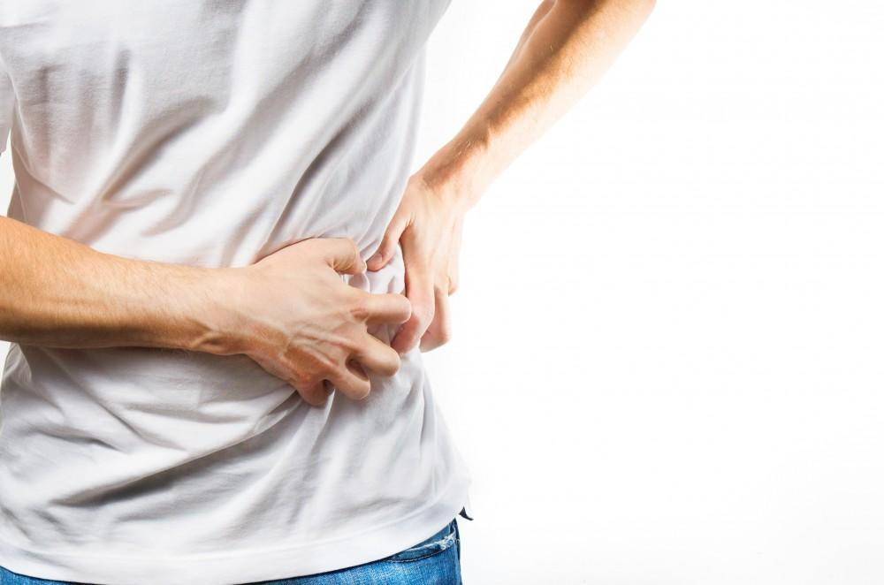
Management of Kidney Stones
Dr. Durgesh Kumar Pushkar
MD, DM [Nephrology]
Assistant Professor
Department of Nephrology, KGMU

Slide 3
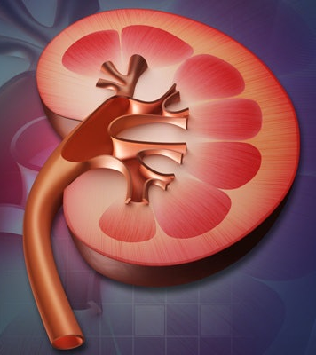
Objectives
Epidemiology and Risk factors
Pathophysiology
Approach to a patient with kidney stones
Medical management
Surgeon’s point of view
Prevention of recurrent stones
Impact of Nephrolithiasis on kidney function
Renal prognostic markers
Transplant setting

Slide 4
Epidemiology
Prevalence increases with age, increasing prevalence over time
Lifetime risk of stone formation – Males 12-16%, females 6-8%
Male: female= 1.3:1
Incidence – 1-3/1000/year
Eighty percent of patients with nephrolithiasis form calcium stones, most of which are composed primarily of calcium oxalate.

Slide 5
Recurrence rates-
  15% in 1 year
  35-40% in 5 years
  50% risk in the next 10 years
30-40% of untreated individuals will form another stone within 5 years after the initial episode
Active interventions can reduce the likelihood of recurrence by 50%!

Slide 6
Non-dietary risk factors
2-fold higher risk in those with family history
Race- Asians have a higher risk
Systemic disorders – Primary HPT, dRTA, Obesity, Gout, DM, Metabolic syndrome, Gallstones
Women with DM
GI conditions – Enteric hyperoxaluria
High humidity, low fluid intake, higher insensible fluid losses
Medullary sponge kidney- Among calcium stone formers, in 12 to 20 percent overall and 20 to 30 percent of women or patients under age 20 years.
UTI
Cystinuria
Notes:
It is unclear whether the anatomic changes somehow cause the metabolic disturbances (eg, high urine calcium, low urine citrate) or whether their predisposition to nephrocalcinosis (and the interstitial deposition of calcium phosphate) increases the likelihood of nephrolithiasis

Slide 7
Dietary risk factors- Ca.Ox
Calcium - a higher dietary calcium intake is associated with a lower incidence of stone disease while calcium supplements were associated with a small increase in risk (apparent paradox)
Oxalate - Dietary contribution - 10-50%; substantial proportion of urinary oxalate is derived from endogenous production (Glycine, Glycolate, Hydroxyproline); reduced absorption of dietary oxalate due to low bioavailability and inter-individual variations.
Sodium - High sodium→ decreased PCT reabsorption→ decreased Calcium reabsorption
Potassium- higher potassium intake may reduce the risk of stone formation by reducing urinary calcium excretion, may increase urinary citrate excretion (since potassium-rich foods tend to have a high alkali content)
Vitamin C*
B6 supplements

Slide 8
Role of high animal protein intake
Higher animal protein intake (both nondairy and dairy) is associated with higher urine calcium , lower urine citrate, whereas higher dairy protein intake is associated with higher urine citrate excretion and lower urine oxalate excretion.
Vegetable protein has a much lesser effect on calcium, uric acid, and citrate excretion since it has a lower sulfur content and therefore generates less acid.

Slide 9
Dietary calcium sources may be ingested with foods containing oxalate
There is binding of dietary oxalate in the gut
Decreased oxalate absorption and excretion.
Relative supersaturation of the urine with respect to calcium oxalate.
Calcium supplements are often taken in the morning or before bedtime, not WITH meals
Ineffective binding of dietary oxalate in the gut
Calcium kept free in the GI lumen
Increase in calcium absorption and excretion
Why the paradox with Calcium intake?

Slide 10
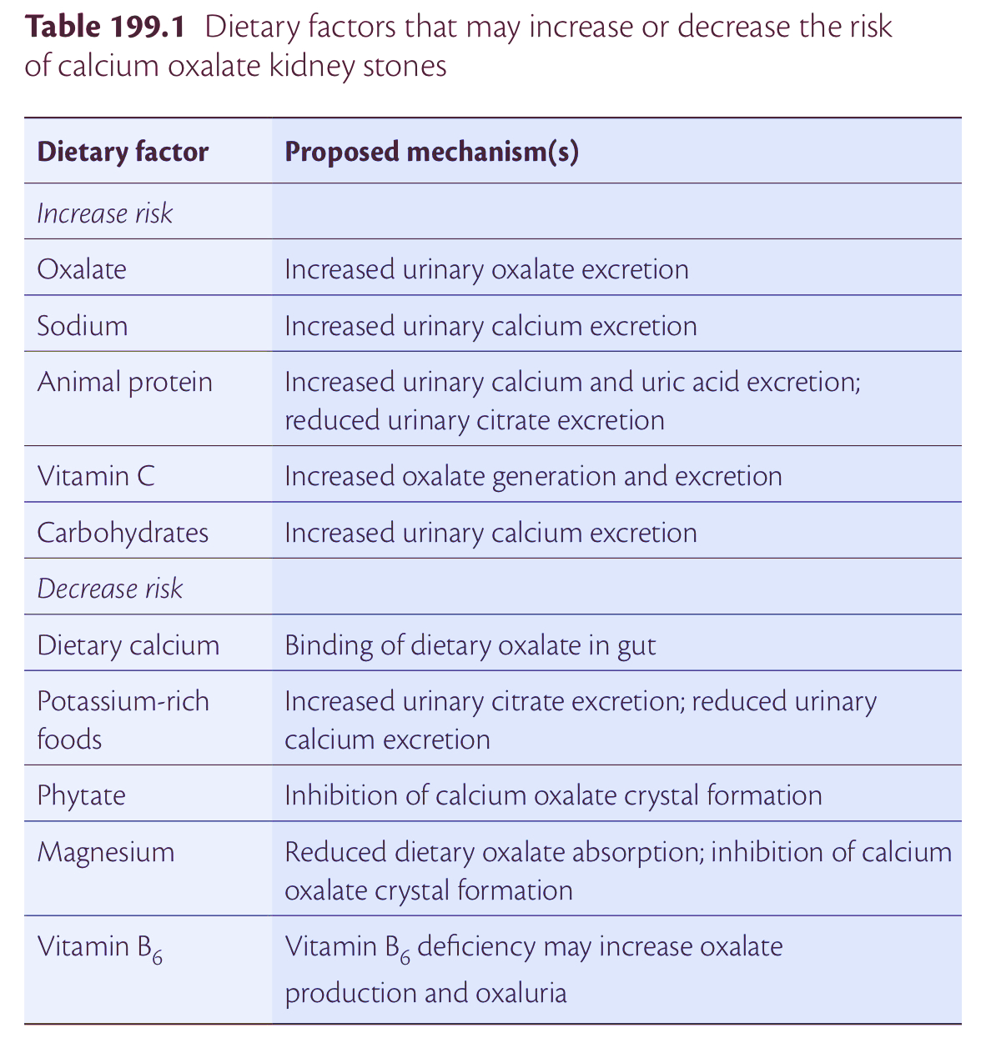

Slide 11
D/D for Calcium stones
Hyperuricosuric calcium nephrolithiasis – in gouty diathesis
Hyperoxaluric calcium nephrolithiasis – enteric, dietary, primary
Hypocitraturic calcium nephrolithiasis – distal RTA, chronic diarrhea, idiopathic
Hypomagnesiuric calcium nephrolithiasis

Slide 12
Dietary risk factors- other stone types
Uric acid stones- more acidic pH (6.5 to 5), high purine intake, low alkaline food intake
Cystine stones – high sodium intake, low alkali foods
Ca.P stones- alkaline pH, high animal protein intake

Slide 13
Beverages and Calcium stones
Higher fluid intake– lower lithogenicity
Coffea, tea, beer and wine –lower lithogenicity (probably due to the inhibition of ADH
Sweetened soft drinks- higher risk

Slide 14
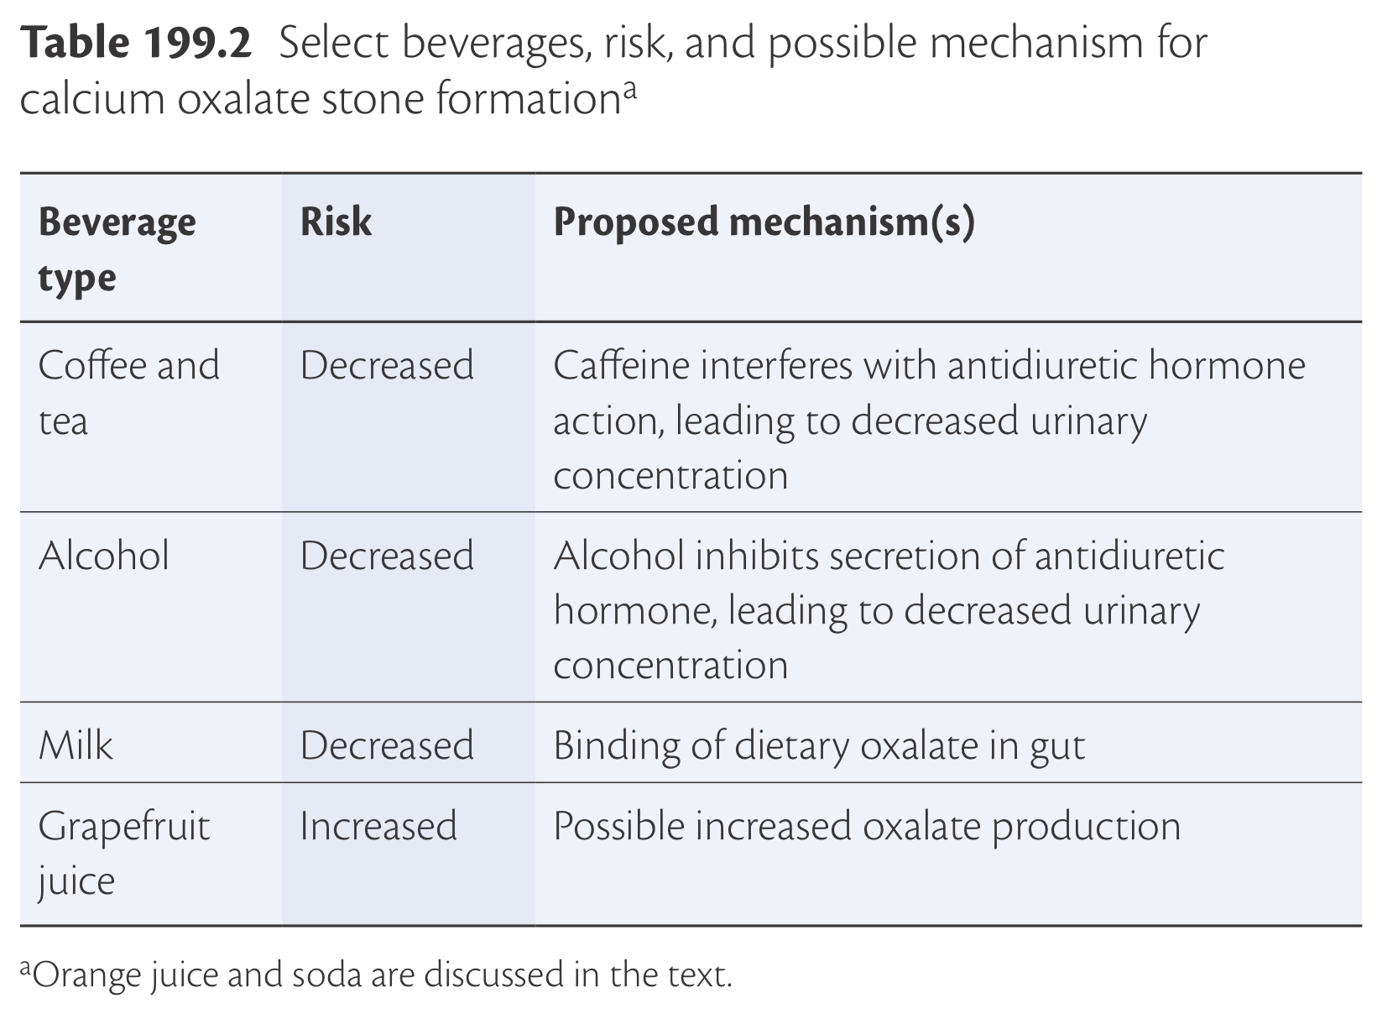

Slide 15
Urinary factors
pH determination since a pH greater than 7.5 raises the possibility of a stone due to urease-producing bacteria and pH less than 5.5 favours uric acid lithiasis
The formation of calcium oxalate crystals is not dependent upon the urine pH, while calcium phosphate crystals only form in a relatively alkaline urine (usually pH >6.8)
Hypercalciuria - >300mg/day in men and >250mg/day in women on a 1g/day Calcium diet
Hyperoxaluria- >45mg/day, independent risk factor for lithogenicity
Hyperuricosuria- >800mg/day in men and >750mg/day in women
Hypocitraturia- <320mg/day

Slide 16
Normal urine is undersaturated with magnesium ammonium phosphate.
Struvite stone formation occurs only when
  ammonia production is increased and
  urine pH is elevated
Both of these requirements are only met when an upper urinary tract infection occurs with a urease-producing bacterium, such as Proteus or Klebsiella.

Slide 17
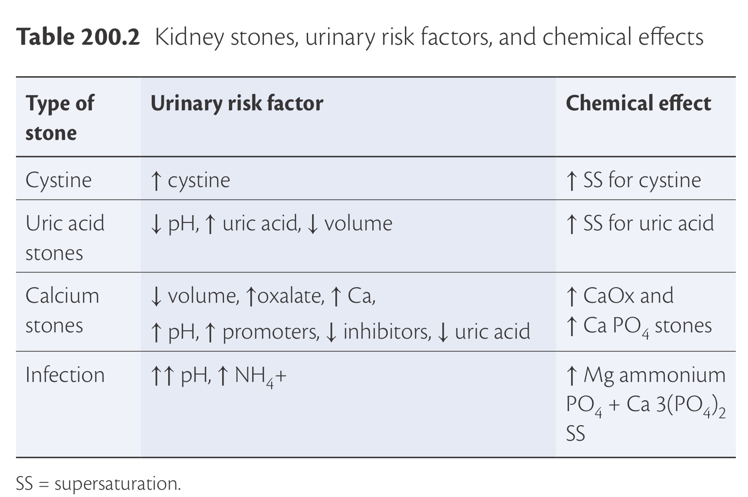

Slide 18
Usual stone composition
Calcium oxalate – 70 to 80 percent
Calcium phosphate – 15 percent
Uric acid – 8 percent
Cystine – 1 to 2 percent
Struvite – 1 percent

Slide 19
History
Age and family history – Cystinuria, Dent disease, Primary hyperoxaluria
History of structural abnormalities
Past history of stones
Occupation under harsh conditions – miners, foundry; dry and humid climates
Diet history- protein and salt rich, high sugar load
History of DM, Obesity, Gout and Metabolic syndrome
Medical history- Chronic diarrhea, ileal resection, jejunoileal bypass, bariatric surgery, conditions causing hypercalciuria (Primary HPT, iatrogenic, Myeloma, Sarcoidosis, Lymphoma, Immobilisation), distal RTA and nephrocalcinosis, history of recurrent UTI, pathological fractures

Slide 20
Medications
Steroids, Calcium and Vitamin D supplements→ hypercalciuria
B6 and Vitamin C→ hyperoxaluria
Carbonic anhydrase inhibitors→ hypocitraturia, hypercalciuria and alkaline pH→ increased risk of Ca.P stones
Indinavir, Ritonavir, Triamterene directly cause insoluble stones
Lithium

Slide 21
Symptoms and signs of renal colic
Pain, Nausea, vomiting and hematuria
RENAL COLIC- begins in the flank, sudden onset, severe intensity, typically waxes and wanes in severity and develops in waves or paroxysms, usually last 20 to 60 minutes, occurring primarily from urinary obstruction with distention of the kidney capsule and typically resolves quickly after passage of the stone.

Slide 22
Location of the pain-
  PUJ: Deep flank pain, due to distension of the renal capsule
  Ureter: Flank, I/L lower abdomen, radiation to the groin
  VUJ: Irritating voiding symptoms
  Bladder: Mostly asymptomatic, rarely positional urinary retention due to ball-valve effect of a stone at the bladder outlet; hematuria*
Atypical symptoms such as vague abdominal pain, acute abdominal or flank pain, nausea, urinary urgency or frequency, difficulty urinating, penile pain, or testicular pain
Hematuria- one of the most discriminating predictors of a kidney stone in patients presenting with unilateral flank pain- two-thirds of patients with a ureteral stone have hematuria.

Slide 23
Nephrolithiasis may lead to persistent kidney obstruction, which could cause permanent kidney damage if left untreated.
If urine is infected proximal to the obstructing stone - UROLOGIC EMERGENCY that requires rapid decompression either by a ureteral stent or a nephrostomy tube.
Staghorn calculi themselves do not typically produce symptoms unless obstructed or infected.
However, they can lead to kidney failure over years if they are present bilaterally- upto 30% of patients develop CKD over 10 years.

Slide 24
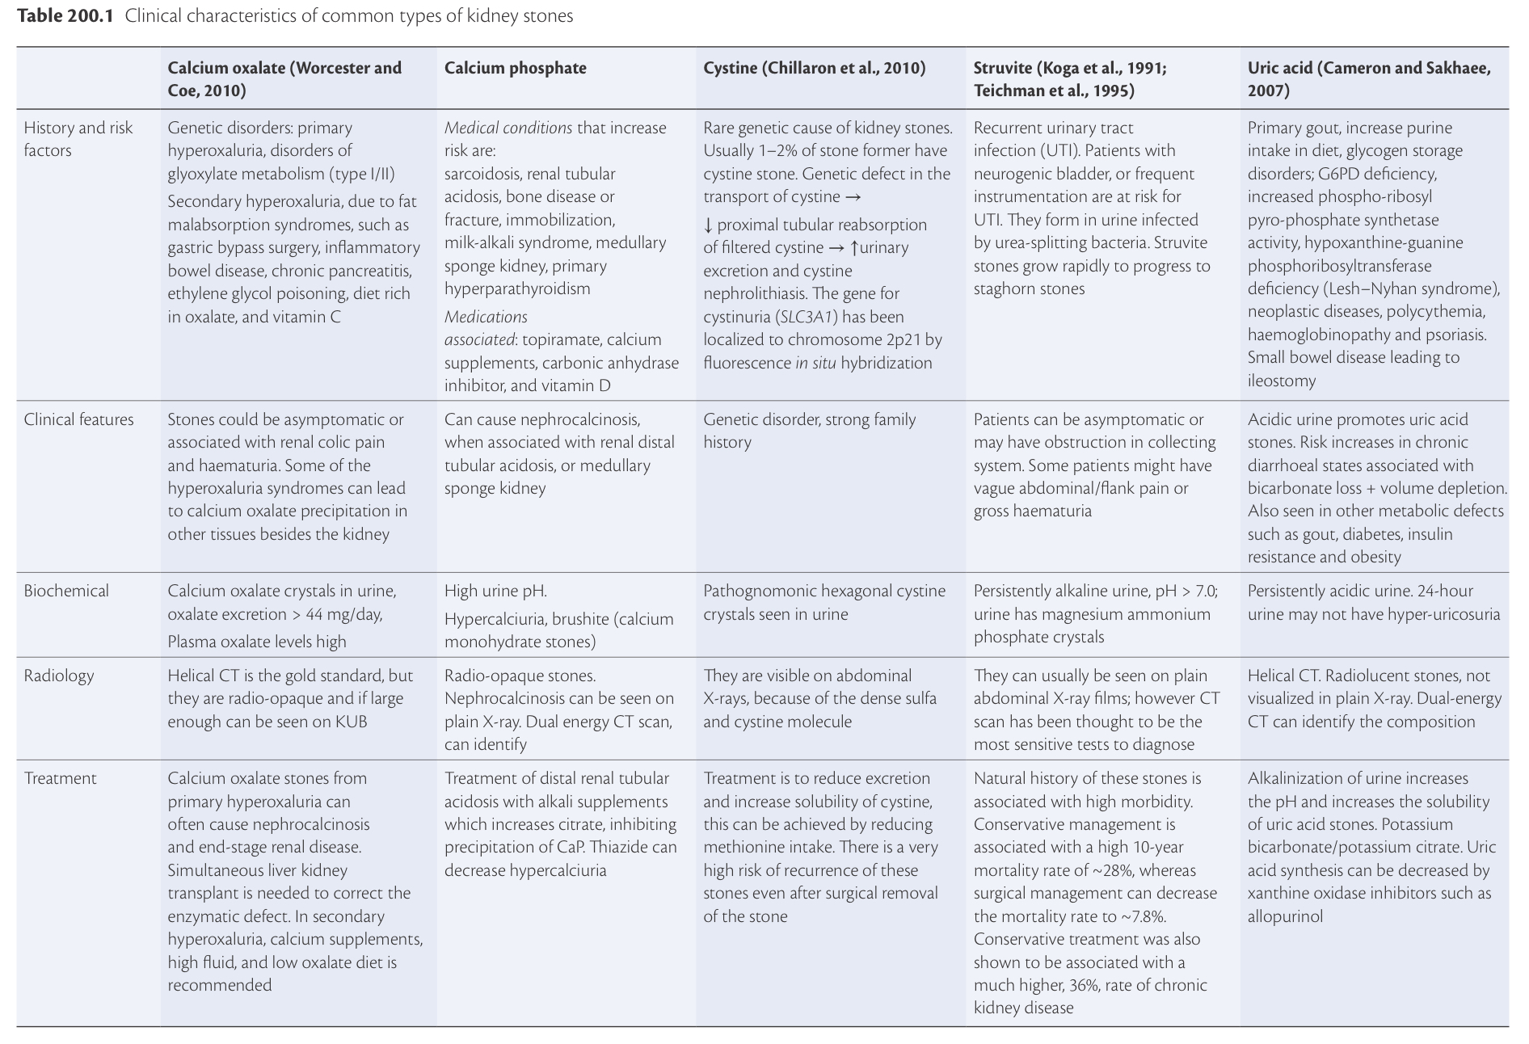

Slide 25
Primary hyperparathyroidism causing Calcium stones
Single benign adenoma – 75%
4-gland hyperplasia – 20%
Parathyroid carcinoma- <1%
PTH induces increased calcium reabsorption in the DCT but the degree of hypercalciuria is less when compared to malignancy, sarcoidosis, vit D intoxication or myeloma.
Stones are composed of hydroxyapatite, Ca.Ox or brushite

Slide 27
Diagnosis of kidney stones- evaluation depends upon
The severity and type of stone disease
Whether it is the first or a recurrent stone
Presence or absence of systemic disease and/or risk factors for recurrent stone formation
Family history of nephrolithiasis

Slide 28
Radiology
NCCT KUB- GOLD STANDARD, 3-5mm cuts
-location and type of radiolucency may help to determine the nature of the stone
Ca.P- usually B/L and a/w nephrocalcinosis, typically MSK
Cystine- radio-opaque, not as dense as Ca.Ox
-Dose of radiation – low dose CT should be done in follow up studies
Sensitivity and Specificity is similar, but it may miss stones <2mm.
IVU- easy to perform, inexpensive, moderate radiation and contrast exposure, lower sensitivity than CT

Slide 29
Renal USG- Procedure of choice to avoid radiation exposure (pregnancy); less sensitive than CT, can miss small stones; sensitivity can be improved using Colour Doppler- assessment of urine flow rates and post-obstructive blush.
Xray KUB- only radio-opaque stones - Calcium, Struvite, Cystine
inexpensive, minimal radiation
Very poor sensitivity and specificity
DECT- mainly to distinguish various types of stones by assessing stone composition, useful to assess stone fragility and efficacy of SWL
MRI- mainly in pregnancy
CECT- Indinavir stones

Slide 30
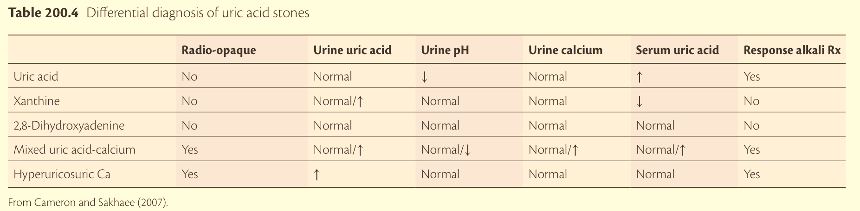

Slide 31
When do we NOT do a CT?
If the patient is pregnant, an ultrasound is the preferred modality.
If the patient has a body mass index (BMI) >30 kg/m² or weighs more than 130 kg (male) or 115 kg (female), then a standard-dose CT is performed.

Slide 32
CT. vs USG
CT
-Highest diagnostic accuracy for nephrolithiasis
-reliably detects hydronephrosis
-Accurate information on the size and number of other stones in the kidneys
-large body habitus or end-stage kidney disease (ESKD)
-sensitivity and specificity of CT using conventional radiation doses is >0.94 and >0.97
The cumulative radiation exposure after six months is approximately 70 percent higher with initial CT.
USG
-In those who are
likely to undergo multiple CT exams for nephrolithiasis
- in pregnant patients
-No radiation
-sensitivity and specificity of ultrasound is 0.70 (95% CI 0.67-0.73) and 0.75 (95% CI 0.73-0.78),

Slide 33
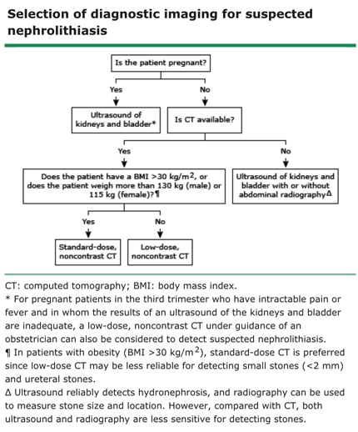

Slide 34
The effective radiation dose of a standard, noncontrast abdominopelvic CT is usually 10 to 12 mSv.
the upper limit of effective radiation dose for low-dose, noncontrast CT is 4 mSv.
Imaging is performed on a multidetector CT scanner with 1 to 5 mm slice thickness.
Intravenous contrast is usually not administered, as it decreases sensitivity for small stones.
However, for detecting stones >3 mm, contrast-enhanced CT demonstrates 0.95 sensitivity.
Noncontrast CT can usually detect secondary signs of urinary tract obstruction. The likelihood of detecting these findings varies with the duration of pain.
In a report of 227 patients with acute nephrolithiasis, ureteral dilatation was seen in 84 and 97 percent at two and eight hours, respectively, and moderate to severe perinephric stranding in 5 and 51 percent at two and eight hours, respectively.

Slide 35
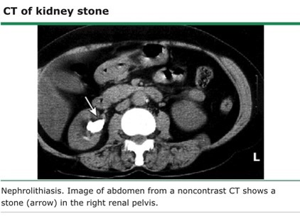
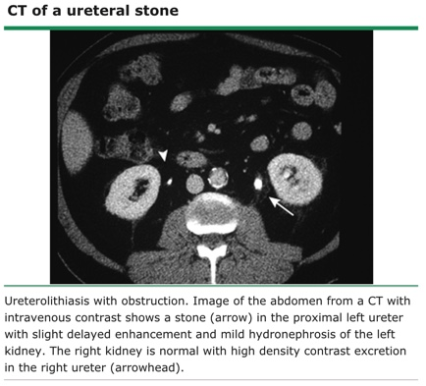
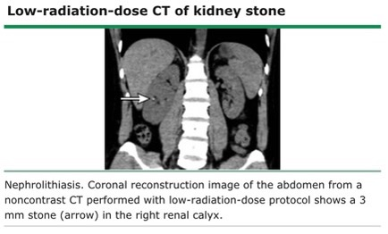
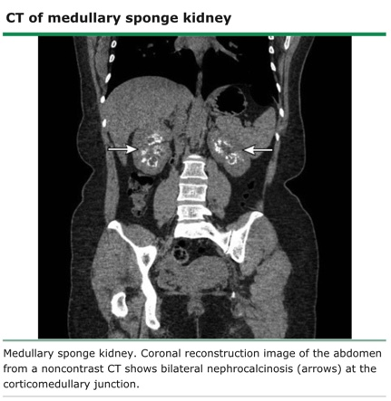

Slide 36
Although magnesium ammonium phosphate and cystine stones are often radiopaque on CT, they are not as dense as stones composed of calcium oxalate or calcium phosphate.
Uric acid stones tend to demonstrate lower density than calcium stones.
Large calculi in the renal pelvis favour struvite stones. Struvite stones usually have a component of carbonate apatite mixed in, which is responsible for their usual radiodensity.
Stones that are radiolucent, which can go undetected even on CT, are composed of protease inhibitors (eg, indinavir, atazanavir), xanthine, or dihydroxyadenine.
Dual-energy CT (DECT) may better characterize stone composition. DECT utilizes scanners that emit two separate radiograph energy sets to differentiate the attenuation properties of matter. However, DECT is rarely used clinically to determine stone composition.

Slide 37
Can CT be used to determine stone composition?
The Hounsfield unit value obtained from a standard CT scan relates to the density of the material in the area of interest, such as a stone.
Calcium oxalate and Brushite stones have high Hounsfield unit values, while uric acid stones have low Hounsfield unit values.
However, this approach is not sufficiently accurate to definitively determine the composition of stones, including struvite.
Dual energy CT may be somewhat more accurate.

Slide 38
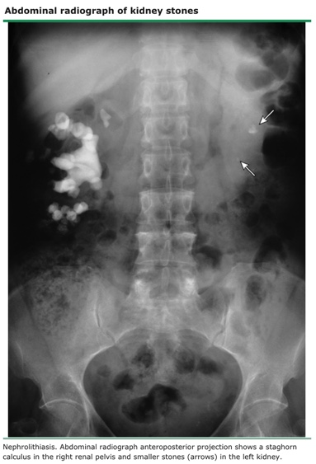
Abdominal Xray
Large radiopaque stones such as calcium, struvite, and cystine stones are seen.
Stones that are radiolucent and often missed on abdominal plain radiography include uric acid stones as well as small (<5 mm) stones (including small calcium-containing stones).
False positives, such as phleboliths and vascular calcifications mistaken for kidney stones, also limit the specificity of the examination.
The effective radiation dose from a single abdominal radiograph is 0.8 mSv.

Slide 39
IVP/ intravenous urography/ IVU
Involves radiographic imaging of the kidneys, ureters, and bladder before and after the administration of intravenous iodinated contrast.
The examination reliably detects hydronephrosis but is less sensitive and specific than CT for the detection of stones.
For follow-up of ureteral calculi or the assessment of ureteral anatomy after stone removal.
The effective radiation dose from an IVP is 3 mSv.

Slide 40
MRI
Stones are poorly seen on MRI as they can only be detected as signal voids in the urine.
MRI is used to localize the obstruction in pregnant patients with hydronephrosis seen on ultrasound.
Intravenous gadolinium contrast is usually not administered and should be avoided entirely in pregnancy.

Slide 41
Digital Tomosynthesis
It is a high-resolution radiograph-based imaging technique that is routinely used in breast cancer screening.
It has been shown to have similar stone detection rates compared with noncontrast CT.
The mean effective radiation dose of DT is lower than that of both low-dose and standard-dose noncontrast CT and more cost effective than noncontrast CT.
The effective radiation dose from a DT is 0.9 mSv.

Slide 42
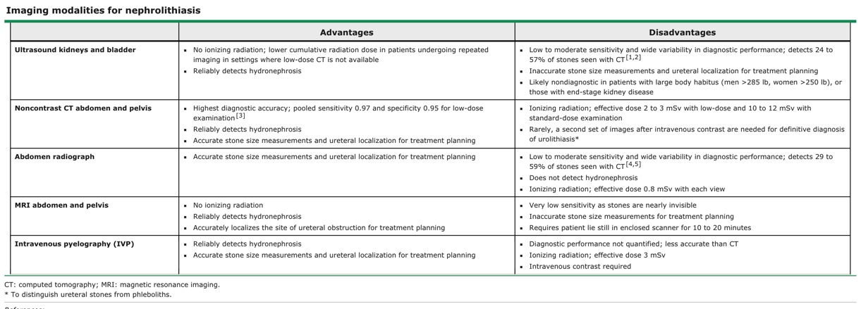

Slide 43
Clinical Mimics
RCC
Pyelonephritis
Ectopic pregnancy
Torsion/ cyst rupture
Dysmenorrhea
Acute intestinal obstruction, diverticulitis, or appendicitis may present with colic but usually not in association with hematuria. In addition, nausea and vomiting are characteristic of intestinal obstruction and renal colic, while abdominal tenderness is characteristic of diverticulitis and appendicitis but not nephrolithiasis.
Aortic aneurysm
Biliary colic and cholecystitis can be associated with flank pain but usually not in association with hematuria.
Acute mesenteric ischemia rarely produces abdominal pain that can be confused with renal colic; in addition, mesenteric ischemia is often associated with metabolic acidosis but not hematuria.
Herpes zoster may produce pain in the flank but is usually accompanied by a rash and not hematuria.
Individuals seeking attention or narcotics may pretend to have renal colic and may have self-inflicted hematuria.

Slide 44
What to do at the first instance?
Limited evaluation- Serum chemistry, Ca, P, Bicarbonate, PTH, pH, stone burden assessment
Targeted evaluation- Low vs high risk stratification
Comprehensive evaluation- Blood and urine analyses, two 24-h urine collections, should be followed only in individuals willing to make changes to their diet or fluid intake or to take medical therapy if warranted by the work-up
Certain asymptomatic patients should undergo evaluation and treatment, based upon their occupation (airline pilots, frequent business travellers) or complexity (neurologic disease, anatomic abnormalities of the urinary tract, such as urinary diversion or solitary kidney).

Slide 45
Blood- Ca, P, iPTH, active Vitamin D levels, TSH, PTHrP, Lithium, plasma oxalate
Urine- Crystal analysis on freshly voided specimens
24-hour urine collections- volume, pH, Calcium, Uric acid, Citrate, Oxalate, Sodium, Creatinine

Slide 46
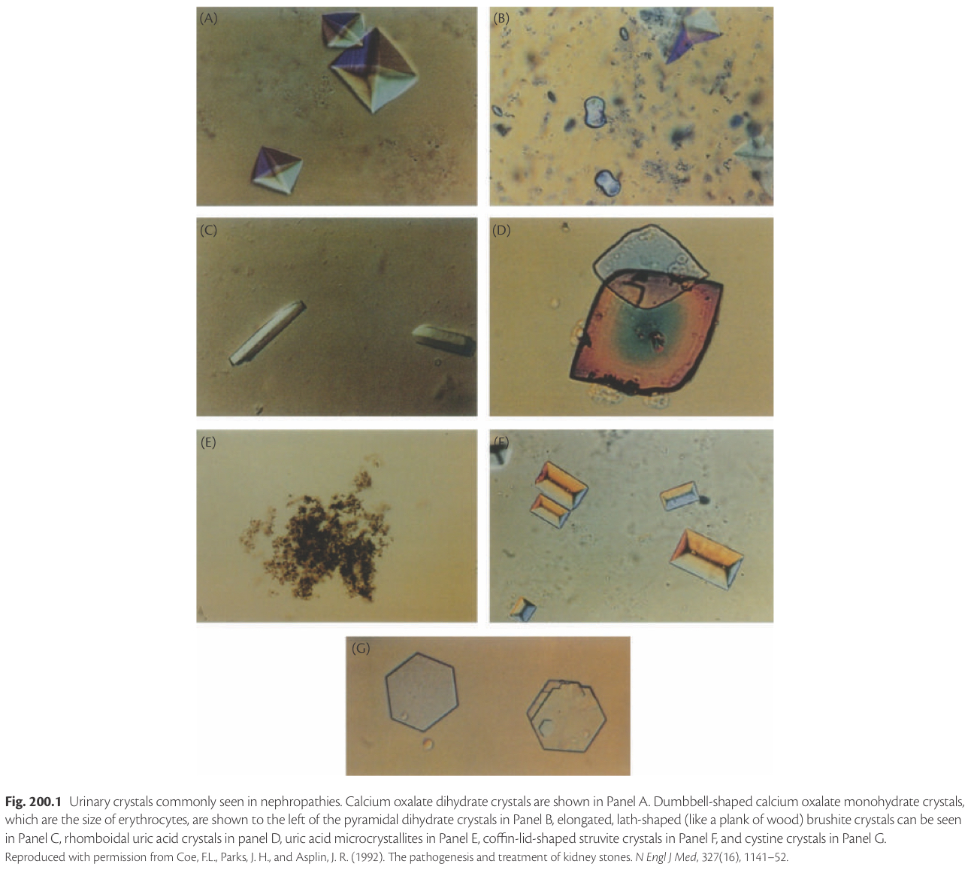

Slide 47
Who is at moderate to high risk for stone recurrence?
Middle-aged, white males with a family history of stones
African Americans, a group in which incident stone formation is less common
Patients with chronic diarrheal states and/or malabsorption, history of bowel surgery or bariatric surgery, pathologic skeletal fractures, osteoporosis, recurrent urinary tract infections in the upper tract, and/or gout
Those with stones known to be composed of cystine, uric acid, or struvite
Obese patients, or patients with diabetes, who have an increased incidence of uric acid stones
Patients taking medication that may put them at higher risk (eg, topiramate, acetazolamide)

Slide 48
Do’s and Dont’s in urine collection
Atleast 2 collections, obtained in the outpatient setting, following their usual diet, fluid intake, and physical activity.
Wait at least one to two months after a stone event to obtain the collections.
Wait at least one to two months after the patient has completely recovered from any interventions, such as shockwave lithotripsy, ureteroscopy, or percutaneous stone removal. "usual routine" when performing their urine.
Measurement of sodium excretion is also important. Higher sodium intake can contribute to increased calcium excretion and will affect the response to a thiazide diuretic when prescribed to reduce urine calcium.
Values should not be measured immediately after the acute stone episode.
Ideally, the patient should be free of pain, infection, and obstruction and following their regular diets.
Volume, pH and excretion of calcium, uric acid, citrate, oxalate, creatinine (to assess the completeness of the collection) and sodium should all be measured.
Ideally, the supersaturation of lithogenic substances should be calculated. The results of the urine collections and stone analysis (if available), dictate subsequent evaluation and management.

Slide 49
Stone Analysis
Quantitative wet chemistry - obsolete
Xray diffraction photography
Infrared spectroscopy – fine structure of the stone, capcity for in vivo stone analysis
Fourier transform infrared spectrophotometry
Crystallography
Thermogravimetric analysis – Ca.Ox
Micro CT
Atomic structure analyses

Slide 50
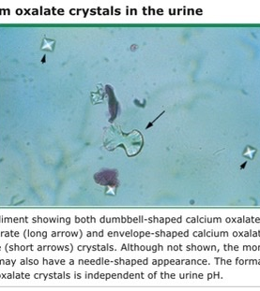
Calcium Oxalate
Most common component found in kidney stones (approximately 70 to 80 percent).
Monohydrate (whewellite) and Dihydrate (weddellite)
Can be present in combination with uric acid or calcium phosphate. Because calcium oxalate stones typically grow on a Randall's plaque (composed of calcium phosphate) on the papillary tip, a laboratory that examines the composition of the nidus may report a stone with an eccentric calcium phosphate nidus (usually 5 percent) and a calcium oxalate body (95 percent).
Urinary risk factors for calcium oxalate crystal formation are lower urine volume, higher urine calcium excretion, higher urine oxalate excretion, and lower urine citrate excretion.
Calcium oxalate crystals are pH insensitive in the physiologic pH range of 5 to 8.

Slide 51
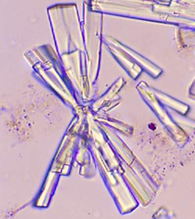
Calcium Phosphate
15 percent of kidney stones
Present in combination with calcium oxalate or struvite.
Because of differences in solubility due to urine pH, calcium phosphate is not found mixed with uric acid.
Apatite which is the crystal type found in bone, or calcium hydrogen phosphate (brushite)
Frequency of apatite is much greater than brushite.
Calcium phosphate crystals in the urine sediment are typically dark and amorphous.
Urinary risk factors for calcium phosphate crystal formation are lower urine volume, higher urine calcium excretion, lower urine citrate excretion, higher urinary pH, and, likely, higher urine phosphate excretion.
Calcium phosphate crystals are pH sensitive, forming in "alkaline" urine (usually pH 6.5 or higher)

Slide 52
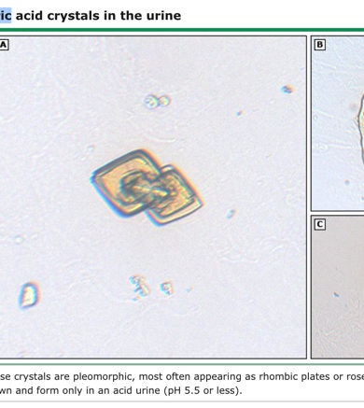
Uric acid
Most common crystal form that contains urate.
Rare crystals that contain urate include sodium urate (which is present in the joint fluid of patients with gouty arthritis) and ammonium urate.
Uric acid is present in approximately 8 percent of analyzed stones, sometimes in combination with calcium oxalate.
The urinary risk factors for uric acid crystal formation are lower urine volume, higher urine uric acid excretion.
Uric acid crystals are pH sensitive, only forming in "acidic" urine (usually pH 5.5 or lower). The urine pH is the most important factor and a much stronger promoter of uric acid crystal formation than the amount of uric acid in the urine

Slide 53
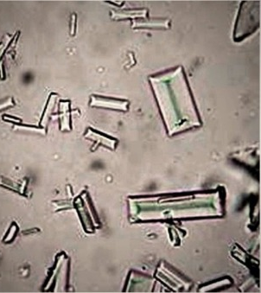
Struvite
Approximately 1 percent of analyzed stones
More common in women than in men (due to the higher risk of urinary tract infections in women).
If a preexisting calcium-containing kidney stone is subsequently infected with a urease-producing bacterium, the stone analysis may report that the composition of the stone includes calcium oxalate or calcium phosphate in addition to struvite.
Because urease splits urea into one carbon dioxide molecule and two ammonia molecules, the net reaction often leads to a urine pH outside of the physiologic range (8.5 or 9).

Slide 54
Clinical relevance of knowing stone composition
Calcium oxalate monohydrate and brushite are hard stones and may not be fragmented as easily with SWL.
Uric acid stones form in acid urine, and alkalinization of the urine can both dissolve existing uric acid stones and prevent new stones from forming.
Calcium phosphate stones form in alkaline urine, and, therefore, increasing the urine pH may increase the likelihood of calcium phosphate precipitation.
Certain stone types may indicate the existence of an underlying predisposing condition
  calcium phosphate stones in primary hyperparathyroidism and distal renal tubular acidosis
  struvite stones in upper urinary tract infection.
  Uric acid stones in DM, due to ? impaired ammoniagenesis.

Slide 55
What to do when we do not know the stone composition?
For a patient with recurrent stone disease (but the type of stone is unknown), it is reasonable to assume that the stone is calcium oxalate or calcium phosphate.
In this setting, certain disorders associated with calcium nephrolithiasis should be excluded as possible underlying causes.
If a patient is a recurrent stone former, then it should be made clear to the patient and the treating urologist that a stone must be sent for analysis if possible from the next stone episode.
If stone composition is unknown, then treatment recommendations to prevent future stone episodes will be influenced by the 24-hour urine results, by crystal type seen in the urine sediment, and the clinical picture.
Monitoring should be performed initially at one year and, if negative, every two to four years thereafter, depending upon the likelihood of recurrence.

Slide 56
The question again arises.. CT or USG?
To allow comparisons of stone burden over time, a modality should be selected that successfully detected the number and size of previous stones.
Stones previously visible by USG → USG
Ultrasound should not be used for radiologic monitoring if prior stones were only quantifiable with CT or KUB.
CT is the most sensitive test for detecting stones, particularly small stones. However, repeated use of standard CT is associated with the highest cumulative dose of radiation.
Low dose CT significantly reduces the amount of radiation exposure and continues to be an effective tool in the setting of acute stone evaluation and during follow-up in the urology clinic in patients with urolithiasis.

Slide 57
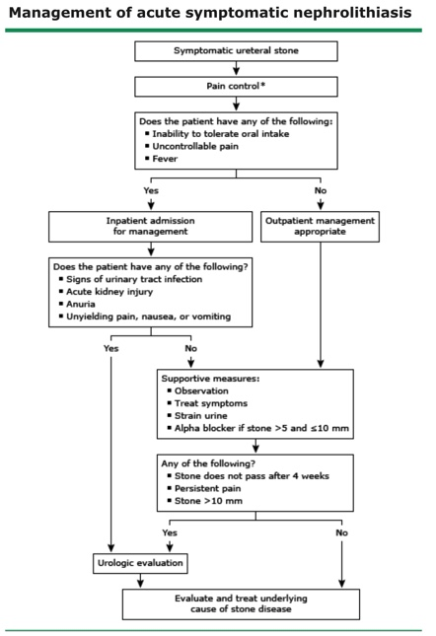
Medical Management
Pain control- NSAIDs rather opioids as the initial choice
Opioids for patients who have contraindications to NSAIDs, have severe kidney function impairment (ie, estimated glomerular filtration rate [eGFR] <30 mL/min/1.73 m²), or do not achieve adequate pain relief with NSAIDs.
Patients who are managed as outpatients should be instructed to report to the emergency department if the pain does not resolve within four hours of the start of the pain.
NSAIDs should be stopped three days before anticipated shock wave lithotripsy (SWL) to minimize the risk of bleeding.

Slide 58
Will a stone pass?
Depends upon the size and location of the stone- smaller and more distal stones are more likely to pass without intervention.
Stone size is the major determinant of the likelihood of spontaneous stone passage.
Most stones ≤5 mm in diameter pass spontaneously.
For stones larger than 5 mm in diameter, there is a progressive decrease in the spontaneous passage rate, which is unlikely with stones ≥10 mm in diameter.
Proximal ureteral stones are also less likely to pass spontaneously.

Slide 59
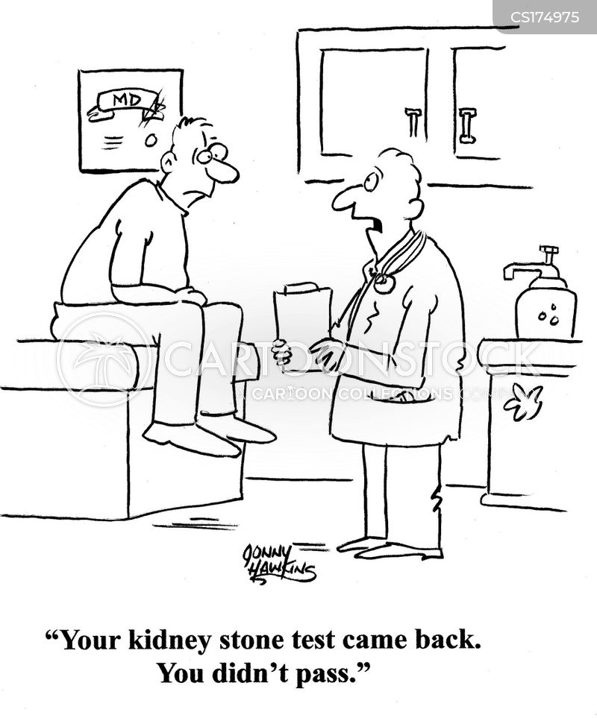
The likelihood of spontaneous stone passage is –
80% for 1 mm stones
75% of 2 to 4 mm stones
60% for 5 to 7 mm stones
50% for 7 to 9 mm stones
25% for stones ≥9 mm.
Spontaneous passage by stone location-
50% for stones in the proximal ureter
80% of stones at the ureterovesical junction.

Slide 60
Medical expulsion therapy
MET increase the passage rate of ureteral stones, including alpha blockers, calcium channel blockers, and antispasmodic agents, with or without glucocorticoids.
In patients with ureteral stones >5 mm and ≤10 mm in diameter, alpha blocker Tamsulosin (0.4 mg once daily) for up to four weeks to facilitate spontaneous stone passage.
Patients are then reimaged if spontaneous passage has not occurred.
Do not administer Tamsulosin or any other form of MET in patients with ureteral stones ≤5 mm or >10 mm in diameter.

Slide 61
What to do in those who do not pass the stone with Tamsulosin?
Obtain imaging to confirm stone passage and refer to urology for potential intervention.
USG to assess for ureteral stone resolution and ongoing hydronephrosis.
Digital tomosynthesis (DT) has been shown to be an effective alternative to noncontrast CT for the follow-up of nephrolithiasis with the added benefits of lower radiation exposure and lower cost.

Slide 62
Urology — Urgent consultation is warranted in patients with urinary tract infection, acute kidney injury beyond that expected from unilateral obstruction, anuria, and/or unyielding pain, nausea, or vomiting.
Outpatient urology referral is indicated in patients with a stone >10 mm in diameter and in patients who fail to pass the stone after a four-week trial of conservative management, including MET, particularly if the stone is >5 mm in diameter or if there is poorly controlled pain.
Current options for therapy of stones that do not pass include SWL, ureteroscopy (URS) with laser lithotripsy, percutaneous nephrolithotomy (PNL), and in rare cases, laparoscopic stone removal.
URS offers higher stone-free rates but with a slightly increased incidence of complications over SWL.
For patients with larger kidney calculi (eg, >1.5 cm), kidney stones of harder composition (eg, cystine or calcium oxalate monohydrate), or stones in complex kidney or ureteral locations (eg, lower pole calyx or mid-ureter), endoscopic stone fragmentation with URS or PNL is preferred.
Once the acute stone episode is over and the stone, if retrieved, is sent for analysis, the patient should be evaluated for possible underlying causes of stone disease.

Slide 63
Surgical Management
Indications for elective surgery –
Ureteral stones >10 mm
Uncomplicated distal ureteral stones ≤10 mm that have not passed after four to six weeks of observation, with or without medical expulsive therapy (MET)
Symptomatic kidney stones in patients without any other etiology for pain
Pregnant patients with ureteral or kidney stones in whom observation has failed
Persistent kidney obstruction related to stones
Recurrent UTI related to stones
(2016 American Urological Association/Endourological Society guidelines)

Slide 64
SWL vs URS
For proximal and mid-ureteral stones that are ≤10 mm- SWL or URS as first-line therapy
For proximal and mid-ureteral stones that are >10 mm- URS as first-line therapy
For all distal ureteral stones- URS as first-line therapy
PNL and laparoscopic, robot-assisted, and open surgery may be considered for patients in
  whom SWL and/or URS are unsuccessful
  complex kidney or ureteral anatomy
  with large (>20 mm) or complex stones
  requiring concomitant reconstructive surgery for anatomic defects (eg, ureteropelvic junction [UPJ] obstruction or ureteral stricture)

Slide 65
When not to do SWL?
Obesity
Pregnancy
Uncontrolled bleeding diathesis
Abnormal kidney/ureteral anatomy,
Preoperative imaging with computed tomography (CT) demonstrates high attenuation of the stone (ie, >900 Hounsfield units), calcium oxalate monohydrate stones, brushite stones

Slide 66
A 2016 systematic review that evaluated the efficacy of URS and SWL for the treatment of ureteral stones reported the following findings:
The overall SFR was significantly higher with URS as compared with SWL (90 versus 72 percent).
For stones ≤10 mm, SFRs were superior for URS compared with SWL at all locations in the ureter: 85 versus 67 percent for proximal ureteral stones, 91 versus 75 percent for mid-ureteral stones, and 94 versus 74 percent for distal ureteral stones.
For stones >10 mm, SFRs were comparable between SWL and URS in the proximal ureter (74 versus 79 percent, respectively) but were superior for URS in the middle and distal ureter (83 versus 67 percent for mid-ureteral stones and 92 versus 71 percent for distal ureteral stones).
Rates of UTI, sepsis, ureteral stricture, or ureteral avulsion were comparable between SWL and URS. However, ureteral perforation occurred more frequently with URS than with SWL (3 versus 0 percent).

Slide 67
Indications for emergency surgery –
Urgent decompression of the collecting system is indicated in the following clinical scenarios:
Patients with obstructing stones and suspected or confirmed urinary tract infection (UTI)
Patients with bilateral obstruction and acute kidney injury (AKI)
Patients with unilateral obstruction with AKI in a solitary functioning kidney

Slide 68
A ureteral stent or percutaneous nephrostomy tube can be used to drain the collecting system.
Definitive stone management can proceed once the infection is treated and the patient is stable.
Stone manipulation in this setting may lead to life-threatening sepsis and should therefore be avoided.
The choice between a ureteral stent or nephrostomy tube may be decided by the operating urologist; both have been shown to be equally effective at drainage.

Slide 69
Shock Wave Lithotripsy
SWL can be used to treat small- to medium-sized kidney stones
Not ideal for the management of large or complex stones or stones located in the lower pole of the kidney. The dependent location of lower pole stones makes it more difficult for fragments produced by SWL to be cleared from the kidney.
Done on an outpatient basis with the patient under conscious sedation, general anesthesia, or regional anesthesia.
Employs high-energy shock waves produced by an electrical discharge. The shock waves are transmitted through water and directly focused onto a kidney/ureteral stone with the aid of biplanar fluoroscopy. The change in tissue density between the soft kidney tissue and the hard stone causes a release of energy at the stone surface. This energy fragments the stone.

Slide 70
The main limitations of SWL are the completeness of stone fragmentation as well as the completeness of fragment elimination.
Alpha blockers may be prescribed to facilitate stone passage following SWL.
Complications – low complication rate.
  Up to 5 percent of patients may experience ureteral blockage due to stone fragments, which is usually transient
  up to 2 percent of patients may develop urinary tract infection (UTI).
  Transient hematuria is common after the procedure but typically resolves within days.
  Major complications such as sepsis and hemorrhage are rare and occur in less than 1 percent.

Slide 71
Ureteroscopy
Treatment of choice for the majority of middle and distal ureteral stones
To manage proximal ureteral and kidney stones.
To manage ureteral stones that have failed SWL.
URS is the modality of choice for patients with obesity, with hard stones, or who are pregnant or have a bleeding diathesis.
Performed on an outpatient basis with the patient under GA. A small endoscope (which may be rigid, semirigid, or flexible) is passed from the urethra proximally toward the affected ureter and kidney, which enables visualization and manipulation of the stone. Flexible ureteroscopes, with their deflection capabilities, are used primarily to access the proximal ureter and intrarenal collecting system, while semirigid and rigid ureteroscopes can be used to reach stones in the mid and distal ureter.

Slide 72
Ureteral access and dilation are the first components of URS.
Ureteral balloon dilators are employed, passed over guidewires that have been fluoroscopically positioned within the kidney collecting system.
After dilation of the distal ureter, the ureteroscope can then be passed under direct vision throughout the ureter and renal pelvis.
If the obstructing stone is small enough to be extracted intact, stone baskets or grasping forceps can be employed for stone removal.
If the stone is too large for intact extraction and requires fragmentation prior to removal, laser fragmentation can be utilized to perform "intracorporeal lithotripsy." Holmium and thulium laser lithotripsy are the technologies of choice to fragment kidney or ureteral stones during URS.
A second or third URS procedure (staged URS) may be required to manage large, complex ureteral or kidney calculi.

Slide 73
Percutaneous Nephrolithotomy
Generally considered to be more effective than SWL or URS for most stones.
Typically reserved for large or complex stones or when attempts at SWL and URS are unsuccessful.
Procedure of choice for patients with stones >20 mm or staghorn stones
Done under GA in the prone or supine position and typically requires an inpatient hospital stay of one to three days.
The procedure involves making a small skin incision in the patient's flank region and then placing a hollow working sheath through the incision to the kidney under fluoroscopic or ultrasound guidance. An endoscope is then passed through the working sheath that will enable visualization and extraction of the stone.
Laser lithotripsy or lithotripters can be used if necessary to fragment the stone prior to removal.
Irrigation with NS is usually performed throughout the procedure

Slide 74
Nephrostomy tube placement –
Following percutaneous stone removal, an indwelling nephrostomy tube may be left in place to facilitate drainage from the kidney and allow for re-entry into the collecting system should a repeat PNL procedure be necessary for residual stone fragments.
However, in patients undergoing uncomplicated PNL who are presumed stone free, placement of a nephrostomy tube may be considered optional.
Tubeless PNL also offers advantages such as less pain, less debilitation, lower cost, and a shorter hospital stay.
PNL has a higher complication rate compared with URS and SWL.- 15 percent, with the most common complications being significant bleeding (8 percent), renal pelvis perforation (3 percent), and hydrothorax (2 percent). Procedural complications are more common with larger stones.
Infectious complications may also occur after PNL

Slide 75
The 2016 American Urological Association guidelines state that ureteral stent placement can be omitted in patients who meet all of the following criteria:
No suspected ureteric injury during URS
No evidence of ureteral stricture or other anatomical impediments to stone fragment clearance
Normal contralateral kidney
No kidney function impairment
No secondary URS procedure planned

Slide 76
Post-op complications
Stent discomfort is common - treatment with an alpha blocker (Tamsulosin 0.4 mg daily, until the stent is removed)
Ureteral obstruction — The accumulation of stone fragments or stone gravel in the ureter, known as steinstrasse, occurs in approximately 4 to 7 percent of cases of SWL and may cause ureteral obstruction.
  Larger stone size appears to be the major predictive factor in steinstrasse formation. Patients may be asymptomatic or may present with passing gravel in the urine, flank pain, and/or fever.

Slide 77
Urinary tract infection (UTI) may occur following SWL, URS, or percutaneous nephrolithotomy (PNL).
A follow-up urinalysis should be performed in all patients following stone removal at two to three weeks after stone surgery when the patient returns for a postoperative follow-up visit or at any time if the patient is symptomatic.

Slide 78
Disease progression from residual stones
Persistent stone fragments are particularly important in patients with struvite (infection) stones
Residual stone fragment larger than 4 mm is associated with higher rates of stone-related events and shorter time to occurrence of stone-related events.
The growth and spontaneous passage of residual fragments appears to be independent of fragment size, emphasizing the importance of obtaining a stone-free status after PNL.
Given that the presence of residual stone fragments after stone removal increases the risk for future clinical stone disease, all attempts to render a patient completely stone free should be made.

Slide 79
Prevention of recurrent calcium stones in adults
Increase fluid intake — spread throughout the day, atleast 2L/day
Reduce nondairy animal protein intake — Nondairy animal protein is much more likely to induce stone formation than vegetable protein since it has a higher sulfur content and therefore generates more acid
Increase fruit and vegetable intake — Foods that are rich in potassium, particularly fruits and vegetables
Limit dietary oxalate intake — To be avoided (eg, spinach, rhubarb, potatoes), nuts and legumes (eg, peanuts, cashews, and almonds).
Low-sodium diet (to 80 to 100 mEq/day) can enhance proximal sodium and calcium reabsorption, leading to a reduction in calcium excretion
Limit sucrose and fructose intake

Slide 80
Drug Therapy
Indicated if the stone disease remains active (formation of new stones, enlargement of old stones, or the passage of gravel)
If there is insufficient improvement in the urine chemistries despite attempted dietary modification over a three- to six-month period. The aim of therapy is to prevent further calcium oxalate precipitation
Thiazide diuretics to reduce urine calcium
Allopurinol for high urine uric acid
Potassium citrate or potassium bicarbonate for low urine citrate

Slide 81
Thiazides in hypercalciuria
Thiazide therapy can lower calcium excretion by as much as 50 percent- primarily by inducing mild volume depletion, leading to a compensatory rise in the proximal reabsorption of sodium, and therefore of passive calcium reabsorption.
The net effect may be a 90 percent reduction in the incidence of new stones.
Generally started at 25mg/day of HCT.
A low-sodium diet is essential for the diuretic to effectively lower urinary calcium.

Slide 82
Uric acid is no longer believed to act as a nidus for stone formation.
Increasing urinary citrate excretion is the goal in patients with low urine citrate
Citrate excretion can be enhanced by alkalinizing the plasma by the daily administration of 30 to 80mEq of Potassium citrate or potassium bicarbonate.
Treatment in individuals with enteric hyperoxaluria is directed toward diminishing intestinal oxalate absorption. The initial regimen consists of a high fluid intake, potassium alkali salt to correct metabolic acidosis if present, and oral Calcium carbonate or citrate (1 to 4g/day) with meals to bind oxalate in the intestinal lumen.

Slide 83
Impact of Nephrolithiasis on kidney function
Obstructive AKI –
10-15% of obstructive AKI caused by nephrolithiasis
1-2% of all AKI events
Factors predicting development of AKI-
  Larger stones (1.05±0.34 cm vs. 0.82±0.40 cm)
  Bilateral ureteral stones
  Presence of a solitary kidney
  Preexisting CKD.
  More common factor in paediatric AKI, up to 30%!

Slide 84
Determinants of renal outcome
Extent and duration of the obstruction
Presence or absence of infection
If outflow is restored in less than 2 weeks, no evidence of long-term renal damage is observed-
The urinary epidermal growth factor (EGF)/ monocyte chemotactic peptide-1 (MCP-1) ratio measured 4 weeks after relief of obstruction correlate with long term outcome, suggesting pathways that favour long term fibrosis are activated quite early
Short-term structural and functional injury after shock wave lithotripsy (SWL), including the development of hematomas, these changes appear to be temporary and largely resolve within 1 to 3 months

Slide 85
RDI model- one year Renal Deterioration Index
Combined renal cortical width
Proteinuria
Nadir GFR 5 days after relief of obstruction
Positive urine culture
RDI > 12 at presentation had markedly increased odds ratio (11.2) of being at CKD stage 5 one year later

Slide 86
Risk of CKD
0.8 to 17.5% of nephrolithiasis patients have CKD stage 2 or greater
0.8–3.2% of ESRD has been attributed to stone disease
  specific urological diagnoses including hydronephrosis
  recurrent urinary tract infection
  a solitary kidney
  neurogenic bladder and ileal conduit
  Struvite stones when compared to Uric acid and Ca stones
  Hereditary stones such as primary hyperoxaluria, cystinuria, Dent disease, and adenine phosphoribosyltransferase deficiency,

Slide 87
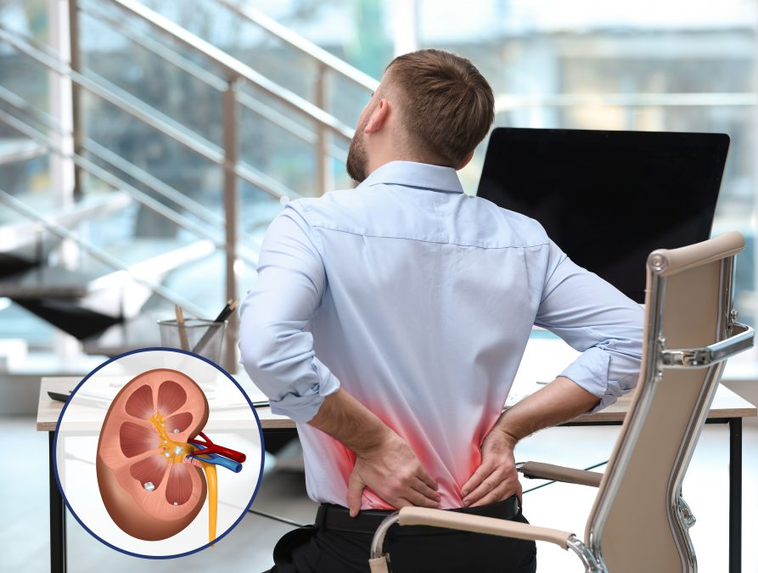
Thank you

