Slide 1
यह कार्यक्रम स्वास्थ्य विभाग और राज्य स्वास्थ्य एवं परिवार कल्याण संस्थान (SIHFW), उत्तर प्रदेश की पहल पर उत्तर प्रदेश टेक्निकल सपोर्ट यूनिट (UPTSU) के सहयोग से हो रहा है।
Principal Secretary, Medical Health & Family Welfare, U.P. Shri Partha Sarthi Sen Sharma
Secretary, Medical Health & Family Welfare, U.P.
Shri Ranjan Kumar
Director Administration & Director, SIHFW
Shri Shiv Sahay Awasthi
1

Slide 3
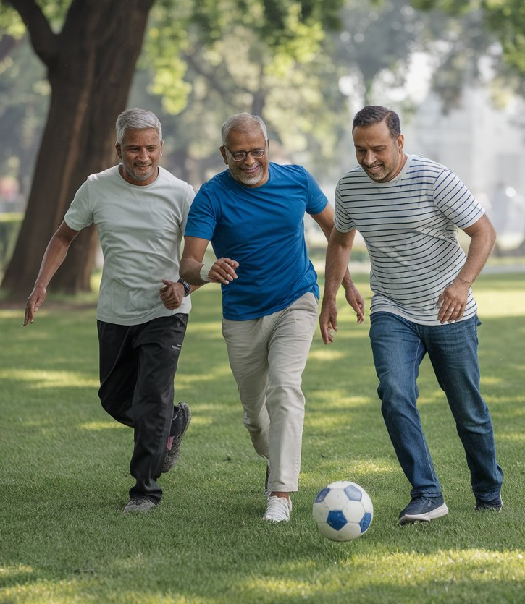
LIFESTYLE DISORDERS PREVENTATION AND MANAGEMENT
Dr. AWADHESH DWIVEDI
(BHMS, MD) In charge,
State Government Dispensary,
Manwa, Sitapur

Slide 4
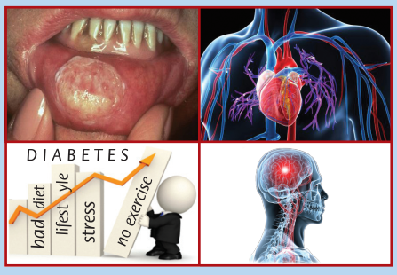
DEFINITION
Lifestyle disorders refer to a group of chronic diseases or conditions that are primarily caused or exacerbated by an individual's lifestyle choices, habits, and environmental factors. These disorders often result from a combination of factors, including:
1. Unhealthy diet and nutrition
2. Sedentary lifestyle or lack of physical activity
3. Stress and poor stress management
4. Poor sleep habits
5. Substance abuse (tobacco, alcohol, drugs)
6. Environmental factors (pollution, UV radiation)
Lifestyle disorders are chronic conditions linked to unhealthy habits and choices. They have a significant impact on individual well-being and healthcare systems.

Slide 5
Lifestyle disorders are often characterized by:
1. Gradual onset and progression
2. Reversible or manageable with lifestyle changes
3. Strong link to lifestyle habits and environmental factors
4. Increased risk of complications and comorbidities
5. Impact on quality of life and daily functioning
Early detection, prevention, and management of lifestyle disorders can significantly reduce the risk of developing these conditions and improve overall health and well-being.

Slide 6
INCIDENCE
Obesity - 30-40%
Diabetes - 10-15%
Hypertension – 30-35%
Heart Attack - 10-15%
Depression - 15-20%
Higher in urban areas

Slide 7
RISK FACTOR
Controllable Risk Factors
Factors include habits, behaviors, and practices one can change.
Diet
Body weight
Physical activity
Sun exposure
Smoking
Alcohol consumption
Risk factors that cannot be changed or controlled
- Age
Gender
Ethnicity
Heredity

Slide 8
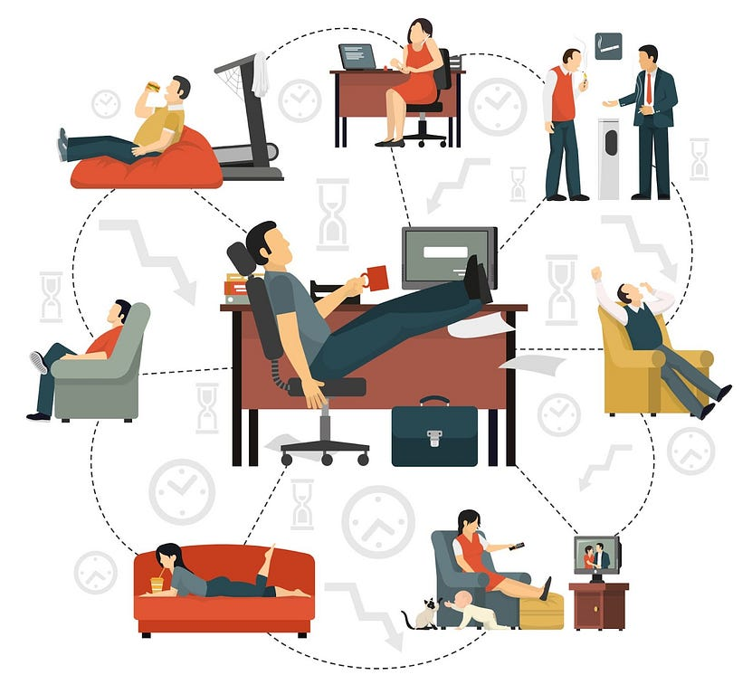
SEDENTARY LIFESTYLE
Increase use of technology
Increase use of automobiles
Benefits of physical activity
Reduce obesity
Reduce HT, DM & Cholesterol
Improve physical & mental strength

Slide 9
FOOD HABITS
Change in food habits
Artificial ingredients
Change in food habits
Change in quality of food
Increase sugar intake
Increase in calorie intake

Slide 10
SMOKING / TOBACCO
Smoking is injurious to health
Increase HR
Increase BPIncrease Heart attack
Increase Stroke
Cancer
Lung diseases
Low sperm count

Slide 11
ALCOHOL
Various adverse effect
Depression
Financial crisis
Bad quality of alcohol
End stage liver

Slide 12
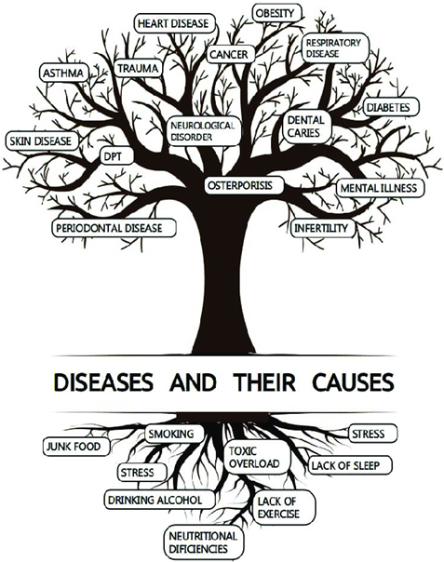
TREE OF LIFESTYLE

Slide 13
CATEGORIES OF LIFESTYLE DISORDERS
Metabolic Disorders (Diabetes, hyperlipidemia, etc.)
Cardiovascular Disorders (Heart Disease, Hypertension, Stroke, etc.)
Mental Health Disorders (Depression, Anxiety, etc.)
Musculoskeletal Disorders (Osteoporosis, Back Pain, etc.)

Slide 14
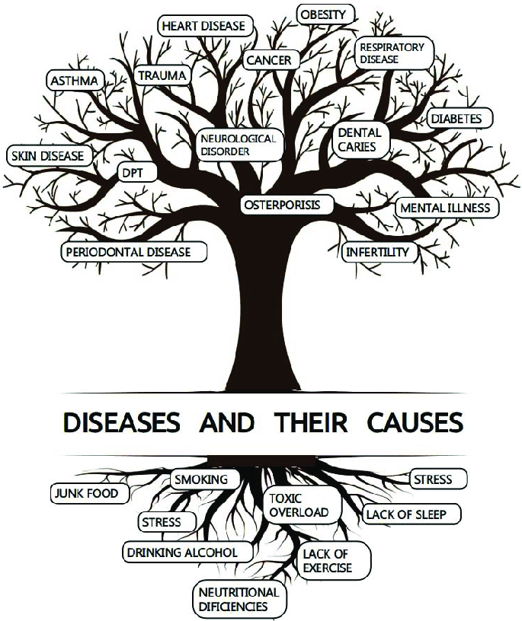
Common examples of lifestyle disorders include:
Cardiovascular disease
(hypertension, heart disease, stroke)
2. Obesity and overweight
3. Diabetes (type 2)
4. Cancer (certain types, such as breast, colon, lung)
5. Respiratory diseases (COPD, asthma)
6. Mental health disorders (depression, anxiety)
7. Gastrointestinal disorders (IBS, acid reflux)
8. Musculoskeletal disorders (back pain, osteoporosis)

Slide 15
PREVENTION & MANAGEMENT OF LIFESTYLE DISORDERS
Lifestyle disorders are preventable and manageable
Making healthy lifestyle choices can significantly reduce the risk of developing various disorders such as obesity, heart disease, and type 2 diabetes.
A holistic approach is essential
Incorporating a balanced combination of nutritious diet, regular exercise, and mental well-being practices is crucial for overall health and disease prevention.
Community and professional collaboration is beneficial
Joining forces with community support groups and healthcare professionals can lead to better treatment adherence, support systems, and improved health outcomes.
Continuous education and awareness are vital
Regularly staying informed about the latest research, guidelines, and healthy practices is key to sustaining long-term success in managing lifestyle-related health conditions.

Slide 16
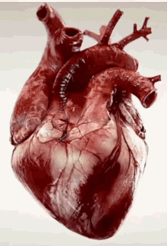
CARDIOVASCULAR DISEASE (HYPERTENSION, HEART DISEASE, STROKE)
Heart diseases are an example of lifestyle diseases and refers to conditions involving the heart, its valves, muscles, vessels, or internal electric pathways responsible for muscular contraction.
Some of the commonly occurring conditions of heart disease include the following: Heart failure,Hypertension, Arrhythmias, and Ccardiomyopathy

Slide 17
HYPERTENSION
Hypertension or high blood pressure refers to the tension or high pressure in the arteries - the vessels responsible for carrying blood from the heart to the rest of the body.
The various complications of hypertension are kidney (renal) disease, heart disease, eye damage, stroke (brain damage), and hardening of the arteries (arteriosclerosis or atherosclerosis).

Slide 18
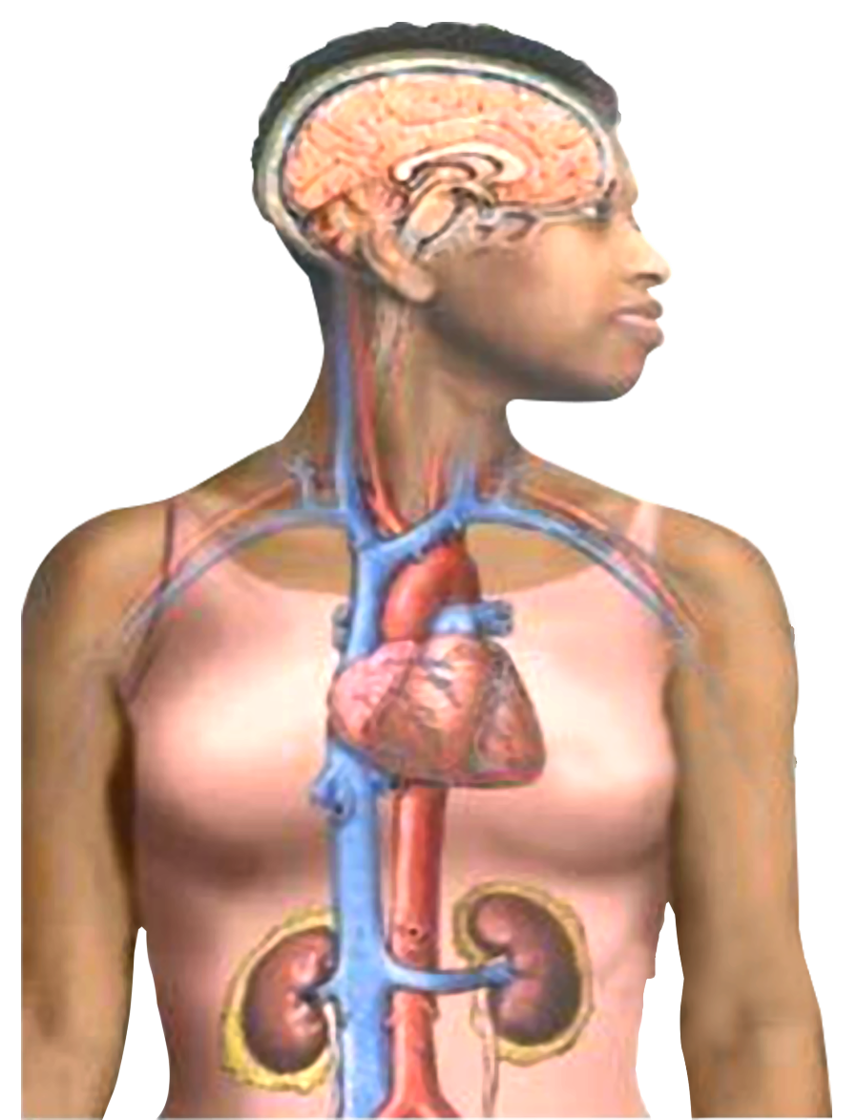
Effect of Hypertension
The common target organs damaged by long standing hypertension are:
Brain
Heart
Kidneys
Eyes &
Peripheral arteries.
Without treatment, high blood pressure (hypertension) can lead to:
Stroke
Blood vessel damage (arteriosclerosis)
Heart attack or heart failure
Kidney failure

Slide 19
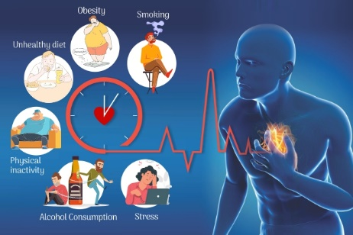
Prevention of Cardiovascular Diseases
Trim your fat intake, eat healthy
Cut down on salt
Keep your weight healthy
Don’t smoke
Don’t take alcohol
Do Yoga and exercise
Monitor your blood pressure and cholesterol
Relax & cut down on stress

Slide 20
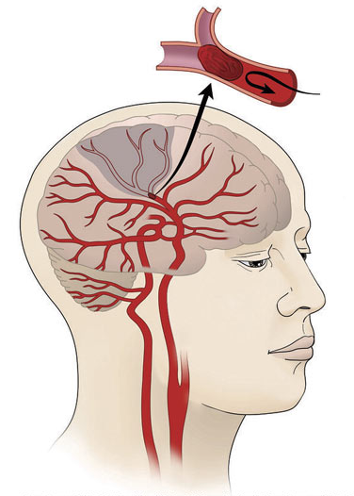
STROKE
A stroke occurs when a portion of the brain loses blood supply and stops working. This results in the part of the body being controlled by the injured brain to stop working.
A stroke is mainly caused because of two reasons – bursting or leaking of a blood vessel (hemorrhagic stroke) or a blocked artery (ischemic stroke).

Slide 21
Prevention of Stroke
Weight Reduction
Smoking cessation
Reduce salt & saturated fat intake.
5 fruits / vegetables a day
Limit alcohol consumption
Regular exercise
If you are hypertensive then don’t skip your Anti-hypertensive drugs

Slide 22
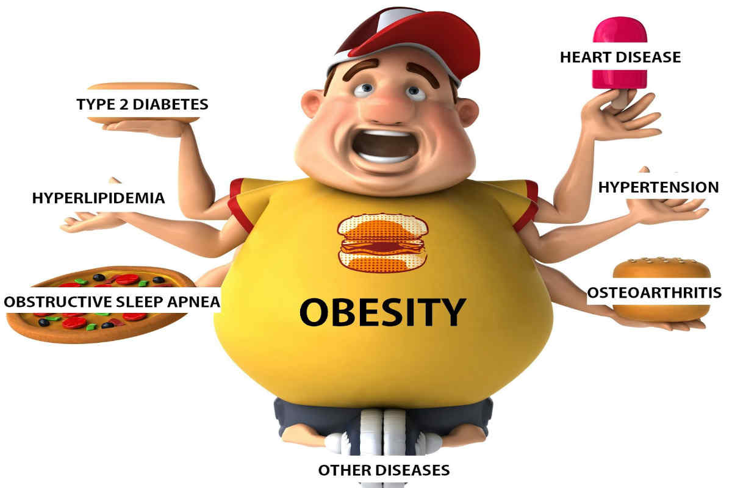
OBESITY
Individuals become obese because of unhygienic and unhealthy eating habits, reduced physical activity, stressful lifestyles, and other factors.
Obese individuals have a body mass index (BMI) greater than 25, and they suffer from cardiovascular diseases, breathing problems, blood pressure, and diabetes.

Slide 23
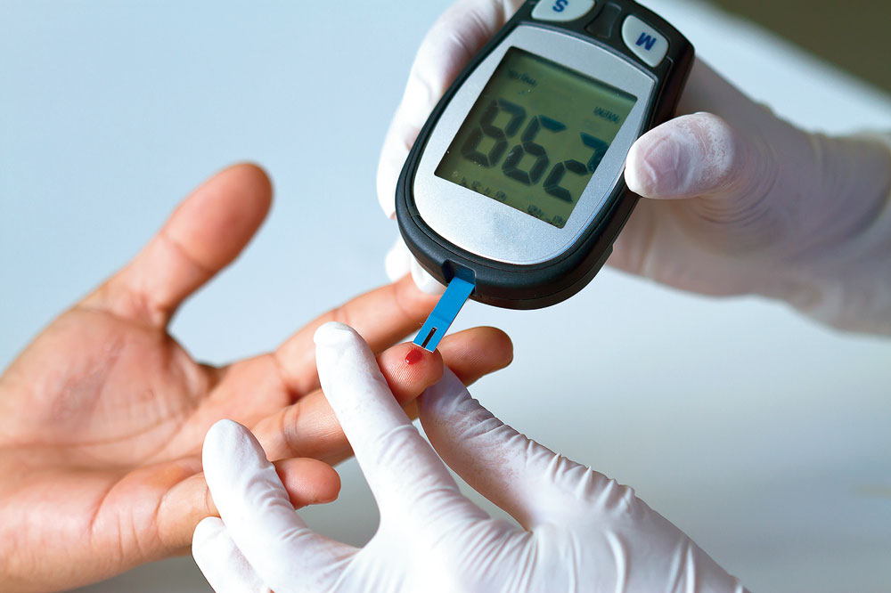
DIABETES
A disorder in which cells are unable to obtain glucose from the blood such that levels high blood-glucose result.
Type 1- Body’s inability to produce insulin (born with)
Type 2 - Inability to respond to\ insulin (develop)
Type 2 Diabetes
Type 2 diabetes refers to a condition where cells cannot utilize glucose or blood sugar efficiently for energy. This occurs when the cells become insensitive to insulin, and the blood sugar levels gradually become too high.
A combination of several factors like broken beta cells, extra weight, metabolic syndrome, etc., are responsible for the cause of this lifestyle disease.

Slide 24
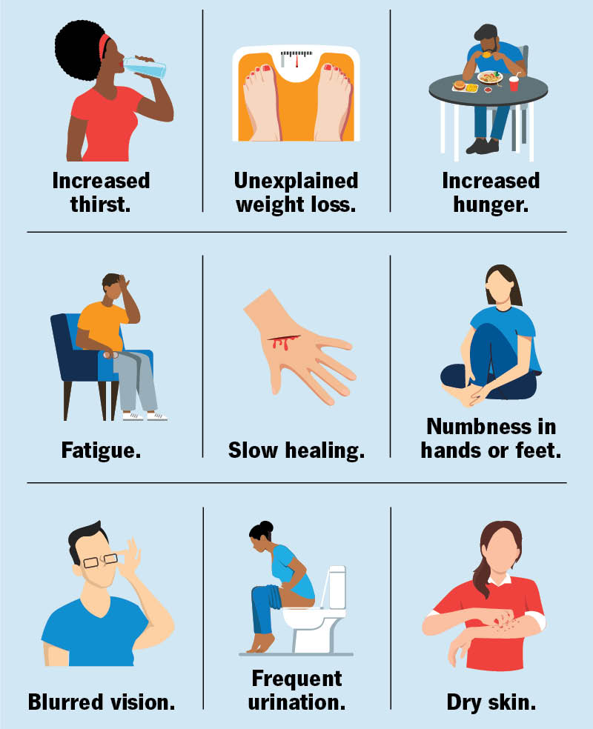
Prevention of Diabetes
Type 2 Diabetes can be prevented by
> Maintaining a healthy weight
> Avoiding smoking > Reduction of Stress > Avoiding Sedentary life > Avoid Junk foods > Exercise-that reduce insulin requirements

Slide 25
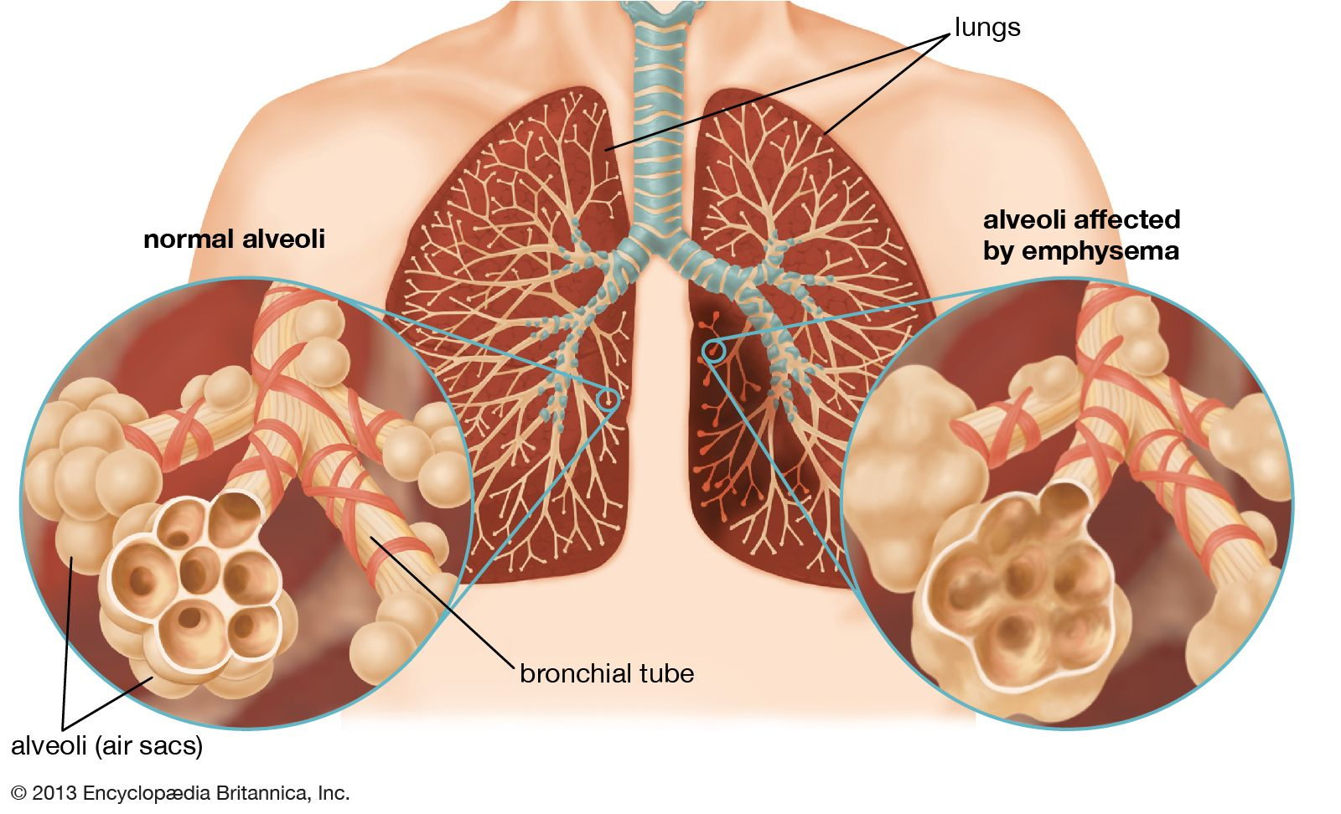
CHRONIC OBSTRUCTIVE PULMONARY DISEASES (COPD)
Chronic obstructive pulmonary disease (COPD) refers to a chronic lung disease that leads to obstructed and inflamed airflow from the lungs.
The various symptoms of COPD include chronic cough with mucus, wheezing, long-term breathing issues, etc.

Slide 26
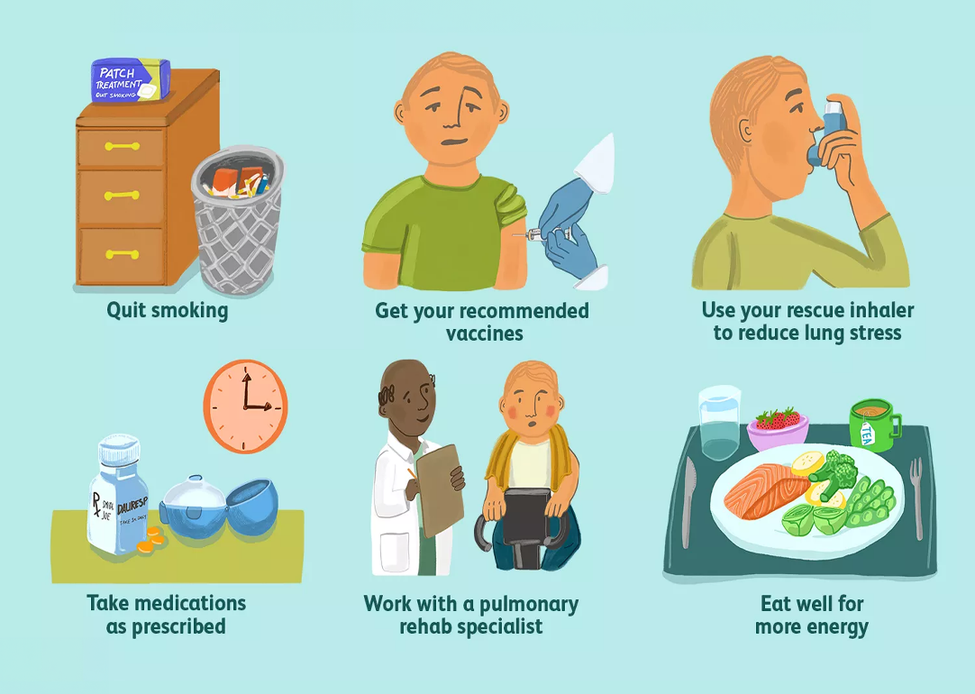
Prevention of COPD
Quit Smoking.
Have Healthy Diet
Take nutrition supplements if malnourished
Do Breathing exercise.
Avoid exposure to fumes & dust.
Improve both indoor & outdoor air quality

Slide 27
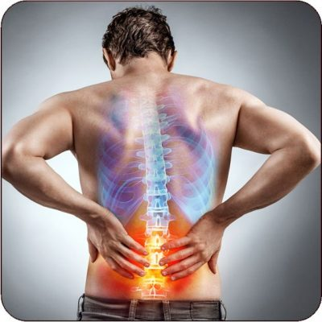
MUSCULOSKELETAL DISEASE
Spondylosis, Osteoporosis, Backpain
Healthy diet with physical activity in childhood & adolescence builds strong & healthy bones.
High peak bone density in this age reduces the risk of osteoporosis in later stages of life.
Exercise strengthens the bones, ligaments & muscle surrounding joints.
With no exercise ligaments become shorter with less elasticity, muscle tone will be lost thus reduce the stability, synovial fluid will be reduced, making the joint more prone to injuries

Slide 28
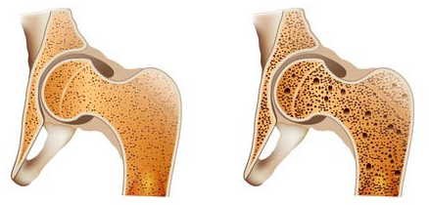
Osteoporosis
Osteoporosis is a lifestyle disorder caused because of a lack of androgen hormones in men and estrogen hormones in women.
This bone-weakening disease is an example of a commonly occurring lifestyle disease in India, and there are over 10 million cases recorded per year.

Slide 29
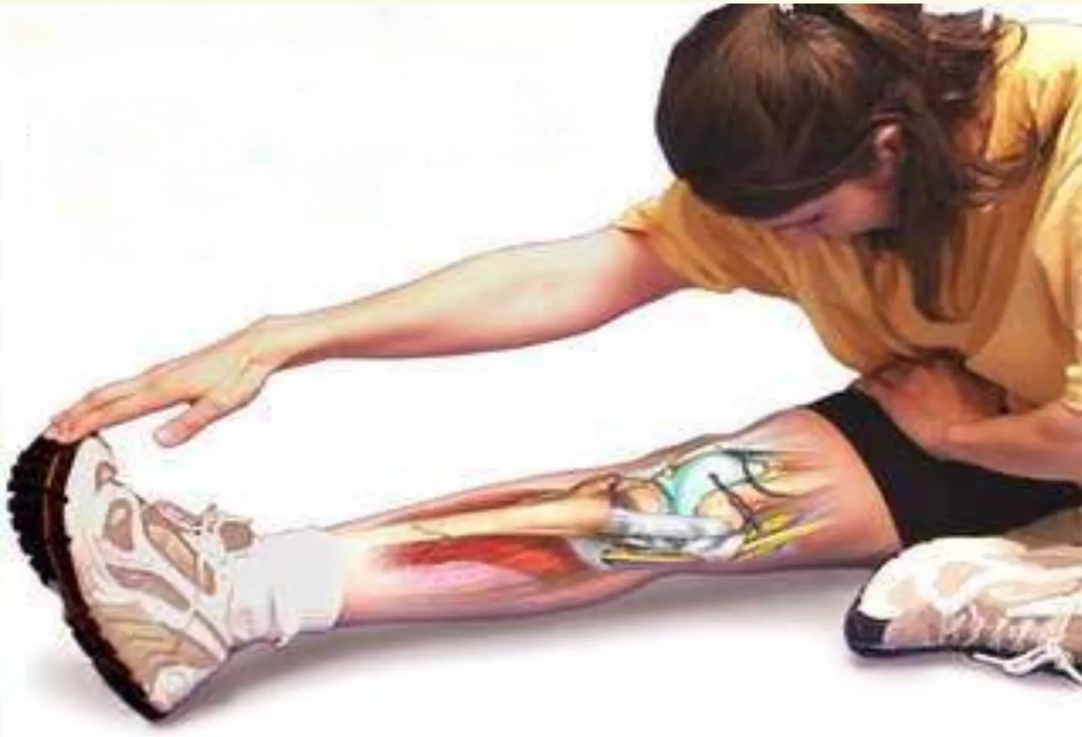
Flexibility exercises help stretch muscles, protect against injury and allow the maximum range of motion for joints

Slide 30
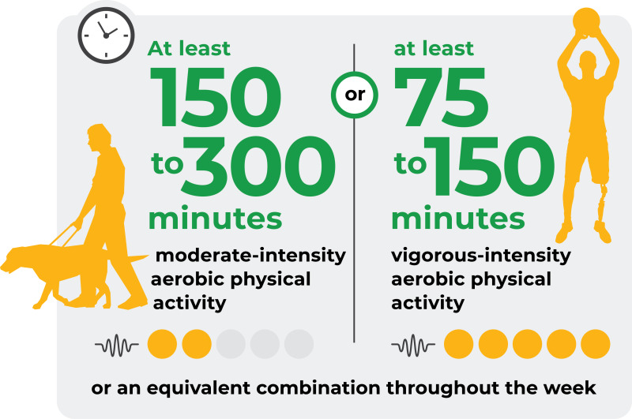
Minimum recommendation for physical Activity by WHO
Children & young people: moderate intensity activity for at least 60m per day.
Adults:- at least 30 mints of exercise most if not all days. Should include flexibility, muscle strength & endurance exercise twice a week.
60 to 90 mints to improve when already in poor health or to lose weight.
Moderate exercise is Brisk walking, swimming, cycling, gardening with moderate effort

Slide 31
STRESS - ADVERSE EFFECTS
Atherosclerosis
Chronic Fatigue
Increase BP
Altered habits
Sleep problem
Depression
Hypertension
Migraines
Stress Effects on Body
Acne
Hives
Depression
Sleep Deprivation
Eating Disorders

Slide 32
DEPRESSION
Depression is a state of low mood and aversion to activity that can affect a person's thoughts, behavior, feelings and sense of well-being. Depressed people can feel sad, anxious, empty, hopeless, worried, helpless, worthless, guilty, irritable, hurt, or restless.
Life events and life style that may precipitate depressed mood include childbirth, menopause financial difficulties, job problems, a medical diagnosis, loss of a loved one, natural disasters, social isolation, relationship troubles, jealousy, separation.

Slide 33
Prevention of Stress and Depression
Healthy Eating- The easiest way to improve your diet is to cut out the junk. Avoiding foods high in refined sugar, and foods packed with saturated fats should be your first step, include amino-acid-rich foods such as meat, dairy products, and certain fruits and vegetables in your diet.
Complex carbohydrate helps to stimulate the feel-good neurotransmitter serotonin, carbohydrates can be found in whole grains, legumes, vegetables such as spinach and broccoli, fruits such as oranges & pears.
Exercise- increases your body’s production of natural antidepressants. Research has shown that exercise reduces stress, improves mood, boosts self-esteem, and provides restful sleep.

Slide 34
Prevention of Stress and Depression
Weight loss- Losing weight not only improves your self-esteem and overall health, but also may give your mind the boost it needs. Eating right and exercising regularly is the tried-and-true method for losing weight and keeping it off.
Meditation-Meditation is the practice of engaging in a mental exercise—such as deep breathing or repetition of a phrase (mantra) Meditation can help relieve anxiety that sometimes accompanies depression.
Sleep-Proper sleep is an important part of a depression treatment plan. Having a calming bedtime routine that helps you wind down and following a consistent sleep

Slide 35
Prevention of Stress and Depression
Relationship-Depression can be alienating, but the right network of friends and loved ones can help you overcome your problems. Spending time with positive, supportive, and loving people can help you through your darkest times.
Avoid Sedentary life- It may lead to depression, stay active, do your hobbies, read books, take active part in social activity

Slide 36
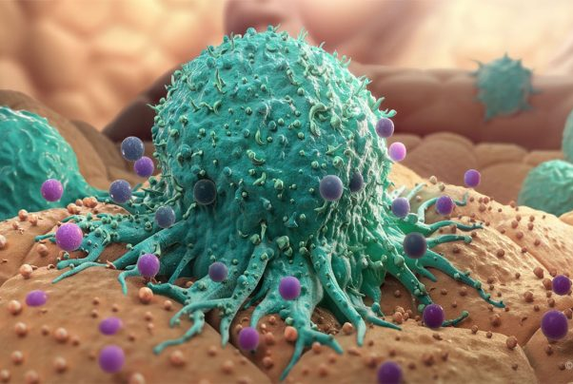
CANCER
A disease caused by uncontrolled cell growth Benign tumors are not cancerous and usually do not spread.
Malignant tumors are cancerous and do spread
Causes:
— Certain viruses (HPV)
— Radiation (UV rays. X-rays)
— Chemicals in tobacco smoke —Asbestos (material used in fireproofing)

Slide 37
Prevention of cancer
Don’t’ smoke!
Eat moderate protein
Wear sunscreen; stay away from tanning beds
Stay active
Eat your veggies and cut the fat
Get regular medical check-ups

Slide 38
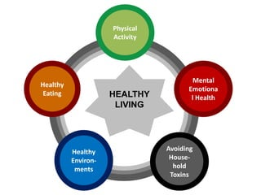
WHAT IS A HEALTHY LIFESTYLE?
As WHO (World Health Organization) define healthy lifestyle is that focuses on incorporating the eight aspects of wellbeing into one's life (emotional, environmental, financial, intellectual, occupational, physical, social and spiritual).

Slide 39
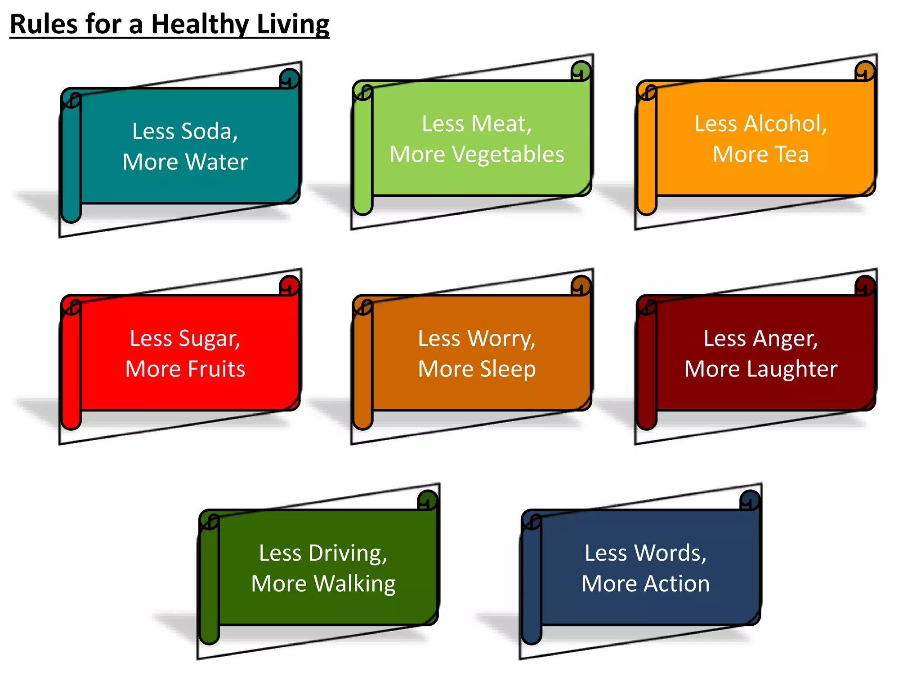

Slide 40
CHALLENGES IN MANAGEMENT OF LIFESTYLE DISORDERS
01: Lack of Awareness and Education
Many individuals lack understanding about lifestyle disorders, hindering early detection and prevention efforts.
02: Barriers to Healthcare Access
Limited access to healthcare services restricts timely diagnosis and appropriate management of lifestyle-related conditions.
03: Stigma Related to Mental Health
Social stigma often prevents individuals from seeking help for mental health issues, impacting overall well-being.

Slide 41
THE ROLE OF HEALTHCARE PROFESSIONALS
Empowering Patients Through Education and Support
01: Educating Patients
Healthcare professionals inform patients on managing lifestyle disorders effectively.
02: Tailored Treatment Plans
Customized plans are essential for addressing individual health needs and follow-up.
03: Community Engagement
Encouraging community health initiatives fosters a supportive environment for wellness.
04: Collaborative Care
Teamwork among healthcare providers enhances patient outcomes and support systems.

Slide 42
Future Trends in Lifestyle Disorder Management
01: Increased Use of Telemedicine
Telemedicine is becoming more prevalent for providing lifestyle coaching remotely, improving accessibility and convenience for individuals seeking guidance.
02: Emphasis on Personalized Nutrition and Fitness Plans
Tailoring nutrition and fitness recommendations to individual needs can enhance effectiveness and adherence, leading to better health outcomes.
03: Integration of Technology and Apps
Incorporating technology and health monitoring apps allows real-time tracking of progress, empowering individuals to take control of their health journeys.
04: Revolutionizing Lifestyle Disorder Management
The application of these trends has the potential to transform the management of lifestyle disorders by offering personalized, accessible, and data-driven solutions.

Slide 43
YOGA for Lifestyle Disorders
MEDITATION & BREATHING TECHNIQUES
YOGAS & ASANAS
Relieves Stress & Anxiety
Boost positive Energy and Mood
Help normalize Blood Pressure
Speeds up a Sluggish Digestion by massaging surrounding muscles
Increases Muscle Flexibility, Strength & Endurance
Increases feelings of Calm & Wellbeing
Heart Rate and Breathing slows down, Blood Pressure normalizes
Oxygen can be used more efficiently
Adrenal glands produce less Cortisol
Mind ages at a slower rate
Improves Immune Function

Slide 44
The Role of Yoga in Preventing Lifestyle Diseases
Yoga plays a significant role in preventing lifestyle diseases by promoting overall well-being and encouraging healthy lifestyle choices.
Here’s how yoga contributes to disease prevention:
Stress Reduction: Yoga incorporates relaxation techniques like deep breathing and meditation, which help reduce stress and its harmful effects on the body. Lower stress levels can minimize the risk of stress-related conditions such as hypertension, anxiety, and insomnia.
Physical Activity: Regular yoga practice involves gentle stretches, strengthening poses, and balance exercises, which contribute to improved flexibility, muscle tone, and joint health. Engaging in physical activity through yoga helps prevent obesity and its associated health issues.
Mind-Body Connection: Yoga fosters a strong connection between the mind and body, enhancing self-awareness and promoting mindful eating habits. Being in tune with bodily signals can lead to healthier food choices and prevent overeating.
Weight Management: Yoga can aid in weight management by burning calories and encouraging mindfulness, reducing the risk of obesity-related diseases like diabetes and cardiovascular conditions.

Slide 45
Improved Circulation: Yoga poses and breathing exercises enhance blood circulation, benefiting the cardiovascular system and reducing the risk of heart diseases.
Hormonal Balance: Certain yoga practices can regulate hormone levels, helping prevent hormonal imbalances that contribute to conditions like polycystic ovary syndrome (PCOS) and diabetes.
Enhanced Immune Function: Regular yoga practice has been linked to improved immune function, reducing the likelihood of infections and chronic illnesses.
Better Sleep: Yoga promotes better sleep quality and helps combat insomnia, contributing to overall health and vitality.
Detoxification: Yoga practices like twisting poses and deep breathing can aid in detoxifying the body, eliminating toxins, and supporting organ health.
By incorporating yoga into a daily routine, individuals can reduce the risk of developing lifestyle diseases and promote their overall health and well-being.

Slide 46
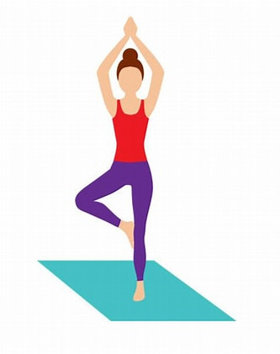
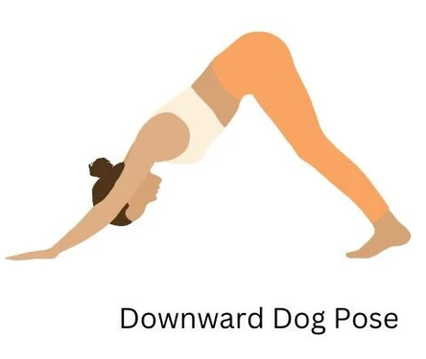
Top 10 Yog asanas for Lifestyle Disease Management
Here’s how yoga can contribute to lifestyle disease management:
1. Vrikshasana (Tree Pose)
Enhances balance and stability, benefiting those with neurological disorders and chronic headaches.
Strengthens leg muscles and pelvic region, aiding in obesity management.
Improves focus and concentration, reducing stress and anxiety.
2. Adho Mukha Svanasana (Downward-Facing Dog Pose)
Stretches and strengthens the entire body, improving joint health and flexibility.
Promotes blood circulation to brain, relieving headache and migraine symptoms.
Reduces stress and anxiety.

Slide 47
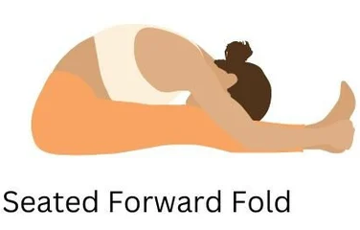
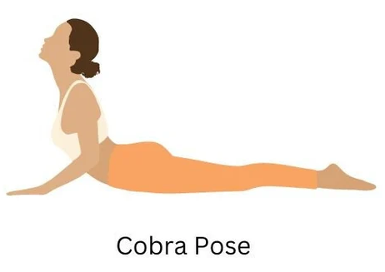
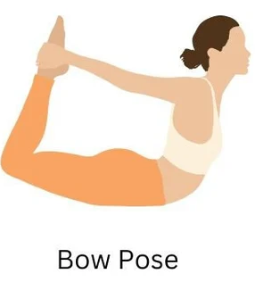
3. Paschimottanasana (Seated Forward Bend)
Alleviates lower back pain and improves posture through spine and hamstring stretches.
Stimulates abdominal organs, aiding digestion and gastrointestinal health.
Promotes relaxation and stress reduction.
4. Bhujangasana (Cobra Pose)
Opens up the chest, enhancing respiratory function.
Strengthens the spine and back muscles, supporting posture and preventing back pain.
Stimulates abdominal organs, benefiting digestion.
5. Dhanurasana (Bow Pose)
Stretches the front body, improving flexibility and stimulating abdominal organs.
Massages the digestive organs, aiding digestion.
Promotes hormonal balance, benefiting conditions like PCOS.

Slide 48
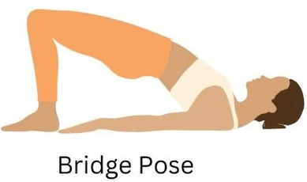
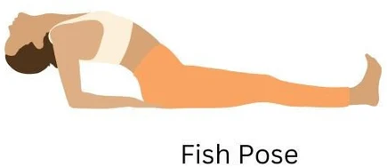
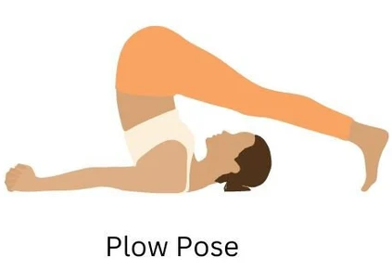
6. Setu Bandhasana (Bridge Pose)
Strengthens the back muscles and spine, aiding in back pain management.
Stimulates the thyroid gland, supporting hormonal balance.
Relieves stress and anxiety.
7. Matsyasana (Fish Pose)
Stretches the chest and throat, improving respiratory function.
Stimulates the thyroid gland and metabolism, supporting weight management.
Promotes relaxation and reduces upper body tension.
8. Halasana (Plow Pose)
Alleviates tension and stiffness in the upper body through spine and shoulder stretches.
Enhances blood circulation to the brain, boosting mental clarity.
Calms the nervous system.

Slide 49
9. Balasana (Child’s Pose)
Relieves back and neck tension, enhancing stress reduction.
Stretches hips and thighs, aiding joint health.
Encourages mindful breathing.
10. Savasana (Corpse Pose)
Induces deep relaxation, reducing stress and improving mental and emotional well-being.
Lowers blood pressure and heart rate, supporting cardiovascular health.
Allows the body to rejuvenate, enhancing overall energy levels.

Slide 50
DIET FOR A HEALTHY LIFESTYLE
To ensure a healthy lifestyle, WHO recommends eating lots of fruits and vegetables, reducing fat, sugar and salt intake and exercising. Based on height and weight, people can check their body mass index (BMI) to see if they are overweight.
Body mass index - BMI
BMI, formerly called the Quetelet index, is a measure for indicating nutritional status in adults.
It is defined as a person’s weight in kilograms divided by the square of the person’s height in meters (kg/m2).
BMI= Weight in Kilogram/Height in Meters (Kg/m2)
BMI was developed as a risk indicator of disease; as BMI increases, so does the risk for some diseases. Some common conditions related to overweight and obesity include: premature death, cardiovascular diseases, high blood pressure, osteoarthritis, some cancers and diabetes.
BMI | Nutritional status
Below 18.5 | Underweight
18.5–24.9 | Normal weight
25.0–29.9 | Pre-obesity
30.0–34.9 | Obesity class I
35.0–39.9 | Obesity class II
Above 40 | Obesity class III

Slide 51
The World Health Organization (WHO) makes the following
5 recommendations with respect to both populations and individuals:
• Eat roughly the same amount of calories that your body is using.
• Limit intake of fats, and prefer less unhealthy unsaturated fats to saturated fats and trans fats.
• Increase consumption of plant foods, particularly fruits, vegetables, legumes, whole grains and nuts.
• Limit the intake of sugar. A 2003 report recommends less than 10% simple sugars.
• Limit salt / sodium consumption from all sources and ensure that salt is iodized.

Slide 52
CONCEPT OF HEALTHY DIET
A healthy Diet is one that helps maintain or improve overall health.
• It provides the body with essential nutrition: fluid, adequate essential amino acids from protein, essential fatty acids, vitamins, minerals, and adequate calories.
• The requirements for a healthy diet can be met from a variety of plant-based and animal-based foods.
• It supports energy needs and provides for human nutrition without exposure to toxicity or excessive weight gain from consuming excessive amounts.
• The crucial part of healthy eating is a balanced diet. A balanced diet - or a good diet - means consuming from all the different good groups in the right quantities.
• Nutritionists say there are five main food groups :
Whole grains / Fruit and Vegetables / Protein / Diary / Fat & sugar

Slide 53
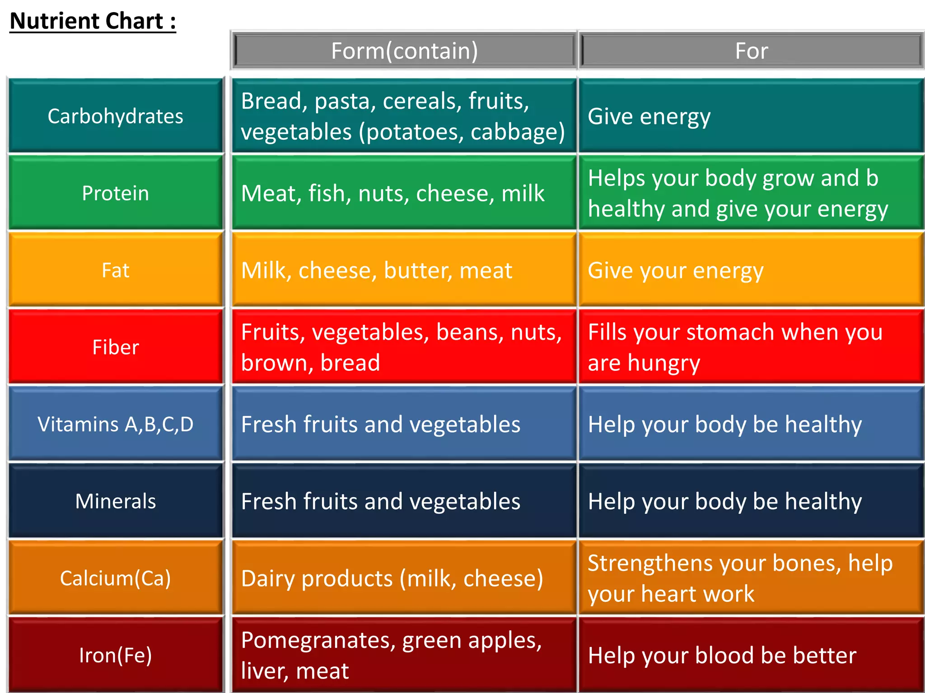

Slide 54
DIET FOR HEALTHY LIFESTYLE
Low carbohydrates, high protein, less oil
More green leafy vegetables & fruits
Avoid junk food & cold drinks
No extra added salt or sugar
Cut down oily food
No smoking
No alcohol
Drink plenty of water
Whole grain / multi grain
Avoid binge eating

Slide 55
Having a Wholesome Diet
A wholesome diet is essential for an individual’s health and wellbeing. One should consume more fresh fruits, green vegetables, and foods rich in fibre and calcium.
Maintaining a Balance Between Physical Activity and Food Consumption
It is essential for every individual to maintain the right balance between physical activity and food
Monitoring the Body Weight
Individuals must ensure to monitor their body weight closely.
Abstaining from Nicotine, Alcohol or Any Other Form of Drug
Around one-third of deaths caused due to Heart and Lung diseases can be prevented by avoiding alcohol, smoking and nicotine.

Slide 56
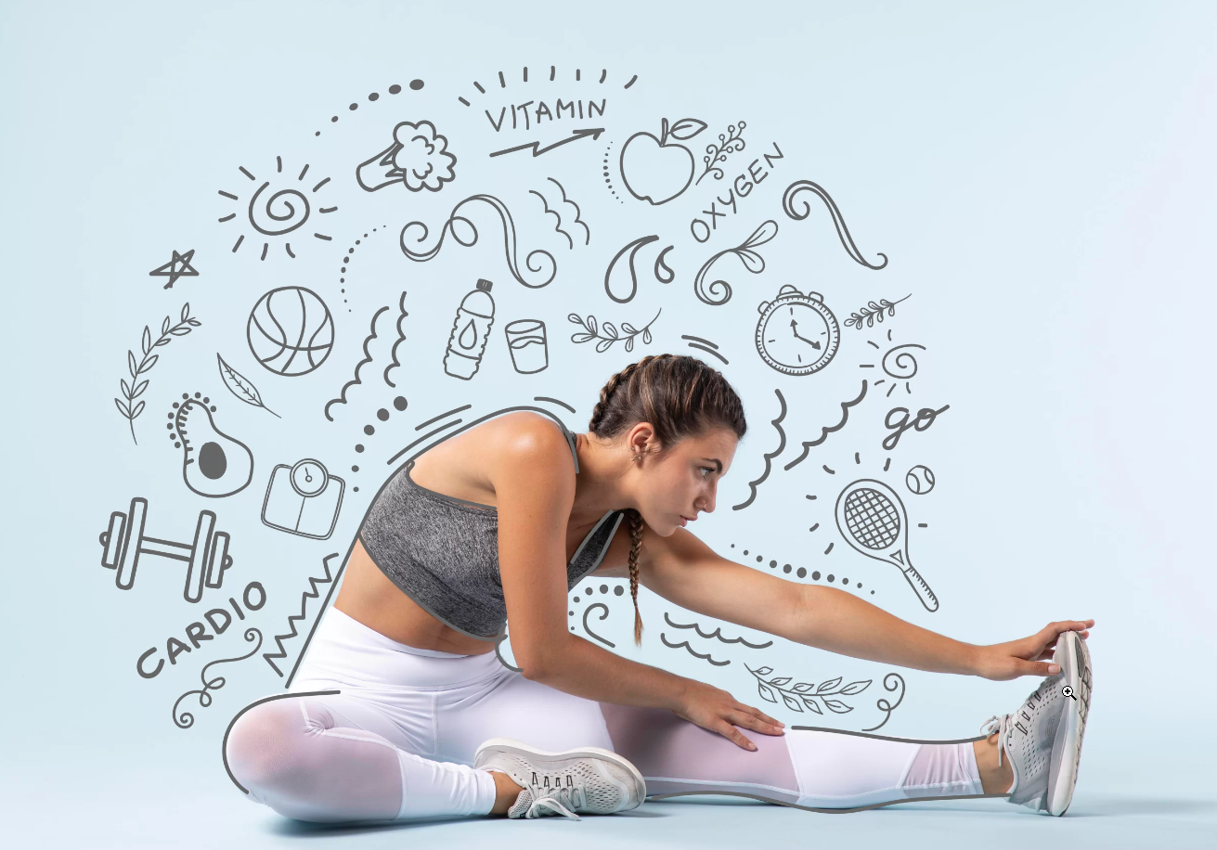
BENEFITS OF EXERCISE
Improved health
Stronger muscles
Better flexibility
Improved posture
Improved heart and lung system
Better appetite
Feeling more relaxed
Better social life
Improved quality of life
Reduced risk of disease and ill-health

Slide 57
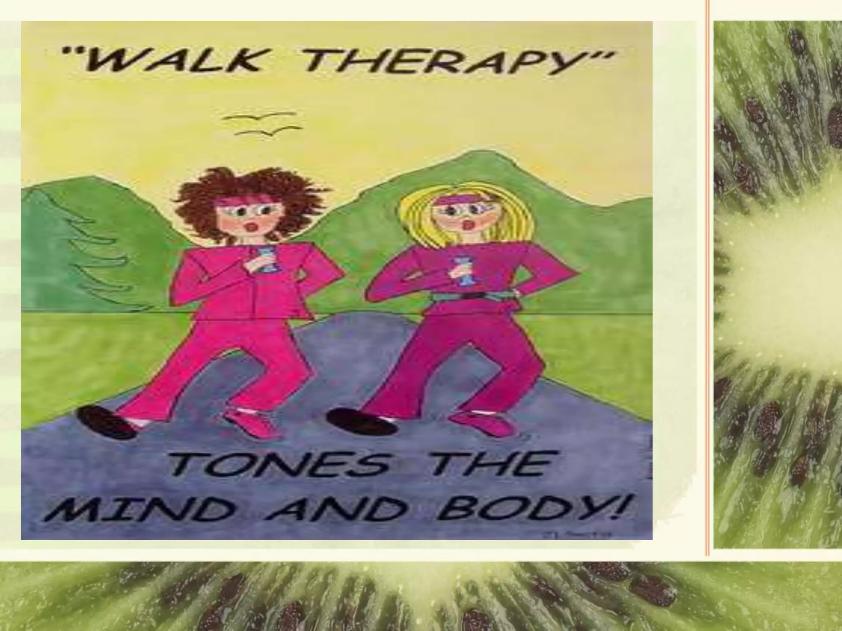
WALK THERAPY Tones the Body and Mind
At least 30-60 mins of brief exercise on the form of walking, jogging, gym, sports etc...
3-5 days/week is enough
Maintain body weight
Try to use stairs
Reduce sitting & screen time
Brief walk after food

Slide 58
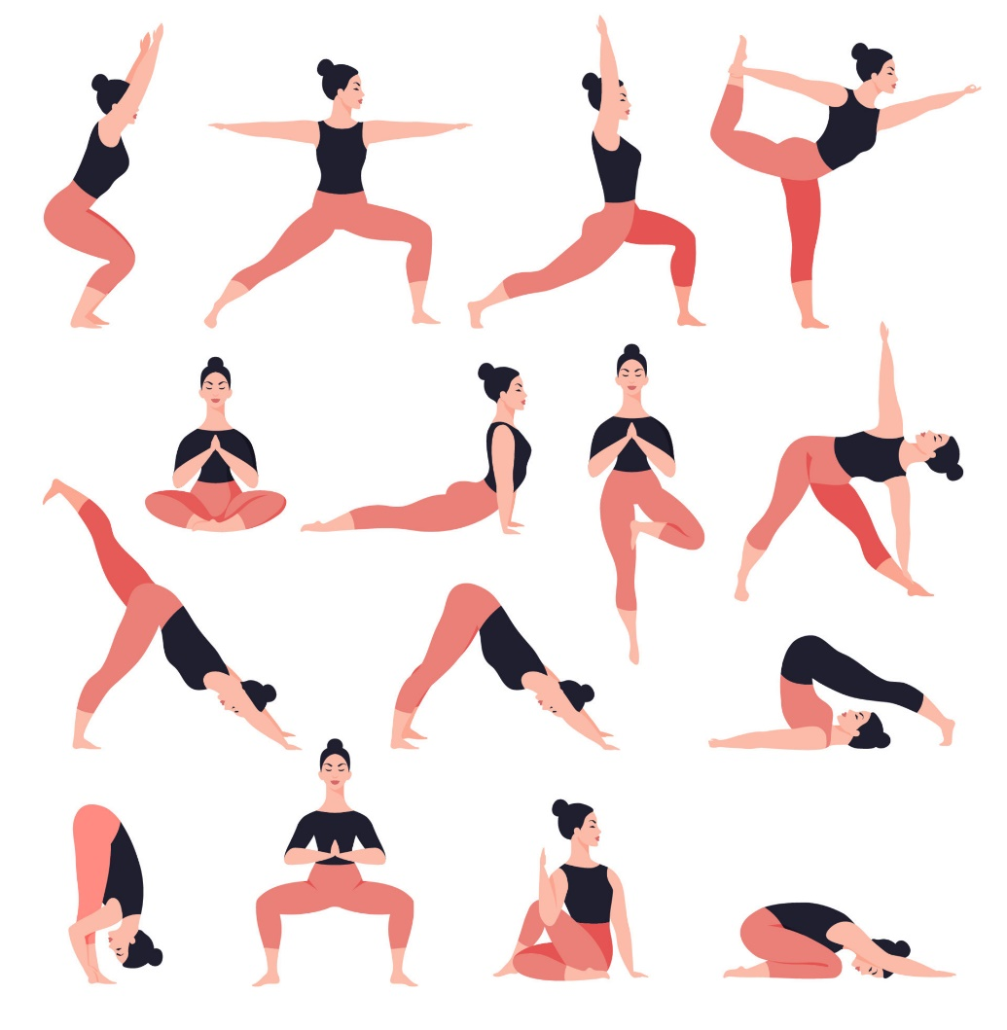
TIPS TO ACTIVE LIFESTYLE
Incorporate physical activity and exercise into your daily tasks
Set yourself achievable goals and challenges to stay motivated and rewarded
Plan and prioritize you activities with rest periods
Use aids to help you stay physically active and able to do more
Get a good night's rest, but avoid sitting or lying still as much as possible during the day
Cycling or walking to the local store instead of driving to pick up small items
Getting off public transport one stop early and walk the extra distance
Try a new sport like Tennis or Badminton.

Slide 59
Always consult your doctor
Do a check up
Plan your food
Keep it simple
USEFUL TIPS
Vary your food
Start your day with a healthy breakfast
Eat small regular healthy snacks
Drink plenty of water
Eat more healthy carbohydrates
Eat protein with every meal

Slide 60
Thank You

