Slide 2
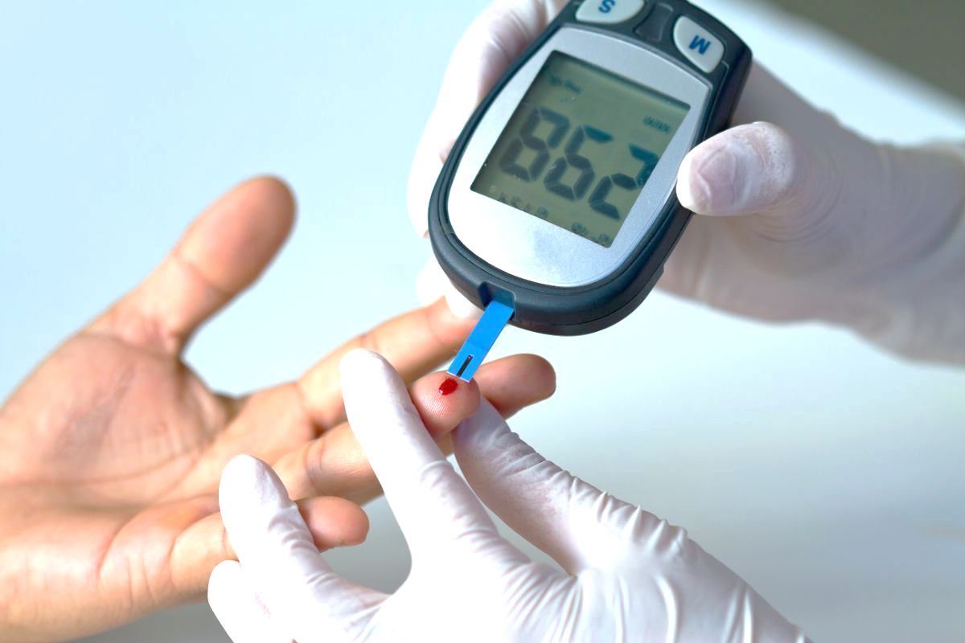
CLASSIFICATION, CLINICAL PRESENTATION AND MANAGEMENT OF DIABETES MELLITUS
“शुक्रवार की शाम, डॉक्टर्स के नाम”
Dr. D. Himanshu
Professor
Department of Medicine
King George’s Medical University
Lucknow
Venue : SIHFW, Indiranagar, Lucknow Date : 29/03/24
Time : 6 pm - 7:30 pm
1

Slide 3
What is Diabetes?
Diabetes is a chronic, metabolic disease characterized by elevated levels of blood glucose (or blood sugar), which leads over time to serious damage to the heart, blood vessels, eyes, kidneys and nerves.
The most common is type 2 diabetes, usually in adults, which occurs when the body becomes resistant to insulin or doesn't make enough insulin
2

Slide 4
ETIOLOGICAL CLASSIFICATION OF DIABETES MELLITUS
Type 1 diabetes
Type 2 diabetes
Specific types
Genetic defects
Transient neonatal diabetes
Diseases of the exocrine pancreas (pancreatitis, pancreatectomy, cystic fibrosis, fibrocalculous pancreatopathy)
Genetic defects in insulin action- type A insulin resistance
Endocrinopathies- Cushing’s Syndrome, Acromegaly, Glucagonoma, Pheochromocytoma, Hyperthyroidism
Drugs or chemicals induced- Glucocorticoids, Diazoxide, Beta Adrenergic Agonists, Thiazides
Infections- Congenital rubella, CMV, Coxackie Virus
Uncommon immune mediated diabetes
Other genetic syndromes- Down’s syn, Klienefelter syn, Turner’s syn, Friedreich’s ataxia
Gestational diabetes mellitus (GDM)
3

Slide 5
T1dm (An autoimmune Disease)
Clinical presentations that may warrant measurement of autoantibodies include:
Catabolic presentation (eg, unintentional weight loss, ketonuria, ketoacidosis) (Since obesity is increasingly common in the population- presence of obesity should not rule out T1DM)
Younger age at presentation (<35 yrs)
Lean body habitus with no features of metabolic syndrome (BMI <25)
Personal history of autoimmune diseases
Strong family history of autoimmune disease, including type 1 diabetes
4
Notes:
Measuring antibodies in T1DM is costly.

Slide 6
T1DM
Pathogenesis: Due to interactions of genetic, environmental and Autoimmune (immunological) causes
Destruction of beta cells
Islet cell directed autoimmunity present- e.g- antibodies against islet molecules- GAD, insulin, IA-2, ZnT-8
Association with other autoimmune diseases- Hashimoto thyroiditis, Graves disease, celiac disease, vitiligo, Myasthenia gravis and pernicious anemia.
5

Slide 7
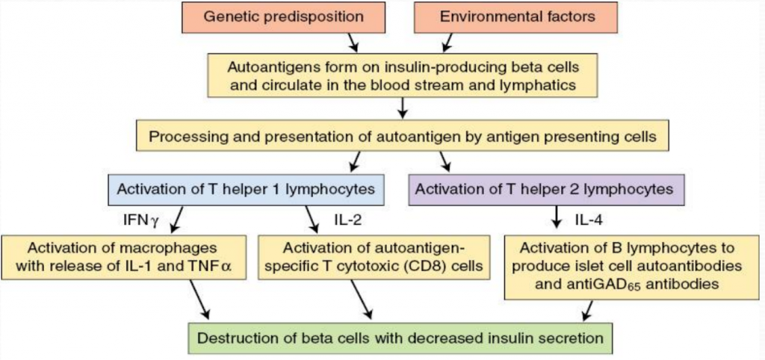
6

Slide 8
LADA (LATENT AUTOIMMUNE DIABETES OF THE ADULT)
At least one antibody should be present
Slow progressive variant of T1DM
Protracted course of development of T1DM (protracted course of depletion of insulin secreting cells)
MAY NOT require insulin at presentation but progress gradually to insulin dependence
7

Slide 9
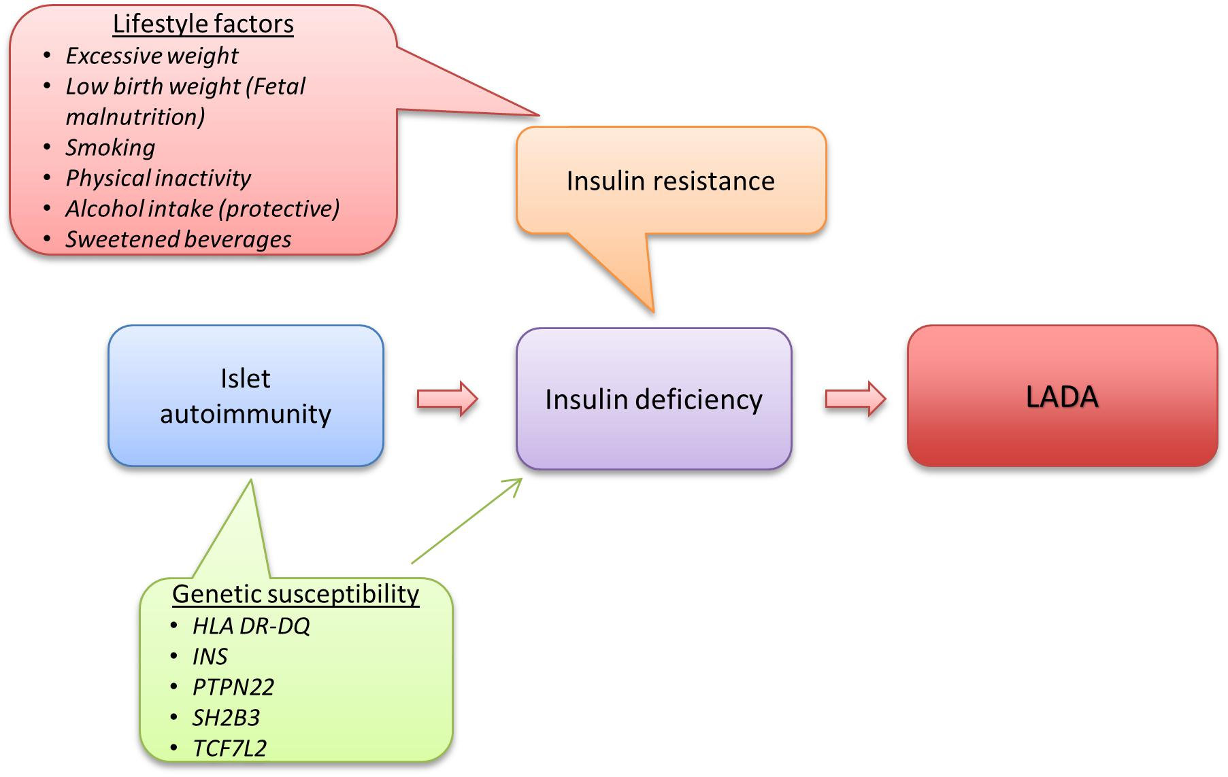
8

Slide 10
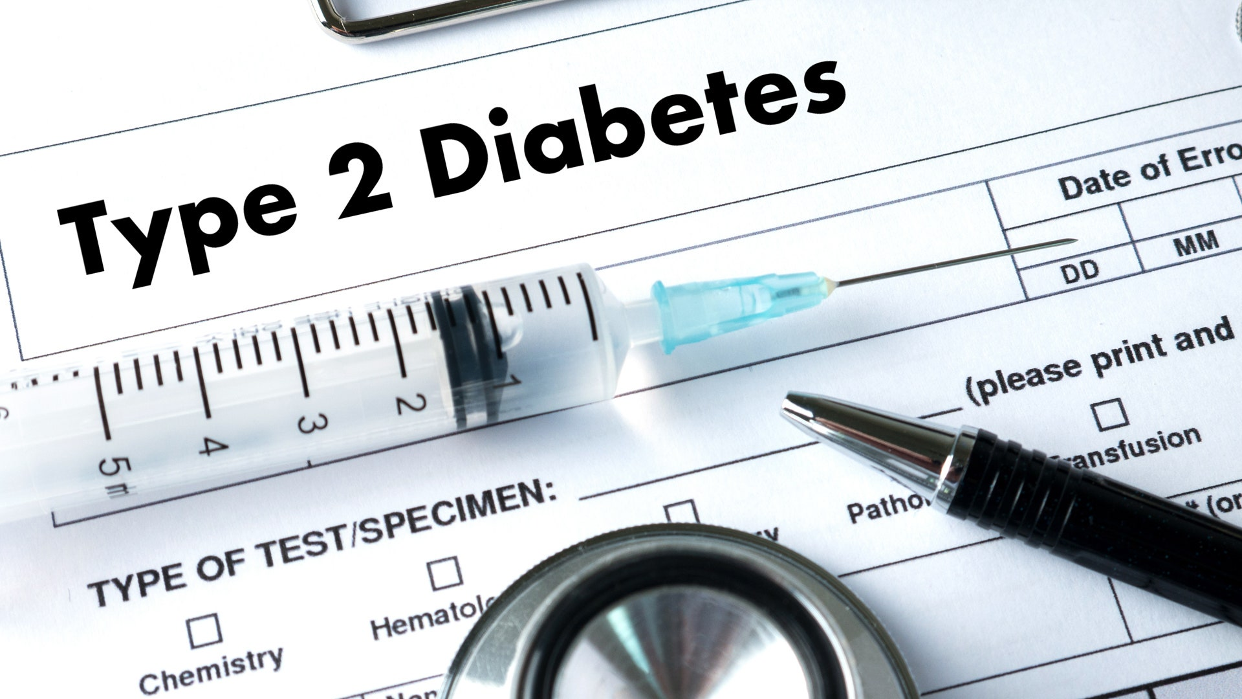
TYPE 2 DIABETES MELLITUS
Varying degrees of insulin resistance and deficiency (Insulin deficiency on a background of insulin resistance)
Genetic predisposition high
Associated with obesity and metabolic syndrome
9

Slide 11
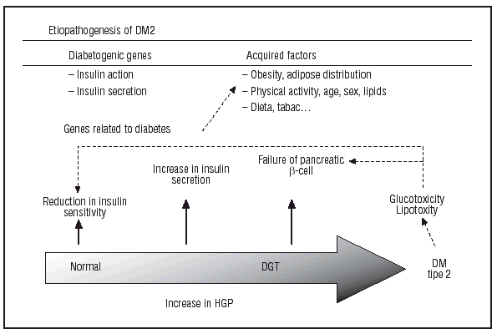
10

Slide 12
Pathophysiology
Pancreas
Insulin
Resisting
High calorie intake
High blood sugars
Adipose tissue
Leptin
Adiponectin
11

Slide 13
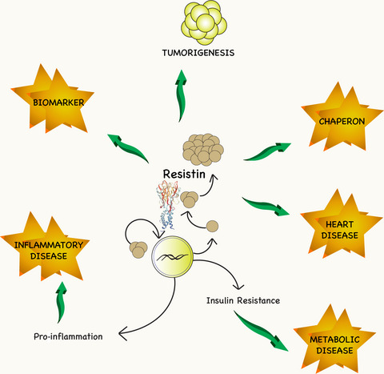
12

Slide 14
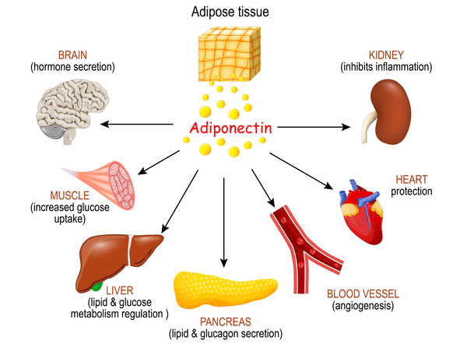
EFFECTS OF ADIPONECTIN
13

Slide 15
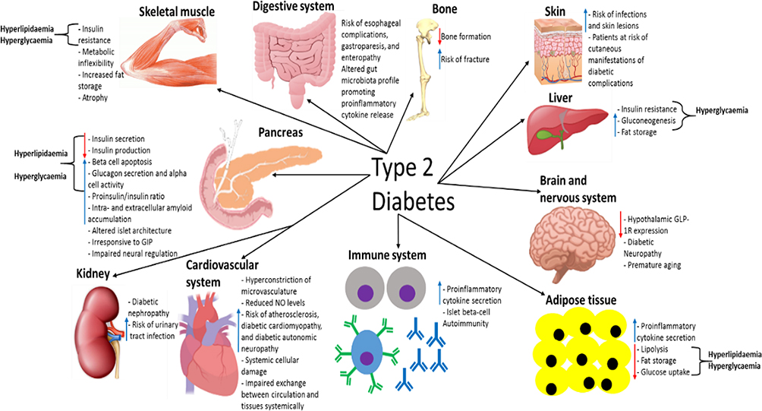
14

Slide 16
T1DM VS T2DM
T1DM | T2DM
Insulin requiremement + | May require insulin later as disease progresses
Early insulin requirement | Late insulin requirement
DKA can be the initial presentation | DKA rare except: Ketosis prone diabetes mellitus
May be thin at presentation d/t poor metabolism d/t absence of insulin | Usually obese at presentation (associated with Metabolic syn)
History of autoimmune diseases in the patient or family present | History of diabetes (TYPE 2) in family present
15

Slide 17
MODY (MATURITY ONSET DIABETES OF THE YOUNG)= monogenic diabetes
Diabetes diagnosed at a young age (<25 yrs)
Autosomal dominant transmission (positive family history in 3 generations)
Usually history of early onset diabetes in a single parent and sometimes also in a grandparent
Autoantibodies absent
Impaired glucose sensing and insulin secretion
No defect in insulin action
May respond to sulfonylureas
Most common- Glucokinase
16

Slide 18
GESTATIONAL DIABETES
In the second or third trimester
If in the first trimester- Pre-existing diabetes
Increased risk of developing diabetes in the next 10-20 years
Children born to a mother with GDM has an increased risk of developing diabetes and metabolic syndrome later in life
17

Slide 19
ATYPICAL DIABETES
Features of both type 1 and type 2
Not a type of monogenic diabetes
E.g. type 2 diabetes before puberty, type 2 diabetes in very lean individuals, ketosis-prone diabetes
18

Slide 20
DIABETES IN THE YOUNG
REF: Indian Journal of medical research: Young onset diabetes: An Indian perspective
19

Slide 21
 | T1DM | T2DM | FCPD | MODY
Age at onset | Any age after 6 months | Adolescence or young adulthood | 2nd or 3rd decade of life | 2nd decade
Family history | Sporadic | Strongly positive (in one or both parents) | - | Positive for at least 3 generations on one side of the family
Genetic predisposition |  | ++ |  | ++
Obesity | Frequency similar to general population Usually lean | ++ | Lean | Frequency similar to general population Usually or normal weight
Insulin resisitance | - | ++ | - | -
C-peptide levels | Low | Normal | Low | Lower than normal
Islet autoantibodies | ++ | - | - | -
20

Slide 22
CLINICAL POINTS TO DIFFERENTIATE BETWEEN CAUSES OF YOUNG ONSET DIABETES
 | T1DM | T2DM | FCPD | MODY
Signs of insulin resistance | - | ++ | - | -
Degree of hyperglycemia | Higher |  | Higher
Complications | DKA Prolonged- Risks similar to T2DM | High CV risk Macro/ Micro vascular complications | Low risk of macrovascular complications | Low risk
Ketosis | + | - | - | -
Insulin requirements | ++ | Late | ++ | Late (can be needed in some forms)
21
Notes:
No ketosis in FCPD d/t- low fat stores

Slide 23
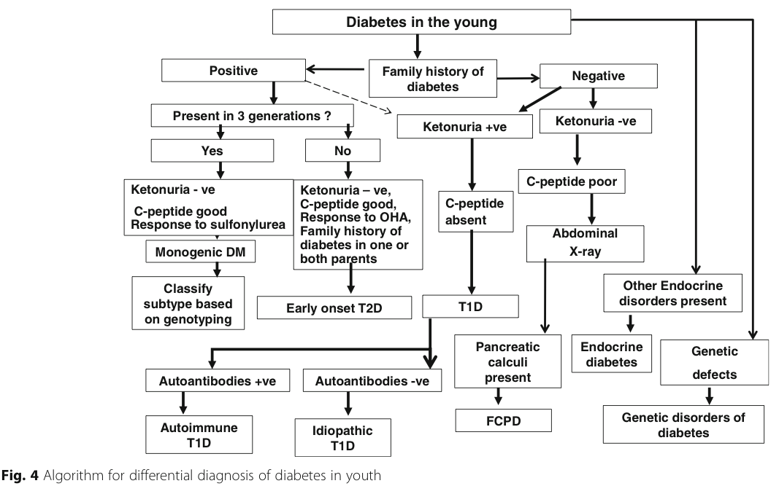
22

Slide 24
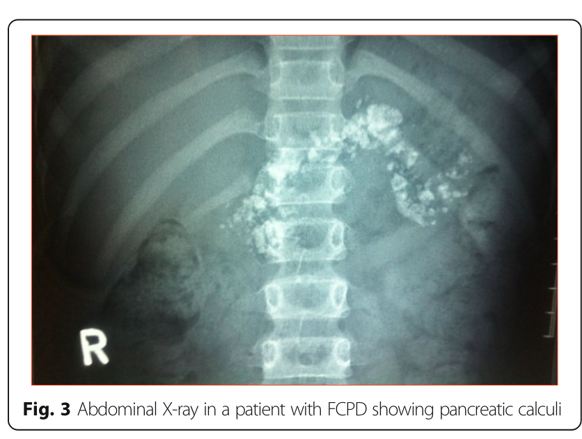
FIBROCALCULOUS PANCERATIC DIABETES
Secondary to chronic calcific NON- alcoholic pancreatitis
Patient from a tropical country (e.g- India)
History of- Recurrent abdominal pain since childhood, steatorrhea, no history of alcohol intake
C/F- patients are usually lean, clinical evidence of Fat-soluble vitamin deficiencies may be present
Low C-peptide levels
Requirement of insulin
23

Slide 25
DIABETES ASSOCIATED IN OTHER DISORDERS:
Cystic fibrosis
Pancreatic pathologies
Endocrinopathies: Acromegaly, Cushing’s disease
24

Slide 26
CLASSICAL SYMPTOMS OF DIABETES
Chronic
Polyuria
Polydipsia
Weight loss
Fatigue and weakness
Blurry vision
Frequent superficial skin infections (vaginitis/ fungal skin infections)
Slow healing of skin after minor trauma
25
Notes:
Bcoz of long delays in clinical recognition, individuals may present directly with diabetes related complications. Chronic complications are usually present after a decade of hyperglycemia

Slide 27
History of complications of diabetes
Macrovascular
Ocular or ophthalmologic
Neurologic
Genitourinary
Dermatological
Periodontal disease
Gastrointestinal
Musculoskeletal
Infective
Neuropsychiatric
26

Slide 28
MACROVASCULAR
Coronary artery disease- Angina, pedal edema, easy fatiguability
Cerebrovascular disease- TIA, Stroke
Peripheral vascular disease- Claudication pain, Rest pain, foot ulcers, impotence
27

Slide 29
Microvascular
Retinopathy
Nephropathy
Neuropathy
Periodontitis
Diabetic Arthropathy
28

Slide 30
RETINOPATHY
Decreased visual acuity
Sudden onset of visual loss (Retinal detachment)
History of floaters
Previous laser treatment or intravitreal injections
Headache
Frequently changing power of glasses being used
Ophthalmologic infections
29

Slide 31
NEUROPATHY
Positive or negative sensory symptoms
Distal sensation and motor weakness
Cranial nerve neuropathies- 3rd, 4th and 6th nerve involvement
Wrist drop and foot drops
Foot ulcers
Oculomotor symptoms
Difficulty walking in darkness
History of foot and leg discomfort (any abnormal sensations felt in? location of symptoms? Has the symptoms ever awoken you at night?)
30

Slide 32
AUTONOMIC NEUROPATHY
CVS- silent MI, Orthostatic hypotension, exercise intolerance
Urogenital- erectile dysfunction
Gastrointestinal- Nausea, early satiety, abdominal bloating
Sudomotor- decreased sweating even after increased temperature, dry skin, gustatory sweating
31

Slide 33
NEPHROPATHY
Usually asymptomatic
Urine testing suggestive of proteinuria
Recent onset hypoglycemia
32

Slide 34
GENITOURINARY
Bladder dysfunction (urgency/ frequency, diminished bladder sensation, increased post voidal residual volume)
Erectile dysfunction
Female sexual dysfunction
UTIs
Superficial infections (balanitis/ vaginitis)
33

Slide 35
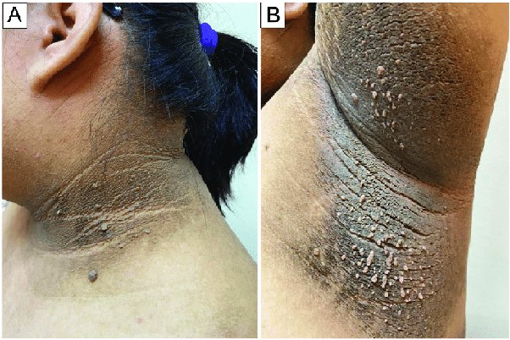
DERMATOLOGICAL
Acanthosis nigricans
34

Slide 36
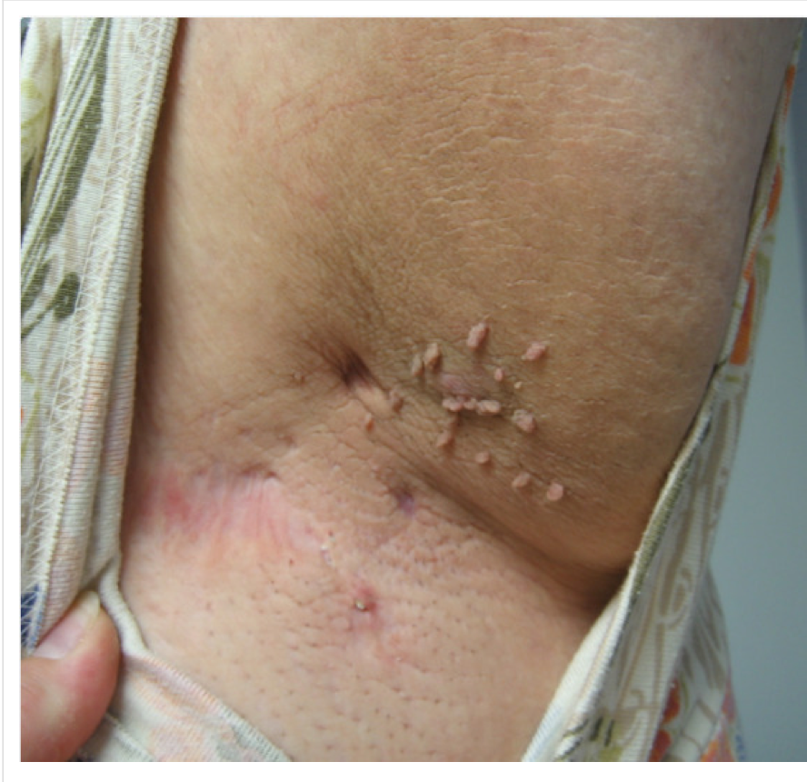
Skin tags
(Acrochordons)
35

Slide 37
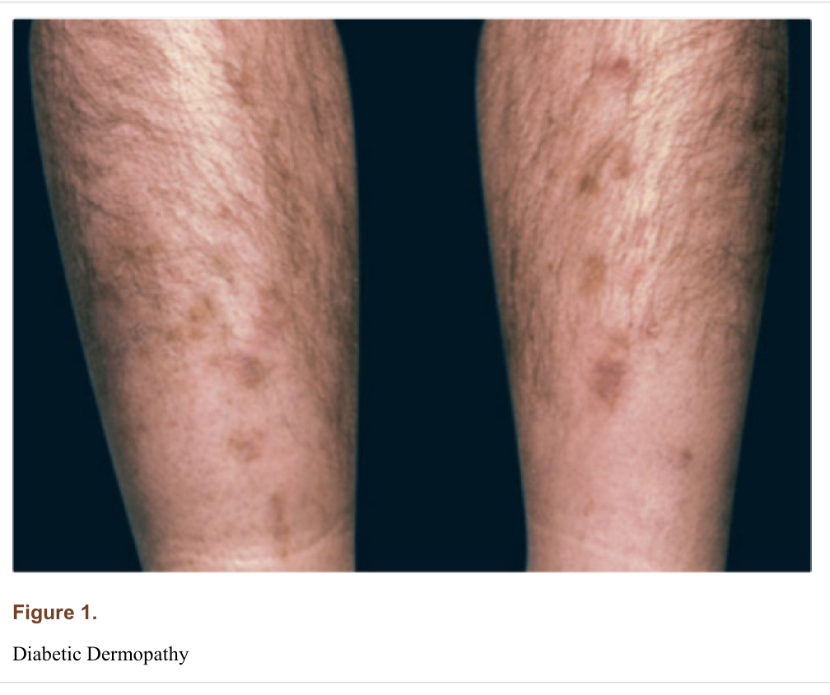
Diabetic dermopathy
36

Slide 38
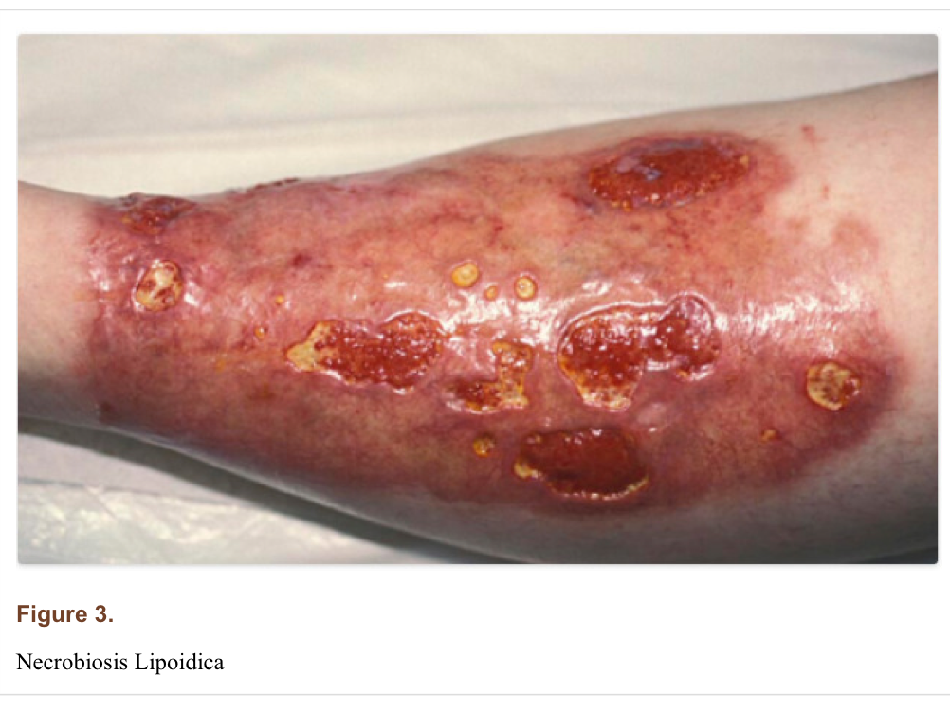
Necrobiosis lipoidica
37

Slide 39
MUSCULOSKELETAL
Hand pain and parasthesias (Carpal tunnel syn)
Limited joint movement- Limitation of movement of small joints of hands (Cheiroarthropathy)
Contractures in hands- Dupuytren’s contractures
Shoulder pain and limitation of movement at shoulder joint- Frozen shoulder (adhesive capsulitis)
Pain in overhead abduction of arms- Rotator cuff tendinopathy
Foot- Charcot foot and hammer toes
38
Notes:
Rotator cuff tendinopathy- mc in supraspinatus tendon; charcot foot due to subluxation of mid arch of foot due to decreased blood flow and mismatch in the muscle activity of anterior compartment and distal muscles

Slide 40
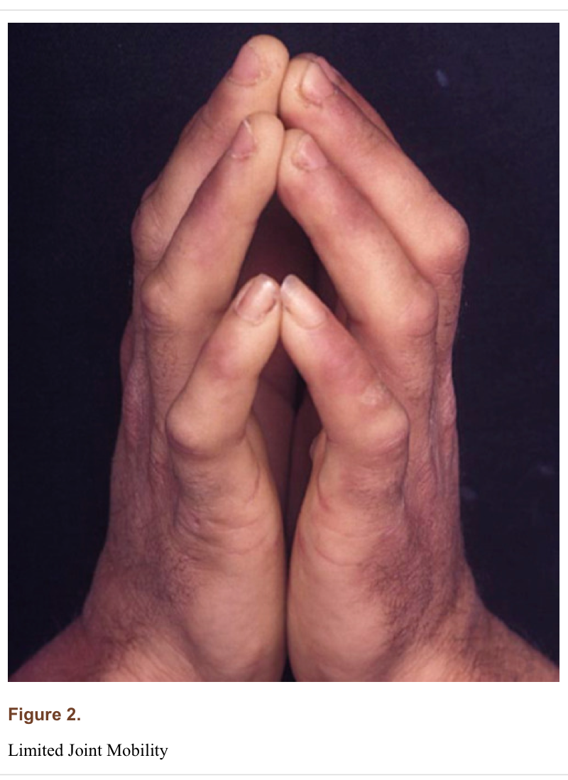
Limited joint mobility (Prayer sign)
39
Notes:
Limitation of movement of small joints of hands

Slide 41
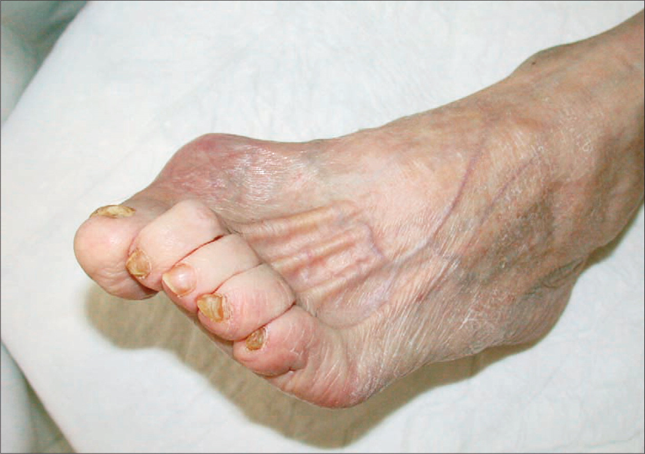
Hammer toes
40
Notes:
Greater flexor tone than extensor tone

Slide 42
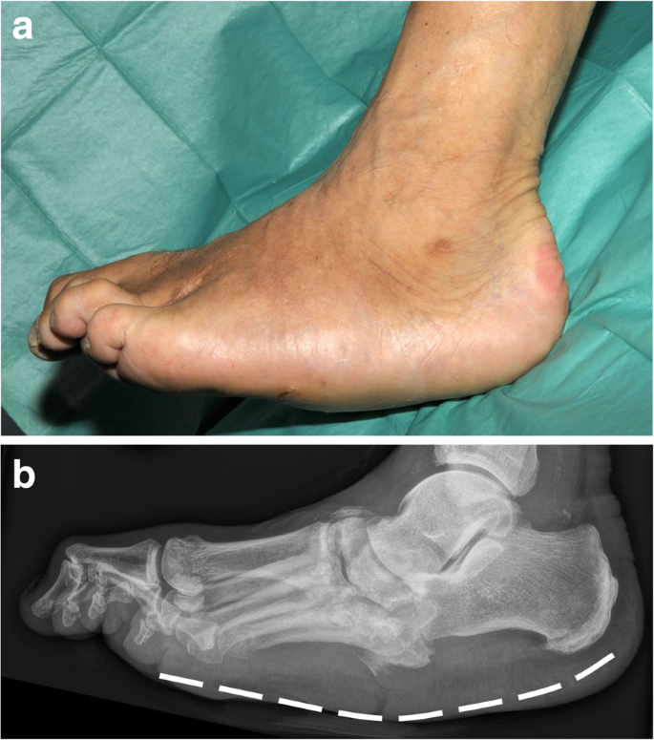
Charcot foot
41

Slide 43
10g monofilament test
To determine the patient’s LOSS OF PROTECTIVE SENSATION (LOPS)- a marker of neuropathy
Use of Monofilament
Identify patients at risk and instate preventive measures
To be conducted for all diabetic patients irrespective of the presence of a diabetic foot ulcer
42

Slide 44
How to do a monofilament test?
PROCEDURE:
Expose the area to be tested
Explain what is the test using the patient’s hand initially
Have the patient close the eyes
10 sites to be tested on each foot, randomly
While testing, touch the skin such that the monofilament bends approximately 1 cm and hold there for 2s (count in head “times one, times two”) and then release
Record the patient’s response as a YES
Repeat the test 3 times at the sites where the patient did not say YES
If there is an ulcer, callus, corn or scar- Apply the monofilament adjacent to such area and NOT directly over them
If the patient says YES without even touching at a site, this also indicates neuropathy and must be designated as LOPS.
A score of 8 or less indicates neuropathy.
43

Slide 45
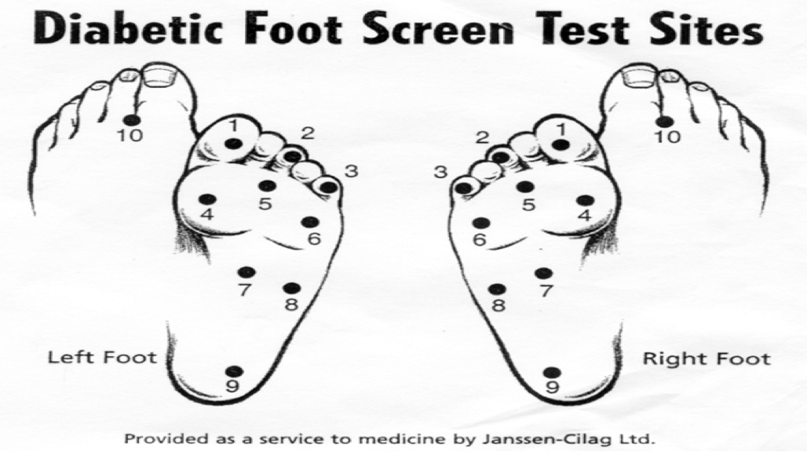
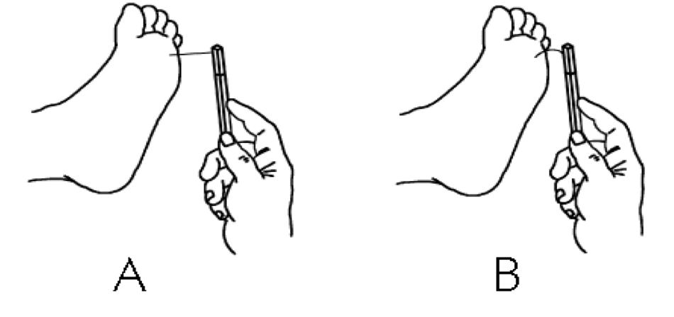
44

Slide 46
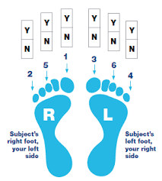
IPSWICH TOUCH TEST
Easier to do
Quicker and simpler
Procedure: lightly and briefly touch the tips of first, third and fifth toes with the index finger
Neuropathy suggested by ≥ 2 fingers being insensate
Less sensitivity and specificity than Monofilament test
Better than not performing a foot sensory examination at all
45

Slide 47
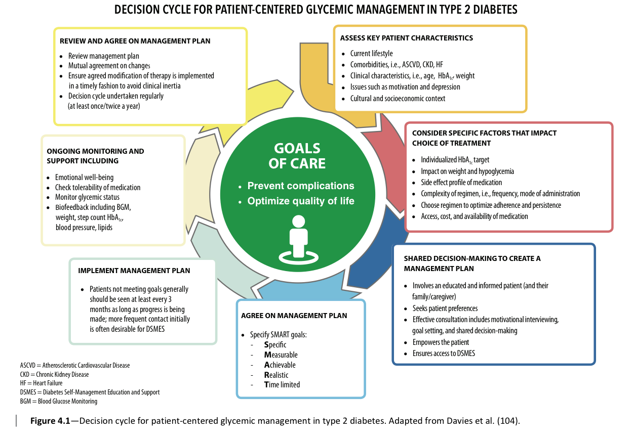
46

Slide 48
Non Pharmacological Treatment of Diabetes Mellitus
47

Slide 49
Importance of non-pharmacological management
“ Lifestyle management is a fundamental aspect of Diabetic care”
48

Slide 50
Components of Lifestyle Management
1. Diabetes Self-Management Education
support
4. Psychosocial distress
2. Medical nutrition therapy
3. Physical activity
49

Slide 51
What is DSMES?
DSMES(Diabetes Self-Management Education and support) should be person-centered and services should facilitate-
Knowledge
Decision-making
Skills mastery necessary for optimal diabetes self-care DSEMS.
ADA guideline 2023
50

Slide 52
When DSMES need to be evaluated
When transitions in life and care occurs
When Complicating factors develop that influences self management
Annually for assessment or when not meeting treatment targets
At Diagnosis
ADA guidelines 2023
51
Notes:
4 critical point ,Health conditions, physical limitations, divorce, loss of spouse, marriage, retirement

Slide 53
Core points of DSME
Diabetes disease process and treatment options
Incorporating nutritional management and physical activity in to lifestyle
Using medications and insulin safely with maximal effectiveness
Monitoring and interpretation of blood glucose and using the results for self-management and decision making
Preventing, detecting, and treating acute and chronic complications
Preventing, detecting, and treating with development of personal strategies to address psychosocial issues
API textbook of medicine 2022
52
Notes:
DIABETES IS CHRONIC DISEASEAS WUTH ANY CHRONIC DIASERASE IT AFFECT

Slide 54
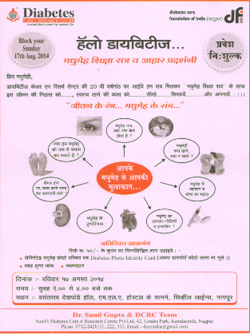
Methods
Individuals session (one to one)
Small group interactive (in room)
Mega group (in hall)
Mass education(radio, TV, print media)
53

Slide 55
Benefits of DSME
Lower HBA1c
Lower self reported weight
Improved clinical outcomes
Reducing hospitalization and healthcare cost
ADA guidelines 2023
54

Slide 56
DIET
“What to eat”
There is not a “one-size-fits-all” eating pattern for individuals with diabetes and meal planning should be individualized for each patient.
55
Notes:
Diabetic diet is not complete deviatrionfron normal dirt, the nutritional requirement of a pt are same as someone without diabetes.

Slide 57
Medical Nutrition Therapy [MNT]
Systemic approach to optimize dietary intake to achieve metabolic control and maximize favorable treatment outcomes in T2DM.
Implementation of MNT in India is challenging owing to its cultural and culinary diversity
International journal of Diabetes in countries (October 2022)
56

Slide 58
Role of MNT in prevention and management
Poster et al. summarized that MNT decreases HBA1c by approximately by 2% in T2DM.
Look AHEAD (Action for Health in Diabetes) trial study the results of intensive lifestyle modification in T2DM demonstrated improved overall metabolic control (decreased HBA1c, systolic and diastolic blood pressures and triglycerides) along with significant weight loss of 8.6% in the initial 1 year of it’s implementation in test group versus the control group with no intervention.
Medicine update 2023
57

Slide 59
Components to be Targeted
Step-1. Total caloric intake
Step-2. Major constituent of diet: carbohydrate, fats, and protein
Step-3. Fiber intake
Step-4. Micronutrients and sodium intake
Step-5. Diet plan : frequency and quantity
Step-6. What to avoid
58

Slide 60
Total Calories
Calories requirement depend upon :
Physical activity
Nutritional status
Restriction of daily calories intake is an important measure.
Ideal body weight calculated by
IBW = (Hight in cm – 100) x 0.9
ICMR Guidelines for Management of Type 2 Diabetes 2018
59

Slide 61
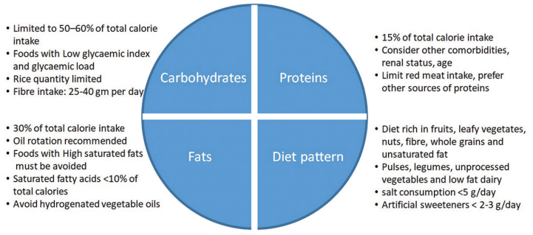
MAJOR CONSITUIENTS OF DIET
<2.3g/day
International journal of Diabetes in countries (October 2022)
60
Notes:
C mainenergy source in Indian dietand it has greatest impact on blood glucose, simple carb like,fat ar concentrated so of energy fat present in cooking oil is the main source is visible fatin diet, there is no single oil which cab be considere as perfect choice, bhigh saturated fat cad, there is no need d protein requirement in renal disease, it does not alter glycemic ,cv riskrate of fallgfr

Slide 62
Relative ability of a carbohydrate food to increase the level of glucose in the blood.
Low glycemic index Food (30-40%) | Moderate GI food (45-55%) | High GI food (65-75%)
Grains- missi roti(aata beasan jau mixed ) aata roti, idli Dals – chana, choley and all dal Green vegetables Fruits- orange Mausami peach apple and guava | Grain-rice poha, noodles Fruits- mango, less ripned banana, papapya Vegetables- potato sweet potato, green pees | Grains- cornflakes, maida products including maida noodle white breads, cakes Sugar ,gur , honey sugarcane juice cold drinks Fruits – water melon, melon cheeku, ripe banana, dates
Glycemic index
61
Notes:
Different carb raise the BS to different extents.Gl of a food itemamt of available carbo in food item

Slide 63
Fiber and diabetes mellitus
Recommended that 25-30 g of fiber should be consumed daily.
Fibers slows absorption of food from gut
Prevents rapid glycemic surges
Improve glucose control and insulin sensitivity
Dietary fibers also regulate bowel movements.
Reduction in triglycerides, LDL
International journal of Diabetes in countries (October 2022)
62

Slide 64
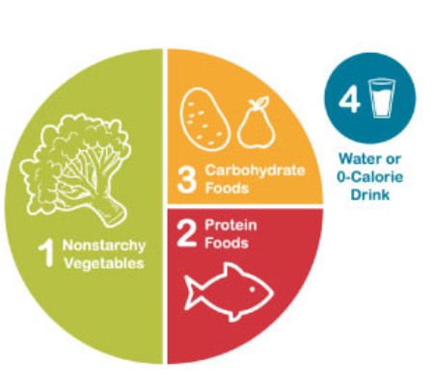
Plate method
Three major meals and two mid-meal snacks.
ADA guidelines 2023
63
Notes:
Spinach, beans,broccoli, cauliflower,cucumber,mashrooms,,tomatos

Slide 65
What to avoid
Overeating
Bingeing
Night time snacking
Eating simple sugars
Beverages and fruit juices
API textbook of medicine 2022
64

Slide 66
Case-1
“My sister (32 year old) is having diabetes for last 3 years. She is on oral medications for the same. She lives with us but does not eat same food as us and buys special products labeled as sugar free or diabetes- friendly. However, her blood sugars levels continue to be high. What could be the possible reason for the same ?
Answer- Products labeled as sugar-free or diabetes friendly do not necessarily mean that they are free of calories and carbohydrates.
Non-nutritive sweeteners such as aspartame, saccharin, and sucralose do not impact on blood sugar.
65

Slide 67
Case-2
A 52 year female came to our OPD. She had diabetes for 2 year. She loves fruits. Should she avoid fruits completely? If no, then which fruit should she consume?
Answer- No
Type- Seasonal, slightly unripe,
Time- Eat them as mid-meal snack
Avoid eating fruits along with or just after meals.
66
Notes:
Friu,ts are power house of essential vitamin and antioxidant

Slide 68
Physical activity
Physical activity
Any body movement by skeletal muscles results in energy expenditure beyond resting expenditure.
Exercise
Physical activity that is planned, structured, repetitive, and purposeful usually aimed at improving on maintaining physical fitness
67

Slide 69
Case-3
Question.2: 43 year old man, known case of hypertension and recently diagnosed diabetes came to our OPD and said “ I have always led a sedentary lifestyle. Now due to diabetes, I am being advised to join the gym however, I have heard that exercising increase the risk of heart attack in people with diabetes. Is this true?
Answer. He is > 35 years old.
k/c/o hypertension( risk of cardiovascular disorder) should evaluate before starting an exercise program
68

Slide 70
Medical evaluation before exercise program
Routine exercise- stress testing is not indicated prior to initiating exercise program in asymptomatic individuals.
Healthcare providers should evaluate patients with T2DM before starting an exercise program, especially in individuals leading sedentary lifestyles and risk of cardiovascular disorder.
High risk patients should encouraged to start with short periods of low intensity exercise and slowly increase the intensity and tolerated.
69

Slide 71
Diabetes complication | Exercise recommendations
Severe peripheral Neuropathy | Encourage non weight bearing exercise such as swimming, bicycling or arm exercise
Autonomic Neuropathy | Because of association with increased cardiovascular risk cardiac evaluation prior to exercise program
Microalbuminuria and Nephropathy | No specific restrictions for isolated microalbuminuria or nephropathy
Retinopathy | Proliferative diabetic retinopathy (PDR) or severe Non PDR , avoid vigorous aerobic or resistance Exercises
Hyperglycemia | If ketosis is present , exercise should be avoided, no need to postpone exercise for hyperglycemia
Hypoglycemia | Not frequently, seen if patient is not on insulin or insulin secretogouges if glucose is<90mg/dl ingest carbohydrates
70

Slide 72
Types of exercise
Aerobic/endurance exercise
Activities that result in increased cardiac output and improve cardiorespiratory fitness.
Eg. Swimming, Cycling, Walking, Rowing.
Strength/resistance training-
Exercise that increases muscle tone and strength over time.
Increase insulin receptor and sensitivity for 12-48 hours afterward by increasing GLUT-4 transporter
Eg. Lifting weights, Wall push-ups, Lifting your body weight, Using a resistance band.
71
Notes:
Using oxygen for energy, invole large gropu muscles

Slide 73
Balance exercise
Diabetics especially older patients, are at risk of falls with neuropathy increased postural sway.
Eg. Standing up and sitting down from a chair without using your hands, Walking while alternating knee lifts with each step.
Flexibility exercises – improve the range of motion around joints especially in elderly diabetics, and decrease the risk of injury.
Eg.Back flexibility, shoulder stretch, seat hamsting stretch
72

Slide 74
The Exercise Prescription (FITT-VP model)
>5 days/week of moderate or >3days/week of vigorous exercise
Even a combination of both >3-5 days/week
Frequency
Moderate and/or vigorous as perceived
Intensity
30-60 minutes/day of moderate or 20-60 minutes of vigorous exercise
Time
73

Slide 75
The Exercise Prescription (FITT-VP model)
Regular continuous rhythmic movements involving all muscle groups in purposeful manner (aerobic+resistance)
Type
One to multiple sessions each lasting >10 mintues to achieve daily desired duration and volume
Volume
One to multiple sessions each lasting >10 mintues to achieve daily desired duration and volume
Pattern
Gradual progression till desired level of exercise goals achieve “start low and go slow”
Progression
74

Slide 76
Exercise recommendations
A minimum of 150 min/week of physical activity is recommended for healthy Indians.
High predisposition to develop T2DM and CAD advocation of 60 mins of exercise
>30 min of moderate-intensity aerobic activity each day
15-30 min of work related activity
15 min of muscle strengthening exercise (at least 3/week)
STEPS- At least 5000 steps per day.
Use of apps or Talk tests for assessment of intensity of exercise.
75

Slide 77
Psychosocial stress
Diabetic patients and particularly those with poor glycemic control have negative impact on their psychology .
Psychological disturbances lead to worsened glycaemic control as these factors affect motivation of patients and associated with craving of food and binge eating.
Psychological counselling is important in less motivated individuals and may require periodic assessment
API textbook of medicine 2022
76

Slide 78
Pharmacological Management of Diabetes Mellitus
77

Slide 79
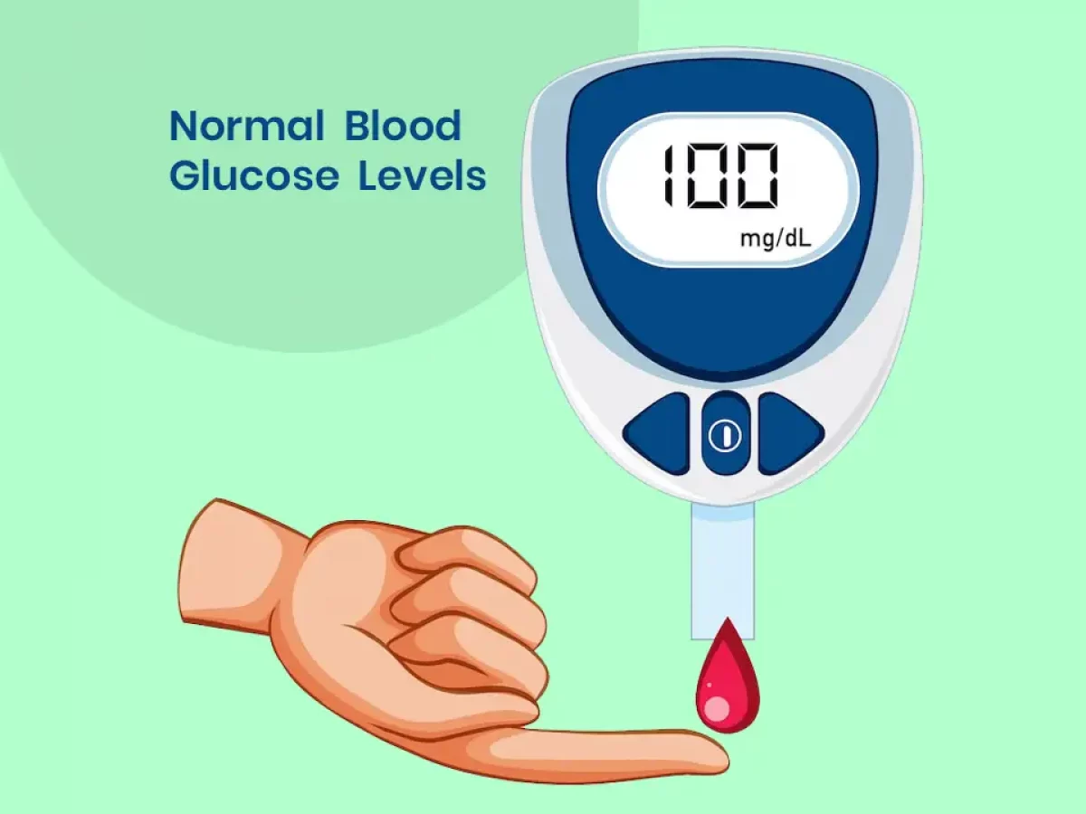
Short Term Assessment of Glucose measurements by the patient
1- SMBG
2-CBGM
Long-term control by
1. HbA1c
2.Review of the patient’s SMBG and/or CGM
78

Slide 80
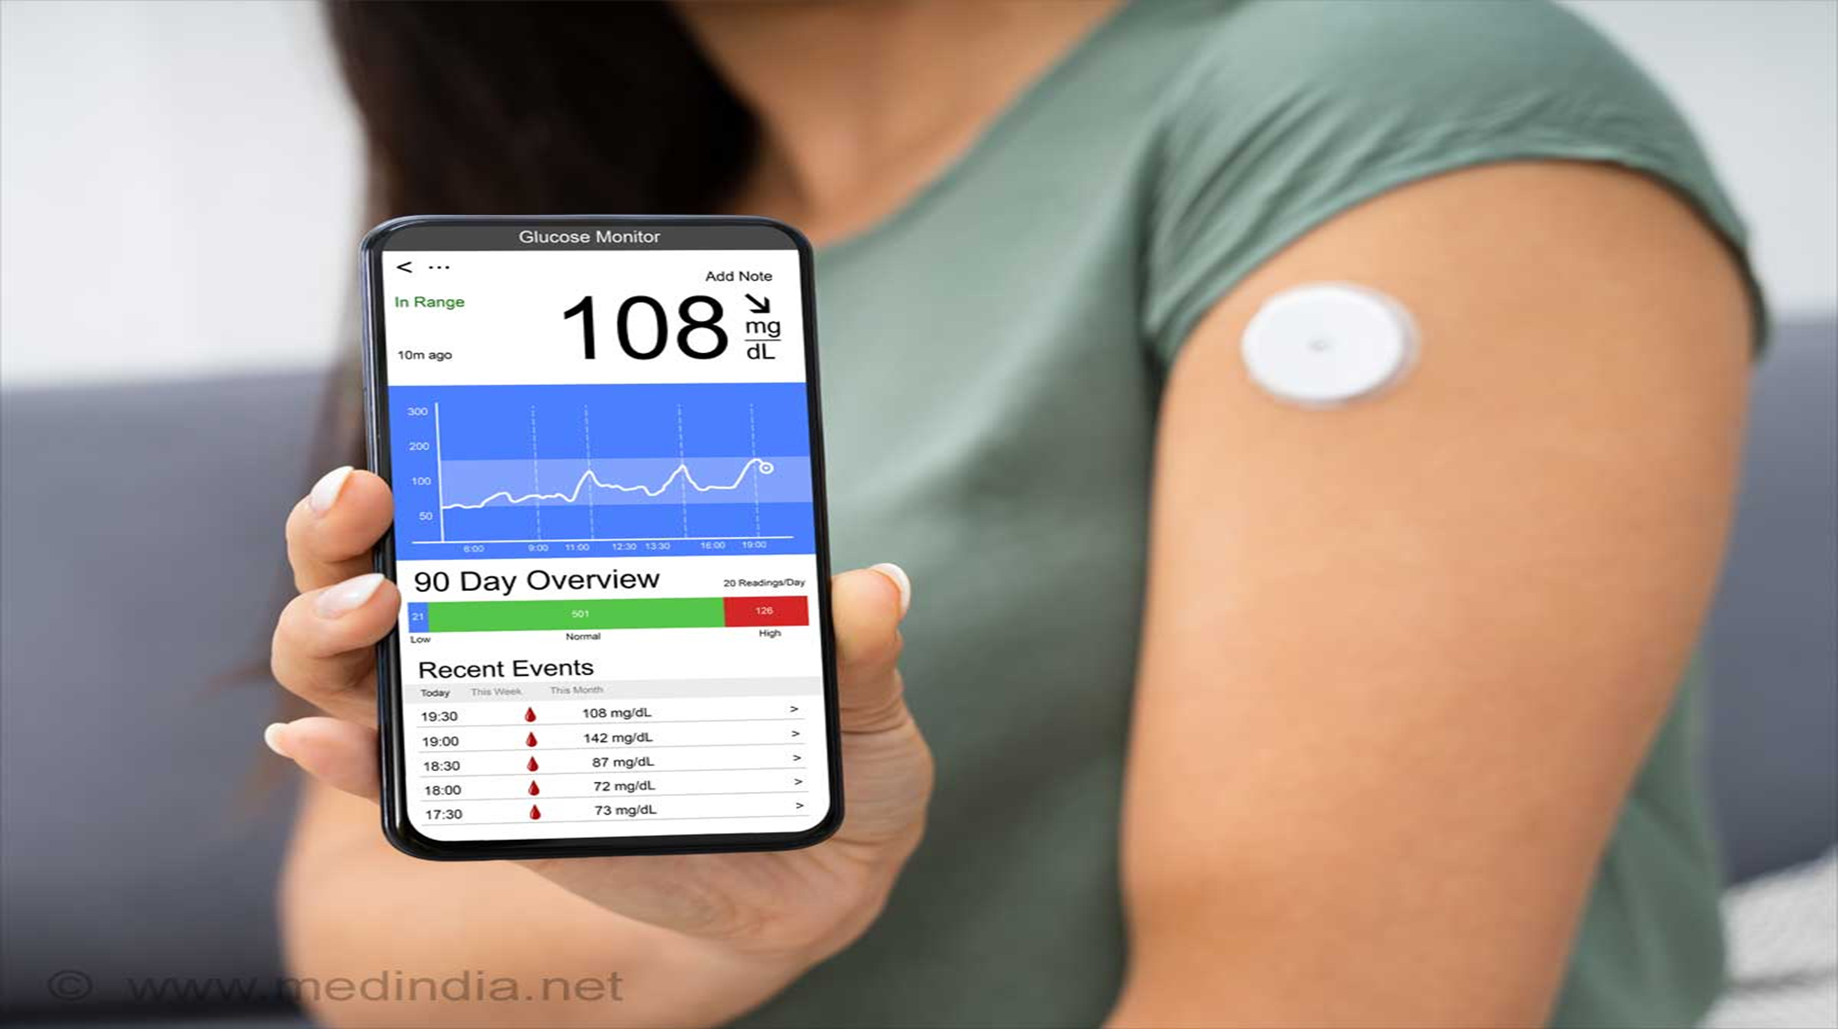
Continuous Glucose Monitoring
Time in a glycemic range
(TIR, or time in range)
Ambulatory glucose profile
Amount of time in the hypoglycemic range
Glucose management indicator (GMI)
79
Notes:
CGM allows the patient to monitor glucose trends that can be used to avoid predicted hyper- or hypoglycemia.

Slide 81
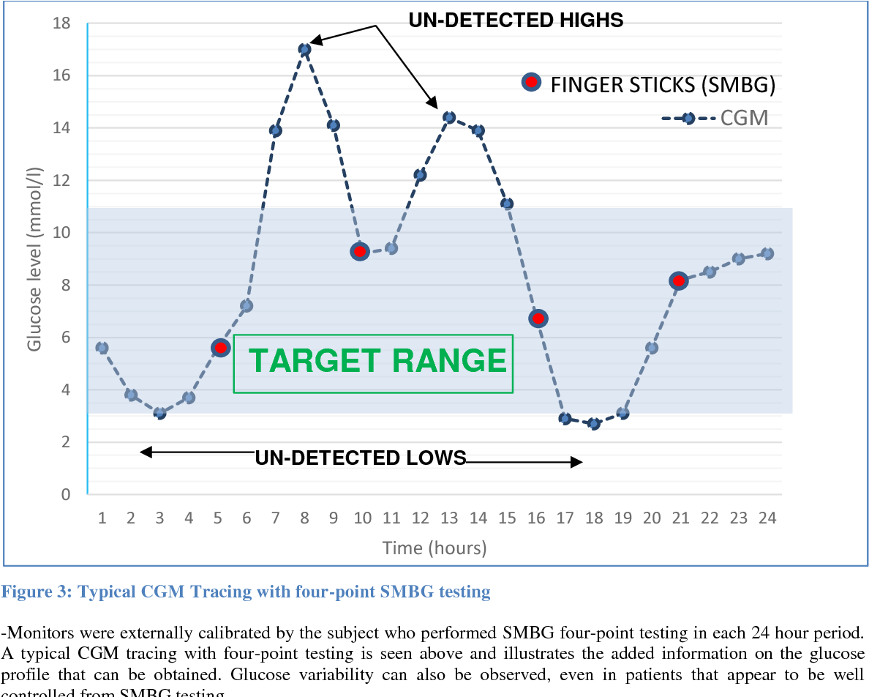
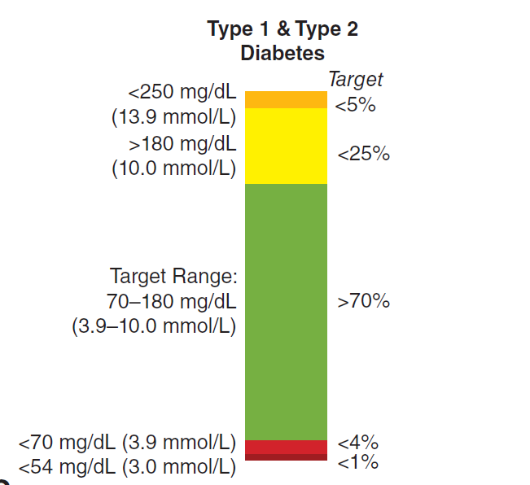
CGM profile is used to generate an estimate of time-in-range with glycemic goal shown on the left side of the bar and target % time in that glycemic range shown on the right side of the bar.
80

Slide 82
Assessment of Long-Term Glycemic Control HbA1c
Due to nonenzymatic glycation of hemoglobin;
Glycemic history over the previous 2–3 months.
In patients achieving their glycemic goal, the ADA recommends measurement of the HbA1c at least twice per year.
More frequent testing (every 3 months) is warranted when glycemic control is inadequate or when therapy has changed.
The fructosamine assay (measuring glycated albumin) reflects the glycemic status over the prior 2 weeks.
81
Notes:
As the primary predictor of long-term complications of DM, the HbA1c should mirror, to a certain extent, the short-term measurement by SMBG or CGM.

Slide 83
ESTABLISHMENT OF TARGET LEVEL OF GLYCEMIC CONTROL “Patient-centered Approach”
The target for glycemic control (as reflected by the HbA1c) must be individualized.
In most individuals, the target HbA1c should be <7% with a more stringent (≤6.5%) target for some patients.
A higher HbA1c goal may also be appropriate for the very young or old or in individuals with limited life span or comorbid conditions.
More stringent glycemic control (HbA1c ≤6%) is not beneficial, and may be detrimental, in patients with type 2 DM and a high risk of CVD.
Achieve an HbA1c as close to normal as possible without significant hypoglycemia.
82

Slide 84
TYPE 1 DM
83

Slide 85
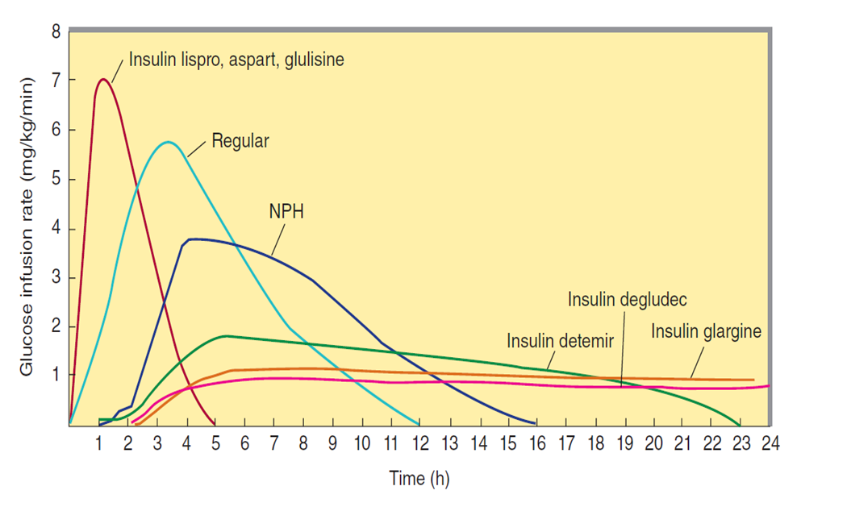
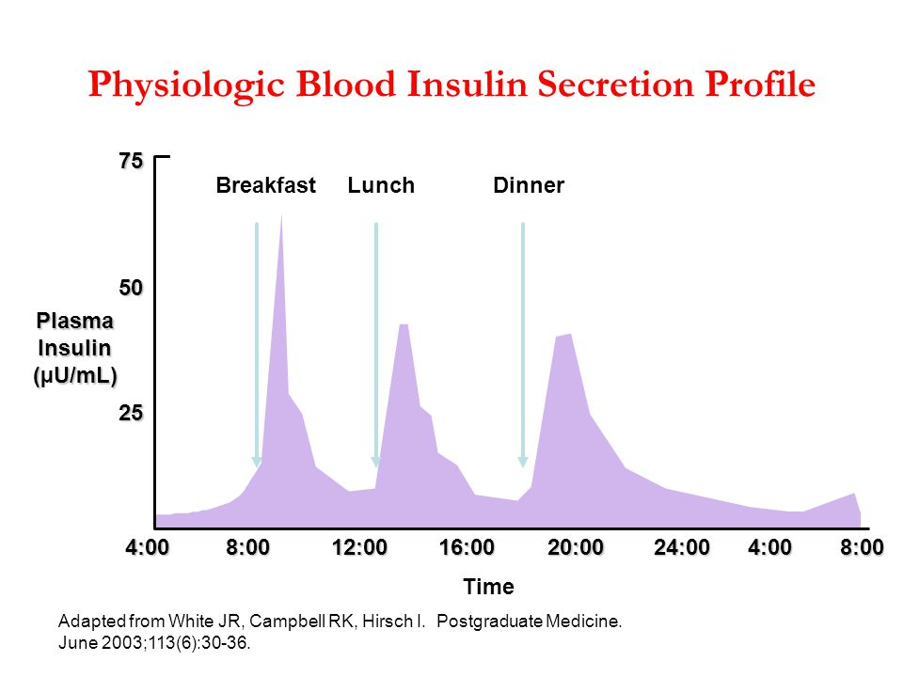
REF :Basic and Clinical Pharmacology 15e: KATZUNG AND VANDERAH
84

Slide 86
INSULIN PREPARATIONS
REF : Williams Textbook of Endocrinology - 14th Edition
85

Slide 87
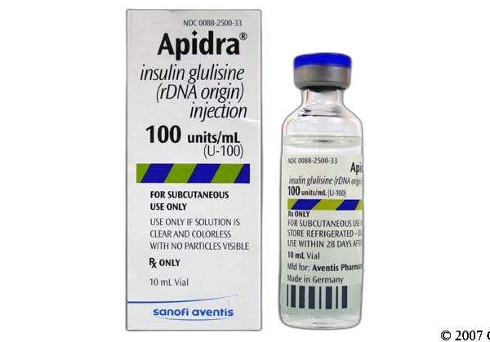
SHORT ACTING INSULINS
Advantageous for allowing entrainment of insulin injection and action to rising plasma glucose levels following meals.
Thus, insulin aspart, lispro, or glulisine is preferred over regular insulin for prandial coverage in many patients
Decreased number of hypoglycaemic episodes, primarily because the decay of insulin action corresponds to the decline in plasma glucose after a meal.
86

Slide 88
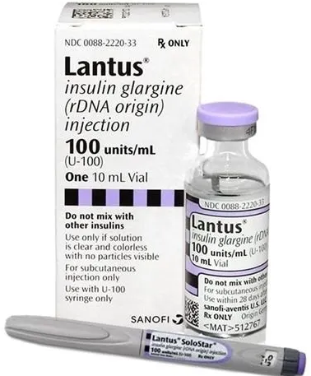
LONG ACTING INSULINS
Glargine - The duration of action is longer (~24 h), and there is a less pronounced peak. A lower incidence of hypoglycemia.
Detemir -reversibly binds to albumin and prolongs its action by slowing absorption and catabolism, but its duration of action may only reach 12–20 h.
Degludec forms multihexamers in subcutaneous tissue and binds albumin, prolonging its duration of action (>42 h); it provides similar glycemic control as glargine but with less frequent nocturnal and severe hypoglycemia.
These are usually prescribed with short-acting insulin in an attempt to mimic physiologic insulin release with meals.
87

Slide 89
88

Slide 90
Non-Insulin Treatments for Type 1 Diabetes
Pramlintide
Metformin
SGLT2 Inhibitors
GLP 1 (Liraglutide
Pramlintide is the only non insulin drug approved for use in adults with type 1 diabetes.
Metformin caused small reductions in body weight and lipid levels but does not improve A1C
Liraglutide 1.8 mg daily, showing modest A1C reductions (0.4%), decreases in weight (5 kg), and reductions in insulin doses.
SGLT2 inhibitor use in type 1 diabetes is associated with an increased rate of diabetic ketoacidosis(EDKA)
89

Slide 91
Type 2DM
ORAL
HYPOGLYCEMIC AGENTS
90

Slide 92
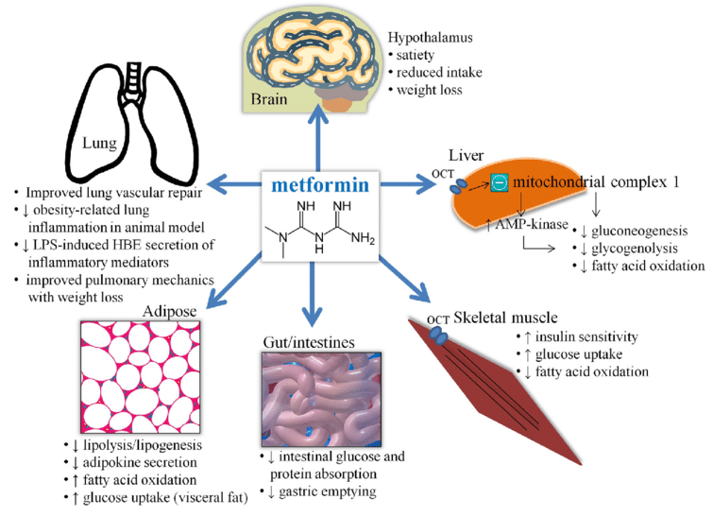
Metformin
91

Slide 93
GI symptoms with higher doses, the initial dose should be low and then escalated every 1–2 weeks to a maximally tolerated dose of 2000 mg daily.
The major toxicity of metformin, lactic acidosis, is very rare and can be prevented by careful patient selection.
Vitamin B12 levels are lower during metformin treatment and should be monitored.
92

Slide 94
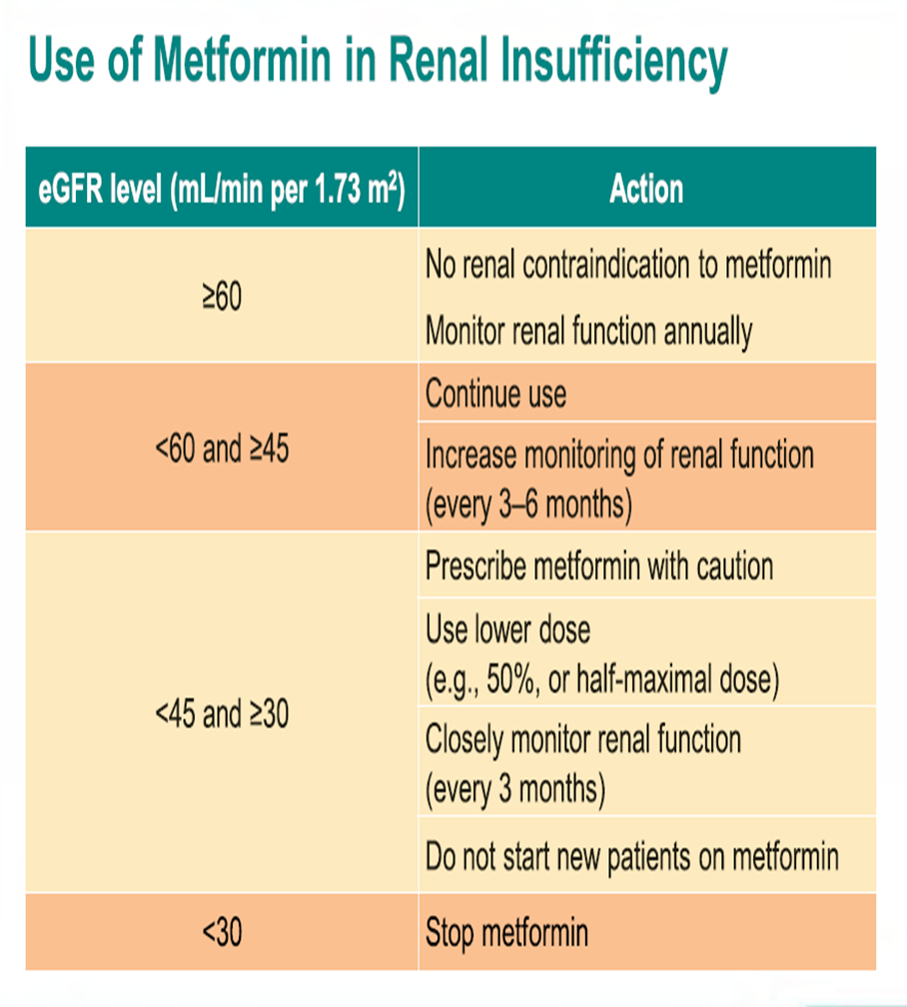
93

Slide 95
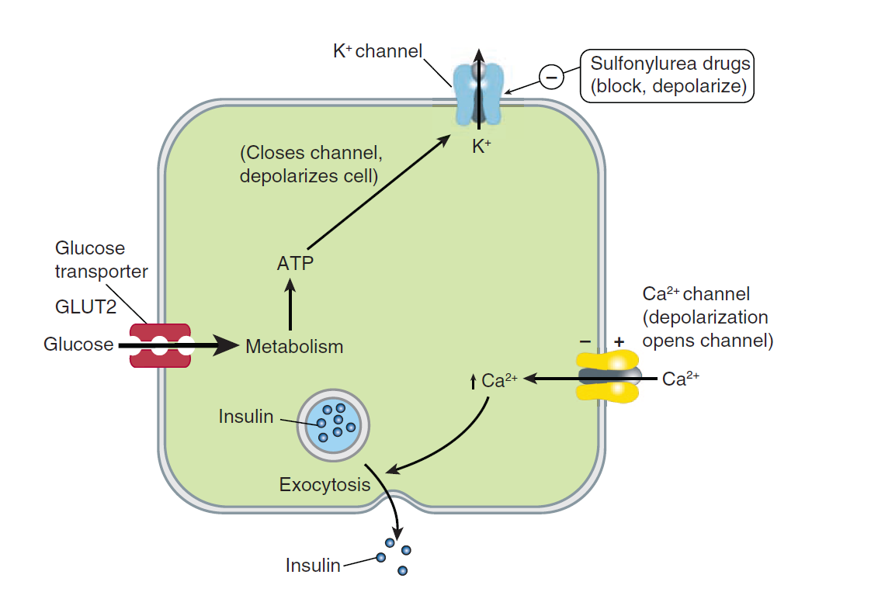
Insulin Secretagogues— Agents That Affect The ATP-sensitive K+ Channel
Insulin secretagogues stimulate insulin secretion by interacting with the ATP-sensitive potassium channel on the beta cell.
These drugs are most effective in individuals with type 2 DM of relatively recent onset (<5 years) who have residual endogenous insulin production
Include-
Sulphonylureas
Meglitinides
94

Slide 96
SIDE EFFECTS OF SU
Hypoglycemia, related to delayed meals, increased physical activity, alcohol intake, or renal insufficiency.
Weight gain
Drug interactions with alcohol and some medications including warfarin, aspirin, ketoconazole, α-glucosidase inhibitors, and fluconazole.
95

Slide 97
Reduce both fasting and postprandial glucose and should be initiated at low doses and increased at 1- to 2-week intervals based on SMBG.
96

Slide 98
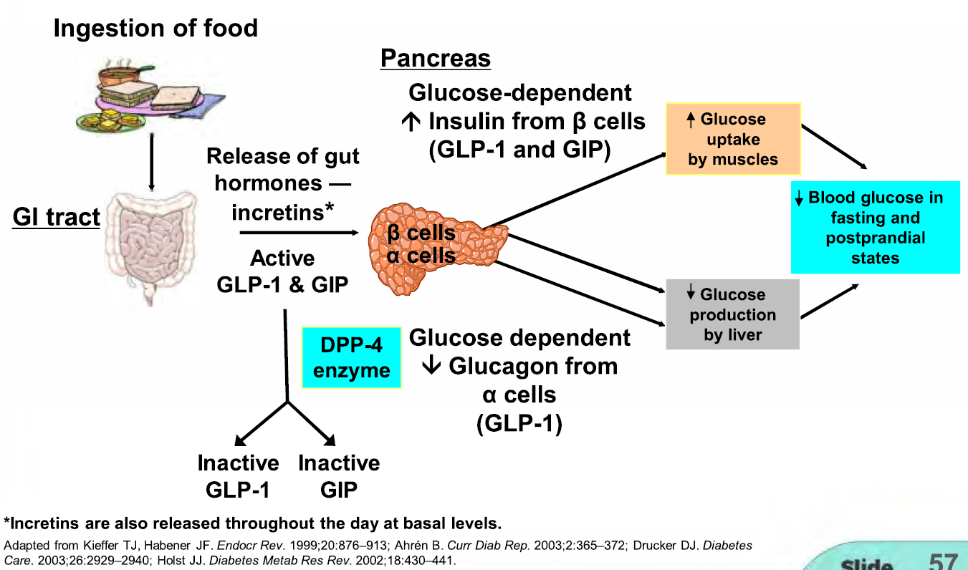
Insulin Secretagogue-Agents That Enhance GLP-1 Receptor Signaling
“Incretins” amplify glucose-stimulated insulin secretion so, they experience modest weight loss and appetite suppression, no hypoglycemia
GLUCAGON LIKE PEPTIDE -1 (GLP-1)
GLUCOSE DEPENDENT INSULINOTROPIC POLYPEPTIDE (GIP)
DIPEPTIDYL PEPTIDASE IV INHIBITOR (DPP IV i)
97

Slide 99
98

Slide 100
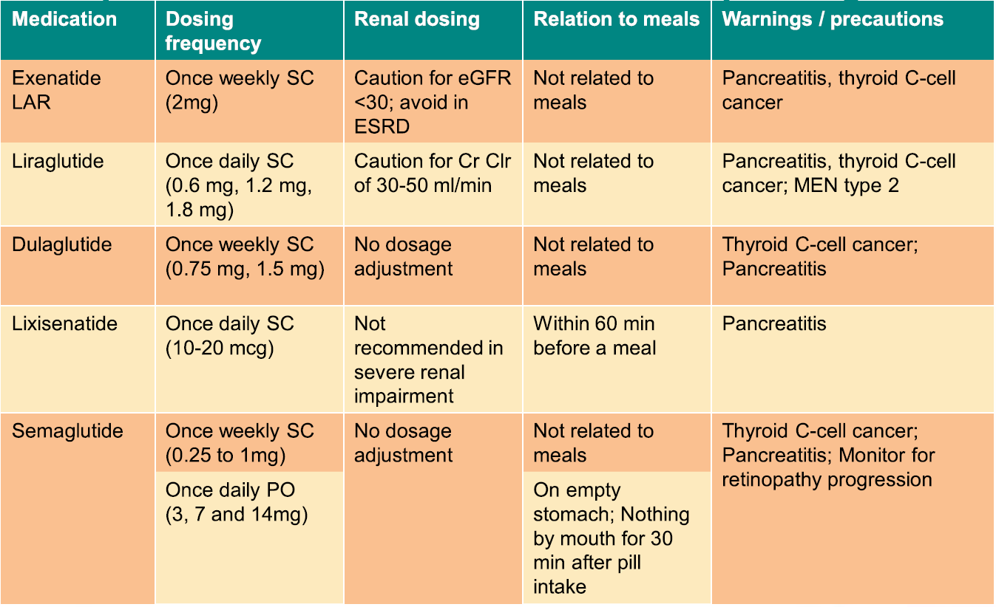
99

Slide 101
DPP-IV INHIBITORS
Inhibit degradation of native GLP-1 and thus enhance the incretin effect.
No hypoglycemia or weight gain
have a preferential effect on postprandial blood glucose.
Avoided in renal insufficiency, allergy, including rash, hypersensitivity reactions (including anaphylaxis, angioedema, and Stevens-Johnson syndrome).
Reasonable to avoid these agents in patients with pancreatic disease or with other significant risk factors for acute pancreatitis (e.g., heavy alcohol use, severely elevated serum triglycerides, hypercalcemia).
100

Slide 102
A-GLUCOSIDASE INHIBITORS
Reduce postprandial hyperglycemia by delaying glucose absorption
Therapy should be initiated at a low dose with the evening meal and increased to a maximal dose over weeks to months
Major side effects (diarrhea, flatulence, abdominal distention)
May increase levels of sulfonylureas and increase the incidence of hypoglycemia.
Should not be used in individuals with inflammatory bowel disease, gastroparesis, or a serum creatinine >177 μmol/L (2 mg/dL).
Not as potent as other oral agents in lowering the HbA1c
101

Slide 103
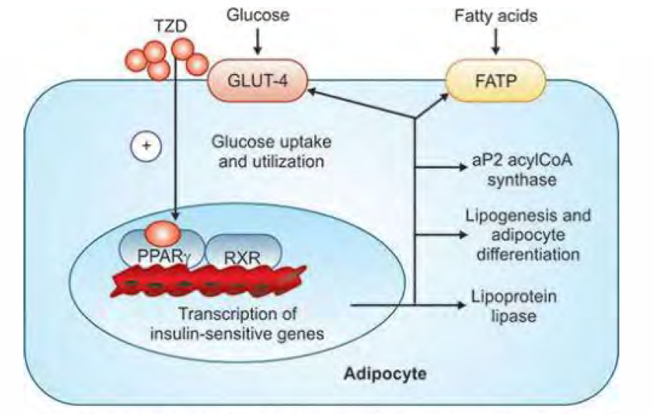
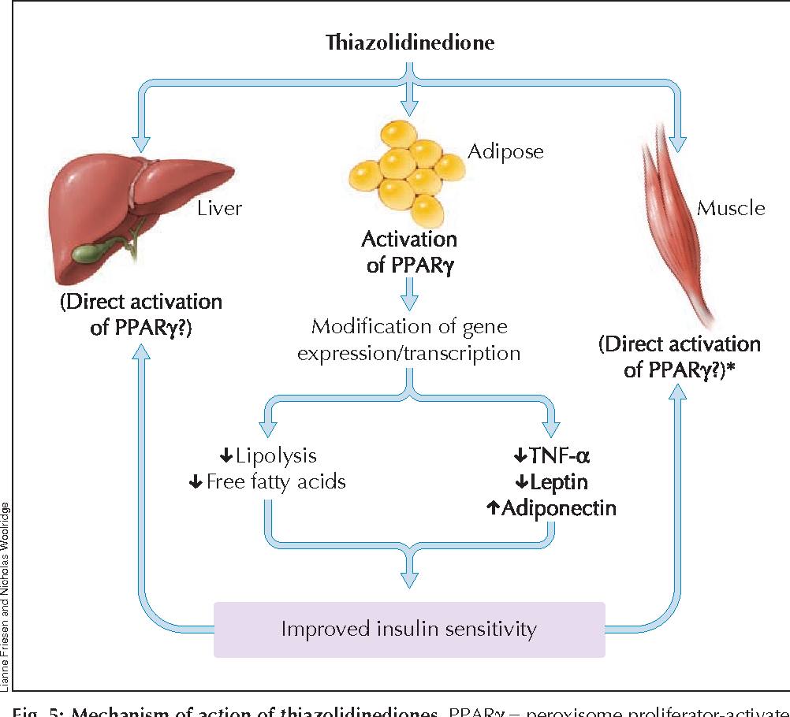
THIAZOLIDINEDIONES
102

Slide 104
Side effects of TZDs
Weight Gain
Peripheral Edema, Diabetic Macular Edema
Bladder Cancer
Congestive Heart Failure
Redistribution of fat from central to peripheral locations.
Circulating insulin levels decrease with use of the thiazolidinediones, indicating a reduction in insulin resistance.
103

Slide 105
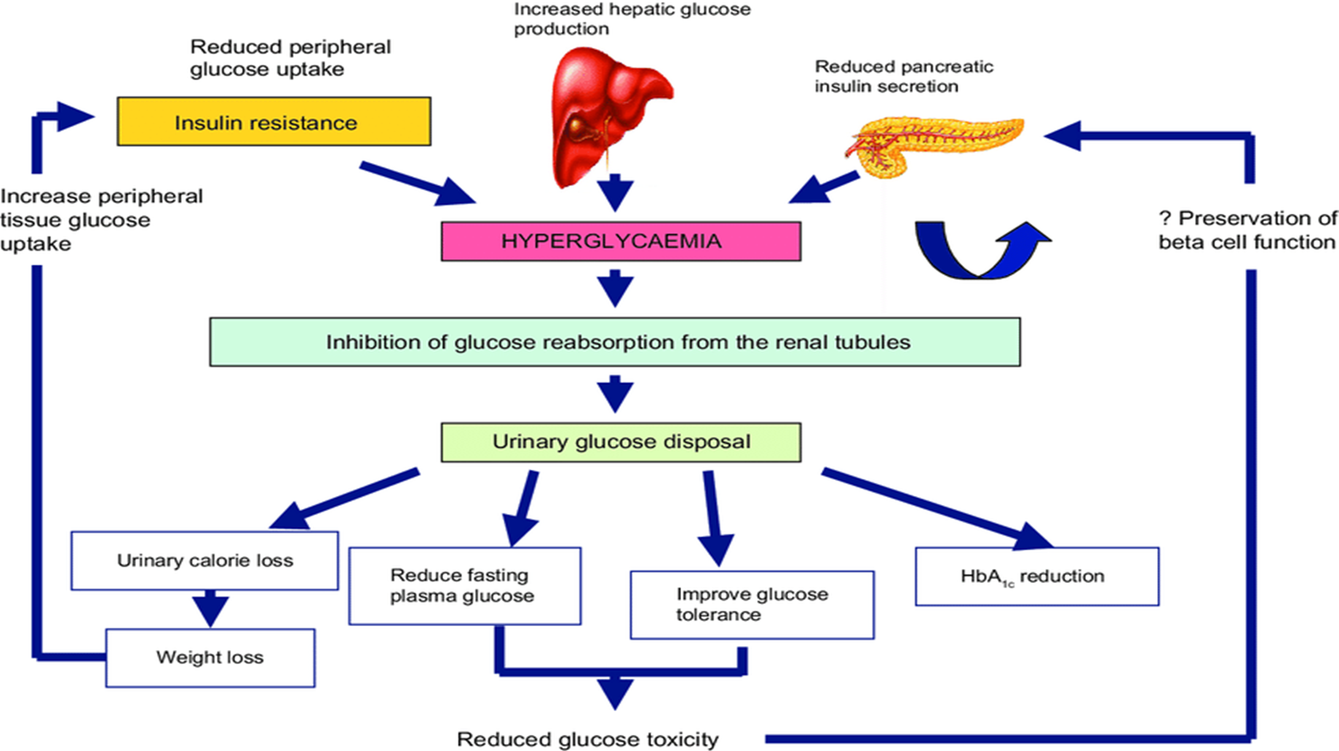
SODIUM-GLUCOSE CO-TRANSPORTER 2 (SGLT2) INHIBITORS INSULIN THERAPY IN TYPE 2 DM
Empagliflozin or canagliflozin reduces CVD events and all cause cardiovascular mortality in patients with type 2 DM and established CVD.
All SGLT2 inhibitors may reduce hospitalization for CHF.
Empagliflozin, canagliflozin, and dapagliflozin have all been shown to reduce progression of diabetic kidney disease but should not be initiated in patients with stage 3b CKD (eGFR <45 mL/min per 1.73 m2) and should not be used with stage 4 CKD (eGFR <30 mL/min per 1.73 m2).
104

Slide 106
105

Slide 107
INSULIN THERAPY IN TYPE 2 DM
106

Slide 108
107

Slide 109
INSULIN THERAPY IN TYPE 2 DM
Particularly used in
Lean individuals or those with severe weight loss,
Underlying renal or hepatic disease that precludes oral glucose-lowering agents, or in individuals who are hospitalized or acutely ill.
Usually initiated in a single dose of long-acting insulin (0.1–0.4 U/kg per day), given in the evening or just before bedtime (NPH, glargine, detemir, or degludec).
The insulin dose may then be adjusted in 10–20% increments as dictated by SMBG results.
Both morning and bedtime long acting insulin may be used in combination with oral glucose-lowering agents.
Initially, basal insulin may be sufficient, but often prandial insulin coverage with multiple insulin injections is needed as diabetes progresses (see insulin regimens used for type 1 DM).
Other insulin formulations that have a combination of short-acting and long-acting insulin are sometimes used in patients with type 2 DM because of convenience but do not allow independent adjustment of short-acting and long-acting insulin dose and often do not achieve the same degree of glycemic control as basal/bolus regimens.
108

Slide 110
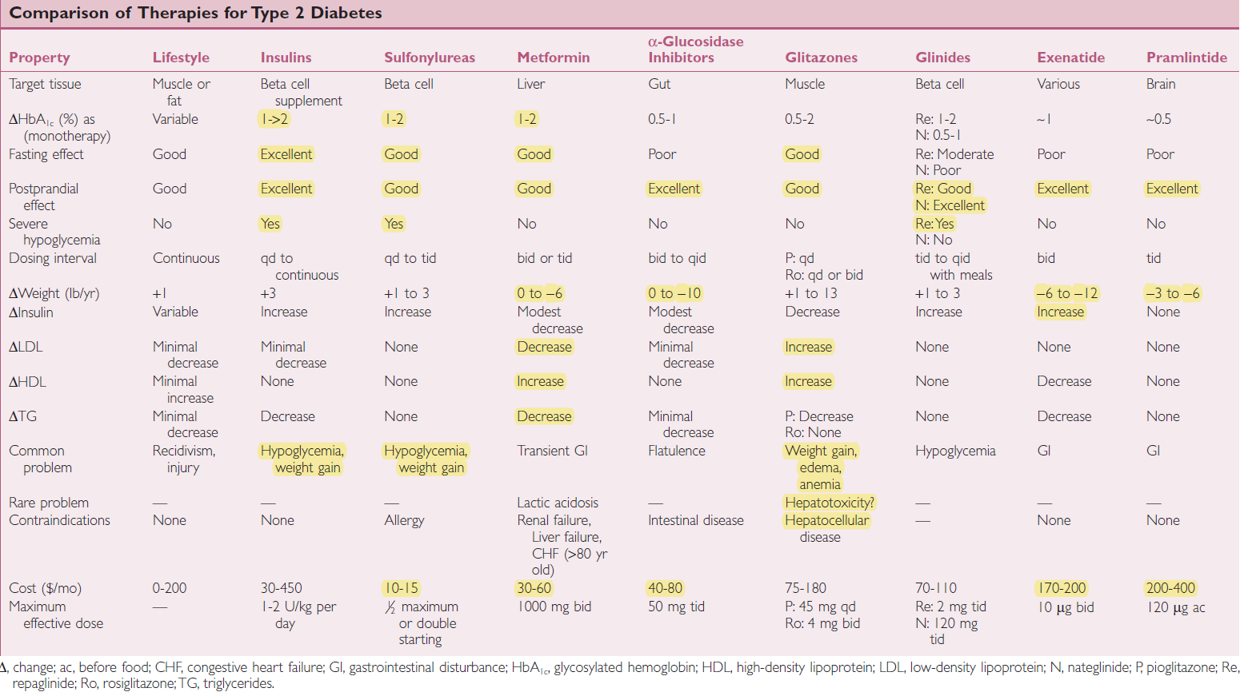
109

Slide 111
Bromocriptine
Suppression of hepatic glucose output Indicated in type 2 diabetes treated on diet alone or with SU, metformin or TZD who are not at target. Available as 0.8 mg tablets Given as a single dose PO within 2 hours of waking
Hydroxychloroquine
Dual PPAR-a/ PPAR-y agonist Decreases plasma TG levels and increase HDL-C levels Approved for the treatment of type 2 diabetes and diabetic dyslipidemia as well as nonalcoholic fatty liver disease Dosage-4 mg OD
Main mechanism of action is by impairing insulin degradation 400 mg once daily
Saroglitazar
Colesevelam
Bile acid binding resin (sequestrant) Can also reduce blood glucose levels by effects on the farnesoid X receptor. Also increases GLP-1 levels Dosage- 3.75 g OD
110

Slide 112
111

Slide 113
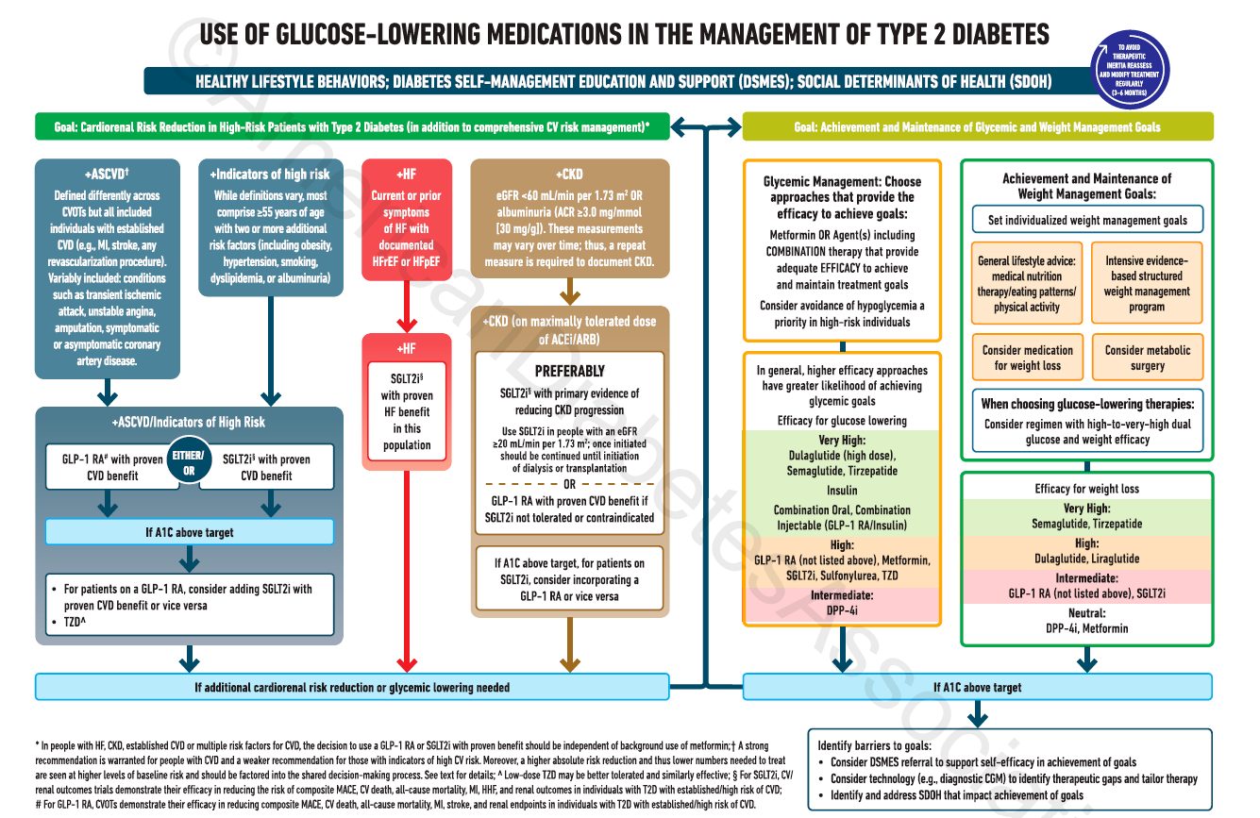
112

Slide 114
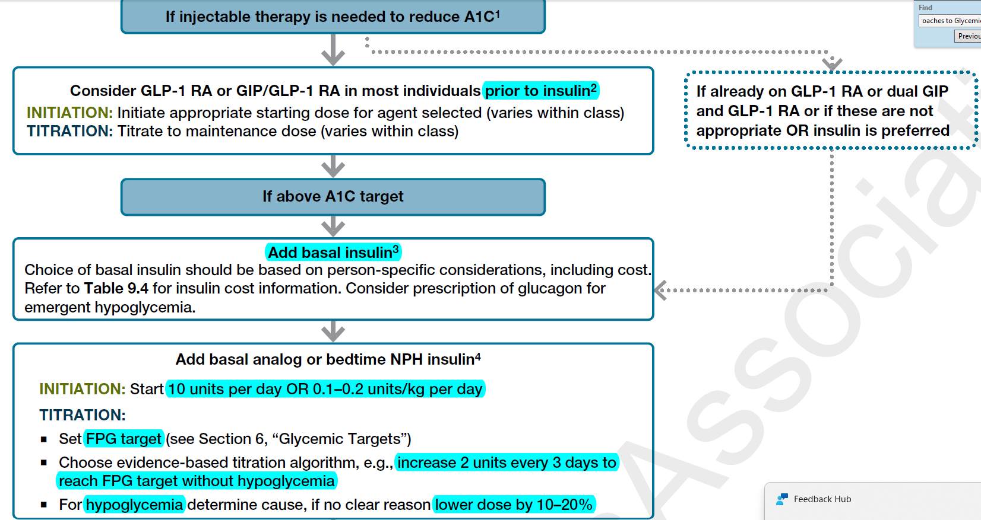
113

Slide 115
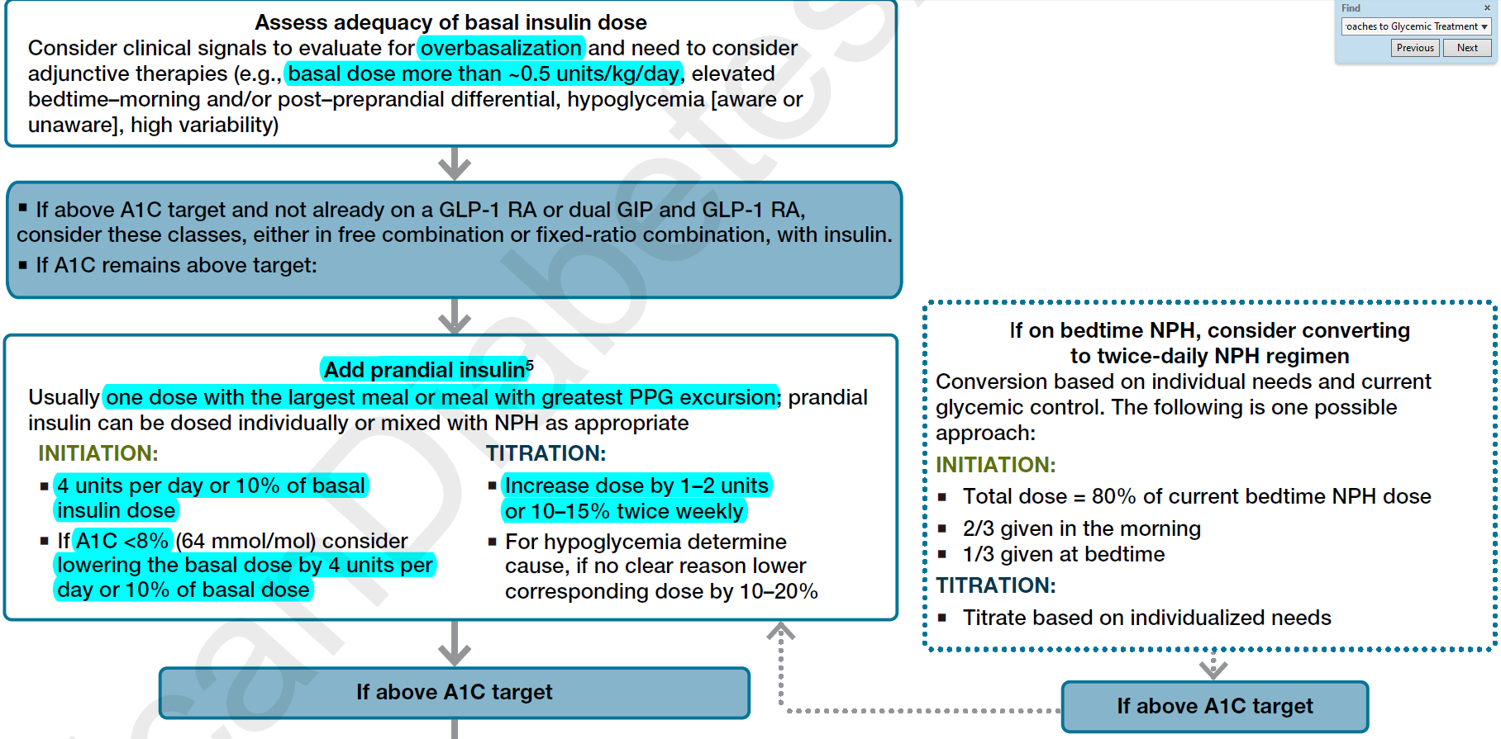
114

Slide 116
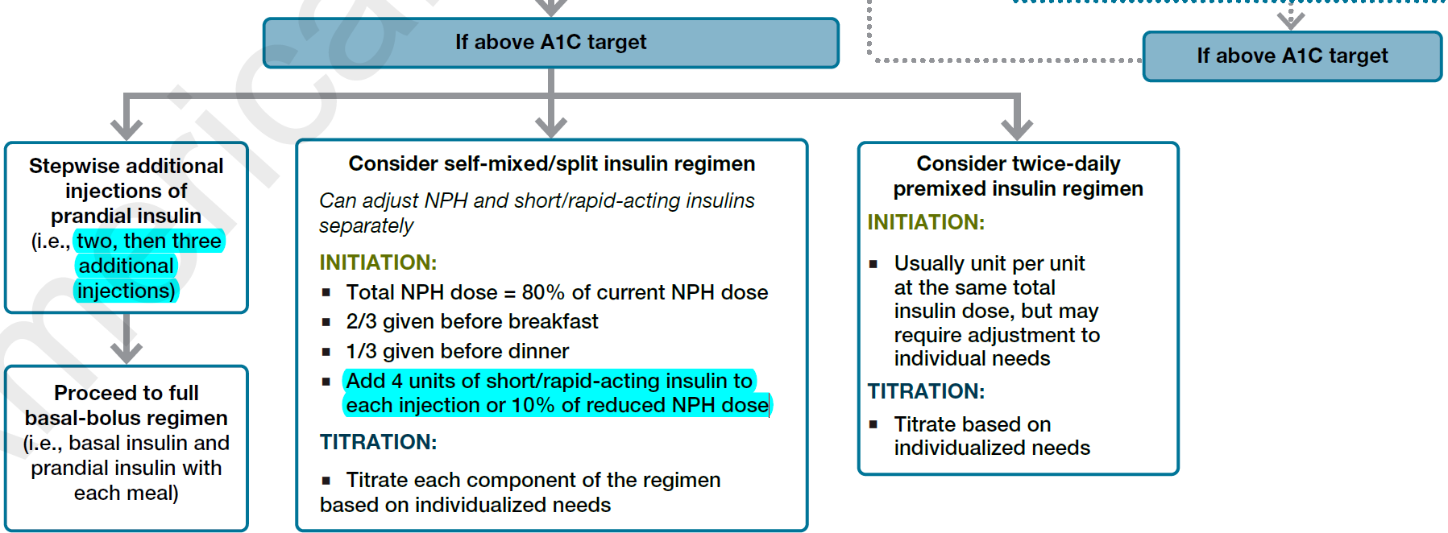
115

Slide 117
Case-1
45 year old male, developed severe chest pain and was taken to cardiac center and was diagnosed to have MI with Acute LVF. He was also found to have HbA1c of 9 and deranged fasting sugars. How will u manage his sugars, both in hospital and on discharge?
116

Slide 118
Case-2
A 29 year old female who is pregnant, was found to have fasting sugars around 129 and PP of 182. How will you manage?
117

Slide 119
Case-3
A 37 year old male who was also chronic alcoholic was brought to emergency with severe abdominal pain. His sugars were found to be 423mg/dl. Discuss D/D.
His Amylase/Lipase were highly raised. How will you manage this patient, both in IPD and after discharge.
118

Slide 120
119

Slide 121
Thank You
120

