Slide 1
यह कार्यक्रम स्वास्थ्य विभाग और राज्य स्वास्थ्य एवं परिवार कल्याण संस्थान (SIHFW), उत्तर प्रदेश की पहल पर उत्तर प्रदेश टेक्निकल सपोर्ट यूनिट (UPTSU) के सहयोग से हो रहा है।
Principal Secretary, Medical Health & Family Welfare, U.P. Shri Partha Sarthi Sen Sharma
Director Administration & Director, SIHFW
Dr. Rajaganapathy R

Slide 3
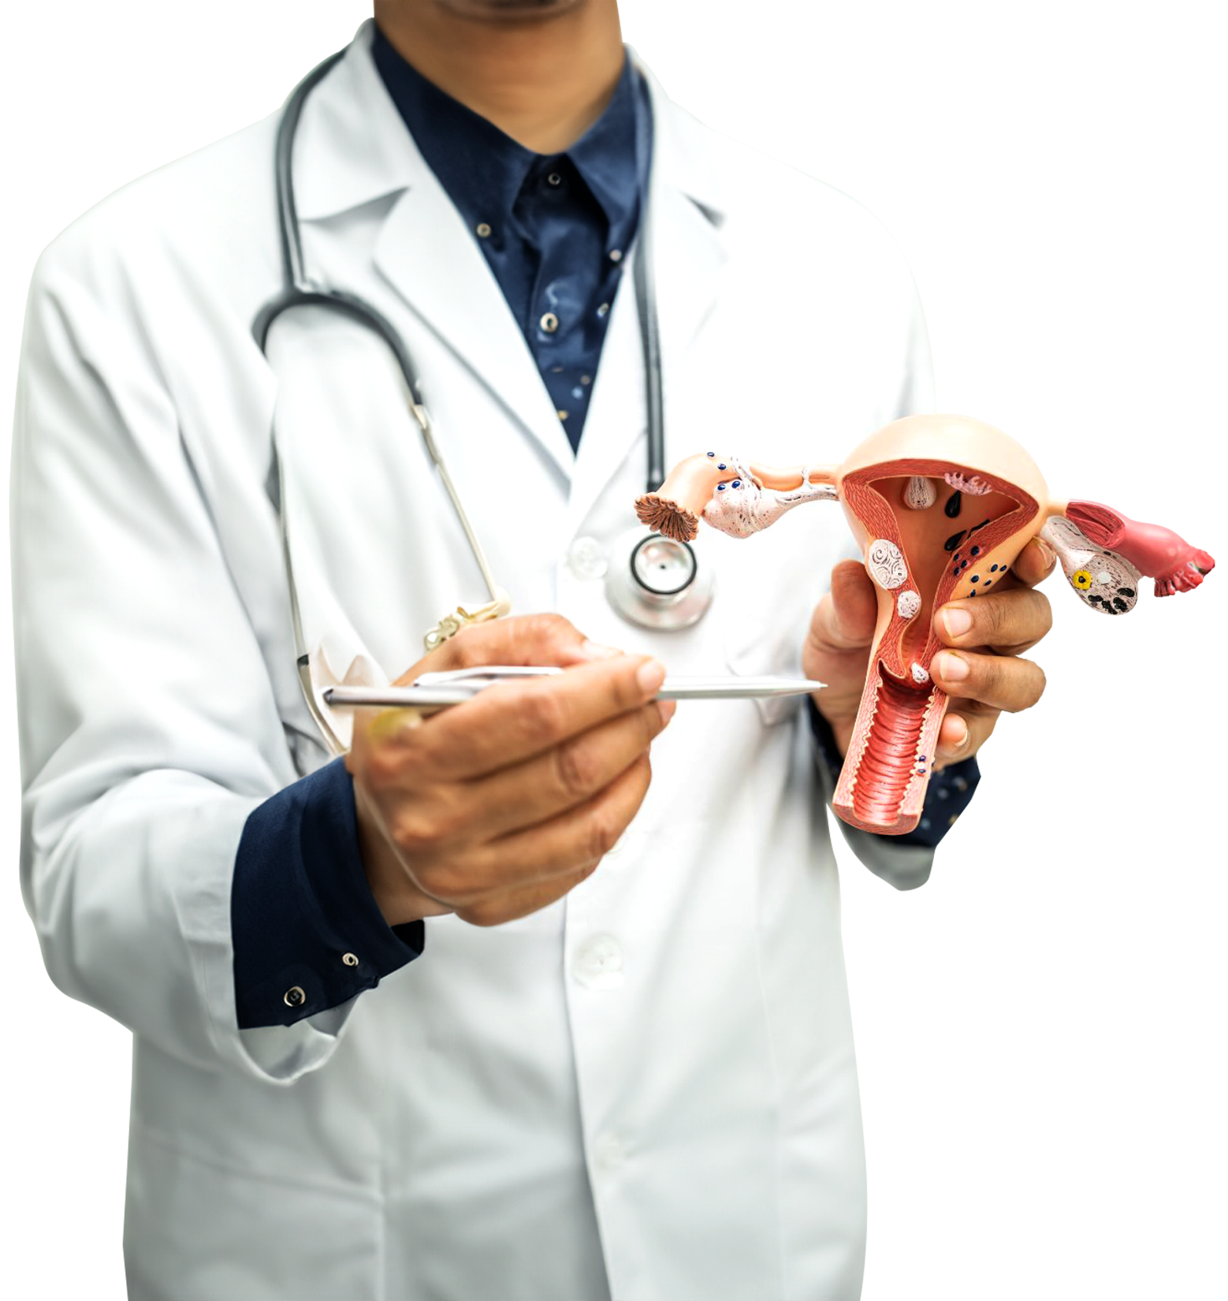
CERVICAL CANCER PREVENTION BY HPV VACCINATION AND SCREENING
Prof Nisha Singh
MD (AIIMS) FICOG
Incharge, Genital cancer control Unit
Department of Obstetrics and Gynecology
King George’s Medical University, Lucknow

Slide 4
Why we need to talk about cervical cancer
Globally, we see 649,847 new cases and 341,365 deaths due to cervical cancer per year.
Nearly 85% of the disease burden lies in low/ middle-income countries (LMICs), which lack universal screening programs.
India
One out of five women who die due to cervical cancer is from India.
Second most common cancer in Indian women with annual new cases above 123,000 and Annual deaths above 77,000
A public health problem- magnitude more than maternal mortality

Slide 5
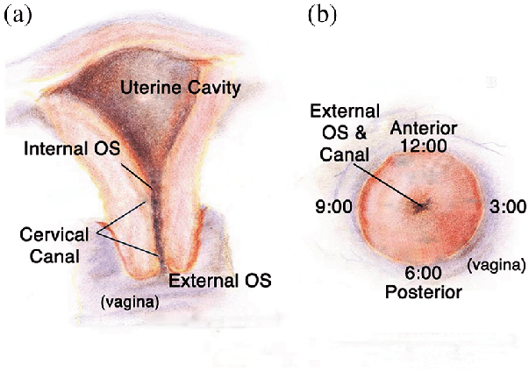
Anatomy of Cervix
The cervix- distal fibro muscular portion of the uterus, cylindrical or conical in shape, 3 to 4 cm long and 2.5 cm in diameter
Ectocervix- portion of cervix lying outside the external os
Endocervix- a tubular cavity within the cervix, passage between the ext and int os.6-8 mm in diameter

Slide 6
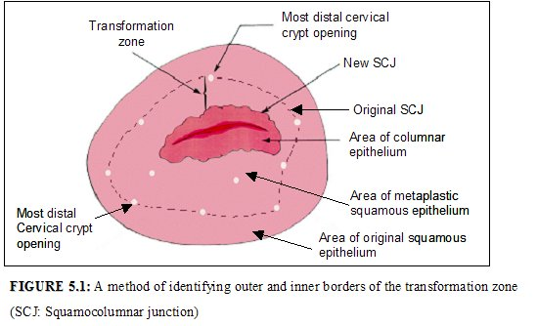
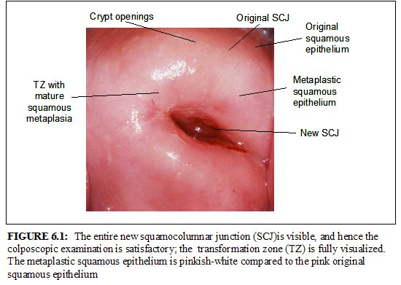
Transformation Zone

Slide 7
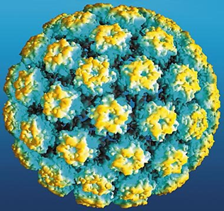
Human Papilloma Virus
Non-enveloped double-stranded deoxyribonucleic acid (DNA) virus
More than 150 known types
“Low-risk” HPV types- Types 6, 11, 42, 43, or 44 cause respiratory papillomatosis and genital warts.
“13 High-risk” types - Types 16, 18, 31, 33, 35, 39, 45, 51, 52, 56, 58, 59, 68.
Cervical cancer the most common HPV-related disease

Slide 8
HPV Infection Characteristics
Affects 15 to 59 years of age.
Most sexually active women and men infected at some point in their lives, may be repeatedly too.
Peak time - shortly after becoming sexually active.
Most HPV infections are asymptomatic.
HPV infections usually clear up without any intervention within a few months after acquisition, and about 90% clear within 2 years.
Yet, all women are at risk of HPV infection becoming chronic leading to pre-cancerous lesions and invasive cervical cancer.

Slide 9
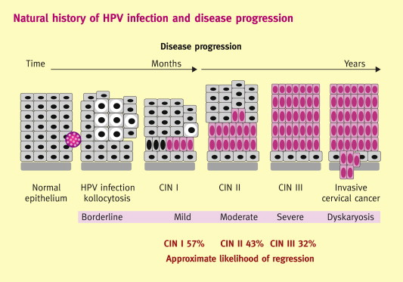
HPV Infection Natural history

Slide 10
Risk Factors for HPV Persistence
HPV type – its oncogenicity or cancer-causing strength
Immune status – immunocompromised (HIV positive) have a more rapid progression to pre-cancer and cancer (5 to 10 years)
Coinfection with other sexually transmitted agents, (BV, HSV, chlamydia and gonorrhoea)
Parity and young age at first birth
Tobacco smoking
Menstrual hygiene

Slide 11
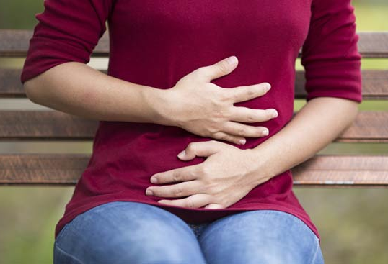
17th November 2020 - The red letter day
WHO released strategies
to eliminate cervical cancer by 2030
The 90:70:90 Mantra
Vaccination of 90% eligible girls,
Screening of 70% eligible women
Treatment of 90% CIN and CA Cervix cases

Slide 12
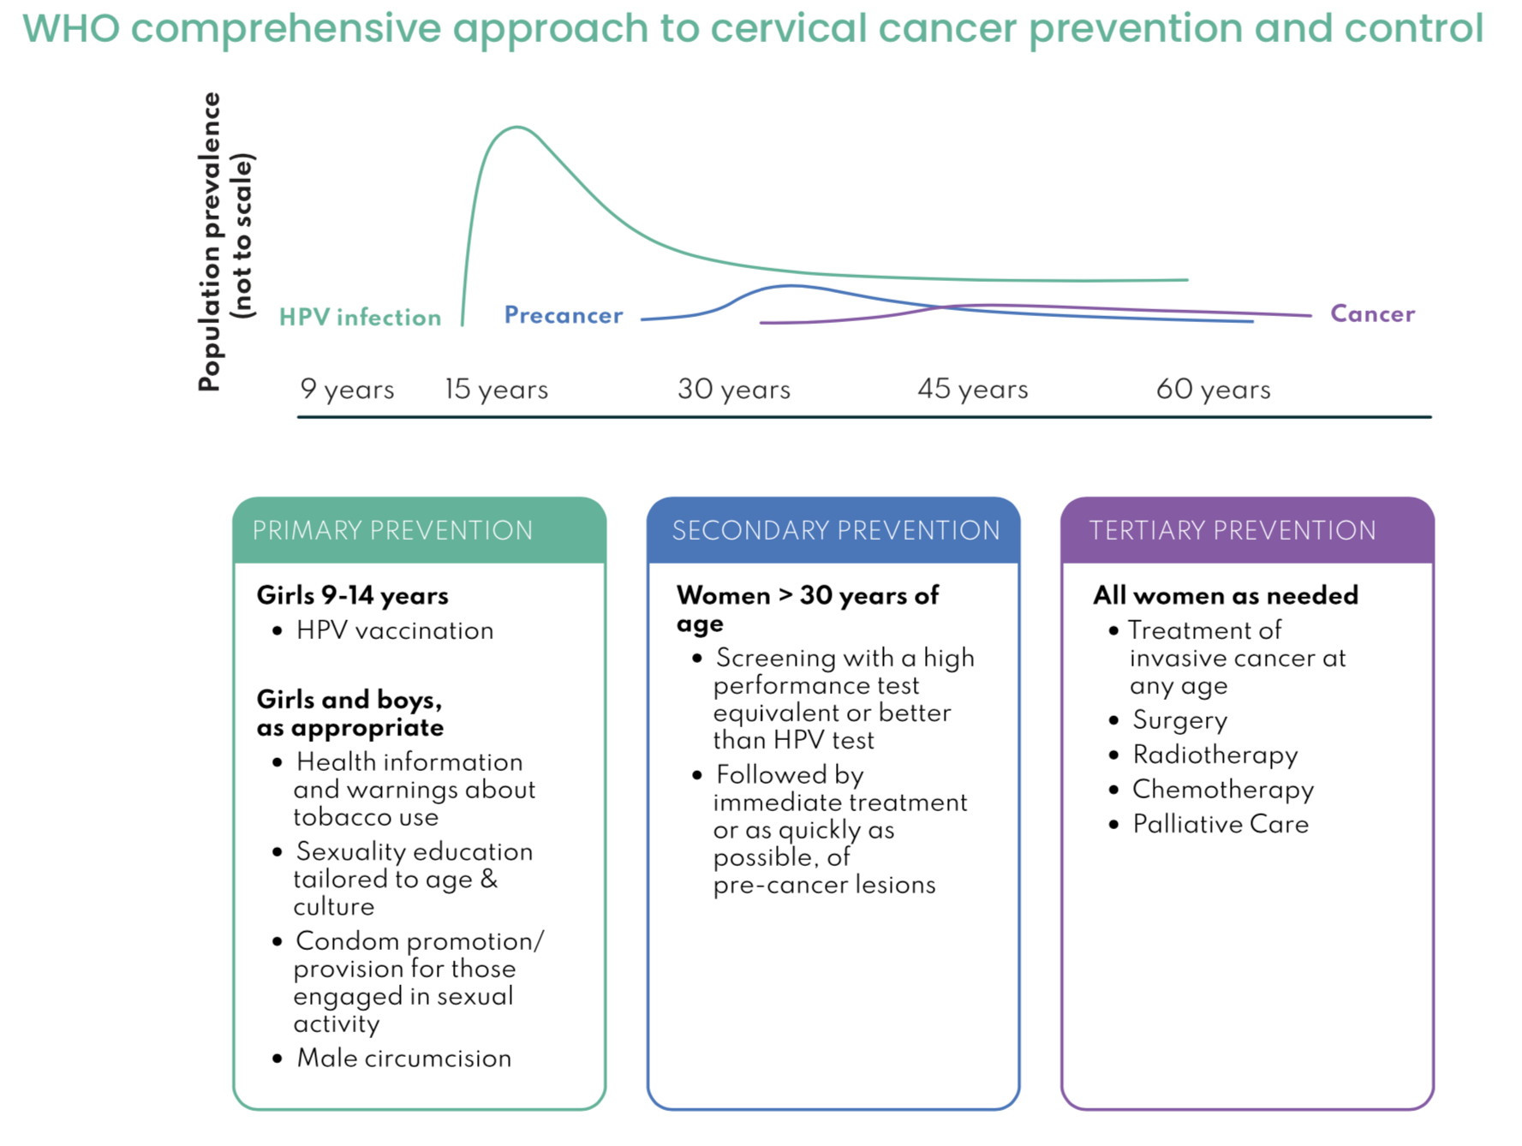
“Cervical cancer is a NCD we can overcome”

Slide 13
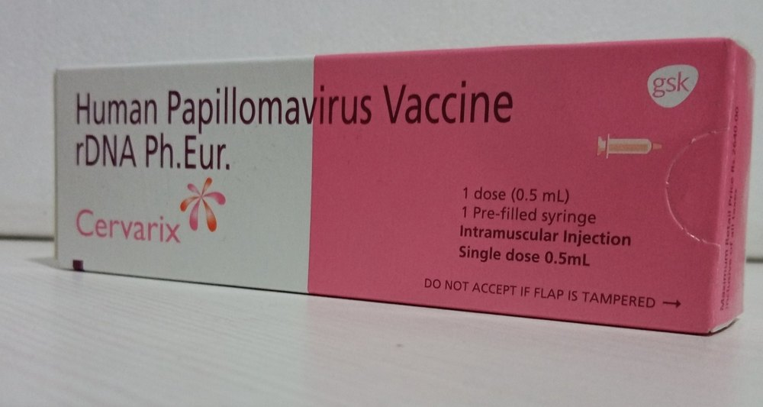
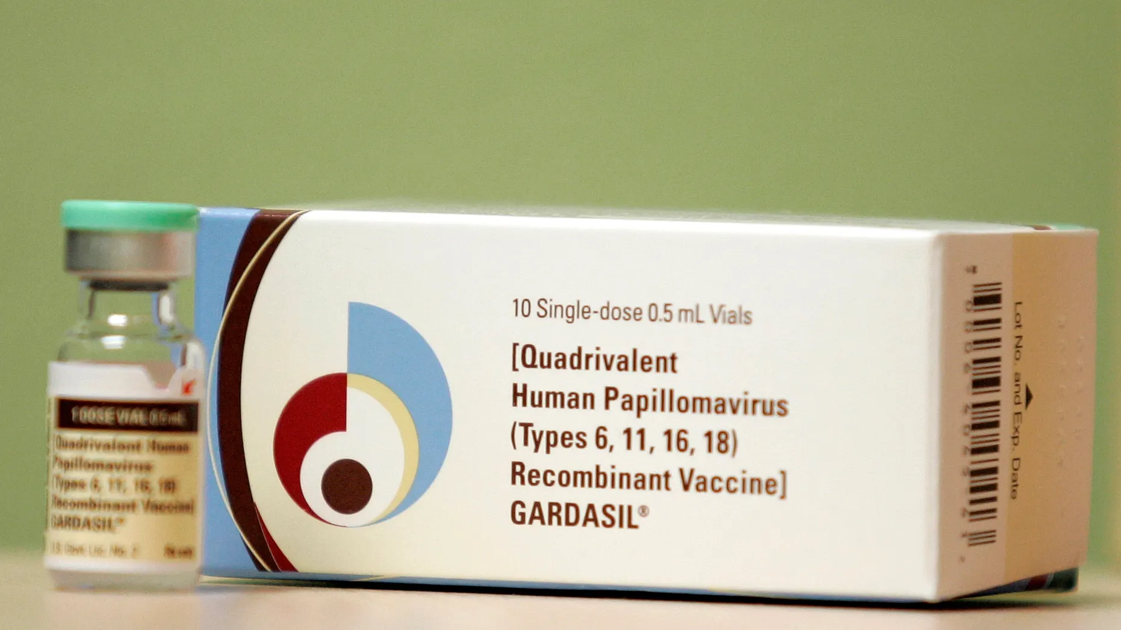
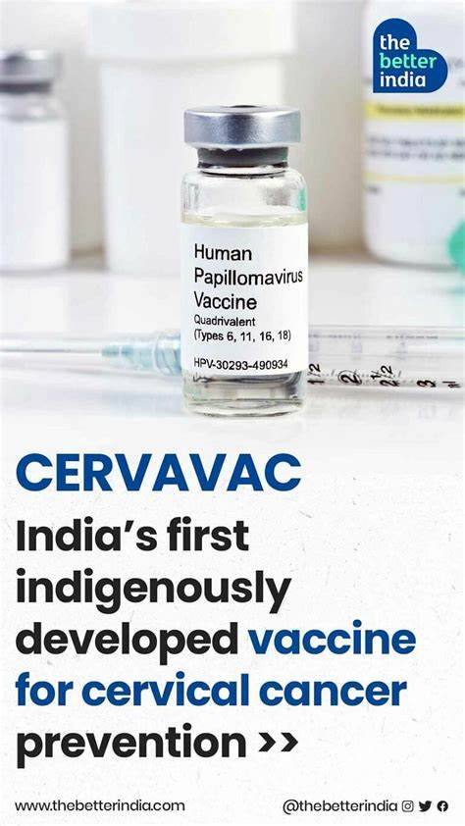
HPV Vaccines available in India
CERVARIX
GARDASIL
GARDASIL-9 CERVAVAC

Slide 14
 | Cervavac | Gardasil | Cervarix | HPV 9
Manufacturer | SII | Merck | GSK | Merck
VLP types | 6/11/16/18 | 6/11/16/18 | 16/18 | 6,11,16,18, 31, 33, 45, 52, 58
Dose L1 protein |  | 20/40/40/20 µg | 20/20 µg | 60/40/20/20/20/20/20/30/40
Adjuvant | AS04: MPL (50); Aluminum hydroxide salt (500) | 225 µg Al OH phosphor sulfate | 500µg Al OH, 50µg 3O deacylated-4’monophosphoryl lipid A | 500 µg Alum hydroxy phosphate sulfate
Schedule (months) | 0, 6 0,2,6 | 0, 6 0, 1-2, 4-6 | 0, 5-13 0, 1-2.5, 5-12 | 0, 5-13 0, 1-2, 4-6 mths
Licensed | India 2022 | 2006, 2008 India | 2009 | USA 2014,India 2018

Slide 15
Age and dose recommendations
The Geometric Mean Titres (GMTs) induced by both vaccines are two times higher in girls aged 10-15 than older girls aged 16-26.
So ideally should be given before 15 years
Two doses recommended intramuscularly before 15 years age. (WHO 2015)
The second dose of HPV vaccine should be given 6 to 12 months after the first dose (may be extended to 15 months)
Three doses recommended after age of 15 years

Slide 16
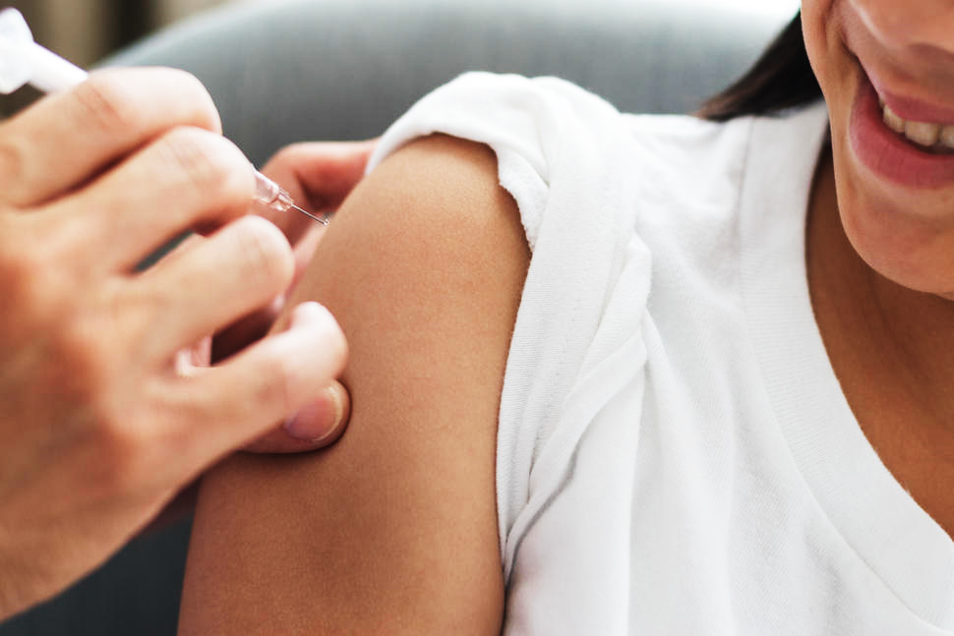
Single dose vaccination
Robust antibody titres were found well above natural infection titres with single dose in Indian studies
November 2019, WHO’s Strategic Advisory Group of Experts (SAGE) - one dose to girls under 15 years of age followed by a second dose 3 to 5 years later.
WHO position paper in 2022 - Alternative single-dose schedule. As an off-label option, a single-dose schedule can be used in girls and boys aged 9–20 years.

Slide 17
Well Proven
Efficacy
Safety
N Engl J Med 2020; 383:1340-8. Cervical cancer as endpoint - The Swedish experience 2020
1,672,983 girls and women, 10 to 30 years old studied from 2006 through 2017.
After adjustment for all covariates, the cervical cancer incidence rate ratio was 0.12 (95% CI, 0.00 to 0.34) among women vaccinated before the age of 17 years and 0.47 (95% CI, 0.27 to 0.75) among women vaccinated between 17 to 30 years.
The vaccine safety concerns investigated by Global advisory committee on vaccine safety (GACVS)
No issues found to change recommendations
Frequency of anaphylaxis similar to other vaccines
No excess frequency of GBS, thromboembolic disorders or regional pain syndrome as compared to general population

Slide 18
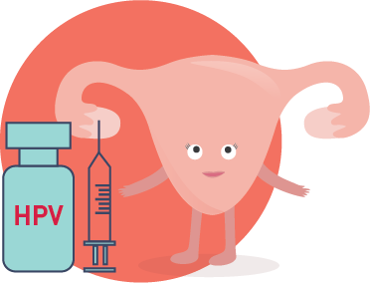
HPV Vaccination in special situations
Immunodeficienct (HIV positive) - three doses recommended for all age groups
Pregnancy- Vaccination should be delayed until completion of pregnancy. If a woman is found to be pregnant after initiating the vaccination series, remaining doses should be delayed but MTP is NOT recommended. Women vaccinated during pregnancy should be reported to the respective manufacturer.
Breastfeeding women- may receive HPV vaccine
After CIN treatment - No therapeutic benefit. They can be vaccinated, but with prior counselling that vaccine will not help in treating the already existing HPV infection or lesions.
Interchangeability of brands - efforts should be made to administer the same vaccine for all doses when using a multi-dose schedule. However, if the vaccine used for the prior dose(s) is unknown or unavailable, any HPV vaccine can be administered to complete the recommended schedule.

Slide 19
Counseling by health care workers
HPV vaccine (CERVAVAC) is developed in india.
CERVAVAC is available in subsidised rate
HPV vaccine can prevent cervical cancer
It can prevent some types of cancer.
HPV vaccine will soon be included in vaccination schedule
It can prevent a common infection.
It has lasting benefits.
I think it is important.
To follow up in hospital if any danger signs occur
Prevention is better than cure
It is a safe vaccine

Slide 20
HPV vaccination as part of National Immunization programs
125 countries have included the HPV vaccination in their NIP for girls and 47 for boys too
Australia, UK, USA and Canada Bhutan, Panama and Rwanda, Nepal, Bangladesh &Thailand
HPV vaccine should be administered at the same visit as other age-appropriate vaccines, such as Tdap, Meningococcal conjugate (MCV4) Hepatitis A & B vaccines.
No clinically relevant interference reported
Single visit administration increases the compliance and complete dose.
Each vaccine should be administered using a separate syringe at a different anatomic site.

Slide 21
SCREENING
The second strategy
Looking for disease without signs and symptoms
Screening for Cervical cancer through
The cause of cervical cancer - HPV DNA
The precursor - CIN (Cervical intraepithelial Neoplasia) evidence may be cytological, histological, morphological

Slide 22
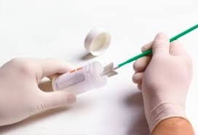
HPV Tests
Test | Technique | Name
DNA | Direct Genome Detection | Hybrid Capture 2 Qiagen
 |  | Care HPV test
 | Amplification | GP5+/GP6+ bio PCR-EIA
 |  | Cervista HPV HR, Hologic
 | Amplification and Genotyping of HPV 16/ 18 | Cervista HPV 16/18
 |  | Cobas HPV test, Roche
 |  | Xpert HPV
 |  | Abbott Real Time High Risk (HR) HPV assay
 |  | PapilloCheck
RNA | Amplification of E6, E7 proteins | Aptima HPV Assay
 |  | PreTect HPV – Proofer HV
 | Monoclonal antibodies | Avantage HPV E6 test
High sensitivity and specificity (90%)
Reflex HPV test
HPV Co test-
HPV Self test

Slide 23
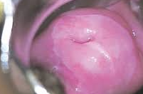
VIA- visual Inspection with acetic acid
5% acetic acid is applied on Cervix (transformation zone) for one minute
Abnormal areas are seen as aceto-white areas-VIA positive
Mechanism- Protein coagulation of abnormal cells
Very Useful test in low resource setting-community screening

Slide 24
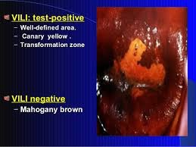
VILI-visual inspection with lugol’s iodine
Apply Lugol’s Iodine to the Cervix
Abnormal areas do not take up Iodine due to low glycogen content - Iodine negative areas
Preparation - Dissolve 10 g potassium iodide in 100 ml of distilled water and add 5 g iodine crystals, while shaking. Filter and store in a tightly stoppered brown bottle

Slide 25
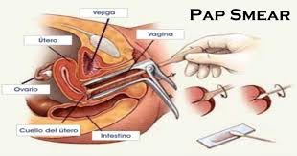
Pap Smear
LBC-Liquid based cytology
Advantages over conventional cytology-
Better yield of cells -Low incidence of inadequate smears (1.9%)
Reflex HPV testing possible and Automated reading possible
Accuracy- Overall sensitivity not better, 11% more sensitive for LSIL + lesions
Limitations- expensive, automated reports
Options- Thin prep (Hologic), Surepath (BD)

Slide 26
Screening Guidelines- WHO 2021
Age- start at 30 years stop after 50 if two tests negative
Frequency- For HPV every 5-10 years. At least twice in lifetime. For other tests- VIA or cytology- 3 years. At least twice in life time - 35 and 45 years
Scaling up to twice-lifetime screening and cancer treatment would reduce mortality by 34∙2%, averting 300,000 deaths by 2030
Method- HPV DNA test is best- by HCW or self collection

Slide 27
Screen and treat in community programs
Screen See and Treat in Colposcopy clinics
HPV / VIA positive
Criteria for ablation fulfilled
Treat immediately, with or without biopsy
Lower probability of over-treatment in high prevalence areas
Post-hoc analysis is possible if biopsy taken
Screen positive in hospital setting
Colposcopy scoring- indicates a high grade lesion
Simultaneous treatment done – excision or ablation
Low probability of over-treatment- two tests done
Post-hoc analysis of biopsy report/excision specimen

Slide 28
Third strategy Treatment of CIN
Ablation- destryoing abnormal cervical tissue
Cryotherapy- freezing
Thermoablation- heating
Excision- removing abnormal cervical TZ
LEEP (LLETZ)- using a LOOP
SWETZ- with straight wire Cold knife conization (cone biopsy)- using knife (no cautery)

Slide 30
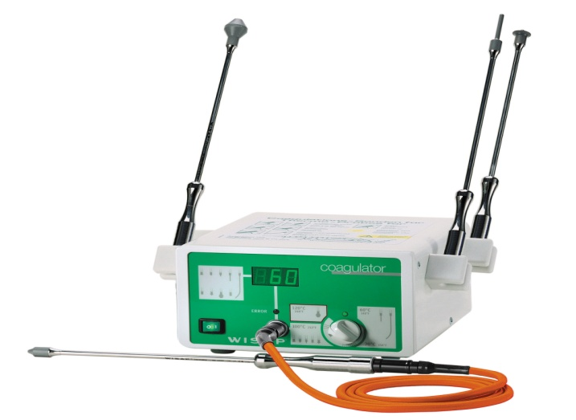
Thermoablation
WISAP cold coagulator
LIGER thermo ablator
Electricity operated SS probe. Teflon coated 30s activation (100deg C) 20 -30s app, 2 min cooling
Battery operated Teflon coated probe 16mm flat, 19 mm nipple 8s activation(100 deg C), 20s app, 10s cooling autoclavable, Cydex

Slide 31
Summary
Vaccinate all girls 9-14 years
Screen all women 25-65 year
Choose method - resource based - HPV is best
Single visit strategy for CIN treatment - Ablation OR LEEP
Early diagnosis and treatment of cervical cancer
Followup is important

Slide 32
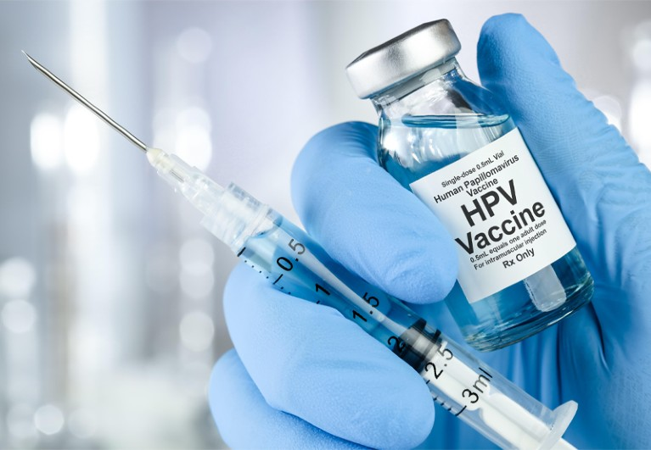
Thank You
Prof Nisha Singh
MD (AIIMS) FICOG
Incharge, Genital cancer control Unit
Department of Obstetrics and Gynecology
King George’s Medical University, Lucknow

