Slide 1

ASTHMA AND COPD:
Risk Factors and Management
“शुक्रवार की शाम, डॉक्टर्स के नाम”
Dr. Surya Kant
Venue : SIHFW, Indiranagar, Lucknow
Date : 22/03/24
Time : 6pm-7:30 pm
MD (Gold Medalist), D.Sc. (Honoris Causa)
FCCP (U.S.A.), FACP (USA), FRCP (London), FRCP (Glasgow), FGAPIO, FAPSR, FISEB, FGSI,
FAMS,FIAMS, FNCCP, FCAI, FIMSA, FIAB, FICS, FUPDA, FIACM, FICP, FCGP, FISC, FUAPMI, FISH
Professor & Head, Dept. of Respiratory Medicine, K.G.M.U.,UP, Lucknow
Honorary professor, IMA, IMA-CGP, IMA-AMS
Member, Governing Body, AIIMS Patna
Member, Board of Management, Rajasthan University of Health Sciences
Member, National steering committee, Doctor’s for clean air movement in India
Past President, Indian College of Allergy, Asthma and Applied Immunology(ICAAAI)
Past President National College Of Chest Physician(NCCP)
Past President , Indian Chest Society.

Slide 2
Consider
These
  We breathe 25,000 times a day
  We can live without food: 3 WEEKS
  We can live without water: 5 Days
  We can live without air: Not more than 3 minutes

Slide 3
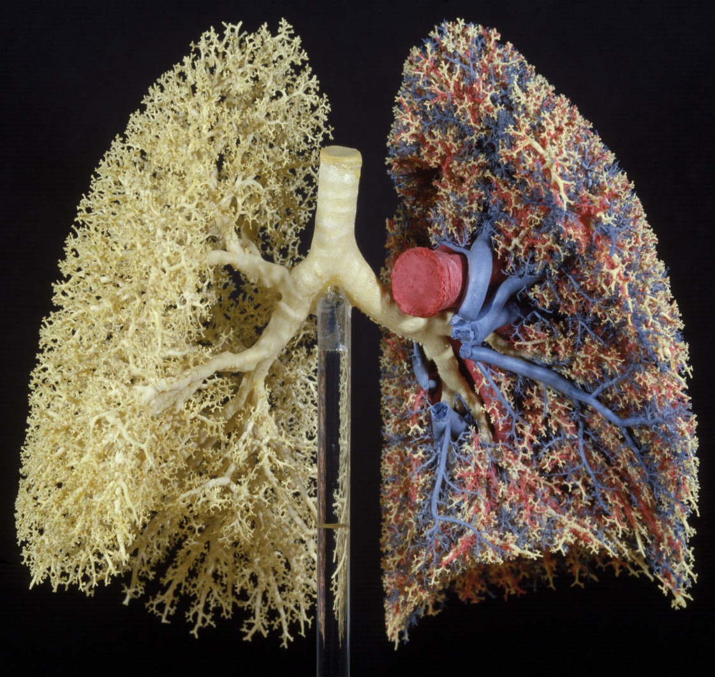
LUNGS : THE ORGAN OF RESPIRATION
100m²
10,000 lt. air pass in and out every 24 hours
10,000 lt.blood pass every 24 hours
500 Liters of oxygen delivered every day

Slide 4
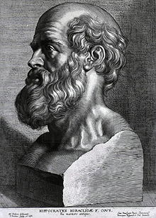
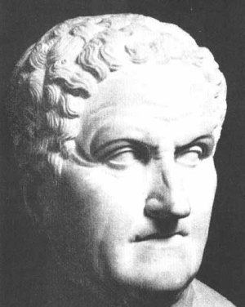
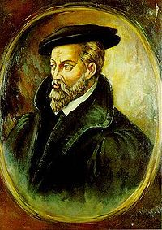
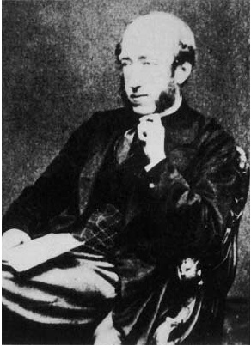
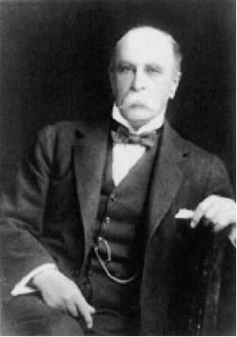
Understanding of asthma etiology in ancient times
First described by Hippocrates (460-377 BC)
Derived from Greek word ‘asthmaino’ indicating ‘panting or gasping’
First etiological link was made by Galen (130-201 AD)
Also described the asthma-AR link
Link between environment and airway symptoms described by Georgius Agricola (1494-1555)
First report of occupational asthma
Henry Hyde Salter (1823-1871) classified asthma into intrinsic and extrinsic in 1860
Suspected involvement of neural and vascular mechanisms
In 19th century, Sir William Osler, explained emergence of concepts of airway inflammation and AHR
Respir Med 2007; 10: 378- 388
Am J Respir Crit Care Med 2004; 170: 215-221

Slide 5

Asthma
34.3 million cases
13% of global burden
BURDEN IN INDIA
In the world for the
Total number of Asthma Cases
Total DALYs
Total asthma deaths
43% of the global asthma deaths, indicating Asthma remains very poorly managed in India
AIM study:
  India had the greatest number of asthma patients reporting both daytime and nighttime symptoms,
  Greatest number of people reporting school or work absenteeism and the worst QoL
Reference- MOH&FW, GOI

Slide 6
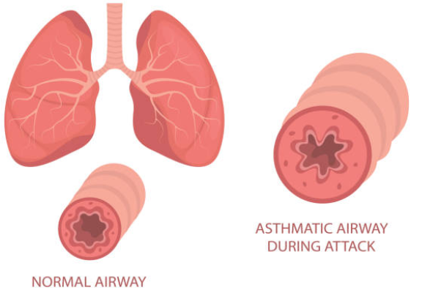
Definition-GINA 2023
Asthma is a heterogeneous disease, usually characterized by chronic airway inflammation.
It is defined by the history of respiratory symptoms such as wheeze, shortness of breath, chest tightness and cough that vary over time, period, frequency and intensity, together with variable expiratory airflow limitation
Notes:
the Global Initiative for Asthma (GINA), a network of individuals, organizations, and public health officials to disseminate information about the care of patients with asthma, and to provide a mechanism to translate scientific evidence into improved asthma care. The GINA Assembly was subsequently initiated, as an ad hoc group of dedicated asthma care experts from many countries. The Assembly works with the Science Committee, the Board of Directors and the Dissemination and Implementation Committee to promote international collaboration and dissemination of information about asthma. The GINA report (“Global Strategy for Asthma Management and Prevention”), has been updated annually since 2002, and publications based on the GINA reports have been translated into many languages. In 2001, GINA initiated an annual World Asthma Day, raising awareness about the burden of asthma, and becoming a focus for local and national activities to educate families and health care professionals about effective methods to manage and control asthma.
Both symptoms and airflow limitation characteristically vary over time and in intensity. These variations are often triggered by factors such as exercise, allergen or irritant exposure, change in weather, or viral respiratory infections.
Asthma is usually associated with airway hyperresponsiveness to direct or indirect stimuli, and with chronic airway inflammation. These features usually persist, even when symptoms are absent or lung function is normal, but may normalize with treatment
Heterogeneous: having variety of character or form or components; or having increased variety, diversity
This definition was reached by consensus, based on consideration of the characteristics that are typical of asthma and that distinguish it from other respiratory conditions.
Both symptoms and airflow limitation characteristically vary over time and in intensity. These variations are often triggered by factors such as exercise, allergen or irritant exposure, change in weather, or viral respiratory infections.
Symptoms and airflow limitation may resolve spontaneously or in response to medication, and may sometimes be absent for weeks or months at a time
Asthma is characterized by variable expiratory airflow limitation, i.e. expiratory lung function varies over time and in magnitude to a greater extent than in healthy populations. In asthma, lung function may vary between completely normal and severely obstructed in the same patient. Poorly controlled asthma is associated with greater variability in lung function than well-controlled asthma
This variability in more in asthma and very less in COPD and other respiratory diseases.

Slide 7

Touch me Not Plant…..
Hypersensitivity reaction by touch me not plant

Slide 8
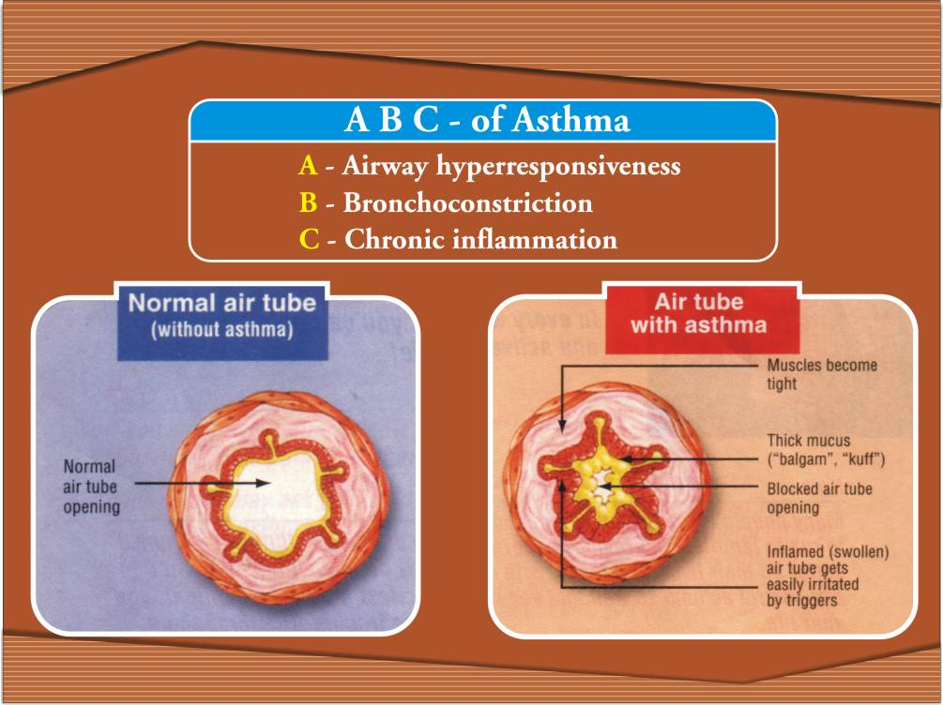
Underlying cause of asthma is the chronic inflammation

Slide 9
RISK FACTORS FOR ASTHMA

Slide 10
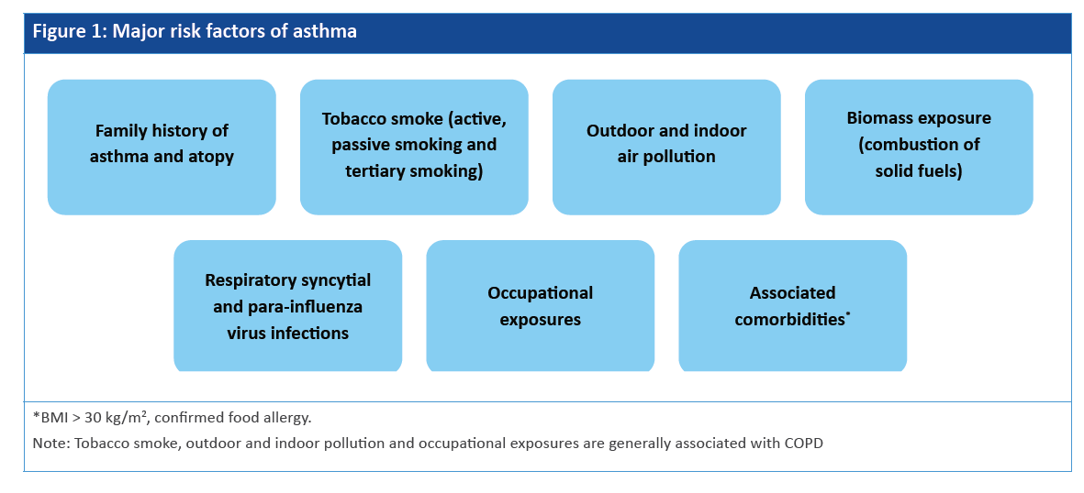
Major risk factors
The exact cause of asthma is unknown; but it could be partly genetic or environmental in origin. There
are some major factors which are important either to cause or to produce its clinical manifestations

Slide 11
Clinical Challenges In Management of Asthma
Majority of Indian patients remain undiagnosed or wrongly diagnosed
Those who get diagnosed remain poorly or inadequately treated
Most of the Indian patients continue to be on oral medications rather then inhalational therapy
Productivity loss due to asthma
High prevalence of CVD in asthma patients
Currently available ICS+ LABA combinations are BD dosing

Slide 12
MANAGEMENT

Slide 13
Long term goals of asthma management
To achieve good control of symptoms
To minimize future risk of exacerbations,
The patient’s own goals regarding their asthma and its treatment should also be identified

Slide 14
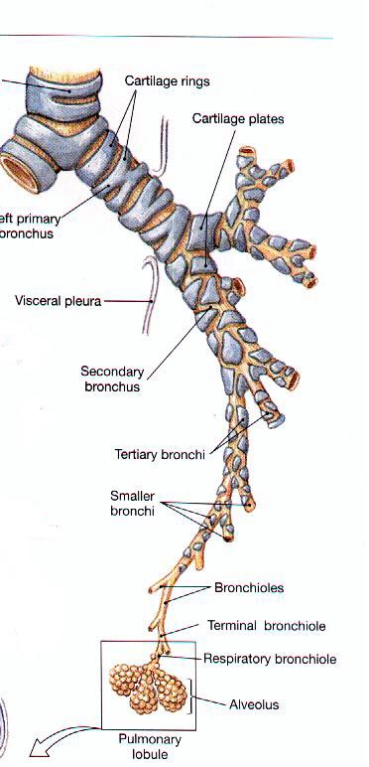
The 7D Approach for Asthma management
Doctor
Diagnosis
Gaps identified !
Drug
Dosage
Device
Deliberation
aDherence

Slide 15
DOCTOR
Notes:
15

Slide 16

DOCTOR
Update yourself…albeit
With the right material !!

Slide 17
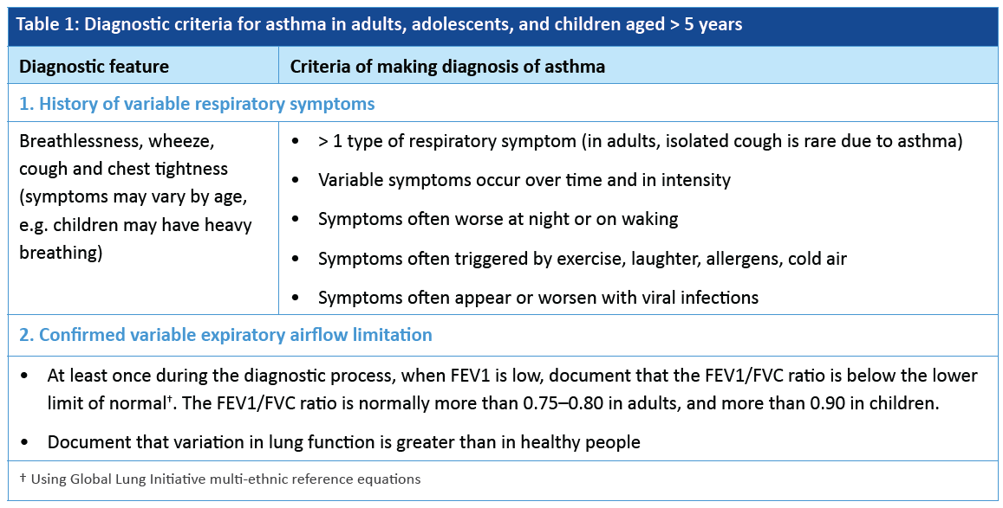
Diagnosis of asthma

Slide 18
Physical Examination
Bilateral Diffuse Rhonchi
OR
Polyphonic Wheeze

Slide 19

Peak Flow Meter

Slide 20
Diagnosis of Asthma by spirometry
Evidence of obstruction → FeV1/FVC % < 70 %
Post bronchodilator FeV1 → >200ml and 12% change
PEFR →Adults : average daily diurnal PEF variability >10%* Children: average daily diurnal PEF variability >13%

Slide 21
Peak expiratory flow (PEF) done on PEF meter can be a good indicator for asthma diagnosis if it shows reversibility on bronchodilator medication .
Bronchodilator reversibility is defined as an increase PEF of >= 20% after bronchodilator administration with atleast 60 lit/min absolute increament

Slide 22
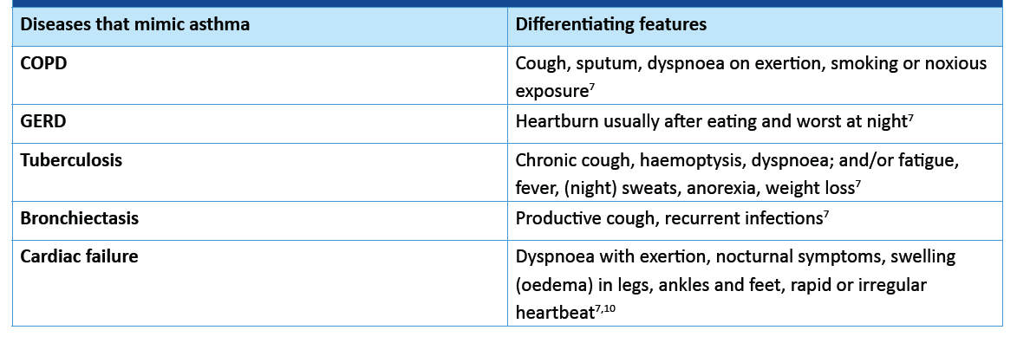
Differential diagnosis

Slide 23
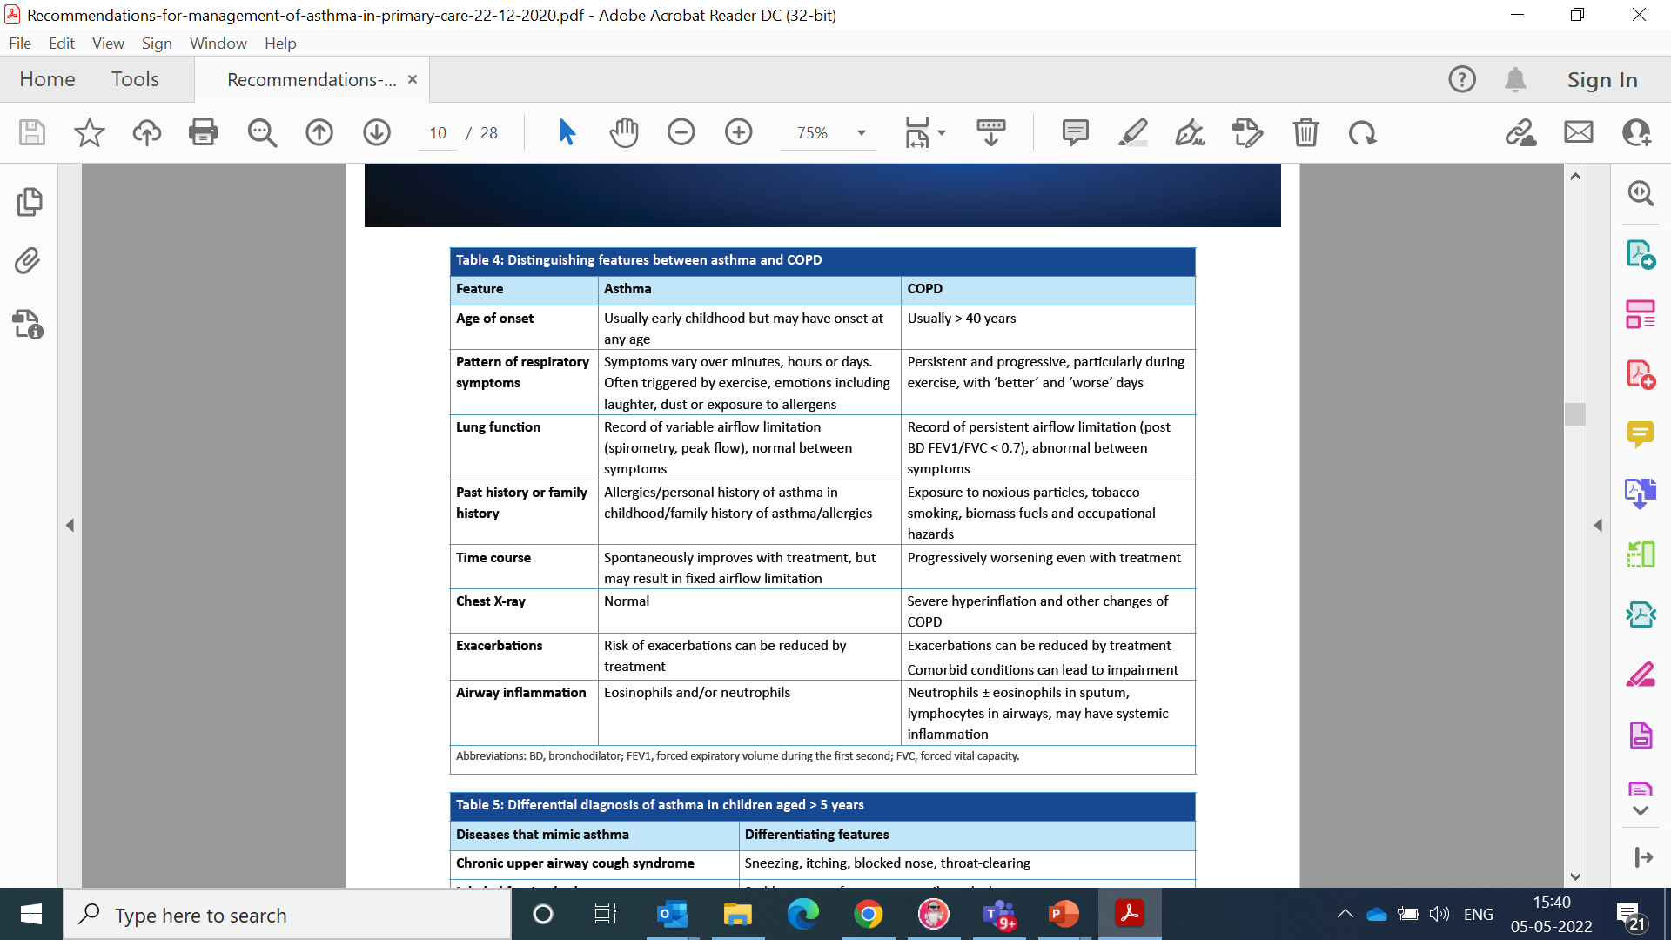
Distinguishing features between asthma and COPD

Slide 24
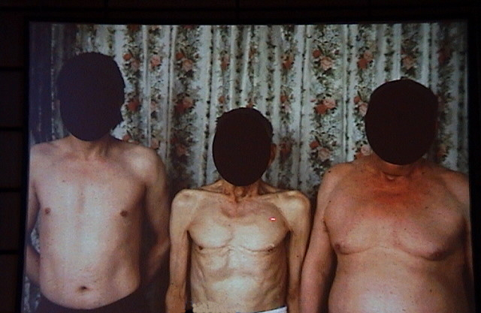
Asthma
COPD
Notes:
Look at these chests.
The far left chest is that of an asthmatic as you can see and has normal dimensions. In contrast, look at the marked hyperinflation of the chest of the patients on the right. The man in the centre is an underweight patient with COPD and the man on the far right is an obese patient with COPD. The significantly variant chest dimensions are quite obvious to see.
Studies have recently shown that the underweight COPD patients do much worse than those who are overweight. Nutrition is therefore an important part of the long-term management.

Slide 25
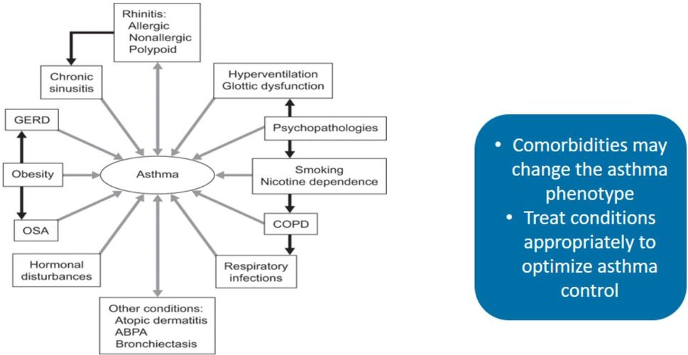
ASTHMA & CO-MORBIDITIES

Slide 26
DRUGS & DOSAGE

Slide 27
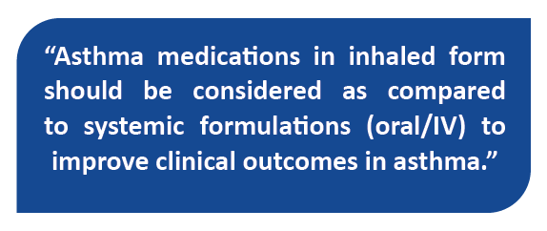

Management of Stable Asthma
Preferred Route of Administration on in Stable Asthma
Currently, inhalation therapy represents the first line of choice for delivery of drugs to treat asthma than oral medications
However, recent Indian AP-AIM survey conducted in 9 urban cities have reported
  Only 36% and 50% Indian patients with asthma used controller and rescue inhalers with a majority still preferring the oral route of asthma medication.
  Due to preference given to the oral route, this study reported worst clinical outcomes in asthma despite the fact that entire spectrum of highly effective inhaled medications is available at affordable cost.
GPs can play an important role by counselling and informing the patients the clinical benefits of inhaled route over oral route

Slide 28
ASTHMA MEDICATIONS
CONTROLLER MEDICATIONS
ADD-ON (CONTROLLER) THERAPIES IN SEVERE ASTHMA
RELIEVER MEDICATIONS

Slide 29
Asthma Pathology:
Spasm and swelling
Spasm needs a RELIEVER - Bronchodilator
Swelling needs a PREVENTER - Anti-inflammatory
Notes:
29
To understand asthma pathology does not require a detailed discussion of airway inflammation.
Suffice it to know that asthma is basically a combination of airway smooth muscle contraction ( bronchospasm or SPASM ) and airway lining oedema with mucus hypersecretion ( inflammation or SWELLING ). Treatment of the SWELLING or inflammation requires anti-inflammatory drugs which are basically the most important drugs for the regular treatment of asthma. These drugs are called preventers.
The SPASM on the other hand needs smooth muscle relaxant drugs called bronchodilators or RELIEVERS.
Often, in the beginning of asthma management you may need both these classes of drugs and as the patient gets better, you may need only need preventers.

Slide 30
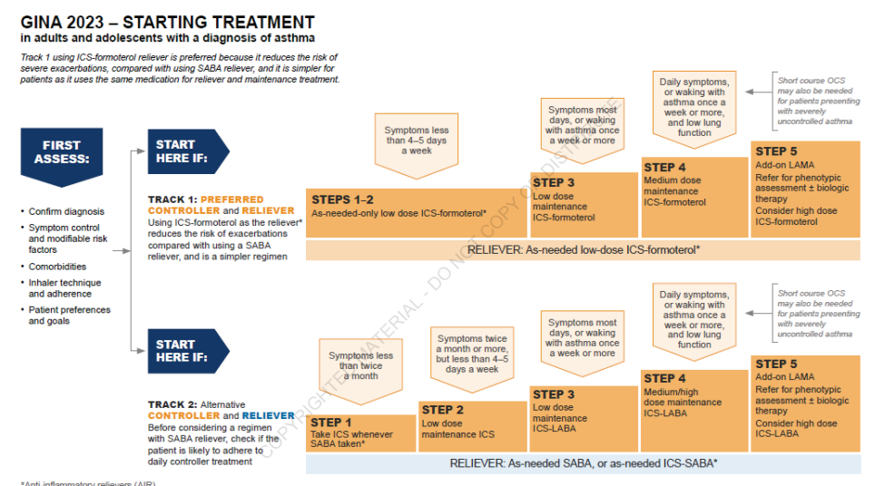
Guideline Recommendations for Asthma Management..

Slide 31
ICS+ LABA
BECLOMETHASONE +
FORMOTEROL
BUDESONIDE +
FORMOTEROL
FLUTICASONE FUROATE + VILANTEROL
FLUTICASONE PROPIONATE + FORMOTEROL
FLUTICASONE PROPIONATE + SALMETEROL
INHALED CORTICOSTEROIDS (ICS)
BECLOMETASONE
BUDESONIDE
CICLESONIDE
FLUTICASONE PROPIONATE
FLUTICASONE FUROATE
CONTROLLER
LEUKOTRIENE MODIFIERS-MONTELUKAST

Slide 32
LOW DOSE ICS FORMOTEROL
BECLOMETHASONE
+
FORMOTEROL
BUDESONIDE
+
FORMOTEROL
SABA
SALBUTAMOL
TERBUTALINE
RELIEVER
SHORT ACTING ACTING CHOLINERGICS-
IPRATROPIUM BROMIDE,

Slide 33
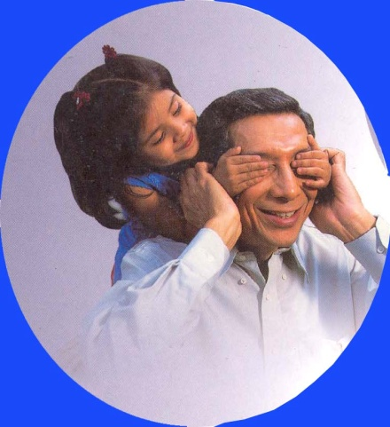
The story of preventers
Regular
Preventer
Occasional
Preventer
Notes:
33

Slide 34
ADD-ON (CONTROLLER) THERAPIES IN SEVERE ASTHMA
ideally considered for persistent symptoms and/or
exacerbations despite optimized treatment with high dose controller medications (e.g. a high dose ICS and a LABA).

Slide 35
ADD-ON (CONTROLLER) THERAPIES IN SEVERE ASTHMA
DRUGS | AGE | EXAMPLES
LONG ACTING ANTICHOLINERGICS | >= 6 yrs | TIOTROPIUM
ANTI IMMUNOGLOBULIN E (ANTI IGE) | >= 6 yrs | OMALIZUMAB
ANTI INTERLEUKIN 5 | >=12 yrs >=18 yrs | MEPOLIZUMAB RESLIZUMAB
ANTI IL 5 RECEPTOR | >=12 yrs | BENRALIZUMAB
ANTI INTERLEUKIN 4 RECEPTOR | >=12 yrs | DUPILUMAB
SYSTEMIC CORTICOSTEROIDS |  | PREDNISONE, PREDNISOLONE, METHYLPREDNISOLONE, HYDROCORTISONE

Slide 36
DOSAGE

Slide 37
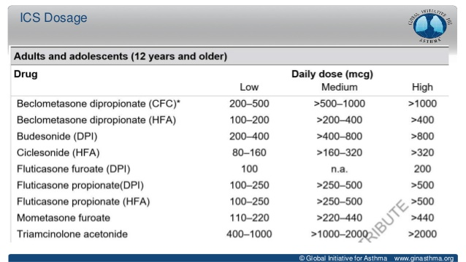

Slide 38
DEVICE

Slide 39
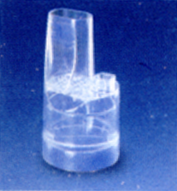
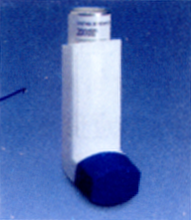
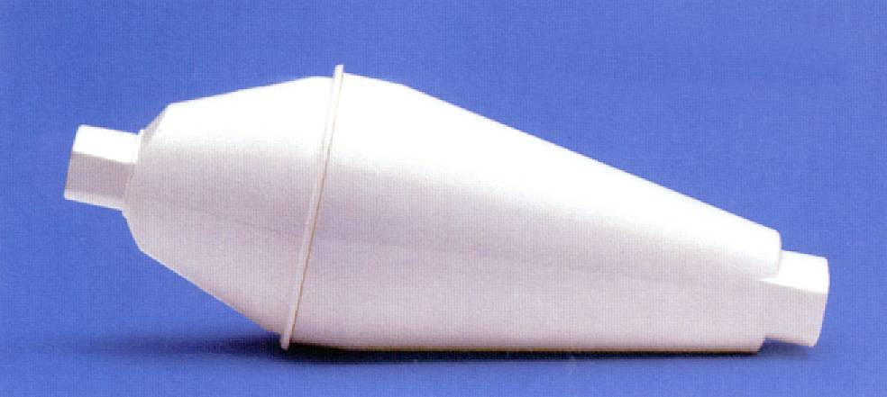

Slide 40
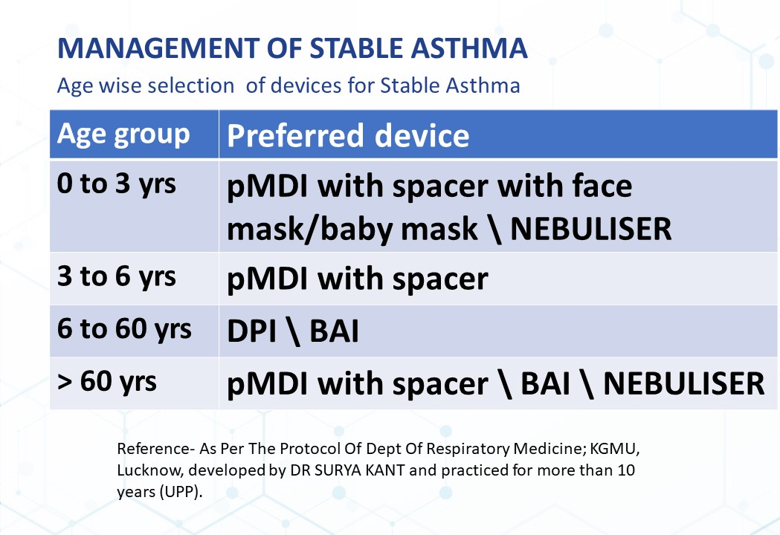

Slide 41

DELIBERATION

Slide 42
Patient Education………
Asthma education must be a part and parcel of Asthma Management
Before advising Inhaled therapy, you must convince the patient
Provide emphasis on compliance & adherence to therapy
Life-long disease but control forever

Slide 43
ADHERENCE

Slide 44
“Drugs don’t work in patients who don’t take them.”
C. Everett Koop, M.D.
Former Surgeon General of the US
Osterberg & Blaschke, 2005, “Adherence to Medication” NEJM.

Slide 45
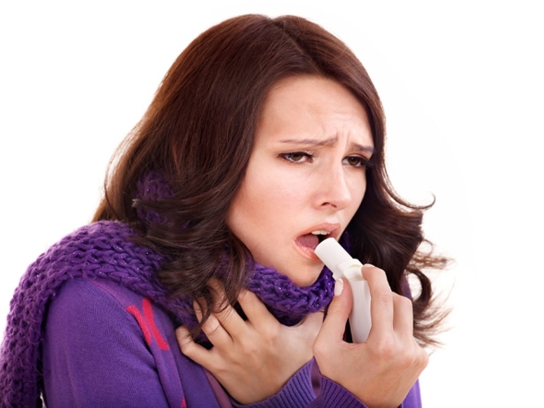


100% asthma patients in India are either uncontrolled or partly controlled
32% asthma patients in India reported having night-time symptoms every night
42% asthma patients in India reported having day time symptoms
67% asthma patients in India reported exacerbations in the previous year
78% asthma patients in India reported missing work or school in last one year(16.5 days)
Only 36% and 50% of Indian asthmatics used controller and rescue inhalers
Respirology 2013; 18(6): 957-67

Slide 46
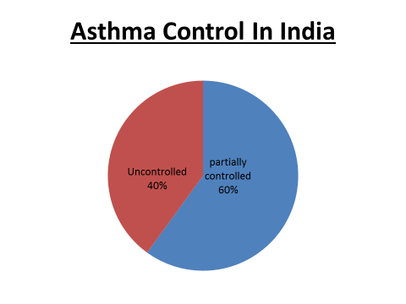

Slide 47
When do you take medicines for asthma?
Respiratory Medicine Vol 96 (2002) 835-840

Slide 48
When do you stop medicines for asthma ?
Respir Med 2002; 96: 835-40

Slide 49
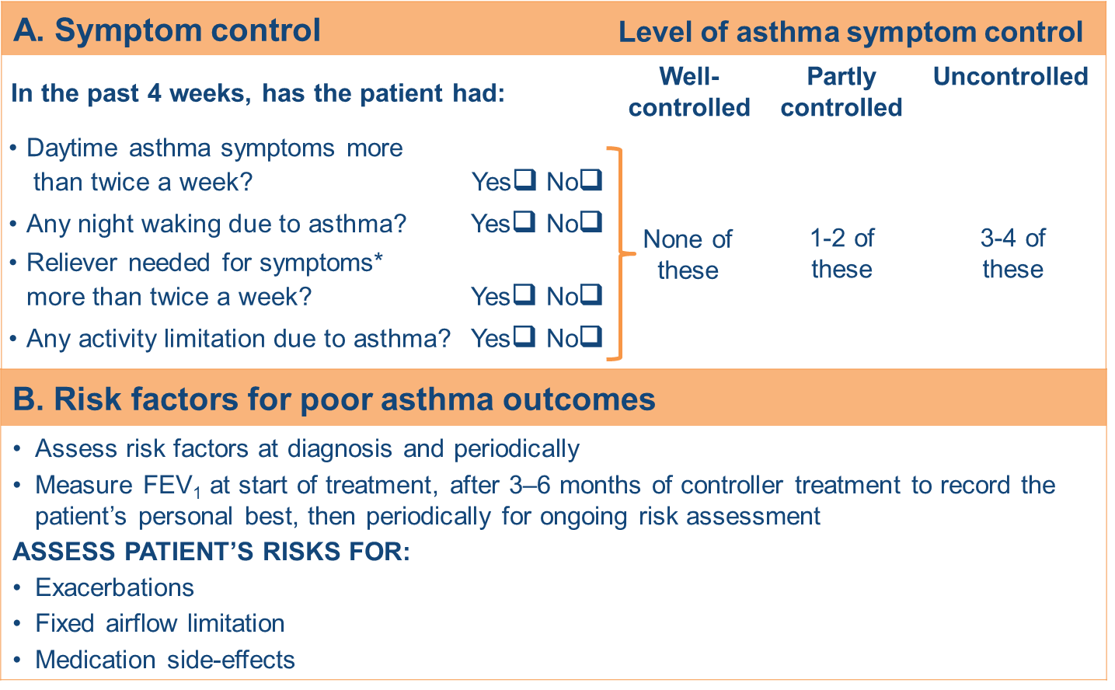
Assessment of asthma: Asthma Control

Slide 50
ASTHMA TREATMENT
PHARMACOLOGICAL
NON PHARMACOLOGICAL

Slide 51
Non pharmacological therapies and strategies
Cessation of smoking
Physical activity
Healthy diet
Weight reduction
Breathing exercises
Avoidance of occupational exposures

Slide 52
YOGA AND ASTHMA
Beyond Drugs…

Slide 53

AADIYOGI
First teacher of yoga

Slide 54

Maharishi Hiranyagarbh
The Founder of yoga on earth

Slide 55
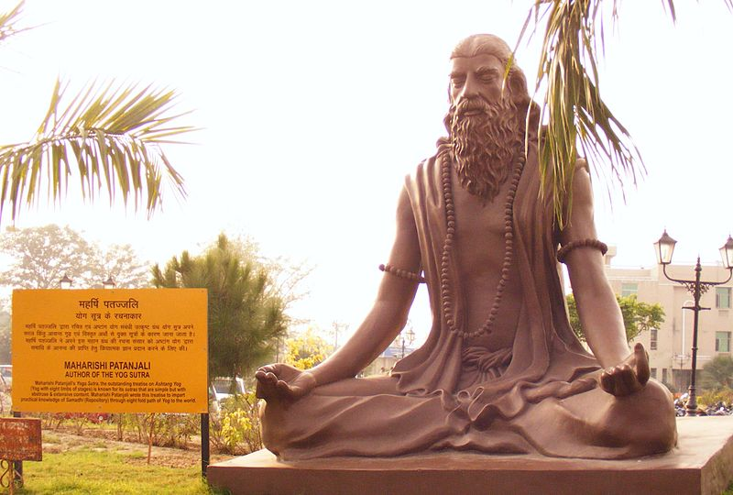
Maharishi Patanjali

Slide 56
MAHARISHI PATANJALI
THE FATHER OF MODERN YOGA
THE COMPILER OF YOGASUTRA
PATANJALI WAS THE COMPILER NOT AN
ORIGINATOR OF YOGA
THE YOGA SUTRAS WERE COMPILED PRIOR TO 400 CE BY SAGE PATANJALI

Slide 57
Benefits of yoga
Yoga tries to cure asthma by cleaning the lungs and making the patients internally strong, so that patient doesn’t react to stressful situation
As the disease is primarily of the lungs and respiratory system, pranayama and asanas selected are to restore the health of the lungs and the respiratory system
The postures prescribed drain out the mucous from the lungs and relax the lung muscles
Yoga also teaches to breath correctly
Yoga not only clears the lungs but also gives the will power to give up smoking through meditation
The breathing exercises originate and increase their flexibility
By strengthening immune system, they also reduce dependency on medication
Asthma symptom score can be improved with in a shorter period of time by the regular practice of yoga with standard medical treatment

Slide 58
A Randomized Controlled Trial to Evaluate the Role of Yoga in the Management of Mild to Moderate Persistent Chronic Bronchial Asthma
Doctoral degree awarded by King George’s Medical University, U. P., Lucknow
Enrollment No. KGPH- 090008
to
Dr. Shruti Agnihotri
Supervisor
Dr. Surya Kant
Degree awarded in December 2014

Slide 59
Randomized Controlled Trial (RCT) done in King George’s Medical University
with the collaboration of Lucknow University
Enrolled Patients (241)
Randomization
Cases Controls
(n= 121) (n=120)
Standard Medical Treatment Standard Medical Treatment +
Yoga Intervention
(30 min. for 6 months)
Patients were assessed periodically at baseline, at 3rd month and at 6th month.
Assessment of bio- chemical profile and antioxidant status
Assessment of Symptom Scores
Assessment of Spirometric indices
Assessment of Inhaled Medication
Assessment of Asthma Quality of life

Slide 60
Role of Yoga in the Movement of Psychological Factors in the Patients of Bronchial Asthma
Post- doctoral fellowship awarded by Indian Council of Social Science Research,
New Delhi
Sanctioned No. 3-150/17-18/ PDF/GEN
to
Dr. Shruti Agnihotri
Supervisor
Dr. Surya Kant
Thesis Submitted in February 2022

Slide 61
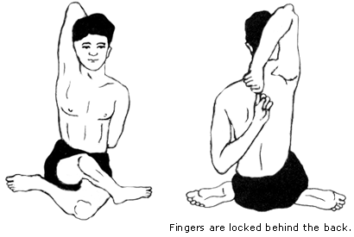
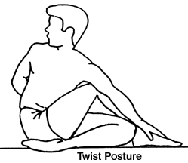
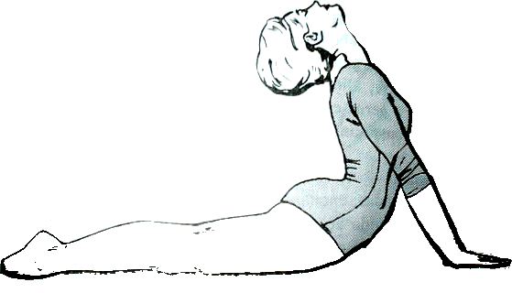

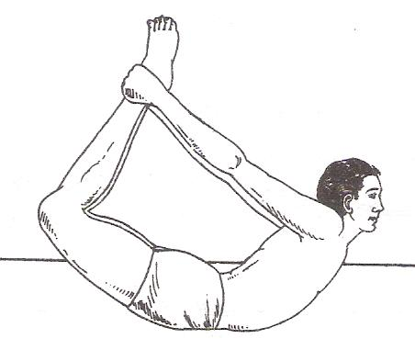
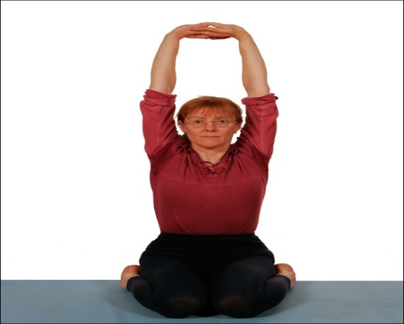




Gomukhasana
Ardhamatsyendrasana
Bhujangasana
Dhanurasana
Prvatasana
Paschimmottanasana
Naukasana
Tadasana
Shavasana

Slide 62
Publications related to Yoga in Respiratory Practices :
Agnihotri S, Kant S, Kumar S, Mishra RK, Mishra SK. Impact of yoga and Pranayama on Symptom Scores in Asthmatics. International Journal of Innovative Research and Studies. 2013; 2(9):64-74.
Agnihotri S, Kant S, Kumar S, Mishra RK, Mishra SK. Impact of Yoga on Biochemical Profile of Asthmatics: A Randomized Controlled Study. International Journal ofYoga.2014; 7:16-22.
Agnihotri S and Kant S. Assessment of Yoga and Antioxidant Status in Asthma Patient: A Randomized Controlled Study. ejpmr, 2019,6(3), 303-307.
Agnihotri S and Kant S. Yoga is a powerful weapon in defeating Asthma. World Journal of Advance Health Care Research. 2019,3(1), 43-45.
Agnihotri S, Gaur P, Bhattacharya S, Kant S, Pandey S. Benefits of Yoga in Respiratory Diseases. Indian J. Pharm. Biol. Res.2018; 6(4):10-13.
Agnihotri S, Kant S, Mishra SK, Verma A. The assessment of Effects of Yoga on quality of life in asthma Patient: A Randomized Controlled Study.AYU2017;38:28-32.
Agnihotri S, Kant S, Mishra SK, Gaur P. Impact of Yoga in Asthma Treatment. Asian J. Pharm.Hea.Sci.2017;7(2):1705-1708.
Agnihotri S, Kant S, Mishra SK, Singh P. Role of Yoga in Childhood Asthma. Indian J TraditKnowle.2017; 16(3):S21- S24.
Agnihotri S, Kant S, Kumar S, Mishra RK, Mishra SK. The assessment of Effects of Yoga on Pulmonary Functions in asthmatic Patient: A Randomized Controlled Study. The Journal of Medical Society. 2016; 30: 98-102.
Agnihotri S, Kant S, Mishra SK, Mishra RK. Efficacy of Yoga on requirement of rescue inhaled medication in asthma patients. Indian J TraditKnowle. 2016; 15(4):675-79.
Agnihotri S, Kant S, Verma VK, Mishra SK, Pandey S. Role of jalaneti and pranayama in allergic rhinitis with asthma. Int J Yoga - Philosop Psychol Parapsychol 2016;4:3-7.

Slide 63
Publications related to Yoga in Respiratory Practices :
13. Agnihotri S, Kant S, Mishra SK, Singh R. Efficacy of Yoga in Mild to Moderate Persistent Chronic Bronchial Asthma. Indian J TraditKnowle.2016;15(2):337-40.
14. Agnihotri S, Kant S, Singh R, Mishra SK, Kumar S, Verma A. Role of Yoga in Pregnancy with Asthma. International Journal of Pharma Research & Review. 2015; 4(8):1-6.
15. Agnihotri S, Kant S, Mishra SK, Tripathi PM. Role of Yoga in Asthma Management. Dynamics of Human Health. 2015;2(1): http:// journalofhealth.co.nz/? page_id= 768.
16. Agnihotri S, Kant S, Mishra SK, Tripathi PM. Prevalence of Asthma and its Treatments: A Resource. Dynamics of Human Health.2015;2(1): http:// journalofhealth. co.nz/? page_id =772.
17. Agnihotri, Shruti. and Kant, Surya. (2020). To Evaluate the Impact of Pranayama and Meditation on Psychological Disorders in Patients with Bronchial Asthma. DHH, 7(2):https://journalofhealth.co.nz/?page_id=2158].
18. Agnihotri S, Kant S. Pranayama and Meditation impact on spirometric indices in asthma patients. Ejpmr. 2019;6(12): 352-356.
19.. Agnihotri S, Kant S. Asthma and Psychiatric disorders. International Journal of Scientific Research. 2019;8(12): 1-2. DOI : 10.36106/ijsr.
20. Agnihotri S and Kant S. Yoga is a powerful weapon in defeating Asthma. World Journal of Advance Health Care Research. 2019,3(1), 43-45.
21. Agnihotri S, Gaur P, Bhattacharya S, Kant S. Pandey S. Benfits of yoga in respiratory diseases. Indian j.pharm.biol.res. 2018; 6(4):10-13.

Slide 64
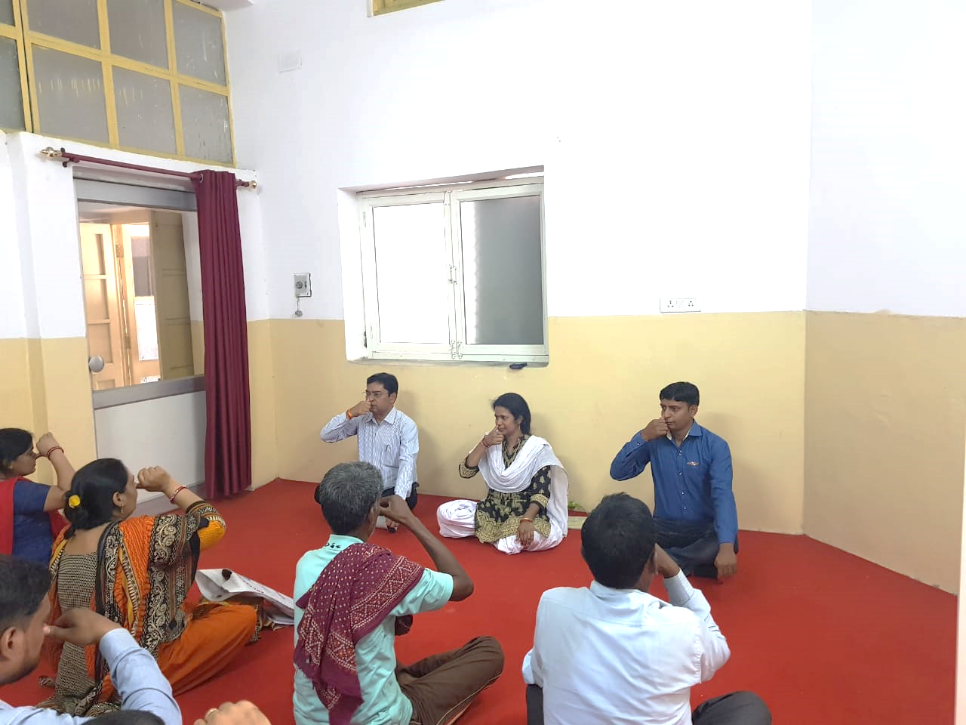
Patients performing yoga in the Yoga Room, Department of Respiratory Medicine, KGMU, U.P., Lucknow

Slide 65
Overlap: Asthma & COPD
COPD
Asthma
‘Wheezy
Bronchitis’?
Airways affected:
Alveolar destruction
(emphysema)
Bronchioloitis
Fibrosis
BHR ?
Inflammatory cells:
Neutrophils
Macrophages
CD8+ T cells
Mediators:
IL-8, TNFα, LTB4
ROS
Airways affected:
Large and small
No emphysema
Mucus plugs
Fibrosis ?
BHR
Inflammatory cells:
Eosinophils
Mast cells
CD4+ T cells
Mediators:
IL-4, IL-5, cysLTs
Histamine
Overlap of two conditions¹
30% of COPD cases overlap with asthma
Irreversible
Reversible
Airway obstruction
1 Soriano JB, Davis KJ, Coleman B, et al. Chest 2003; 124: 474–81
2Lange P, Parner J, Vestbo J, et al. N Engl J Med 1998; 339: 1194–1200

Slide 66
Definition of COPD
GOLD 2024
Chronic Obstructive Pulmonary Disease is heterogenous lung condition characterized by chronic respiratory symptoms ( dyspnea, cough, sputum production exacerbations) due to abnormalities of airways ( Bronchitis & bronchiolitis) and/or alveoli (emphysema) that cause persistent, often progressive, airflow obstruction.
GOLD – Global initiative for Obstructive Lung diasese.

Slide 67

COPD
GLOBAL | Data
Prevalence | 391 Million (Yr. 2019)
DALY | 63.85 M - 2015
Deaths | 3.2 Million; Yr. 2015
COPD
INDIA | Data
Prevalence | 55.3 Million
DALY | 22.37 M - 2016
Deaths | 0.848 Million; Yr. 2016
GOLD 2020, WHO-2015; J Glob Health. 2015 Dec;5(2):020415;
Lancet Respir Med. 2017 Sep; 5(9): 691–706
Respirology 2018; http://www.healthdata.org/india
Lancet Respir Med. 2022 May; 10(5): 447–458
Notes:
the differance between proportion of prevalence and proportion of death raise the need of new devices or change in the prescription pattern.

Slide 68
Burden of disease: India: COPD
India ranks number two in the world.
The second leading cause of death and DALYs in India, and in terms of absolute numbers, India ranks No. 2 in the world for COPD deaths as well as DALYs.
Although India contributes to 17.8% of the global burden of COPD, it contributes to a disproportionate 27.3% of the global COPD deaths and 28.5% to the global COPD DALYs, indicating mismanagement of COPD in India.
There is a wide heterogeneity in the burden of COPD between different states in India, with Uttar Pradesh, Bihar, West Bengal, and Rajasthan having the highest burden.
Tobacco smoking contributes to only 20-25% of the national COPD burden, while air pollution (household and outdoor)contributes to over 50% of the national COPD burden.

Slide 69
RISK FACTORS FOR COPD

Slide 70
Risk factors for COPD
MODIFIABLE
SMOKING (FIRST HAND AND PASSIVE SMOKING)
ENVIRONMENTAL POLLUTION
INDOOR POLLUTANTS
OCCUPATIONAL EXPOSURE
NON MODIFIABLE
AGE AND SEX
LOW SOCIOECONOMIC STATUS
LUNG GROWTH AND DEVELOPMENT
GENETIC FACTORS :
Alpha 1 antitrypsin deficiency, Matrix metalloproteinases 12 (MMP-12) and Glutathione- S Transferase have been related with decline in FEV1 or FEV1/FVC.

Slide 71
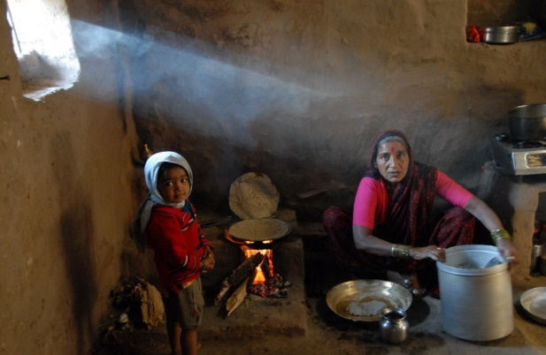

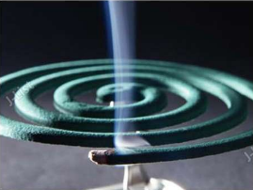

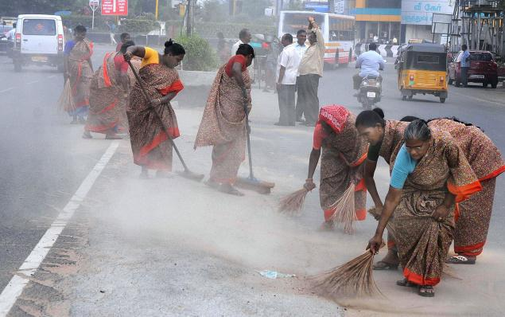
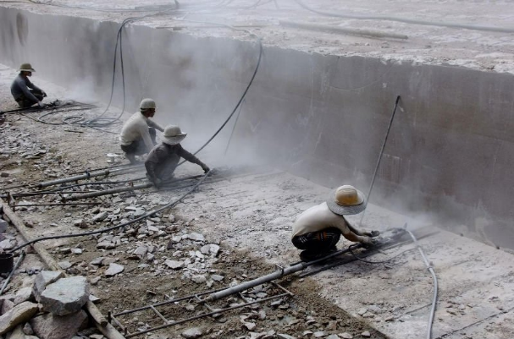
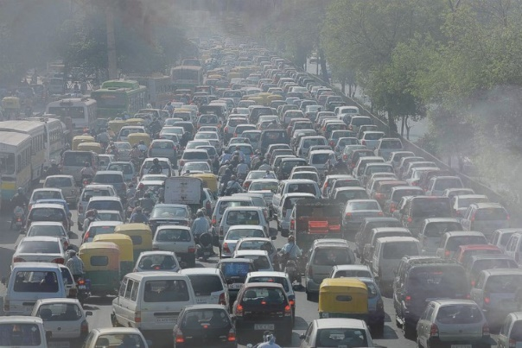
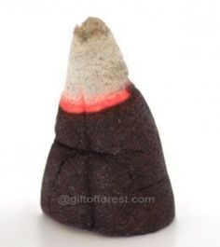


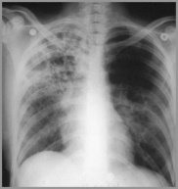
A Large Number of People in India are At Risk for COPD
750 million
120 million
600 million
35 million in India

Slide 72
PATHOGENESIS

Slide 73
Aetiology, Pathobiology and Pathology of COPD
Airflow limitation
Persistent airflow limitation
Pathobiology
Impaired lung growth
Accelerated decline
Lung injury
Lung and systemic inflammation
Pathology
Small airway disorders or abnormalities
Emphysema
Systemic effects
Aetiology
Smoking and pollutants
Host factors
Clinical manifestation
Symptoms
Comorbidities
Exacerbations
.
Notes:
Aetiology, pathobiology and pathology of COPD as presented by GOLD 2021 showing the development of COPD and the significance of exacerbations.
Reference:
Global Initiative for Chronic Obstructive Lung Disease 2021. Available at: https://goldcopd.org/wp-content/uploads/2020/11/GOLD-REPORT-2021-v1.1-25Nov20_WMV.pdf. Accessed: 1/12/2020.

Slide 74
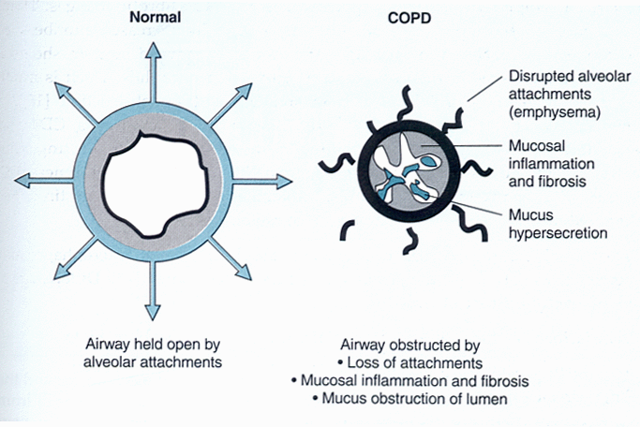
Airway pathology in COPD

Slide 75
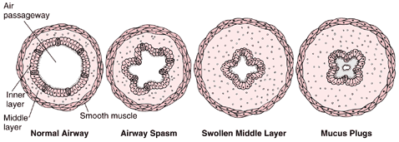
Change in airway in COPD

Slide 76
COPD is a systemic disease
IT INVOLVES THE
AIRWAY +INTERSTITIUM
EXTRAPULMONARY SITES
PULMONARY VASCULATURE

Slide 77
Extrapulmonary effects of COPD

Slide 78
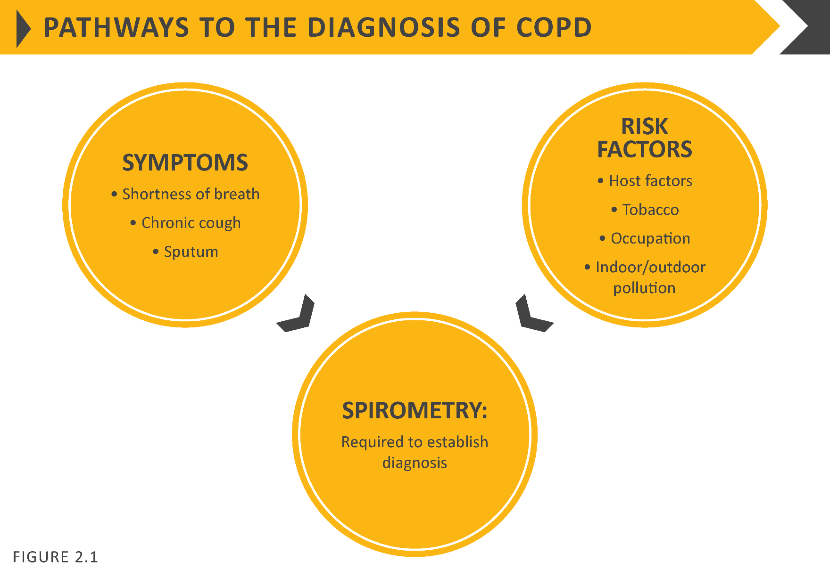

Slide 79
Symptoms of COPD
Any individual of age greater than 40 years and presence of any of the following should be considered to have COPD and should be advised Spirometry for establishing the diagnosis of COPD.
Dyspnea : Progressive
Persistent
Characteristically worsen with exercise
Chronic cough : May be intermittent and may be unproductive
Chronic sputum production
History of exposure to risk factors
Family history of COPD

Slide 80
Physical Examination of the Chest
Wheezing rarely as pronounced as asthma
Diminished sounds bilaterally
Hyperinflation ( Reduced crico-sternal distance, often < 2 fingers)
Notes:
80

Slide 81
Physical Examination of the Chest (Contd.)
As disease becomes more severe…
Pursed-lip breathing
Barrel chest
Accessory respiratory muscles
Indrawing of lower intercostal spaces (pump-handle mvt.)
Notes:
81

Slide 82
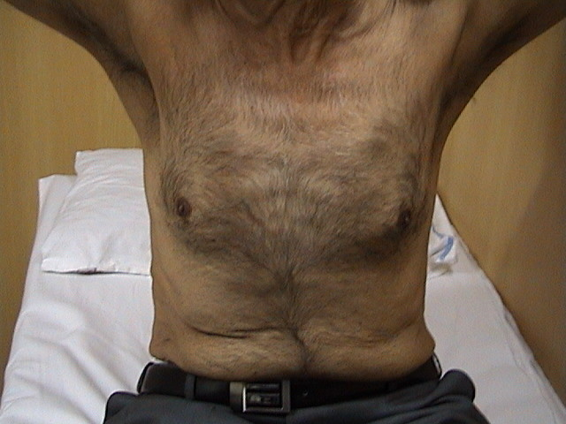
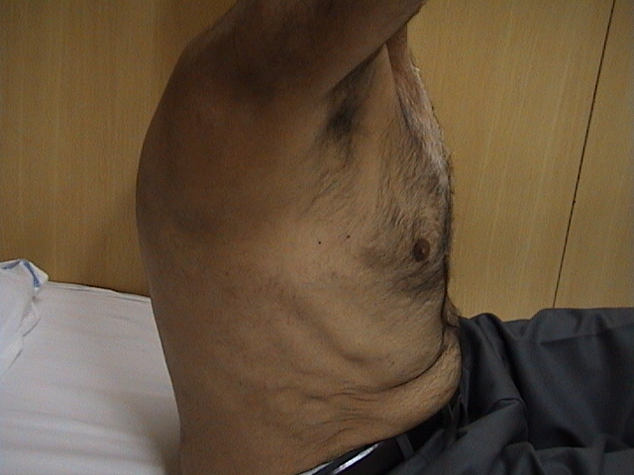
Barrel shaped chest
Notes:
82

Slide 83
Chest Radiography
Changes due to enlargement of total lung capacity
Loss of diaphragm curvature
Enlargement of lung fields
Loss of airway and blood vessel markings
Large emphysematous bullae
Notes:
83

Slide 84
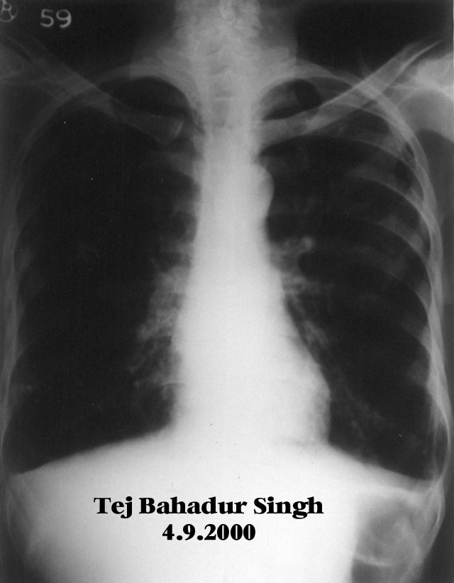
Notes:
84

Slide 85
COPD – Approach to a diagnosis
Progressive
Dyspnoea
Chronic cough
One or more of these indicators
Spirometry
Patient
40+ years
Chronic sputum production
Post-bronchodilator FEV₁/FVC <0.70
Risk factors
e.g. smoker
Persistent airflow limitation confirmed
Recurrent lower RTI
Family history of COPD
COPD diagnosis
For Healthcare Professionals Only
Notes:
Spirometry is required to make a definite COPD diagnosis. The presence of a post-bronchodilator FEV1/FVC <0.70 confirms the presence of persistent airflow limitation and thus of COPD.
Reference:
Global Initiative for Chronic Obstructive Lung Disease 2021. Available at: https://goldcopd.org/wp-content/uploads/2020/11/GOLD-REPORT-2021-v1.1-25Nov20_WMV.pdf. Accessed: 1/12/2020.

Slide 86
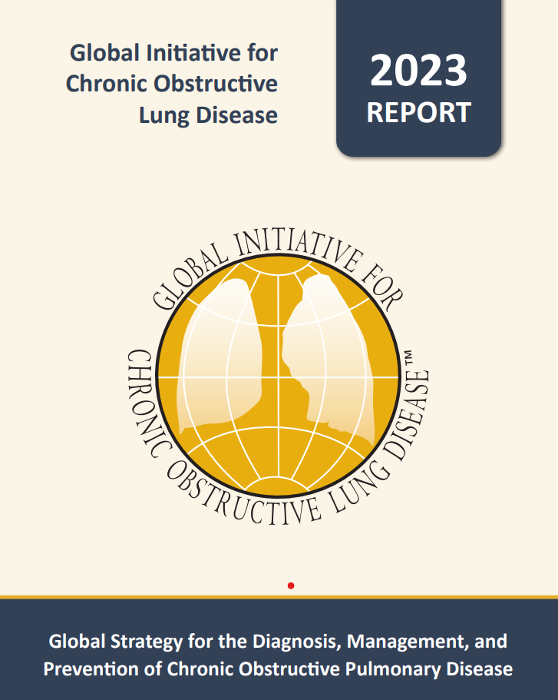
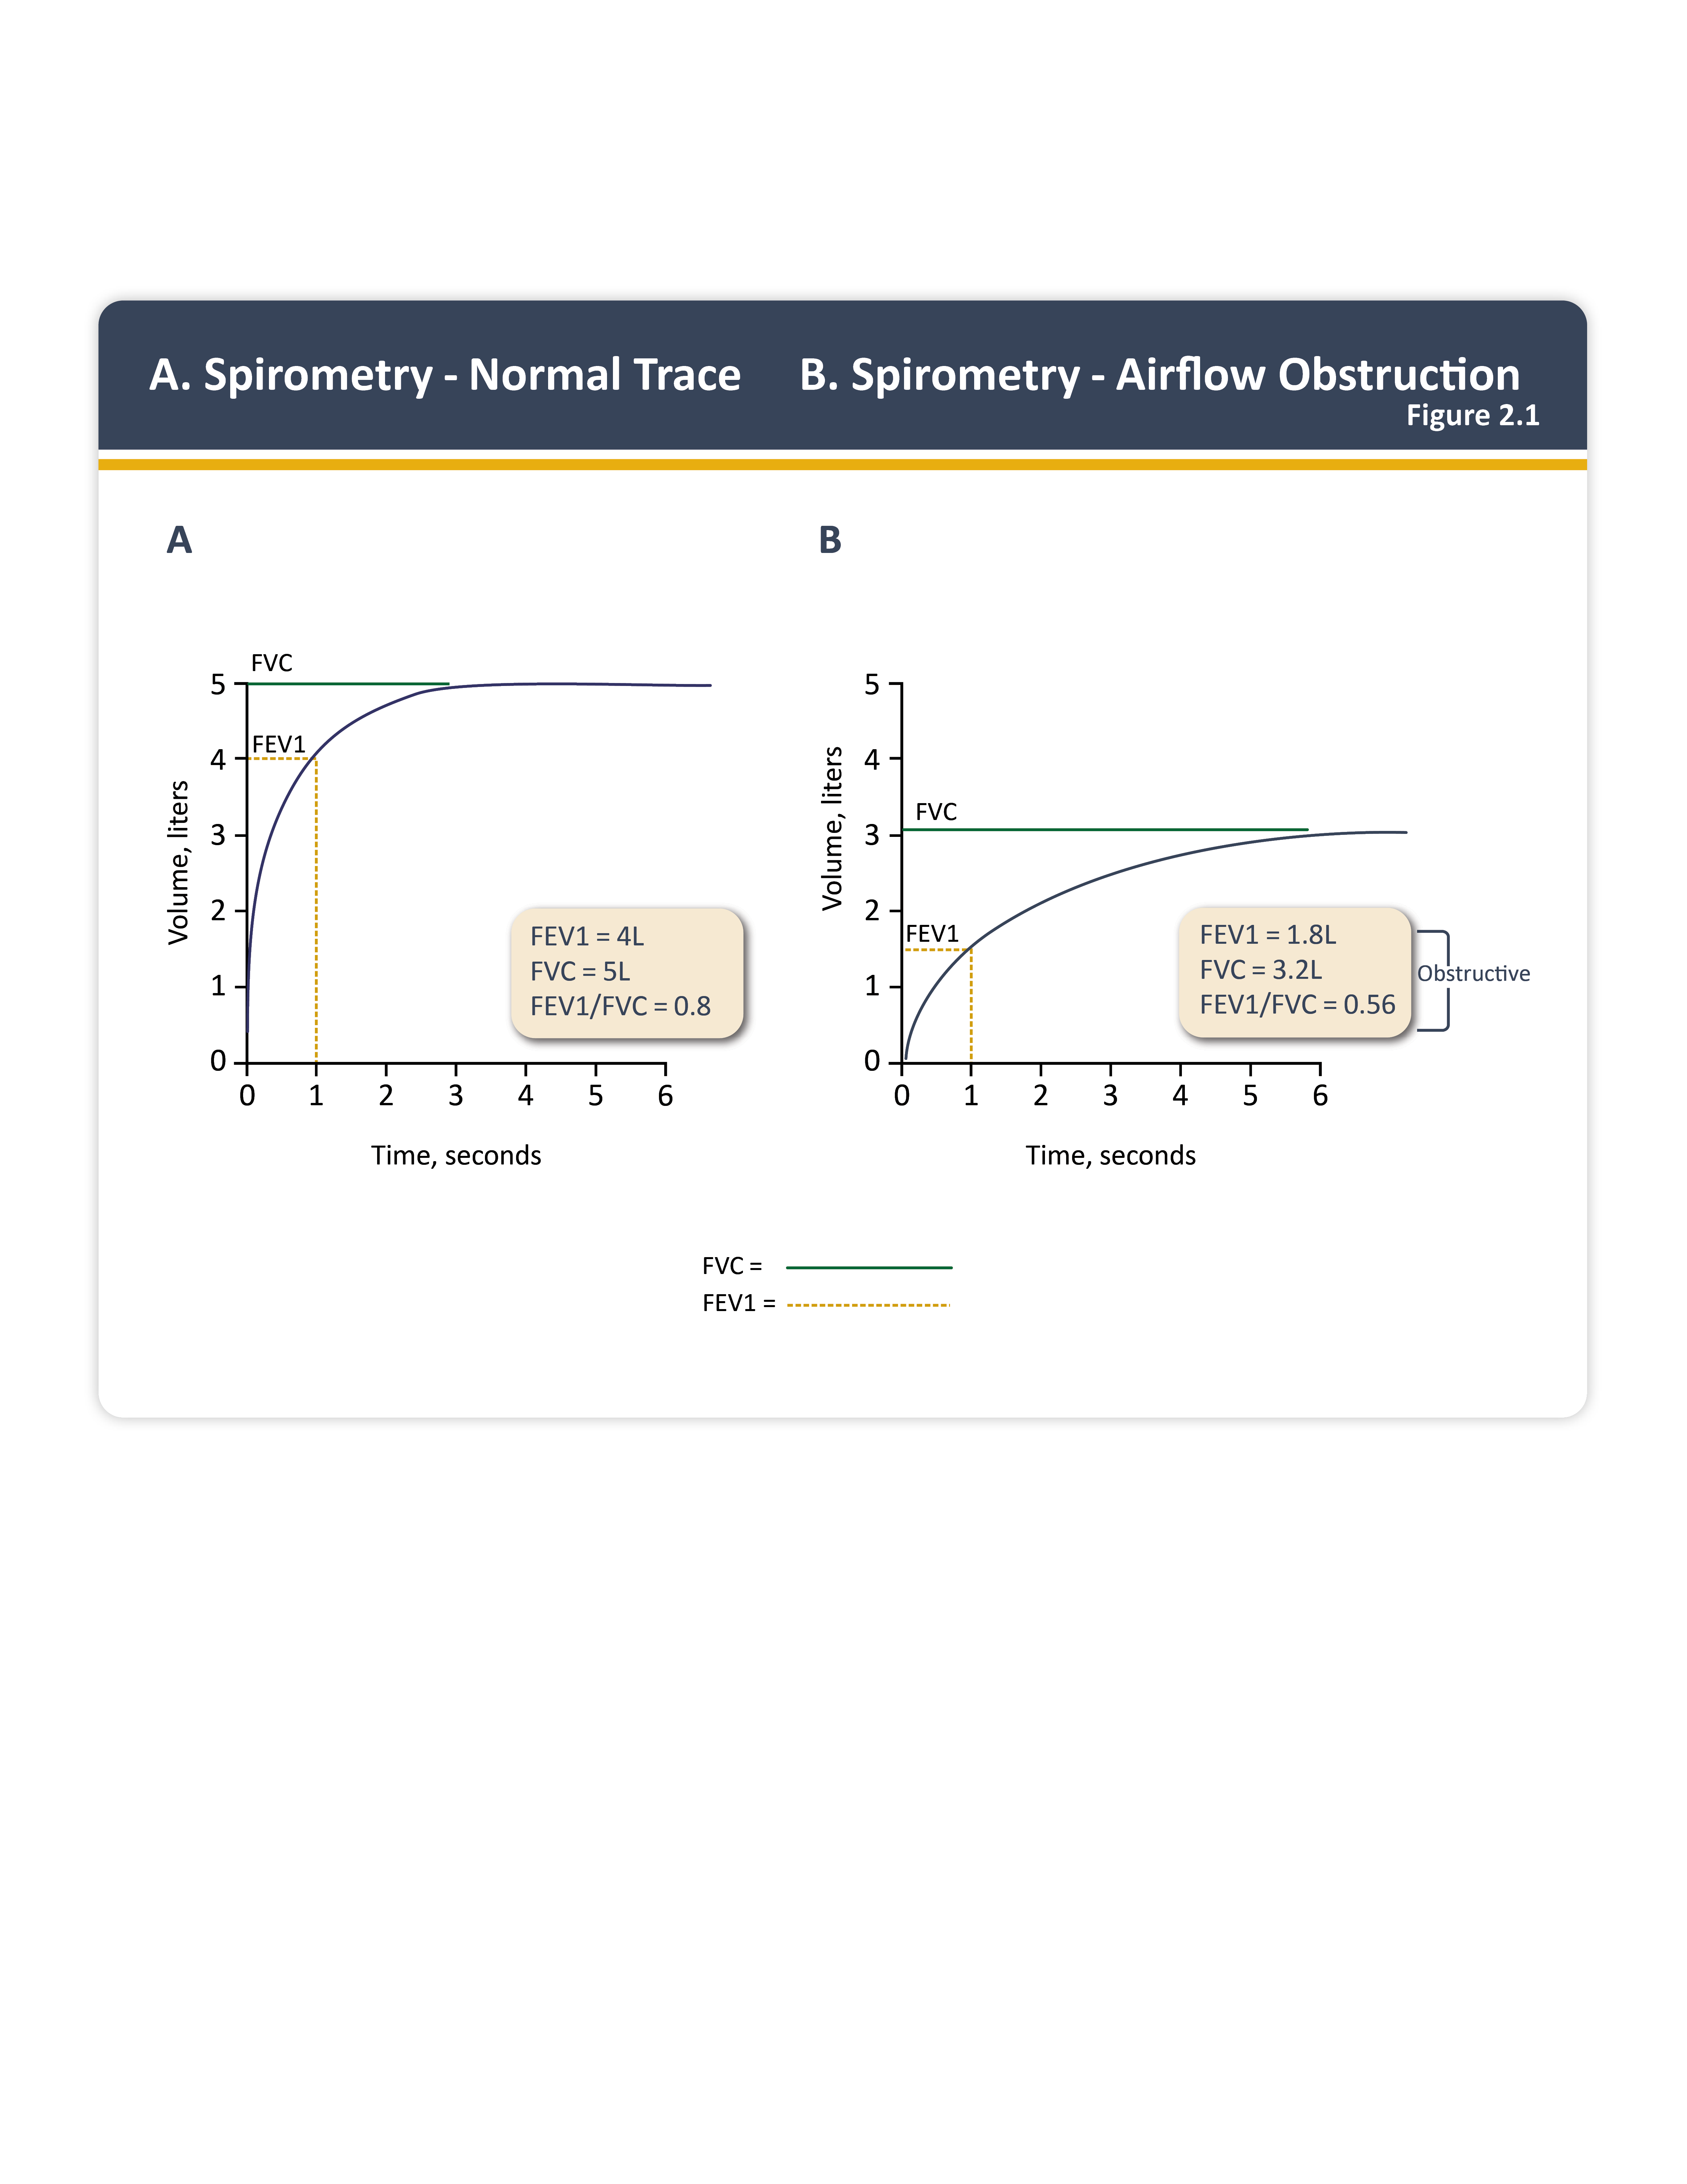

Slide 87
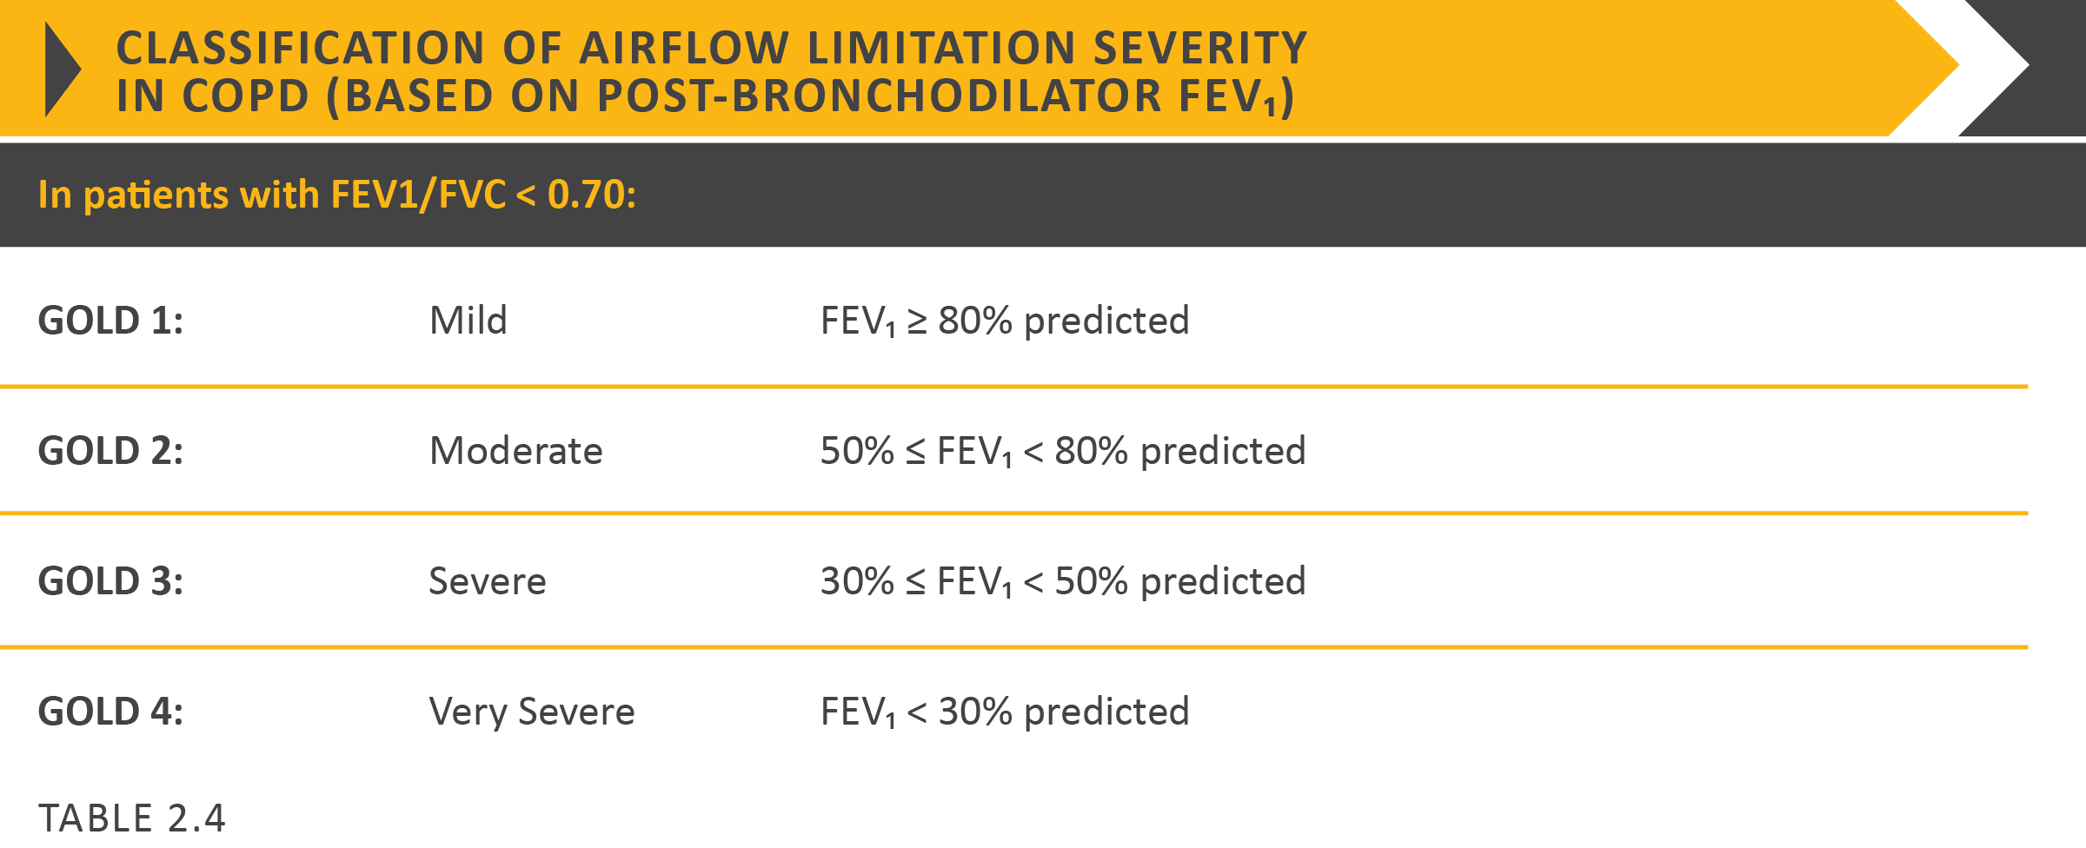

Slide 88
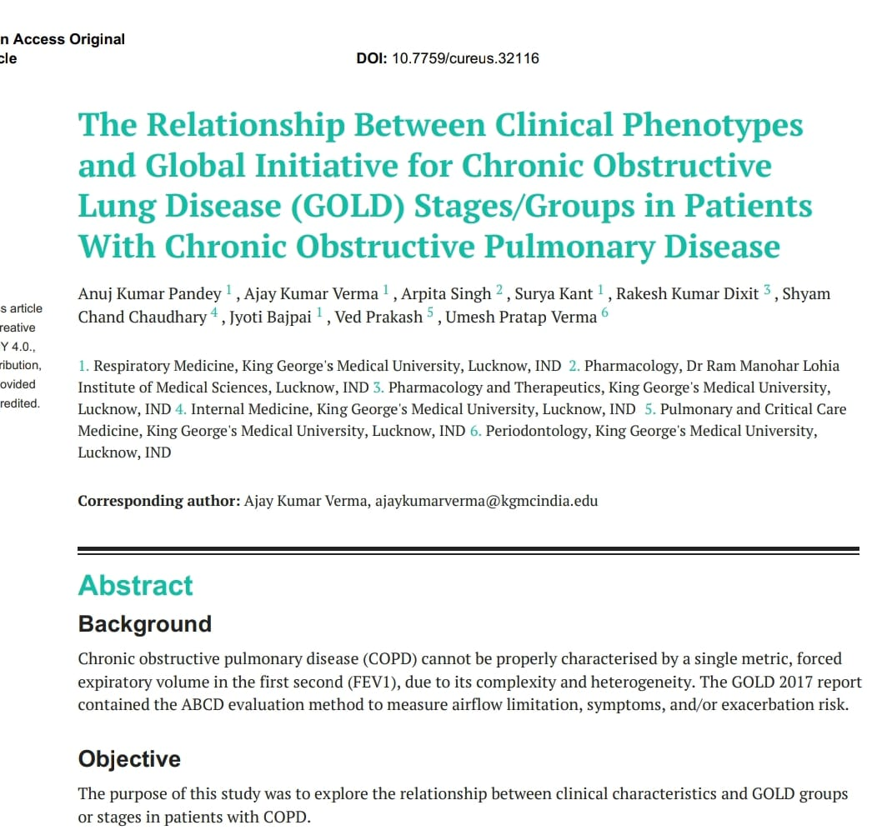
The Relationship Between Clinical Phenotypes and Global Initiative for Chronic Obstructive Lung Disease (GOLD) Stages/Groups in Patients With Chronic Obstructive Pulmonary Disease
STUDY DONE IN RESPIRATORY MEDICINE DEPARTMENT KGMU FROM 2019 TO 2022
Published in cureus 2022.14(12):e32116,DOI-10.7759

Slide 89


Slide 90
MANAGEMENT OF COPD

Slide 91

GOLD Update … !!

Slide 92
Goals of Pharmacotherapy
To control patient symptoms
To reduce complications, including the frequency and severity of exacerbations
Improving the overall the health status and exercise tolerance

Slide 93



ABCD ABE
GOLD 2017
GOLD 2023
https://goldcopd.org/gold-teaching-slide-set/ accessed 22 Jul 2022

Slide 94


Combined Assessment of COPD
When assessing risk, choose the highest risk according to GOLD grade or exacerbation history. One or more hospitalizations for COPD exacerbations should be considered high risk.)
Patient | Characteristic | Spirometric Classification | Exacerbations per year | CAT | mMRC
A | Low Risk Less Symptoms | GOLD 1-2 | ≤ 1 | < 10 | 0-1
B | Low Risk More Symptoms | GOLD 1-2 | ≤ 1 | > 10 | > 2
C | High Risk Less Symptoms | GOLD 3-4 | > 2 | < 10 | 0-1
D | High Risk More Symptoms | GOLD 3-4 | > 2 | > 10 | > 2

Slide 95
Pharmacological Agents
Beta₂-agonists
  Short-acting beta₂-agonists : Salbutamol/levosalbutamol
  Long-acting beta₂-agonists : Salmeterol / Formoterol
  Ultra long acting beta 2 agonists : Indacaterol/Olodaterol
Anticholinergics
  Short-acting anticholinergics : Ipratropium
  Long-acting anticholinergics : Tiotropium/Glycopyrronium/Aclidinium
http://www.goldcopd.org/other-resources-gold-teaching-slide-set.html. Accessed 04.5.2015

Slide 96
Contd..
Methylxanthines
Inhaled corticosteroids
Systemic corticosteroids
Phosphodiesterase-4 inhibitors: Roflumilast
http://www.goldcopd.org/other-resources-gold-teaching-slide-set.html. Accessed 04.5.2015

Slide 97
Choice of inhalation Device for Indian Patients
1. Dry Powder Inhaler(DPI)
2. Metered Dose Inhaler(MDI) with Spacer
3. Nebuliser
Factors for selection of inhalation Device:
Age
Severity of disease
Feasibility

Slide 98
Rationale for Bronchodilators in COPD
Inhaled bronchodilators are the main pharmacological agents that:
  Improve symptoms
  Decrease exacerbations and
  Improve quality of life in COPD
Bronchodilators may improve symptoms especially breathlessness by reducing hyperinflation
Vijayan VK. Indian J Med Res 137, 2013, pp 251-269

Slide 99


Slide 100
Non-Pharmacologic Management of COPD (As per GOLD 2024)
Patient Group | Essential | Recommended | Depending on Local Guidelines
A | Smoking cessation (can include pharmacologic treatment) | Physical activity /Pulmonary Rehabilitation | Flu vaccination Pneumococcal vaccination, COVID 19[As Policy],Tdap,RSV,ZOSTER
B-E | Smoking cessation (can include pharmacologic treatment) | Physical activity/Pulmonary rehabilitation | Flu vaccination Pneumococcal vaccination, COVID 19[As Policy],Tdap,RSV,ZOSTER

Slide 101

Pulmonary Rehabilitation
It is an important part of the recovery process.
The goal of rehabilitation is to help the patient regain their strength, mobility, and lung function, and return to their normal activities as soon as possible.

Slide 102


Pulmonary Rehabilitation Centre
Department of Respiratory Medicine
King George’s Medical University, UP, Lucknow

Slide 103
SUMMARY
Asthma is a major health problem of India and globally too
In India, asthma is misdiagnosed, under diagnosed and poorly treated leading to 43% global share of asthma mortality
Most updated treatment of asthma is inhalation therapy, however, only 36% of Indian asthmatics are on inhalation therapy
ICS+LABA combination therapy is efficacious, however, adherence and twice daily doses are the challenges
Newer once daily ultra LABAs may be a boon for such patients and may increase adherence and outcome of asthma patients
Gibson PG, et al. Lancet. 2017;390(10095):659-668.
Notes:
Reference
Gibson PG, et al. Effect of azithromycin on asthma exacerbations and quality of life in adults with persistent uncontrolled asthma (AMAZES): A randomised, double-blind, placebo-controlled trial. Lancet. 2017;390(10095):659-668. doi: 10.1016/S0140-6736(17)31281-3.

Slide 104
SUMMARY
COPD is a major health problem of world and India too.
It is preventable and treatable disease.
History of smoking/ passive smoking , occupation and exposure to noxious particles and gases is very important.
Both Pharmacological as well as non pharmacological strategies of treatment should be properly utilised to make its treatment holistic.
Smoking cessation , avoidance to noxious particles or gases, vaccination and pulmonary rehabilitation are the important pillars of non pharmacological therapy.
Clinical challenges of COPD is very much important , should not be forgotten.
GOLD 2024

Slide 105
Thank You

