Slide 1
यह कार्यक्रम स्वास्थ्य विभाग और राज्य स्वास्थ्य एवं परिवार कल्याण संस्थान (SIHFW), उत्तर प्रदेश की पहल पर उत्तर प्रदेश टेक्निकल सपोर्ट यूनिट (UPTSU) के सहयोग से हो रहा है।
Principal Secretary, Medical Health & Family Welfare, U.P. Shri Partha Sarthi Sen Sharma
Director Administration & Director, SIHFW
Dr. Rajaganapathy R
1

Slide 3
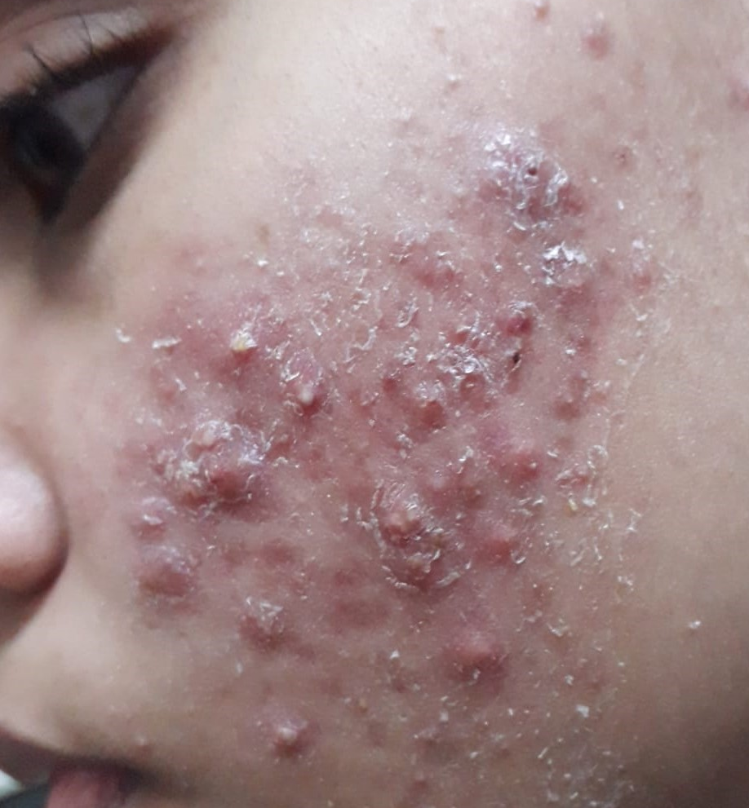
ACNE
Dr. M.H. Usmani
MBBS (KGMU LKO UP)
DVD (BRD MC GKP UP)
Senior Consultant Dermatologist
Balrampur Hospital Lucknow

Slide 4
The department is blessed and perhaps very fortunate to have
Guidance of
Shri Partha Sarthi Sen Sharma, IAS
Principal Secretary
Department of Medical Health & Family Welfare UP
&
Direction & Leadership of
Dr Rajaganapathy R., IAS
Director (Administration) & Director (SIHFW) UP
Department of Medical & Health Services UP
Who have combined to fulfill a big gap in continuing medical
education of medical officers of PMS services

Slide 5
GRATITUDE
I take this opportunity to thank all my teachers- Prof. Lalit Mohan, Prof. K.K. Singh, Dr Santosh Kumar Singh & Prof Anil Gupta all at BRD Medical College Gorakhpur UP whose knowledge and expertise inspired me and prepared me to serve my patients and humanity.

Slide 6
DISCLAIMER
Medical Science is constantly changing with new researches being done at extraordinary pace.
New knowledge is being added every day so changes in diagnostic criterions, treatment guidelines, dosage and use of drugs become necessary from time to time.
This module is addressed to Medical Officers of UPPMS services, Residents, Medical students and Paramedical staff of Department of Medical and Health services Uttar Pradesh and not meant for general public.

Slide 7
INTRODUCTION
Acne is a multi factorial chronic inﬂammatory disease of sebaceous gland with periodic remission and exacerbation, with high morbidity, decreasing patient's quality of life. It is considered as one of the top three common skin disease in adolescents and young adults world wide, with a estimated prevalence of 85% in this population (13-25yrs). It one of the top ten global disease.
Male & Females are equally aﬀected however more number of female patients come to OPD probably due to higher prevalence in adult females and increased cosmetic sensitivity. In india there is overall Male preponderance and urban more affected than rural
Nodulocystic acne is 5-10 times more common in males. In general acne are more severe in males

Slide 8
IMPACT ON WELL BEING…… SIGNIFICANT
The eﬀects of acne extends beyond skin and leads to psychological distress, depression and anxiety affecting self esteem.
Patients do experience psycho social isolation.
In one study suicidal tendency was reported as in 7% of patients who themselves described their acne as “problem acne” or “substantial acne”. Appropriate psychiatric screening and referral is a must and impact on mental well being needs to be appreciated.

Slide 9
AGE…CAN OCCUR AT ANY AGE
Acne vulgaris (common acne) starts usually at puberty /teenage (cases as early as 8 yrs reported) and spontaneously resolve by fourth decade of life but eruptions may continue in many individuals even in fifth decade of life. Some patients may have onset in adult age itself.
Neonatal acne (variant) starts at birth and infantile acne presents between 1 to 12 months of life and may extend into childhood. Both are less prevalent versions.

Slide 10
GENETIC DISEASE?
Family history of acne is reported by 63%-78% of patients. Children with acne have one or both parents with the disease.
98% of monozygotic twins have acne while only 55% of dizygotic twins have it.
It is also reported that severity of acne may be genetically determined. However individual genes have not been identified. Several candidate genes are under study.

Slide 11
ENVIRONMENTAL EFFECT OR EXTERNAL FACTORS… DO THEY HAVE A ROLE… YES!
Hot humid environment d/t ductal hydration
Smokers have more severe grade than nonsmokers
Exposure to oils and halogeneted chemicals
Diet as discussed later
Drugs as discussed later
Cosmetics-do cause comedones
Stress - release of substance P contributing to seborrhea and role of Corticotropin-releasing hormone as discussed later, have an effect on eruptions and clinical presentations
Soaps cleansers remove sebum from skin but do not reduce sebum production. Repeated trauma by scrubbing of face may worsen acne by rupturing comedones.
Occlusive clothing like bra straps, casts, shoulder pads cause acne mechanica by occluding pilo-sebacious follicles.

Slide 12
WHAT NOT TO EAT…
Dietary restrictions on class of foods or any specific food has not been demonstrated to be of benefit in treatment of acne as of now.
Low glycemic diet benefits in acne has been proposed by few researchers. More dietary fibres , more fish seafood zinc, selenium is considered helpful by some researchers.
Some researchers consider it to be IGF-1 mediated disease and modified by diets that increase IGF-1
On basis of above Chocolates, cheese and milk (casein well as whey protein) in large quantity to be avoided. However strict restrictions of above should be done with caution, as not to compromise nutritional intake. Yoghurt (although milk product) consumption is considered safe.

Slide 13
COURSE OF DISEASE…
The onset is gradual in teenage. As early as 8 years reported. Abrupt onset is reported in drug induced acne and androgen secreting pathology/tumor.
Lasts, several years and then spontaneous remission occurs (if untreated leaves behind series of sequel and complications). By fourth decade of life in more than 70% pts it clears off, while in rest they continue to erupt. In one study after 50yrs 15% women and 7% men were reported to have acne.
During acne years re-occurances as well as fluctuations in degree of involvement are common. More than half of female pts report worsening of acne just before menses. (premenstrual flare)

Slide 14
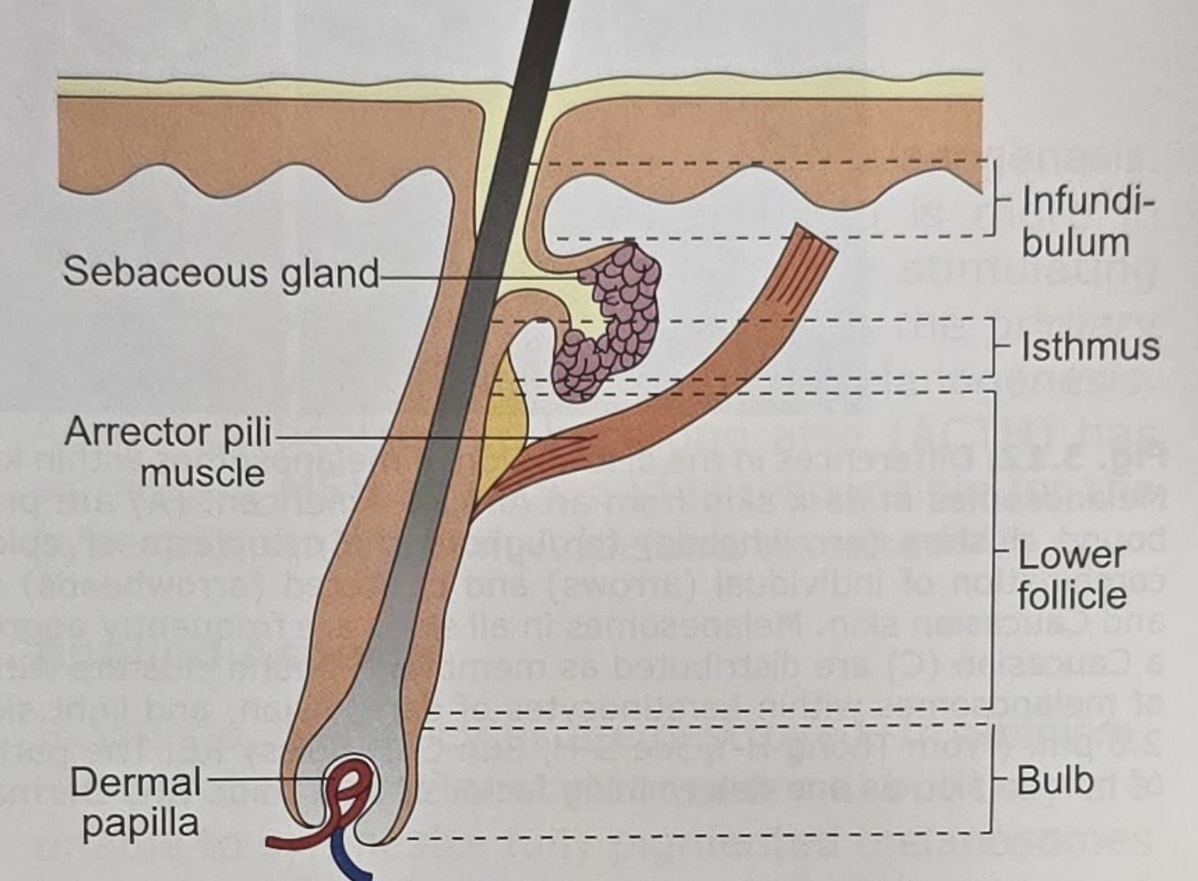
SEBACIOUS GLAND. THE CULPRIT SITE IN ACNE
Sebacious glands are associated with hair follicles and rest between follicle and the epidermis. The activity of the gland is controlled by androgens however acne is not a disease of total circulatory hormones. The sebacious glands contain an enzyme called 5 alfa- reductase , which converts less potent testosterone into more potent dihydrotestosterone, which is directly responsible for gland activity.
The epithelium of the upper hair follicle, the infundibulum, becomes hyperkeratotic with increased cohesion of the keratinocytes, resulting in the obstruction of the follicular ostium, where keratin, sebum, and bacteria begin to accumulate in the follicle and cause dilation of the upper hair follicle, producing a microcomedon.
Sebacious gland is now considered as a neuroendocrine organ with ability to coordinate local response to stress and normal functions

Slide 15
PATHOGENESIS OF ACNE
Four pronged pathogenesis theory
All four pathogenic factors are interrelated and under hormonal and immune influence are
FOUR PRONGED PATHOLOGY OF ACNE
1 | INFLAMATION
2 | HYPERKERATINIZATIN OF DUCTAL EPITHELIUM
3 | INCREASED SEBUM PRODUCTION
4 | INCREASED COLONIZATION OF P ACNES

Slide 16
Recent researches further clear the cellular and molecular mechanisms involved in above traditional theory of pathogenesis

Slide 17
INFLAMMATION
Inflammation is now recognized as kickstarter of all pathologies, which run simultaneously, as there is evidence that sub clinical follicle centric inflammation actually precedes comedone formation and is mediated by IL-1.
Certain strains of P. acnes elicit host inflammatory response. The genomes of acne-enriched and healthy skin-associated strains revealed in a research that the phylotypes associated with acne selectively harbor a plasmid and two chromosomal regions that contain genes possibly involved in pathogenesis, adhesion to epithelial tissues, or induction of human immune response.

Slide 18
Both innate and adaptive immunity are expressed and involved in pathogenesis.
P.acnes induced secretion of IL1, IL2, 8, 12 & TNF- alfa mediating through toll like rectors 2 n 4 may be responsible for induction and maintenance of inflammation and lead to CD4 cells and neutrophil rush in. All these may lead to increase in comedone size and rupture of comedones
Certain strains of P. acnes induce distinct Th1 & Th17 immune response which potentially contribute to inflammation. Both Th1 and Th17 cells can trigger antimicrobial activity against bacteria, but the lysis of these bacteria can release components that directly activate the innate immune response, resulting in inflammation. Moreover, Th17 characteristically induce the recruitment of neutrophils, which contribute to antibacterial activity but also cause tissue injury. P.acnes also induces inflammation directly.

Slide 19
The P.acnes cell wall stimulates anti P.acnes antibody development which enhance anti-inflammatory response by activating complement initiating cascade of pro inflammatory events.
The inflammation progresses, through entire life cycle of acne and even persists in scarring stage with inflammatory infiltrates seen in most of atrophic scars. After palpable lesions of acne flatten out follicular inflammation takes months to settle despite treatment due to innate immunity against remnants of P.acnes thus need for continued treatment.

Slide 20
HYPERKERATINIZATION
Proposed factors in keratinocyte hyperproliferation in pilosebacious canal include androgen stimulation, decreased linoleic acid, increased IL-1a activity, and direct effects of P. acnes.
Dihydrotestosterone (DHT) is a potent androgen that plays a role in acne pathogenesis.
DHT is converted from dehydroepiandrosterone sulfate (DHEA-S) by 17b hydroxysteroid dehydrogenase (HSD) and 5-alfa reductase enzymes. Compared with epidermal keratinocytes, follicular keratinocytes have increased 17b HSD and 5-a reductase, thus enhancing DHT production.DHT may stimulate follicular keratinocyte proliferation.
Also supporting the role of androgens in acne pathogenesis is the evidence that individuals with complete androgen insensitivity do not develop acne

Slide 21
Follicular keratinocyte proliferation is also regulated by linoleic acid, an essential fatty acid in the skin. Low levels of linoleic acid induce follicular keratinocyte hyperproliferation and the production of pro inflammatory cytokines. The levels of linoleic acid are decreased in individuals with acne and normalize after successful treatment with isotretinoin.
In addition to androgens and linoleic acid, IL-1a has been shown to contribute to keratinocyte hyper-proliferation. IL-1a induces follicular keratinocyte hyperproliferation and microcomedone formation, and IL-1 receptor antagonists inhibit microcomedone formation.
The initial event that upregulates the production of IL-1a has not been determined. Fibroblast growth factor receptor (FGFR)-2 signaling is also involved in follicular hyperkeratinization.

Slide 22
SEBUM
Another key feature in the pathogenesis of acne is the excess production of sebum from the sebaceous gland. Human sebum are composed mainly of triglycerides found ubiquitously and of unique lipids, such as squalene and wax esters not found anywhere else in the body, including the surface of the skin.
On average, people with acne excrete more sebum than those without acne, and secretion rates have been shown to correlate with the severity of clinical manifestations.
The main component of sebum, triglycerides, is important in acne pathogenesis. Triglycerides are broken down into free fatty acids by P. acnes, (normal flora of the pilosebaceous unit). There is reduced level of linoleic acid which is implicated in accumulation of cornified cells.

Slide 23
In return, these free fatty acids promote P. acnes colonization and induction of inflammation. Lipoperoxides also found in sebum induce proinflammatory cytokines and activate the peroxisome proliferator-activated receptors (PPAR) pathway, resulting in increased sebum.
Androgenic hormones activate sebocyte proliferation and differentiation and the induction of sebum production.
Those with acne have higher average serum androgen levels (although still within normal range) than unaffected control participants. 5-alfa Reductase, the enzyme responsible for converting testosterone to the potent DHT, has greatest activity in areas of skin prone to acne, face, chest, and back.
Sebum production is regulated by other hormones as well- estrogens, growth hormone IGF1, insulin, glucocorticoids, adrenocorticotopic hormone and melanocortins.

Slide 24
STRESS… HOW IT INFLUENCES?
Corticotropin-releasing hormone may also play a role. It is released by the hypothalamus and increased in response to stress. Corticotropin-releasing hormone receptors are present on a vast number of cells, including keratinocytes and sebocytes, and are upregulated in the sebocytes of patients with acne.

Slide 25
CLINICAL PRESENTATIONS
Acne presents with any one or more of following lesions.
comedones, (pathognomic sign) open (blackheads) and (white heads) closed with no visible opening
papules, (commonest sign)
pustules,
nodules,
pseudocysts,
sinuses,
keloids, (complication)
hypertrophic scars and atrophic acne scars (commonest complication)

Slide 26
SITES OF PREDILECTION
Lesions usually occurs in seborrheic zones mostly in vellous hairs.
Primary site is face. Upper back, upper arms, shoulders and chest are other sites. (Sebaceous glands of vellous hairs are larger in size with narrow pilary canal and have more end organ sensitivity. Terminal hairs in contrast have large pilary canal which are not blocked

Slide 27
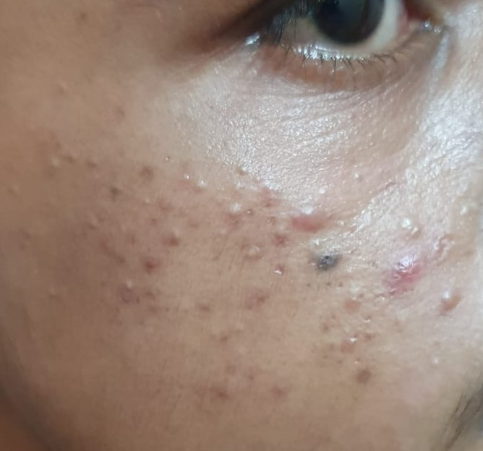
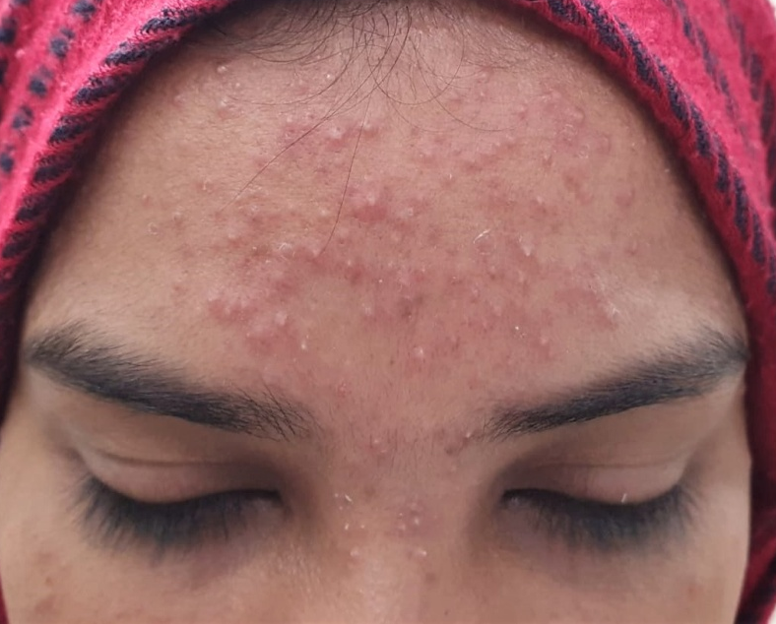
Comedone is a plug of keratinous material, sebum and bacteria lodged in pilar canal
Adult Acne first eruption at 25yr of age
Mostly comedonal acne
Photo contributed by Dr MH Usmani
Sr Consultant Balrampur Hospital Lucknow

Slide 28
Open black comedones
Closed white comedones
Photos contributed by Dr MH Usmani
Sr Consultant Balrampur Hospital Lucknow

Slide 29
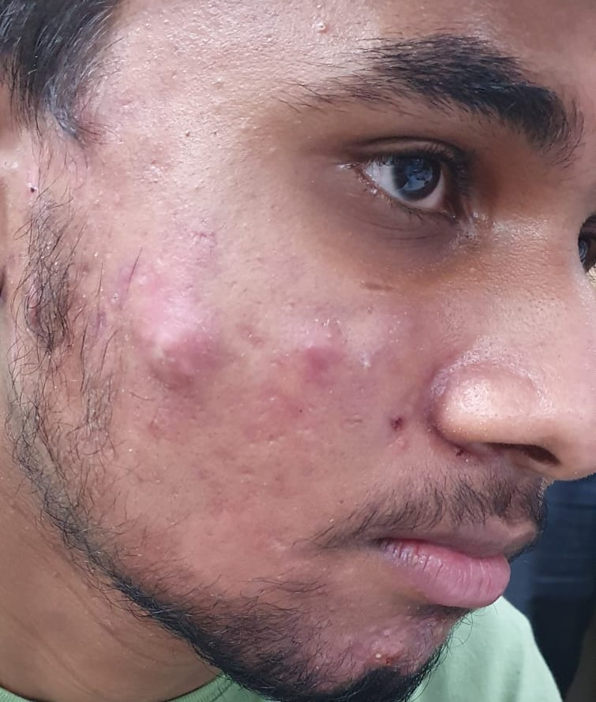
Comedones, papules and pustules in grade II Acne
Nodules and pappules
Photo contributed by Dr MH Usmani
Sr Consultant Balrampur Hospital Lucknow

Slide 30
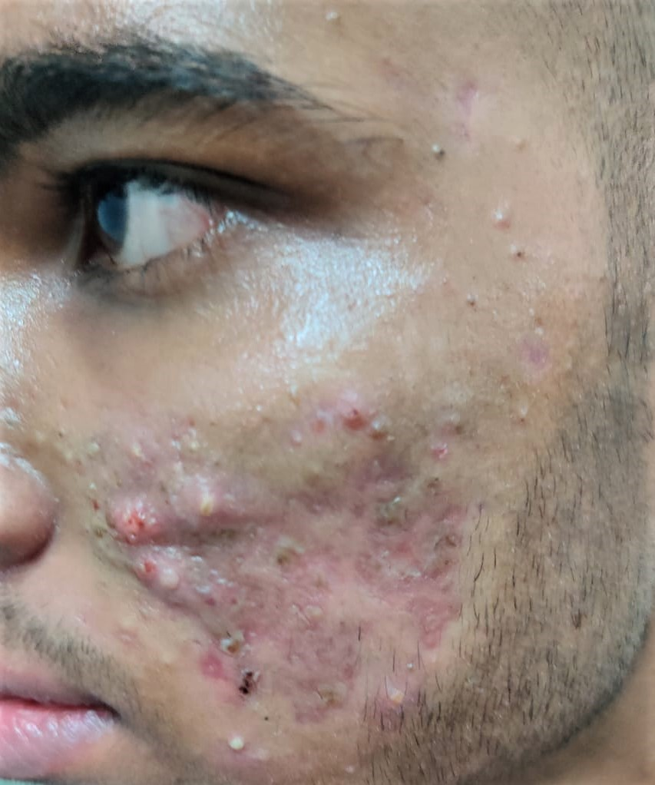
Truncal Acne
Abscess and cyst in
grade III Acne
Polymorphic features
of nodules,cysts papules
and comedones
Photos contributed by Dr MH Usmani
Sr Consultant Balrampur Hospital Lucknow

Slide 31
WHAT DECIDES TYPE OF LESION..
Several lesions are usually present at the same time (Pleomorphic presentation)
Comedone is pathognomic lesion. It is postulated that 54% of inflammatory lesions originate from comedones while many originate from normal skin. Inflammatory infiltrates distribution and extent decide whether the lesion is a papule, pustule or nodule

Slide 32
ACNE SEVERITY GRADINGS
Several grading systems are used
Clinical examination based, for treatment purpose alone
Grading based and or lesion counting based
Grading based-This involves observing the dominant lesions and estimating the extent of involvement
The lesion counting based requires recording each type of acne lesions and determining the overall severity.
Equipment based for research purpose
We follow grading based system as it easy quick slightly less accurate as it cannot distinguish small difference in treatment response

Slide 33
Grading based acne severity system
Source; adapted from Postgraduate Dermatology by Kaushik lahiri & Abhshek de 2022 edition

Slide 34
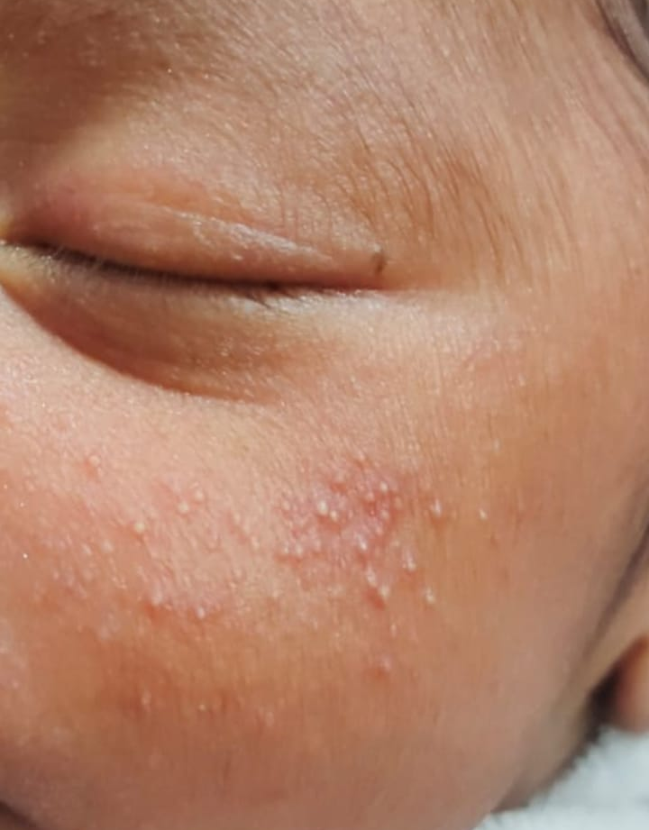
VARIANTS
Neonatal acne
No comedones, only papulopustular lesions. Erupt 2 to 3 weeks after birth.
Due to excessive androgenic activity with malassezia infections. Self resolving over 3 months
Infantile acne
Due to presence of maternal hormones in the child. Common in males. Comedones as well as papules and pustules may be present, never nodules. Onset is 3 to 6 month after birth and may sometimes last up to 2-3 years.
Lab investigation must be performed in all cases
Local applicants are usually sufficient.
Neonatal acne
Photo contributed by Dr MH Usmani
Sr Consultant Balrampur Hospital Lucknow

Slide 35
Adult Acne
Mostly in adult females >25 year of age. Lesions are few usually on lower face, mandibular area, chin involvement is characteristic.
Associated with PCOS, ovarian tumor and congenital adrenal hyperplasia. Familial involvement 50%, genetic factor ?
Other associated disease may be obesity, hirsutism, acanthossis nigricans. PCOS and hormonal work up are part of management in adult acne .
Treatment failure is high with traditional therapies with antibiotics and oral isotretinoin and hormonal therapies are opted for.
Acne Fulminans
Acute onset with fever crusted lesions on sternum & around clavicle associated with myalgia and arthralgia.
Abscess and ulcers are usually present. High chances of scarring. May be Associated with anabolic steroid use.
Adult acne in PCOS pt
Acne fulminans- crusted lesions in presternal area. Usually with fever and myalgia

Slide 36
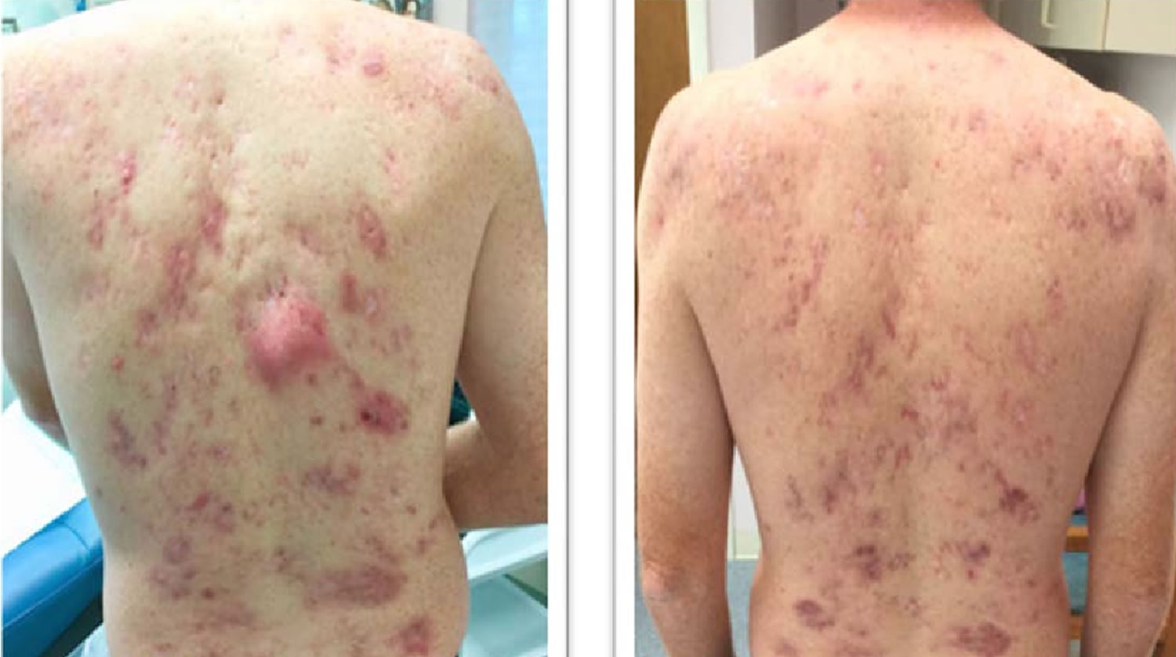
Acne Conglobata
Adolelescant & early childhood acne usually grade III with inﬂamed tender nodules especially in back. Comedones are multiporous. High chance of scarring.
Severe form
May be associated with follicular occlusion syndrome. (Triad of acne conglobata dissecting folliculitis of scalp & hidradenitis suppurativa and sometimes pilonidal sinus also).
Acne Excoriee
Excoriations mimicking acne lesions due to picking. Usually excoriating lesions are on cheek in young girls.
Primary lesions of acne are very few.
Associated with OCD, depression and anxiety.
Counseling and psychotherapy are must. If inflamatory lesion +nt then local applicants and if hyperpigmentation -to be dealt with as in acne vulgaris

Slide 37
PREMENSTRUAL FLARE WHY?
There is reduction in size of sebacious follicular orifice after ovulation contributing to subsequent increase in lesions in premenstrual flare.
Pilosebacious orifice is smallest on 15-20 day of cycle and acne worsens 3-4 days after.
Occur in approximately 44% of women and 25% increase in inflammatory lesions.

Slide 38
ACNE ARE ALSO FOUND IN ASSOCIATIONS WITH OTHER DISEASES
SYNDROMES ASSOCIATED WITH ACNE
PCOS
APERT SYNDROME-Acrocephalosyndactyly
CUSHINGS SYNDROME
PAPA SYNDROME- Pyogenic arthritis, pyoderma gangrenosum, acne congllobata
HAIR-AN SYNDROME - Hyperandrogenism, insulin resistance,acanthosis nigricans
CONGENITAL ADRENAL HYPERPLASIA
ACROMEGALY
SAHA SYNDROME- Seborhea, acne, hirsutism, androgenic alopecia
SAPHO SYNDROME- Synovitis, acne, pustulosis, hyperostosis-ostietis

Slide 39
PCOS THE SILENT CULPRIT IN FEMALES?...YES
Approx 10-34% % of PCOS patients have acne.
Hyperandrogenism in adult female leads to severity of acne in females. If eruption in adults, then they are distributed in jaw lines on mandibles. Usually sudden onset with irregular menses and hirsutism. Clinically hyperandrogenism may be suspected if hirsutism, deepening of voice and or acanthosis nigricans is present.
There is no correlation between acne severity and serum androgen levels hence dose of antiandrogen therapy should not be decided on this.
Referal to gynecologist must for work up case
Antiandrogen therapy is mainstay of treatment. EE-CPA combination is considered good and in case pregnancy is desired metformin may be used.

Slide 40
ACNEIFORM ERUPTIONS
Appear like acne but 4 factors of pathogenesis not involved usually monomorphic papules or pustules
Abrupt onset in any age group
Less or no chances of scarring
Any area may be involved but usually trunk
Follicular eruptions usually papulopustular, are similar in appearance to acne but does not involve 4 pronged acne pathogenesis. E.g are
Acne due to repeated friction e.g. arm pit due to crutches
Acne due to topical chemicals leading to blockage of pilosebecious canal.
Cosmetic acne due to blockage caused by cosmetic products.
Occupational acne due to cutting oil (chlorinated hydrogenated oils)are non inﬂamed with only comedones in axila, neck back, malar and retro auricular area. Acneiform lesions are also seen in gonadal, thyroid and pitutary dysfunctions

Slide 41
DRUGS INDUCING ACNE… ACNEIFORM ERUPTION
Many drugs may initiate monomorphic lesions of acne also called as acneiform eruptions. E.g.
Corticosteroids topical & oral both,
Anabolic steroid,
Lithium,
Isoniazid,
Phenytoin,
Progestin ,
Cyclosporine halogenated compounds
certain chemotherapy esp. epidermal growth factor receptor inhibitors (gefitinib, erlotinib, cetuximab)
Drug induced acne –monomorphic papules

Slide 42
DIFFERENTIAL DIAGNOSIS
Diagnosis is clinical only rarely any confusion
Acne vulgaris presents with variety of lesions
One type of lesions may predominate
Previous acne scar provide circumstantial evidence
DD of INFLAMMATORY ACNE | DD of CLOSED COMEDONES
Folliculiitis | Milia
Rosacea | Sebacious Hyperplasia
Perioral Dermatitis | Acne d/t corticosteroids
Trichoepithelioma | Occupation oil acne
Trichoepithelioma
Folliculitis
Milia
Photos contributed by Dr MH Usmani
Sr Consultant Balrampur Hospital Lucknow

Slide 43
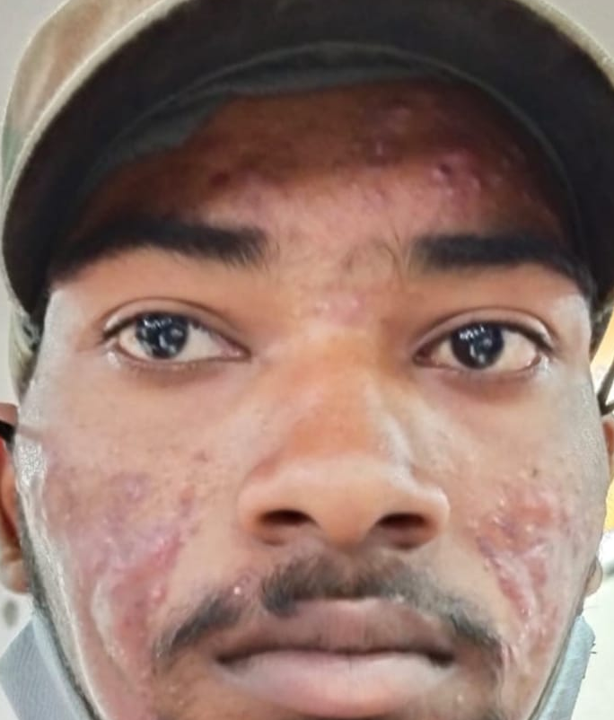
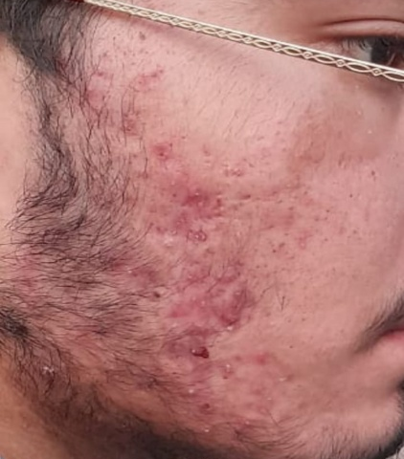
COMPLICATIONS OF ACNE
Huge morbidity with or without cosmetic disfigurement due to acne scars, (Atrophic and hypertrophic scars),
Keloid and Perifollicular Elastolysis.
Post inﬂammatory hyperpigmentation may persists for many months or transient erythema
Depression, anxiety and mood disorders leading to significant morbidity.
Subsequent decrease in quality of life
Photo contributed by Dr MH Usmani
Sr Consultant Balrampur Hospital Lucknow

Slide 44
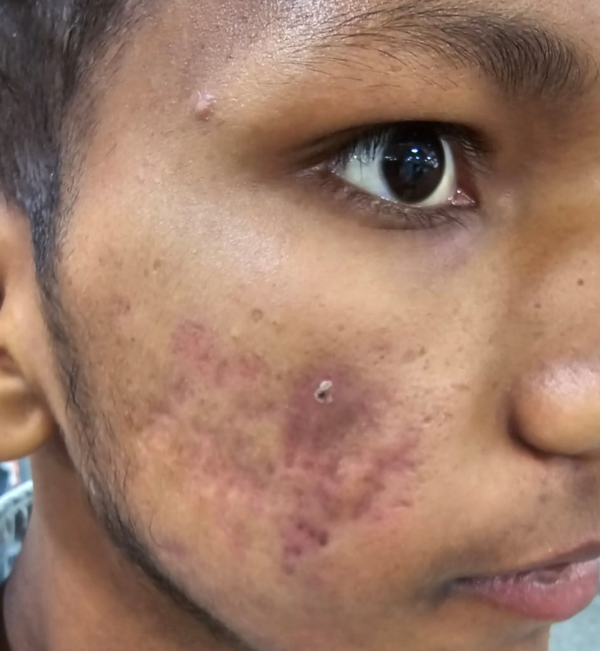
COMPLICATIONS OF ACNE
PIH with acne scars
Photo contributed by Dr MH Usmani
Sr Consultant Balrampur Hospital Lucknow

Slide 45
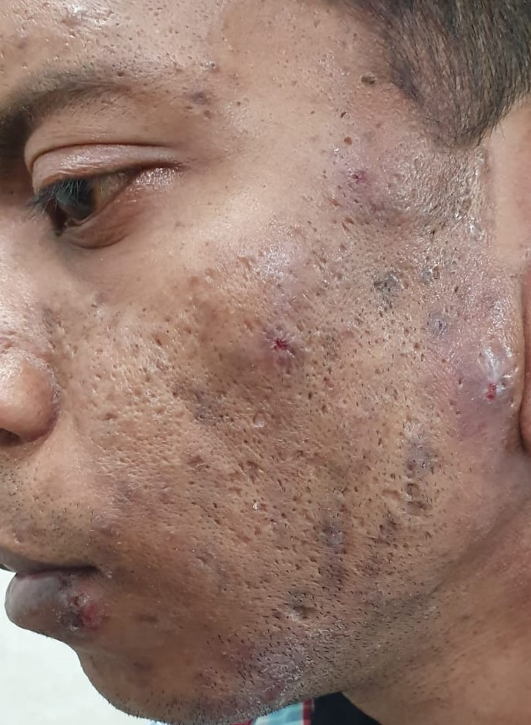
ACNE SCARS
The mechanism of acne scarring is not clear, and although scar formation correlates with inflammatory response, there is no direct correlation of severity of disease and development of scar formation which may occur in even mild to moderate acne.
Scars may be atrophic (more common) or hypertrophic or even keloidal
Atrophic scar have different shapes
Ice pick(narrow deep with epidermal area wide and taper down to dermal lower end as pinpoint
Boxscar (wide scars and do not taper size range from 1.5 mm-4.0mm
Rolling are very shallow very wide scars(>4mm)
Perifollicular elastolysis are atrophic soft pappules on upper part of trunk
Acne scars Icepick, Boxscar & Rolling scars
Photo contributed by Dr MH Usmani
Sr Consultant Balrampur Hospital Lucknow

Slide 46
MANAGEMENT OF ACNE
Includes
Diagnosis
Classification
Investigations required
Counseling related to disease
General measures
Selection of pharmacological agents and non-pharmacological methods
Complications and their resolutions

Slide 47
MANAGEMENT….
History of disease is important to identify variants
Classify patients in comedonal, papulopustular and nodulocystic and truncal involvement for management
Classify & identify predisposing causes(external and environmental factors) and address them. Identify syndromes if any
Identify acneiform lesion--Sudden onset are usually due to drugs (Corticosteroids topical & Oral both, Anabolic steroid, Lithium, Isoniazid, Phenytion, Progestin, Cyclosporine, halogenated compounds certain chemotherapy esp. epidermal growth factor receptor inhibitors) and gradual onset are usually pathological.
Occupational are due to exposure to cutting oils and cosmetic items. Cosmetics, occupational cutting oils, drugs have to be withdrawn and predisposing factors attended.
Reach to diagnosis with severity grading and identify individual predisposing factors

Slide 48
ASSESSMENT….. IMPORTANT HISTORY
History
Onset | Infantile , Childhood, Pre-adolescent, Adolescent, Adult or late onset
Family History | Positive family history
Duration | Sudden onset, chronicity
Course | Spontaneous remission, Remissions with treatment Re-occurances and their frequency, Scarring tendency
Aggravating factors | Premenstrual flaring, Drugs Aggravating, Change of cosmetic items , Change of diet, Smoking , Sun exposures,
Drug History | Treatment history for acne and other disorders
Associations | PCOS, Irregular menses, Hirsutism, Alopecia,AcromegayAarthritis,

Slide 49
INVESTIGATIONS
Investigations usually not required as diagnosis is purely clinical However if hyperandrogenism is suspected.
AMH (Antimullerian Hormone) is a good screening test for PCOS
DIHEAS, Prolactin, LH,FSH, Total & Free Testesterone,TSH and ultrasound to check ovaries for polycystic lesions
17-hydroxyprogesterone to diagnose congenital adrenal hyperplasia
(test during menstruation and not during midcycle). Pt taking contraceptive to discontinue it for 1month before investigation)
Routine fitness tests before starting isotretinoin (if required) CBC,LFT & Lipid profile and S. electrolytes before starting spirinolactone

Slide 50
MANAGEMENT….
Treatment to be initiated as early as possible to prevent complications, permanent sequele like scars AND SUBSEQUENTLY TO PREVENT DECREASE IN LIFE QUALITY AND MAINTAINANCE OF MENTAL HEALTH.
Hence counseling to evaluate psychosocial impact depression anxiety must be assesed.
Acknowledge the patient sentiment. Do not dismiss acne as small issue. It may be huge for patient.
Counsel to adherence of treatment required for managing symptoms
Treatment should be customized for need of patient

Slide 51
GENERAL MEASURES/COUNSELING
Make the patient understand his /her disease, course nature and therapy and importantly, how cosmetic deterioration can be avoided, minimized or corrected as the case may be.
Evaluate psychosocial impact
Counsel to avoid oils , and heavy cosmetics
Reassure to improve emotional health
Educate about premenstrual flares and other variations
Do not vigorously cleansing and too frequent washing. Two times is sufficient.
Antibacterial soaps (chlorhexidien or triclosan) do not have effect on P.acnes
In dry skin, non-comedogenic moisturizer to be used.

Slide 52
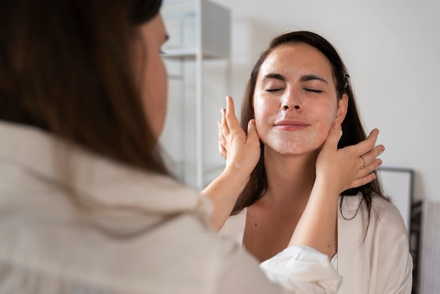
TREATMENT TOOLS AVAILABLE
Go through all tools available
Then customize to need of patient

Slide 53
TOPICAL AGENTS
IN ACNE TREATMENT
TOPICAL ANTIBIOTICS | SPECIFICATION | PREGNANCY SAFETY
OXENOXACIN | 2% LOTION | NEW DRUG
CLINDAMYCIN | 1% GEL/CR | B
CLINDAMYCIN +NICOTINAMIDE | GEL | B
AZITHROMYCIN | 1% GEL | B
NADIFLOXACIN | 1% GEL/ CREAM (not recommended by AAD. Least resistance | C
CLARITHROMYCIN | 1% GEL | C
BPO | SPECIFICATION | PREGNANCY SAFETY
BENZOYL PEROXIDE | 2.5%3.5%,5.5%,4%,5%,7.5% GEL/ MICROSHERE | C

Slide 54
RETINOIDS | SPECIFICATION | PREGNANCY SAFETY
ADAPALENE | 0.10% | C
TRETINOIN | 0.025%,).05% 0.01% CREAM MICROSHERE 0.04% | C
TAZORETENE | 0.05% AND 0.1% | X NOT TO USED
ISOTRETINOIN | 0.05% GEL/CR | D NOT TO USED
OTHER DRUGS | SPECIFICATION | PREGNANCY SAFETY
AZELAIC ACID | 10%,15%,20% GEL/CR | B
DAPSONE | 5% GEL | C
SALICYLIC ACID | 1%,2% FACEWASH CR | C, AVOID
SALICYLIC GLYCOLIC COMB |  | AVOID
BENZYL PEROXIDE plus CLINDAMYCIN
ADAPALENE plus CLINDAMYCIN
BENZYL PEROXIDE plus ADAPALENE
NADIFLOXACIN plus ADAPELENE
POPULAR COMBINATION TOPICALS

Slide 55
ANTIBIOTIC | DOSAGE | FEATURES | OTHER
DOXYCYCLINE | 100MG -200 PER DAY/ (40mg/day sub antimicrobial dose for 6months has significantly better results) | C/I in PT BELOW 9 YRS AND PREGNANCY. NOT TO BE USED BEYOND 2-3 MONTHS. PHOTOSENSTIVE. CONSIDERED AS BEST OPTION. SOME STUDIES FIND IT BETTER THAN MINOCYLCINE. Can be taken with food. photosenstivity | REDUCES P ACNES. ANTIMETALLOPROTEINASE ACTIVITY REDUCES INFLAMMATION. Should not be used beyond 2-3 months in full doses
MINOCYCLINE | 100MG OR 45ER,55ER PER DAY | C/I in PT BELOW 9 YRS PHOTOSENSTIVE. MANY CONSIDER IT BETTER THAN DOXY CYCLIN. SPOTTED PIGMENTATION ON LONG TERM USE esp in acne scars hard palate, anterior shins | decrease free fatty acid concentration and inflammation there by and takes several wks to get evident hence several wks of tt required.
LYMECYCLINE | 300MG PER DAY 408 MG / day
AZITHROMYCIN | 500 THREE DAYS PER WK | SAFE PROFILE. LESS PILLS. RESISTANCE FOUND TO BE ON HIGHER SIDE | GI disturbance and diorhea common S/E
CLARITHROMYCIN | 250-500MG PER DAY
CLINDAMYCIN | 150-300MG PER DAY | S/E psuedomembranous colitis limiting its oral use, vulvovaginal candidiasis
LEVOFLOXACIN | 500 PER DAY |  | Reserved drug for tuberculosis. Should be used sparingly
DAPSONE | 50 -100 MG FOR 2-3 MONTHS | CAN BE USED AS OPTION WHERE ISOTRETINOIN CANNOT BE USED | G6PD LEVEL EVALUATION TO BE DONE. MORE SO IN PUNJABI KHATRI POPULATION

Slide 56
ISOTRETINOIN….THE BEST AND THE MOST DANGEROUS?
ORAL | DOSAGE | FEATURES | PREGNANCY SAFETY
ISOTRETINOIN | 0.5-1.0mg/kg/day. 20MG SOFTULE PER DAY IS MOST POPULAR DOSAGE IN ADULTS MAX CUMULATIVE DOSE PER YEAR 120MG/KG. USUALLY GIVEN FOR 3 -4 MONTHS AT A STRECH NOT RECOMMENDED UNDER 12YR OF AGE | ACTS ON ALL 4 ASPECTS OF PATHOGENESIS . DRUG OF CHOICE IN TRUNCAL AND NODULOCYSTIC ACNE. Most significant lab anomalies are increase in cholesterol and triglycerides | CAT X PREGNACY TO BE AVOIDED FOR 1MONTH FROM LAST DOSE AS BODY CLEARANCE TIME IS 4WKS Iplege documentation compulsory in US No blood donation up to 4wks from last dose

Slide 57
ISOTRETINOIN
One of the most widely used drugs in management of acne. Produces profound inhibition of sebacious gland activity. It is a category “X” drug in pregnancy. The body clearance time is approximately 4 weeks. Hence should not be used in pregnancy or in likely to get pregnant. The first year of married like is high risk as a majority of couples conceive during first year itself regardless of socioeconomic status in India. iPledge is used in USA. Should be given to pts who have not responded to other therapies.
Daily dosage is 0.5 to 1mg/kg body weight. However the experience says 20 mg daily in over 40 kg bodyweight is sufficient. At low dose incidence of relapses are greater. Total cumulative dose per year should not exceed 120 mg/kg/year. Dose of 20mg daily in an average adult for 3-4 month is sufficient. At our centre we do not give for more than 20wks at a stretch.
Common side eﬀects are extreme dryness , hair loss, myalgias. Xerophthalmia, conjunctivitis, keratitis vertebral hyperostosis and pseudo tumor cerebri should be watched. Monitoring of LFT as raises SGPT (4X stop) & elevates Triglycerides(700-800mg/dL stop) is mandated every 4-6 weeks. Drug has potential to cause depression and hence should not be used in primary depression cases. Repeated courses may result in osteopenia.

Slide 58
HORMONAL THERAPIES
COMBINED OCP | HORMONAL THERAPY COUNTER-ACTS AGAINST EFFECTS OF ANDROGENS ON SEBACIOUS GLAND. AND INHIBIT ACTIVITY OF 5 ALFA REDUCTASE
ETHINYL ESTRADIOL+CYPROTERONE ACETATE | PROGESTINS IN ADDITION BLOCK ANDROGEN RECEPTORS ON SEBOCYTES EE-CPA BETTER THERAPEUTIC EFFECT
CYPEROTERONE ACETATE | BLOCKS ANDROGEN RECEPTORS. INCREASE IN BP REVERSIBLE.
SPIRONOLACTONE | ANDROGEN RECEPTOR BLOCKER & 5alfaREDUCTASE INHIBITOR 50-100 /day. (often recommended with OCPs) S/e POTENTIAL HYPERKALEMIA, IRREGULAR MENSES, BREAST TENDERNESS, FATIGUE
INDICATION OF HORMONAL THERAPY | CONTRAINDICATIONS OF HORMONAL THERAPY
ENDOCRINE ABNORMALITIES | PREGNANCY/LACTATION
ADULT ACNE | HISTORY OF THROMBOEMBOLISM
PREMENSTRUAL FLARES | HISTORY OF MI, HT,BREAST CANCER CHRONIC KIDINEY/LIVER DS
RESISTANT INFLAMATORY ACNE | HISTORY DVT OR IMMOBILISED PT

Slide 59
OTHER
FLUTAMIDE | 250mg bd may with combination with OCP | Androgen receptor blocker Used in acne with hirsutism | Fatal hepatitis reported, avoid in pregnancy
METFORMIN | 250-500mg /day | Reduces IGF-1 and hence sebum production | Used in hyperandrogenism
CORTICOSTEROID | Low dose 2.5-5mg prednisolone at evening to suppress adrenal androgen production | anti-inflammatory | Overlap with isotretinoin to counter initial flare. And in females with elevated DHEAS Short term use otherwise aneiform eruptions
ZINC | 10-30mg or /200mg zinc gluconate | Conflicting views on use. Some say has anti-inflammatory role | Exact role yet to be elucidated.

Slide 60
NON PHARMACOLOGICAL TREATMENT……ANY HOPE?
To overcome side effects and drawbacks of conventional therapies lasers and light devices are now been increasing used in hope of finding a primary separate non pharmacological treatment. However we are still far away from that. However laser and light devices can play a adjuvant role or at best synergistic role.
Blue light PDT is only FDA approved light device as of now.
Most of dermatologists believe in only conventional treatment.
Laser and Light devices for Acne
LASERS | 532NM POTASSIUM TITANYL PHOSPHATE ,585 AND 595 NM PULSED DYE LASER, NEAR INFRARED LASERS (1450 &1540nm and recent 1720nm laser target sebacious glands
LIGHTS | intense pulsed 560 nm filter, pulsedye laser 585 or 595, Blue light 405-420, Diode laser 800nm with indocyanine dye
PHOTODYNAMIC THERAPY | LIGHTS WITH PHOTOSENTITIZERS ALA (5aminoleviilunic acid) OR MAL(methylaminolevilunate)

Slide 61
S.No | Procedure | Done For
1 | Comedones | Comedone extraction with special come done extractor
2 | Abscesss | Drain abscess
3 | Phenolization of abscess wall | In recurrent abscess
4 | Hypertrophic scar and keloid | Intralesional Triamcelelone For severe nodular acne, abscess, hypertrophic, or keloidal scars Dose-10 mg/mL to be diluted with normal saline to 2.5 mg/ mL. 0.1 mL is given at each site.
5 | Chemical peeling( Salicylic acid, mandelic acid, retinol, glycolic acid, black vinegar containing peel and TCA) | as adjuvant in PIH cases, TCA cross done in ice pick spots
6 | Spot peeling with TCA | Ice pick scar respond well to TCA
7 | Subcision | For rolling scar
8 | Scar excision punch grafting | For mostly boxer scar
9 | Microdermabrasion Dermaroller and dermaplaning | For all scar except box scars
10 | Laser, Ablative and fractional laser | For all types of scars
11 | Autologous fat transfe, fillers | For depressed scars

Slide 62
CUSTOMIZATION OF TREATMENT- POINTS TO REMEMBER
Management is designed to remove predisposing causes and to reduce morbidity and complications as it is a chronic disease with relapses.
Certain basic principles of customization are recognised
Nodulocystic and truncal acne respond well to oral isotretinoin and without it do not heal.
In Grade I and II start with one oral antibiotic and one local antibiotic. The best one in oral category are Doxycline/Minocyclin and in local category Clindamycin /Oxenoxacin. If no response in 3-4 weeks add Benzyl peroxide 2.5% local application or adapalene with Benzylperoxide combination. If response not adequate in another 3- 4 week then add oral isotretinoin.
In grade III & Truncal acne, oral isotretinoin may be started from beginning. Oral antibiotics may be continued for 3-4 weeks & then withdrawn. Topical antibiotics may be changed to maintenance antibiotic like Dapsone or Benzoyl peroxide (BOP) or BOP adapalene combination. 16 to 20 weeks of therapy is usually sufficient.
Salycylic acid peel/face wash/Benzyl peroxide face wash may be may be used as adjuvant. Dryness must be watched.
Face cleansers may be used however plain water wash is still good

Slide 63
In androgen producing pathology such as PCOS, cyperoterone acetate may be used for long term up to 6-24 months. Spironotolone in dosage of 50 mg is other drug used (at tertiary care). Spironolactone has emerged as an alternative to antibiotics due to issue of antibiotic resistance for most of common anti acne antibiotics. Electrolyte imbalance issue has to be monitored however in under 30 years of age with normal kidney functions the need to stop spironolactone due to electrolyte imbalance has been rare.
In cases with post inﬂamatory hyperpigmatation azleic acid (10- 20%) is a good option as it reduce PIH and has mild antibiotic and anti inﬂammatory & comedolytic activity. Chemical peels with demelanizing properties used. Laser Q-switched Nd Yag and non ablative CO2 are used.
Cases for surgical procedure to be separated and oral and topical therapies to continue as required
Realistic expectations in treatment must be set on first visit itself. Acne therapy in combination of oral/topical and adjuvant is extremely successful when used properly and appropriately by a well trained medical officer/dermatologist

Slide 64
TREATMENT IN PREGNANCY
Treatment during pregnancy is a therapeutic challenge. Topical agents should be prefered and azelaic acid, clindamycin and BPO are considered safe.
Among oral antibiotics cephalosporins are considered safe followed by azithromycin( increased risk of cardiac septal defects and pyloric stenosis). Superficial chemical peels and light based devices are considered safe however till now their pregnancy category is still not defined

Slide 65
TREATMENT OF ACNE SCARS
Key issue is delay in therapy increases scar chances so therapy to be initiated as soon as possible.
Atrophic scar are much more common than. hypertrophic scar
Scar should be treated after acne eruptions have stopped for at least 1year
Counseling regarding pts goal vs expected extent of improvement. It should be emphasized that despite multiple and combination treatments complete removal of scar is not possible
S.N. | Scar | Procedure
1 | Ica Pick | Punch excsion, TCA Cross
2 | Deep Scars | Scar excsion
3 | For rolling boxcar | Subcision Microneedling Fractional lasers fillers focal dermaabrassion, punch elevation scar revision
4 | Hypertrophic scar | Intralesional steroids, silicon gels cryosurgery, Pulse Dye lasers
5 | For depressed scars | Autologous fat transfer, tissue augmentation with fillers

Slide 66
SIMPLIFY AS PER LEVEL OF CARE
Classify & identify predisposing causes and address them.
At primary and secondary level start with oral and local antibiotics. If acne aggression is not reducing add BOP.(primary level)
In case of no response add BOP+ adapalene and or spironolactone and in PCOS EE+cyperoterone or spirinolactone may be started at secondary and or tertiary care
If appreciable decrease not happening with above add isotretinoin. In cases where isotretinoin is to be started early, start it. Keep a watch on S/e and precautions. Isotretinoin to be started at tertiary care.
Cases for surgical procedures to be identified and proceeded upon. Peeling, I/L Triamcinilone and comedone extraction at primary and secondary care. Rest of procedures to be done at tertiary care.

Slide 67
SUGGESTED READINGS
Andrews' Diseases of the Skin 12th Edition 2016, Publisher ELSEVIER
Rook's Textbook of Dermatology 9th Edition Publisher WILEY Blackwell
Post Graduate Dermatology First Edition by Dr Koushik Lahiri & Dr Abhishek De Publisher Jaypee
IADVL text book of Dermatology 5th edition by Dr S. Sacchidanand, Publisher Bhalani
FITZPATRICK’S Dermatology 9th Edition Publishers McGrawHill Eduction

Slide 68
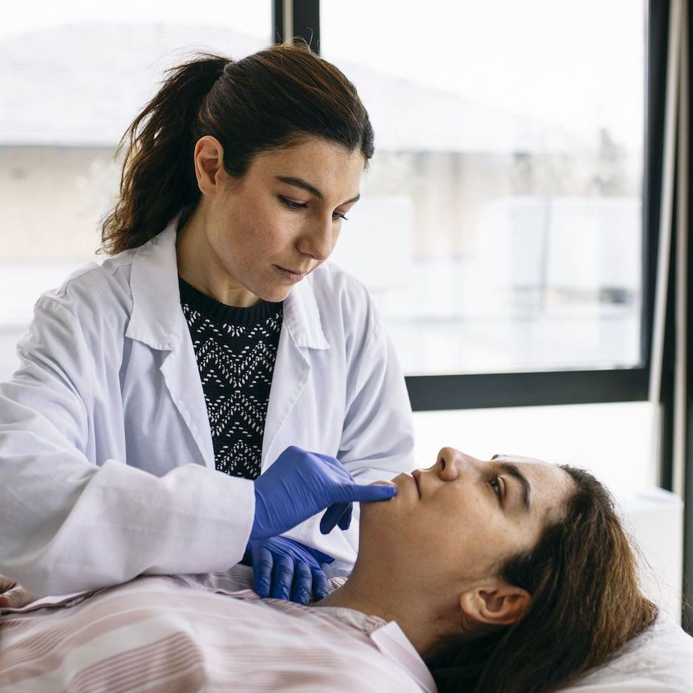
Thanks A Lot
For your patient hearing
TSU for technical help &
SIHFW for managing the show
Dr. M.H. Usmani
MBBS (KGMU LKO UP)
DVD (BRD MC GKP UP)
Senior Consultant Dermatologist
Balrampur Hospital Lucknow

