Slide 1

1

Slide 2


ABNORMAL MENSTRUATUION
ETIOLOGY AND DIAGNOSIS, TREATMENT AND MANAGEMENT
Dr. Smriti Agrawal
Professor and Head,
Department of Obstetrics and Gynecology,
Dr. Ram Manohar Lohia Institute of Medical Sciences, Lucknow
2

Slide 3
PHYSIOLOGY OF NORMAL MENSTRUATION
The Menstrual cycle is the monthly process of changes that occur to prepare the body for possible pregnancy. A menstrual cycle is defined as the first day of menstrual bleeding of one cycle to the first day of menstrual bleeding of the next cycle (ACOG).
The normal menstrual cycle can be described from 2 aspects based on the organ under examination
Ovarian cycle- 1. Follicular phase
2. Luteal phase
Uterine cycle- 1. Proliferative
2. Secretory phase
3

Slide 4
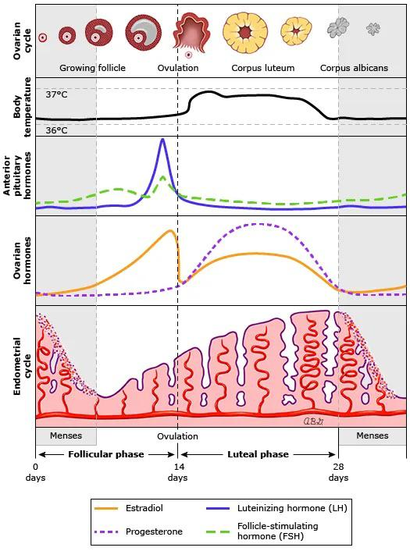
4

Slide 5
FIGO AUB system 1- Normal menses
PARAMETER | NORMAL | ABNORMAL
Frequency | Absent (no bleeding) =amenorrhea
 | Infrequent (>38 days)
 | Normal (>/= 24 to</=38 days)
 | Frequent (<24 days)
Duration | Normal</=8 days
 | Prolonged (>8 days)
Regularity | Normal or “regular” (shortest to longest cycle variation:</= 7-9 days*)
 | Irregular (shortest to longest cycle variation: >/=8 -10 days)
Flow volume (patient determined) | Light
 | Normal
 | Heavy
Intermenstrual bleeding (IMB) Bleeding between cyclically regular onset of menses | None
 | Random
 | Cyclic(predictable) | Early cycle
 |  | Mid cycle
 |  | Late cycle
Unscheduled bleeding on Progestin+- estrogen gonadal steroids (birth control pills, rings, patches, or injections) | Not applicable (not on gonadal steroid medication)
 | None (on gonadal steroid medication)
 | Present
*Normal range (shortest to longest) varies with age: 18 -25 y of age, </=9 days; 26-41y of age, </=7 days; 42-45y, </=9 days.
5

Slide 6
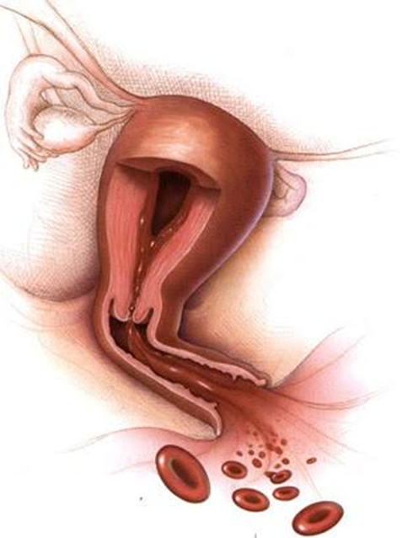
ABNORMAL MENSTRUAL BLEEDING
No bleeding
>38 days cycle
<24 days cycle
Prolonged flow>8 days
Heavy flow
Intermenstrual bleeding
6

Slide 7
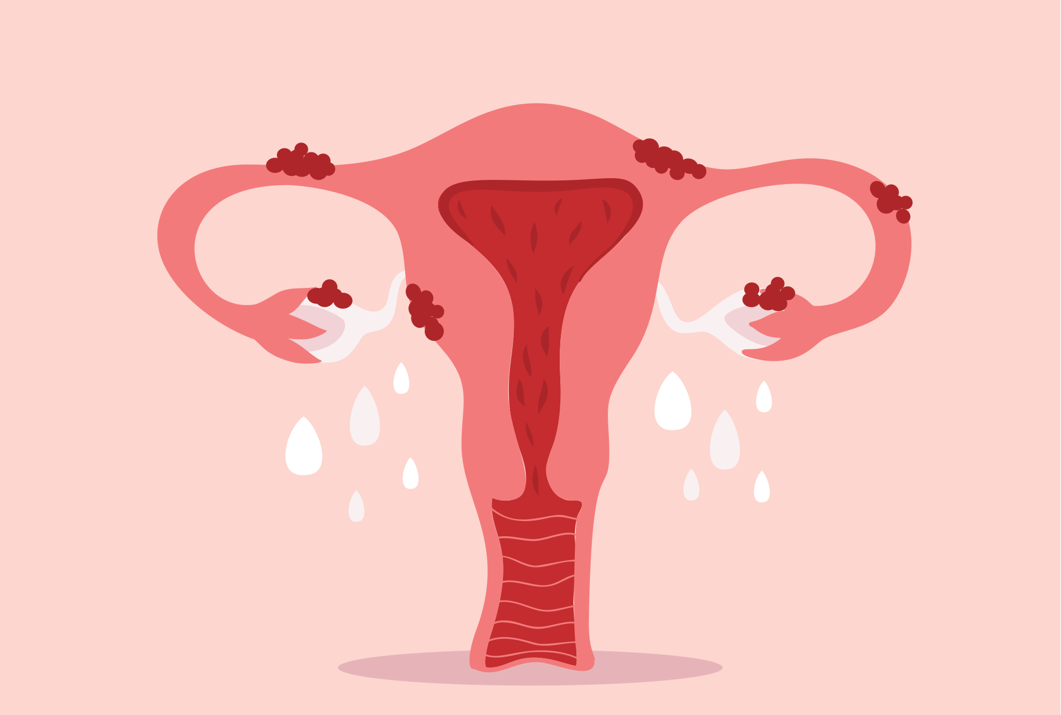
HISTORY
History of pattern of low
Any hormonal intake in recent past
Current and past use of contraception
Treatment history
History of blood transfusion
Family history of uterine cancer
7

Slide 8
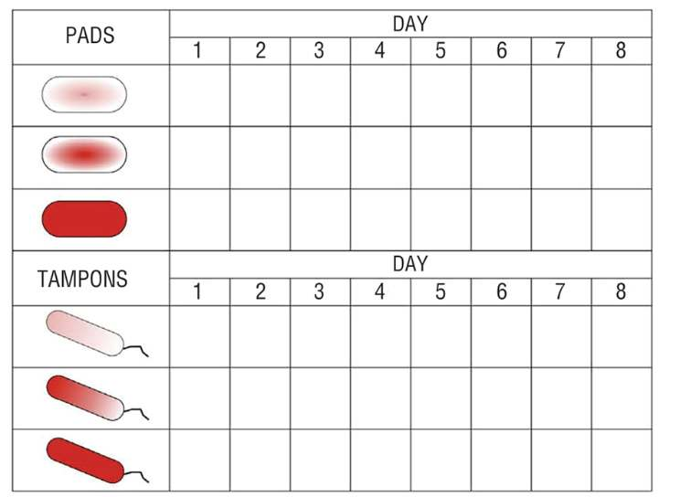
PBAC
8

Slide 9
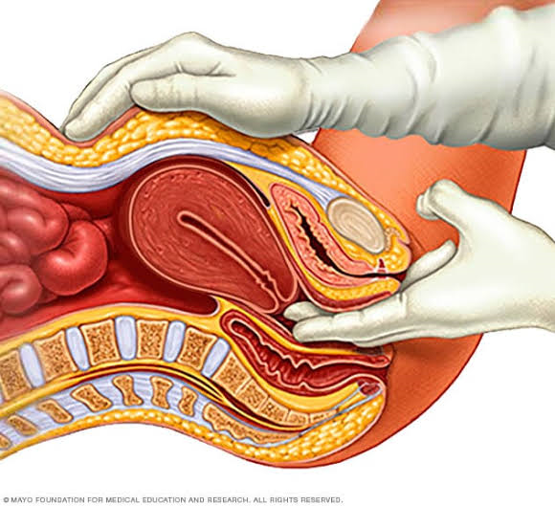
PELVIC EXAMINATION
Per speculum examination: condition of cervix and vagins
Any abnormal discharge or bleeding
If bleeding present whether through od or cervical lesion
Per vaginum examination:
Size of uterus
Mobility of uterus
Tenderness of uterus
Any deviation any mass on uterus
Adnexa- fullness or mass
9

Slide 10
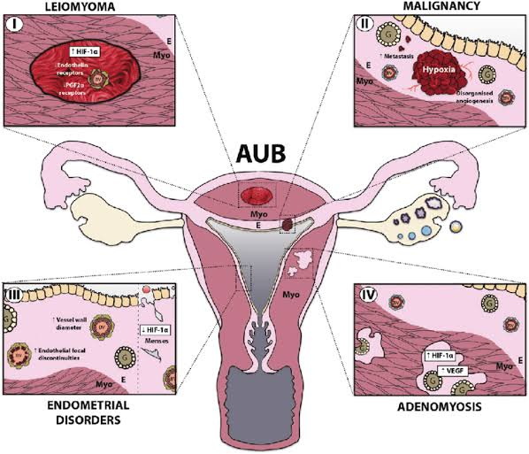
CAUSES AND DIFFERENTIAL DIAGNOSIS OF AUB
AUB can be acute or chronic and is defined as bleeding from the uterus that is outside the normal regularity, frequency, volume and duration and occurs in the absence of pregnancy
PALM-COEIN is an acronym provided by the International Federation of Obstetrics and Gynaecology (FIGO) to classify the etiologies of AUB. PALM describes structural causes while COEIN is for non-structural issues.
10

Slide 11
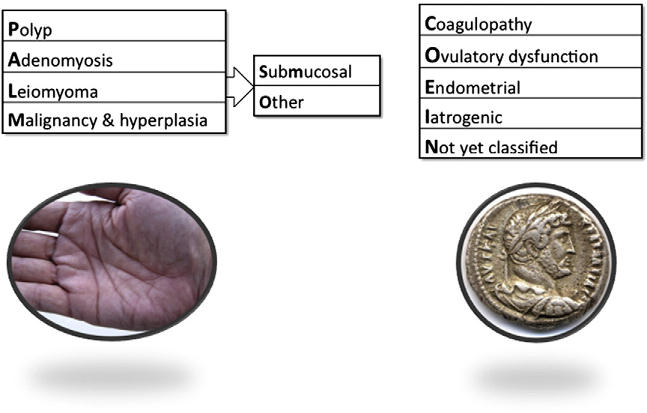
11

Slide 12
DIFFERENTIAL DIAGNOSIS OF AUB
Complications of pregnancy | Abortions, ectopic pregnancy, placenta previa
Pelvic causes | Pelvic inflammatory disease, Tubo-ovarian mass, malignancy, haematosalpinx, endometriosis, Ovarian tumours
Genital tract causes | Benign growths, sexually transmitted infections, vaginitis, malignancy, trauma, foreign bodies
Urinary tract causes | Infections, malignancy, hematuria
Gastrointestinal tract causes | Inflammatory bowel disease, Behçet syndrome
12

Slide 13
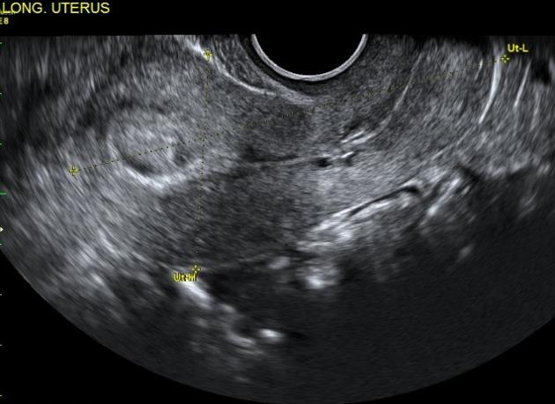
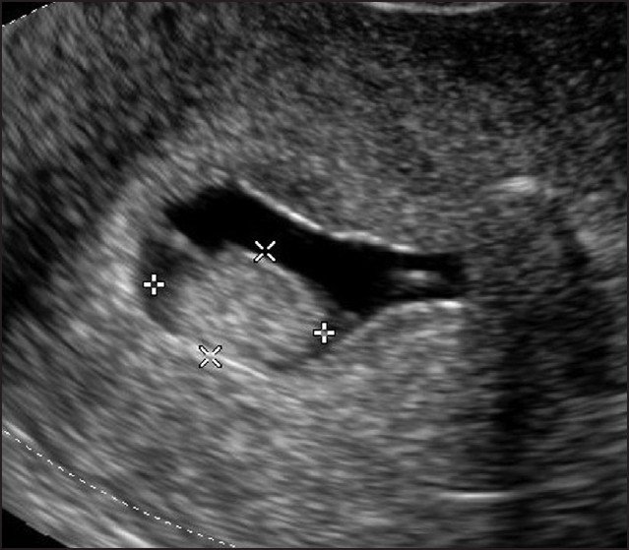
POLYP
Polyps are polypoidal outgrowths of endometrium comprising of mucosal layer of endometrium with fibrovascular core.
CLINICAL FEATURES
- Young women of reproductive age group
- Heavy bleeding during menses
- Intermenstrual bleeding at irregular intervals
- Previous unsuccessful AUB treatment
- Large polyps may be visible at the os during speculum examination
DIAGNOSIS- internal examination, Transvaginal ultrasonography (TVUS), Hysteroscopy, sonohysterography
13

Slide 14
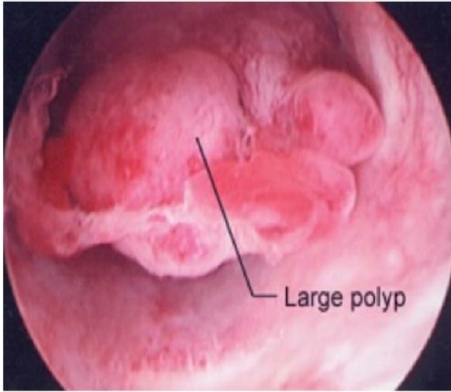
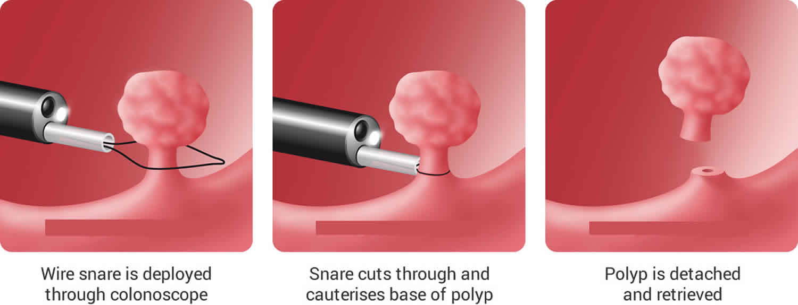
MANAGEMENT
Gonadotropin-releasing hormone agonists, progestins, Hysteroscopic polypectomy
Histopathological examination to rule out hyperplasia and malignancy
14

Slide 15
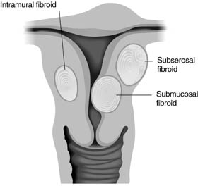
LEIOMYOMA
Leiomyoma/ fibroid is the most common tumour of the female pelvis.
An estimated 70% of women up to menopause develop fibroids and 25% of them are symptomatic requiring treatment.
Leiomyoma is the leading gynaecological cause for hysterectomy and healthcare expenditure.
These are estrogen dependent and occur in the reproductive age group.
The common age of presentation is 35 to 45 years.
Leiomyoma is a frequent cause of AUB especially when submucous in location.
Though usually benign, rarely, sarcomatous changes may occur.
15

Slide 16
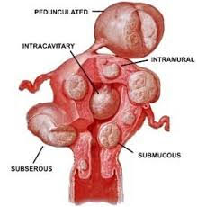
ETIOLOGY-not known, Genetic basis, Familial occurrence common
RISK FACTORS -nullipara or women with low parity, a family history, Early menarche, Obesity, diabetes and hypertension
FACTORS WHICH REDUCE THE RISK OF LEIOMYOMAS -High parity, Exercise, Use of progesterone only contraceptives ,Intake of green vegetables.
CLINICAL FEATURES-Most leiomyomas are asymptomatic. Around 20-50% women experience symptoms
Abnormal uterine bleeding, pain , pressure, infertility, pregnancy complications
DIAGNOSIS-clinical history or physical examination, Ultrasonography, transabdominal and transvaginal, Sonohysterography, MRI for leiomyoma mapping, hysterosalpingography, hysteroscopy and laparoscopy.
16

Slide 17
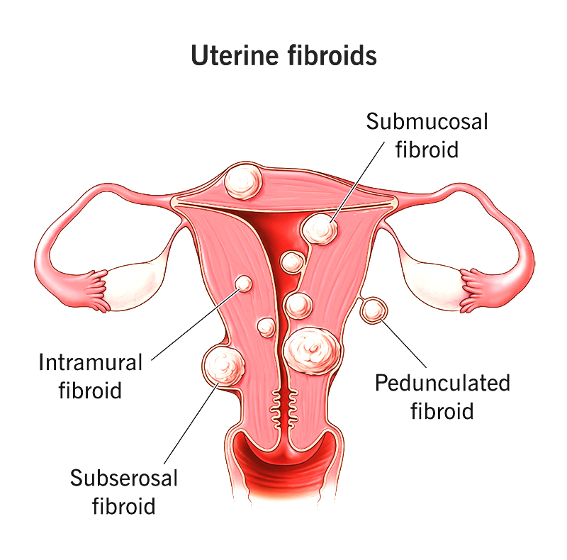
CLINICAL FEATURES OF FIBROID
Abnormal uterine bleeding
Pain
Pressure
Infertility
Pregnancy complications
17

Slide 18
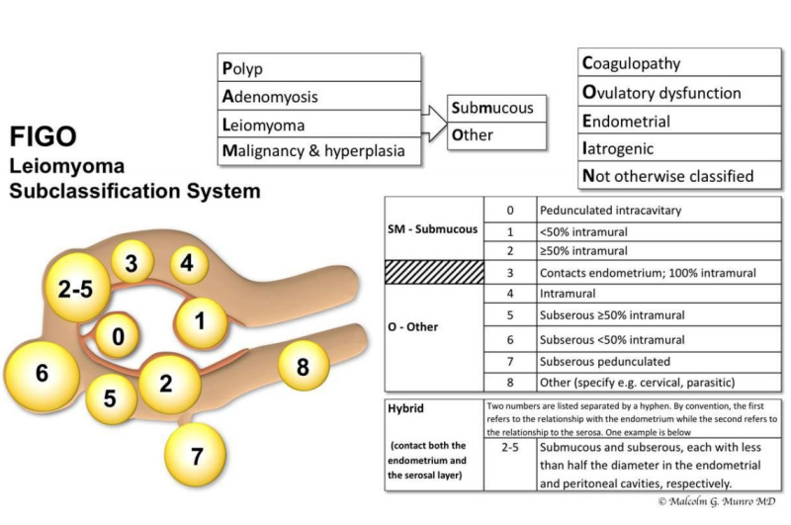
18

Slide 19
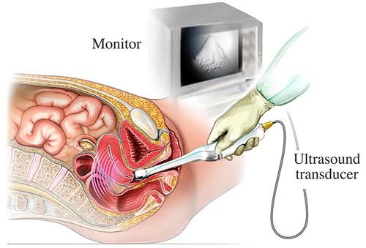
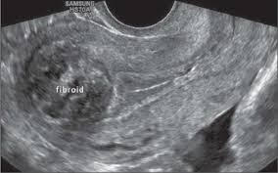
DIAGNOSIS BY ULTRASONOGRAPHY
19

Slide 20
MANAGEMENT
EXPECTANT MANAGEMENT
MEDICAL MANAGEMENT-Not a definitive treatment
GnRH analogues, selective estrogen receptor modulators, selective progesterone receptor modulators, aromatase inhibitors, progesterone releasing intrauterine device
SURGICAL MANAGEMENT
Myomectomy – laparoscopic /Abdominal/ vaginal
laparoscopic myolysis
Uterine artery embolisation
Magnetic resonance guided focused ultrasound
Hysterectomy
20

Slide 21
MEDICAL MANAGEMENT
Not a definitive treatment
Treatment will depend on nature and severity of symptoms, the size, location, and multiplicity of myomas and desire for fertility.
Also useful to decrease menstrual blood loss
May be used preoperatively to decrease the size as adjuvant therapy
Drugs:
NSAIDs- Mefenamic acid 150–600 mg taken daily started with onset of bleeding and given for 3–5 days.
Tranexamic acid tab 500 mg 3 times a day for 4–7 days during menses
Progestogens- norethisterone 10-15 mg in divided doses
Mifepristone- 2.5 mg/day for 3 months- decreases size by 25-30%- may cause endometrial hyperplasia
GnRH analogues- reduces size by 20-50%, reduces bleeding, need for transfusion
21

Slide 22
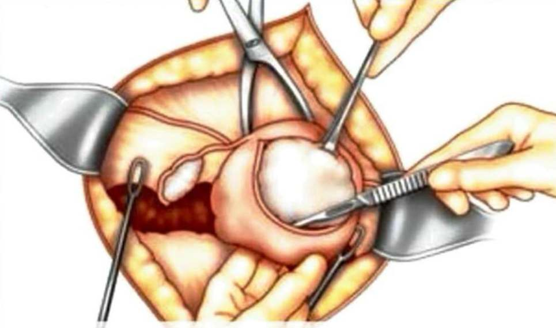
MYOMECTOMY
May be performed abdominally, vaginally, laparoscopically, hysteroscopically
Indicated in
leiomyomas with heavy abnormal uterine bleeding,
leiomyoma with pain or pressure symptoms,
Infertility,
Recurrent pregnancy loss with no other identifiable cause in young patients
22

Slide 23
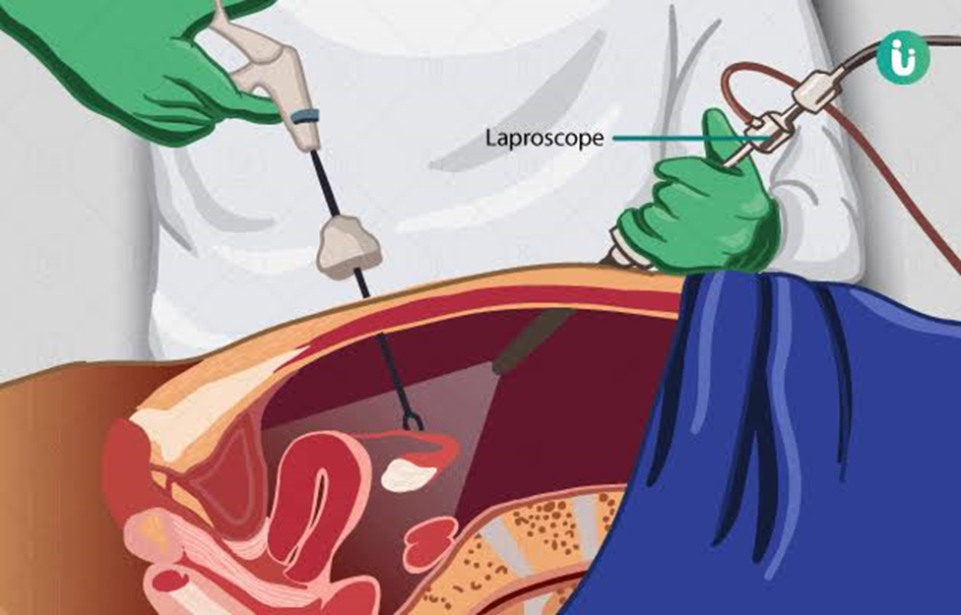
LAPAROSCOPIC MYOMECTOMY
Suitable for subserous and intramural leiomyoma up to 10 cm size
Fibroid excised are removed by electronic morcellators or through posterior colpotomy incision vaginally.
23

Slide 24
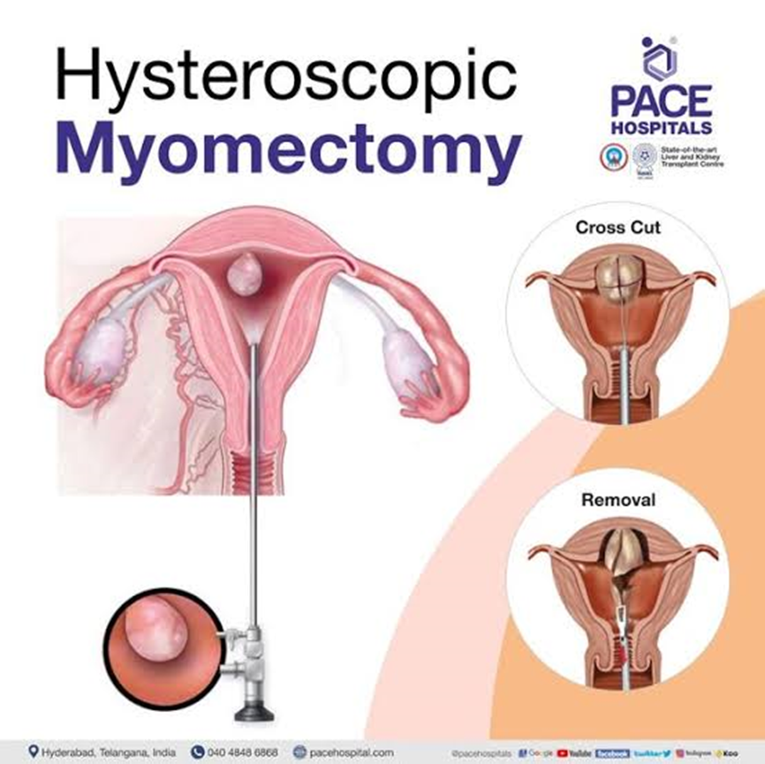
HYSTEROSCOPIC MYOMECTOMY
Hysteroscopic myomectomy - < 5 cm in size, < 50% intramural component, < 12 cm uterine
size
24

Slide 25
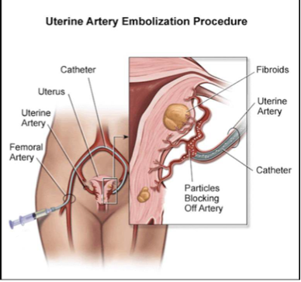
UTERINE ARTERY EMBOLIZATION
Performed by interventional radiologist under C-arm fluoroscopic guidance. The right femoral artery is accessed and a 5 or 6 French sheath is inserted. An arteriogram to demonstrate the arterial anatomy and find the uterine artery origins
Tumors are embolized with particles 500 to 700 micron size, including tris-acryl gelatin (TAG) spheres, non-spherical polyvinyl alcohol (PVA), and spherical PVA.
25

Slide 26
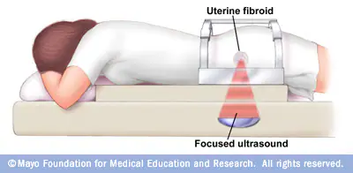
MR HIGH FOCUS ULTRASOUND
ocused ultrasound (FUS) destroys tissues by concentrating a high-energy beam on a specific point and raising its temperature to 60°-85°C. Multiple sonications (focal delivery of energy) are required to ablate a specific tissue
26

Slide 27
Treatment should be tailored depending on the impact of related symptoms, fertility requirements and cavity distortion
Symptoms/Uterine cavity distortion | AUB only | AUB with pressure symptoms, family complete and no desire to retain fertility | AUB symptoms and fertility desire/subfertility
No cavity distortion | UAE EA Hysterectomy | UAE MRgFUS Myomectomy Hysterectomy | Myomectomy UAE (evidence needed) MRgFUS
Cavity distortion | TCRF UAE Hysterectomy | UAE Myomectomy Hysterectomy | TCRF Myomectomy UAE (evidence needed)
27

Slide 28
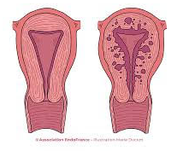
ADENOMYOSIS
Presence of ectopic endometrium in uterine myometrium
RISK FACTORS
Increased parity
Early menarche
Short menstrual cycle
Increased BMI
Cesarean section
Dilatation and curettage.
DIAGNOSIS
The clinical diagnosis of adenomyosis is difficult
The commonest symptoms are heavy menstrual bleeding and dysmenorrhea.
Other symptoms - chronic pelvic pain, dyspareunia, and infertility
28

Slide 29
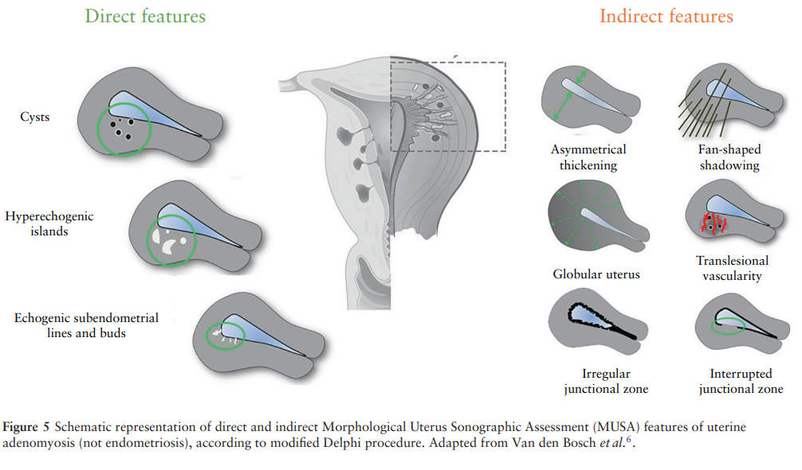
RADIOLOGICAL EVALUATION
Primary modality for confirming the diagnosis
Ultrasound is the preferred modality of choice
29

Slide 30
MALIGNANCY AND HYPERPLASIA
AUB-M
Women with AUB and associated malignant or premalignant lesions (e.g. Endometrial cancer, leiomyosarcoma and atypical endometrial hyperplasia) are categorised here.
Endometrial hyperplasia Endometrial hyperplasia (EH) is defined as irregular proliferation of endometrial glands with an increase in the gland to stroma ratio
RISK FACTORS
Unopposed estrogen therapy, Tamoxifen therapy, Early menarche and late menopause (after age 55 years), Nulliparity, COS (Chronic anovulation),Diabetes mellitus, Hypertension, Granulosa cell tumors ,Lynch syndrome (HNPCC),Cowden syndrome, Family history of endometrial, ovarian, breast or colon cancer, Increasing age (older than 35 years), Obesity….
30

Slide 31
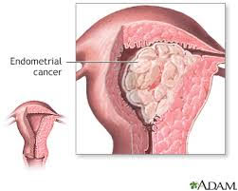
Clinical presentation
· AUB (Most common)
· Postmenopausal bleeding (5% -10% )
· Abnormal cytologic findings on cervical cancer screening (e.g., Atypical glandular cells)
· Postmenopausal patient with a thickened endometrial stripe on imaging
· Incidental finding after hysterectomy
31

Slide 32
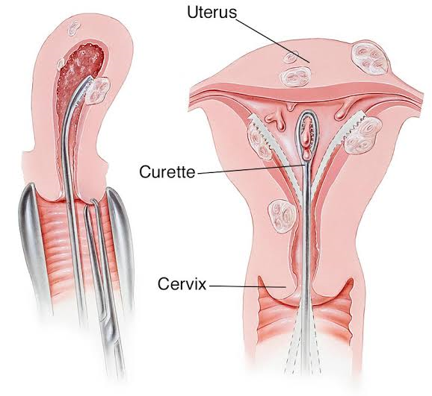
Endometrial sampling
Indications
a) women with age >45 years with AUB- whether prolonged, heavy, irregular or intermenstrual bleeding pattern.
b) women with age <45 years but who are obese, have prolonged intervals between cycles, intermenstrual bleeding or at high risk for endometrial cancer , Women who are obese have
Methods
Office biopsy
Dilatation and curettage
Hysteroscopy directed biopsy
32

Slide 33

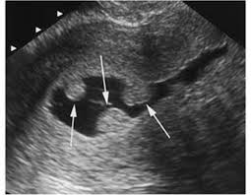
IMAGING
Pelvic ultrasound- it is the fist imaging modality of choice in women with AUB. Transvaginal ultrasound should be preferred as it helps in ruling out any structural causes in myometrium or endometrium.
Saline infusion sonography- it is a technique in whivh steril saline is instilled into endometrial cavity and a transvaginal sonography performed. This technique helps to evaluate endometrial cavity to detect lesions tlike small polyps or submucosal fibroids that may appear as thickened endometrium on transvaginal sonography.
33

Slide 34
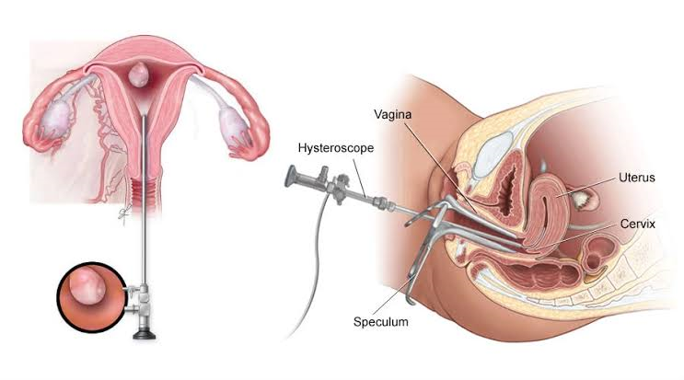
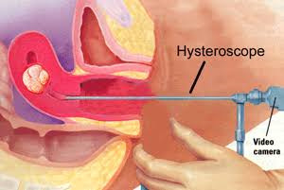
HYSTEROSCOPY
Hysteroscopy- this allows direct visualisation of endometrial cavity. It allows diagnosing lesions and also rargeted biopsy
34

Slide 35
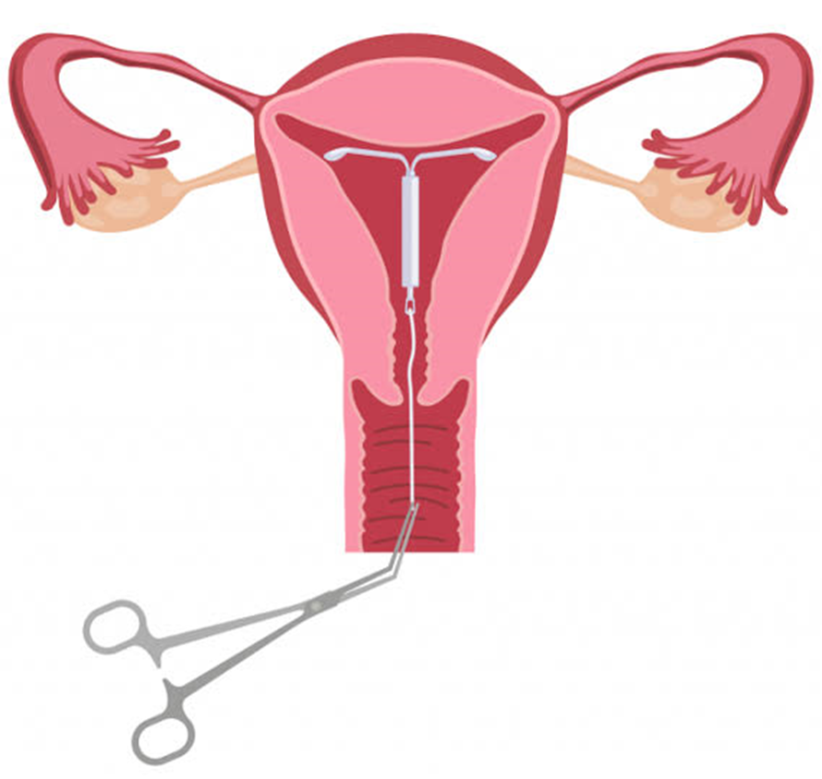
MIRENA
for women in whom estrogen is contraindicated or desire long contraception, the intra uterine device containing 52 mg of progesterone is an ideal choice. It leads to scant bleeding, or amenorrhoea.
35

Slide 36
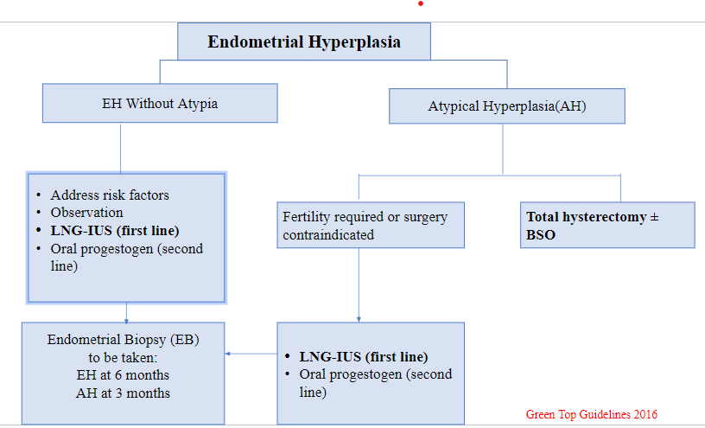
36

Slide 37
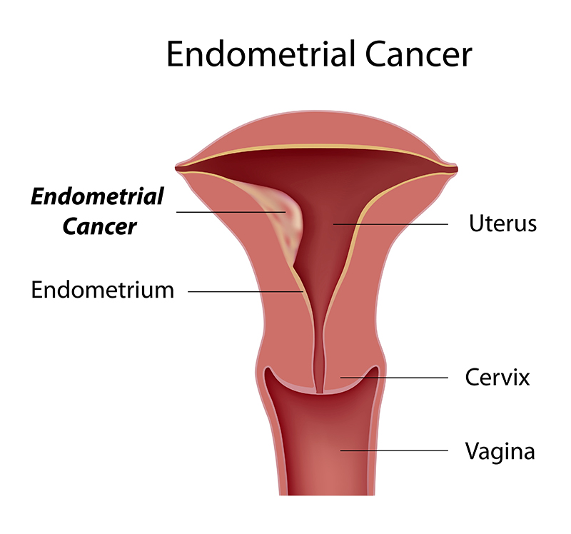
ENDOMETRIAL CANCER
Affects women in the 6th and 7th decades of life (average age 60 years)
It is the 3rd most common gynecological malignancy in India and
2nd most common worldwide. (GLOBOCAN 2018)
There is no routine screening of general population for endometrial cancers.
37

Slide 38
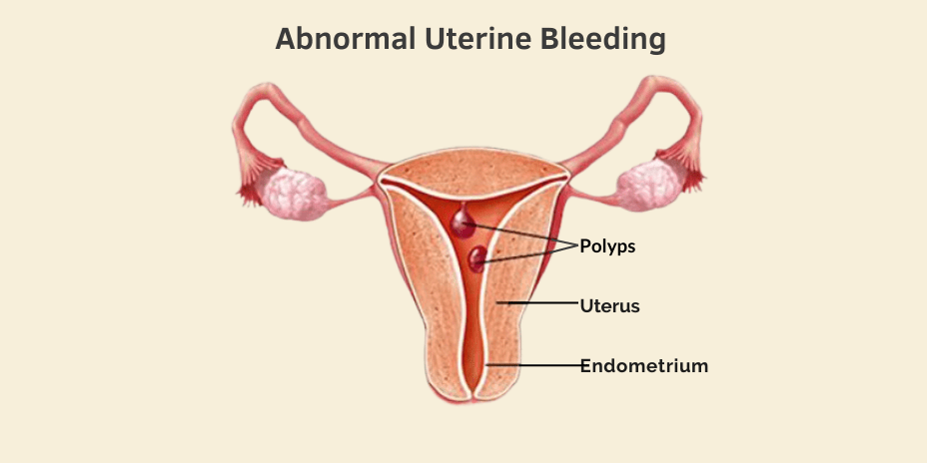
OTHER CAUSES OF AUB
38

Slide 39
COAGULOPATHY (AUB-C)
AUB-C includes the spectrum of systemic disorders of haemostasis that lead to heavy menstrual bleeding.
It accounts for approximately 13% of women presenting with AUB, von Willibrand disease being the commonest. It usually presents in peripubertal age group.
Suspected if the patient has coagulopathy screen positive on the basis of history, bruises and petechiae on examination and deranged coagulation profile
Desmopressin can be used to control acute episode of bleeding. Recombinant Factor VIII or von Willebrand factor are also available and may be required to control severe bleeding.
Further cause specific management should be done by a haematologist.
39

Slide 40
OVULATORY DYSFUNCTION (AUB-O)
Most common cause of AUB, usually seen in adolescent and perimenopausal women.
Presentation ranges for infrequent scanty periods to prolonged and heavy bleeding. There is anovulation or oligo-ovulation. In anovulatory cycles, there is no mid-cycle LH surge, no ovulation and no progesterone production. Unopposed estrogen action leads to prolonged and heavy bleeding.
In some cases, insufficient follicular development leads to low estrogen levels that cannot sustain the endometrium or trigger LH surge. There is no ovulation or progesterone production, cycles short and bleeding is profuse due to lack of PGF2α.
Medical treatment is the first line of management. It includes progestin therapy, OCPs, LNGIUS. Surgical treatment is resorted only when hormonal therapy fails.
40

Slide 41
ENDOMETRIAL CAUSES (AUB-E)
In AUB-E, the primary disorder is at the level of the endometrium. These women have regular ovulatory cycles with heavy menstrual bleeding and no structural abnormality.
There might be alteration in the ratio of prostaglandins and thromboxane production. There might be increase in the fibrinolytic activity.
Chronic inflammation of the endometrium with or without associated PID may lead to HMB. ·
This type of AUB responds well to NSAIDS and antifibrinolytics
41

Slide 42
IATROGENIC CAUSES (AUB-I)
Hormonal contraceptives like OCPs, injectables and implants are an important cause of AUB. Intrauterine contraceptive devices are also associated with heavy menstrual bleeding, intermenstrual and irregular bleeding, especially during initial few months of insertion.
Other drugs like steroid hormones, thyroid hormone, anticoagulant drugs may also lead to AUB.
42

Slide 43
NOT CLASSIFIED (AUB-N)
Some rare causes like congenital and acquired arteriovenous malformations in the uterus can present as heavy menstrual bleeding. Chronic medical disorders like renal failure may be included in this type of abnormal uterine bleeding.
43

Slide 44
CAUSES OF POSTMENOPAUSAL BLEEDING
Cause of bleeding | Percentage(%)
Atrophy | 60-80
Exogenous estrogen | 15-25
Polyps(Endometrial/cervical) | 2-12
Endometrial hyperplasia | 5-10
Endomertial cancer | 10
Cervical cancer | <1
44

Slide 45
ACUTE AUB
Acute AUB refers to an episode of heavy bleeding that, in the opinion of the clinician, is of sufficient quantity to require immediate intervention to prevent further blood loss.
Approach to a patient of acute AUB can be done in following stages:
1. Rapid initial assessment and resuscitation
2. Determine the most probable diagnosis
3. Choose the most appropriate treatment for the patient
45

Slide 46
DIAGNOSIS OF ACUTE AUB
Rapid initial assessment and resuscitation:
Prompt assessment of vitals and signs of hypovolemia
If patient is hemodynamically unstable or is in shock, establish intravenous access with two large bore IV cannulas (18G). Resuscitation with crystalloids should be started immediately.
Prepare for blood transfusion and clotting factor replacements
After initial shock management and stabilization, evaluate the most likely aetiology of acute AUB
46

Slide 47
Determine the most probable diagnosis:
History: Guided by PALM-COEIN system
Rule out pregnancy
Medical history focussed on the current episode of bleeding, age of menarche, LMP
detailed past menstrual history, its regularity, frequency, duration and volume, no. of pads used per day, passage of clots, intermenstrual bleed
obstetric history, details of past pregnancy events
associated dysmenorrhoea, pressure symptoms
Screening for coagulopathy – History of PPH, frequent gum bleed, surgical haemorrhage, bruising one or two times per month, frequent epistaxis or family history of coagulopathy.
Past and treatment history for any medical disorders, hormonal therapy, steroids, contraceptives
47

Slide 48
Physical examination
Pelvic examination
General Weight, height, BMI
Pallor, edema, icterus, Gum bleed, bruises, petechiae, Thyroid enlargement, lymphadenopathy
any signs of endocrine disorders
Systemic examination
Per speculum: condition of the cervix, any visible polyps, abnormal discharge or growth.
Bimanual palpation: uterine size, position, asymmetrical enlargement, any adnexal mass, any tenderness
48

Slide 49
INVESTIGATIONS
Laboratory investigations
Imaging studies
Urine pregnancy test,
complete blood counts, iron profile, peripheral blood smear
coagulation profile
thyroid profile, hepatic and renal function tests, hormone profile
Transabdominal ultrasonography
transvaginal sonography
Saline infusion sonography can be done to delineate the endometrial cavity and show submucosal fibroids and polyps.
MRI can be done for surgical planning
49

Slide 50
TREATMENT
Choice of treatment of AUB depends on the hemodynamic stability of the patient, suspected cause of bleeding, desire for future fertility and underlying medical disorders.
Aims of management of acute AUB-
1. To control the current episode of heavy bleeding
2. To reduce menstrual blood loss in the subsequent cycles
50

Slide 51
Hormonal therapy is the first line treatment
Intravenous conjugated Equine Estrogen 20-40mg, 6-8 hourly till the bleeding is controlled –
Intravenous tranexamic acid (500mg -1g) 12hourly
Tamponade of uterus with Foley‘s catheter used as a mechanical option
Bleeding due to coagulopathies can be managed by intranasal, subcutaneous or intravenous Desmopressin. Recombinant factor VIII and von Willibrand factor are also available
Dilatation and curettage is done as an emergency management. The procedure is diagnostic as well as therapeutic
51

Slide 52
Once the bleeding is controlled, patient is put on high dose monophasic combined oral contraceptive pills/ LNG-IUS /Progestin therapy
Based upon the PALM-COEIN classification of AUB, the cause is determined and specific treatment is given accordingly
Surgical management: Need depends on patient‘s hemodynamic stability, severity of bleeding, contraindications to medical management, failure of response to medical therapy, desire for fertility and underlying medical condition
Surgical options
- Dilatation and curettage (D&C)
- Endometrial ablation
- Transcervical endometrial resection
- Uterine artery embolization
- Hysterectomy
52

Slide 53
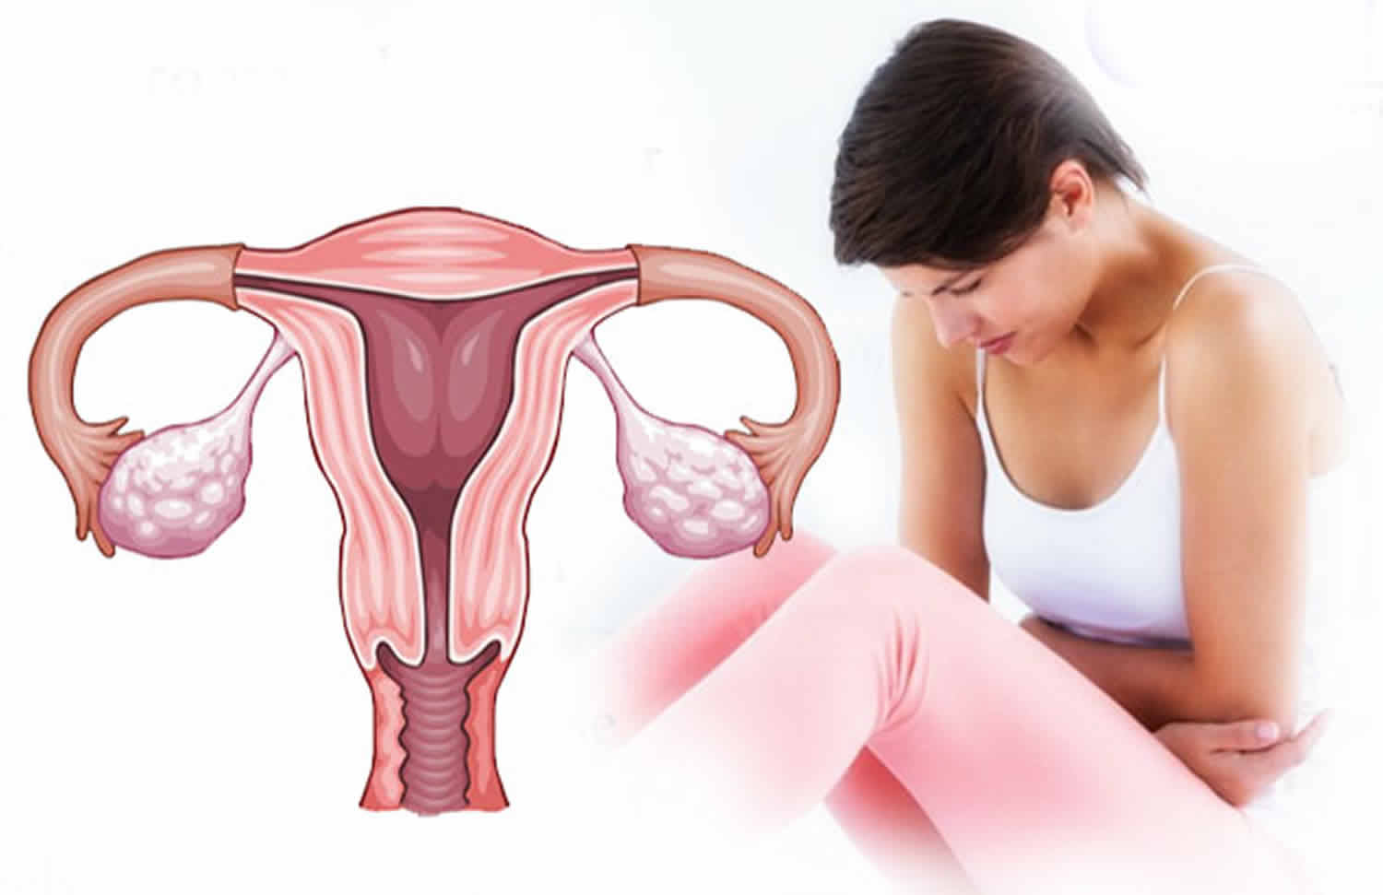
CHRONIC AUB
Chronic AUB is defined as bleeding from the uterine corpus which is abnormal in duration, volume, frequency and or regularity and has been present for the majority of the preceding 6 months.
53

Slide 54
MANAGEMENT OF CHRONIC AUB
The treatment options for AUB are guided by several factors
Etiology of AUB
Severity of bleeding
Associated symptoms and fertility issues
Contraceptive needs
Medical comorbidities
Patients 'preferences regarding medical versus surgical treatment
Time to menopause
54

Slide 55
MEDICAL MANAGEMENT OF CHRONIC AUB
Estrogen -progestin contraceptives
Selective estrogen receptor modulator
Levonorgestrel containing intrauterine device
Oral progestins
Tranexamic acid
NSAID
55

Slide 56
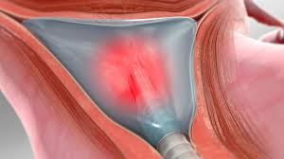
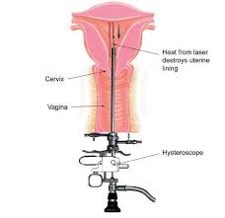
NON-MEDICAL MANAGEMENT OPTIONS OF CHRONIC AUB
Transcervical resection of endometrium
Endometrial ablation
Uterine artery embolization
MR guided focused ultrasound
56

Slide 57
RADICAL TREATMENT
Hysterectomy is the most common gynaecological procedure in the world for management of AUB.
With newer modalities available, hysterectomy should be the last option. However, still hysterectomy is the treatment of choice in patients not responding to other forms of treatment, who have severe symptoms and have completed family.
57

Slide 58
TYPES OF HYSTERECTOMY
Supracervical or subtotal hysterectomy - removal of body of the uterus, keeping the cervix in place.
Total hysterectomy - removal of the body uterus and cervix.
Radical hysterectomy - removal of uterus with cervix, bilateral parametrium, and the upper1-2cm of the vagina. Radical hysterectomy is done when we suspect carcinomas (AUB-M)
58

Slide 59
TYPES OF HYSTERECTOMY DEPENDING ON THE ROUTE OF SURGERY
Open Abdominal Hysterectomy- This is the most common type, accounting for about 54% of hysterectomies done for all non-cancerous (benign) conditions.
Minimally invasive procedure (MIP) :
Vaginal hysterectomy
Laparoscopic hysterectomy
Laparoscopic-assisted vaginal hysterectomy
Robot-assisted laparoscopic hysterectomy
59

Slide 60
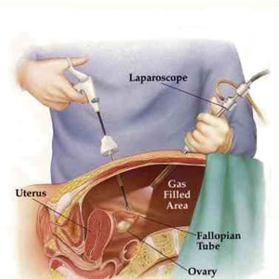
RISKS OF HYSTERECTOMY
Urinary incontinence
Vaginal prolapse
Recto-Vaginal/ Vesicovaginal fistula formation
Chronic pain, Wound infections, blood clots, haemorrhage, reactions to anaesthesia, and injury to surrounding organs
60

Slide 61
AUB IN ADOLESCENCE
Due to immaturity of the hypothalamic-pituitary-ovarian (HPO) axis, AUB is common in adolescents, anovulation being accountable for approximately 80 percent of cases. During the evaluation, pregnancy, trauma, sexually transmitted diseases and underlying bleeding disorders must be ruled out.
PATHOPHYSIOLOGY
With anovulatory cycles, unopposed estrogen stimulates the endometrium, leading to a sustained proliferative phase rather than maturing to a secretory endometrium. Estrogen levels ultimately cannot sustain the hyperplastic endometrial lining, leading to irregular, sometimes heavy, menstrual bleeding.
61

Slide 62
ANOVULATORY UTERINE BLEEDING CLASSIFICATION AS PER SEVERITY AS FOLLOWS
Mild anovulatory uterine bleeding Longer than normal menses (>7 days) or shortened Cycles (<3 weeks) for more than 2 months Haemoglobin ≥ 12 g/dl/mildly decreased (10-12g/dl)
Moderate anovulatory uterine bleeding Moderately prolonged or frequent menses every one to three weeks Haemoglobin >10 g/dl
Severe anovulatory uterine bleeding Heavy bleeding that causes decrease in haemoglobin to less than 10 g/dl, may or may not cause hemodynamic instability
62

Slide 63
63

Slide 64
MEDICAL TREATMENT REGIMEN FOR HEAVY MENSTRUAL BLEEDING
Drug | Dose Schedule | Suggested Dose
Conjugated equine estrogen | 25 mg IV | Every 4-6 hours for 24 hours
Combined oral contraceptives | Monophasic COCs that contain 30-50 micrograms of ethinyl estradiol | Every 6-8 hours until cessation of bleeding
Medroxyprogesterone acetate | 20 mg orally | Three times per day for 7 days
Tranexamic acid | 1.3 g orally or 10 mg/kg IV (maximum 600 mg/dose) | Three times per day for 5 days (every 8 hours)
64

Slide 65


Thank you
Dr. Smriti Agrawal
Professor and Head,
Department of Obstetrics and Gynecology,
Dr. Ram Manohar Lohia Institute of Medical Sciences, Lucknow
65

